Slide 1



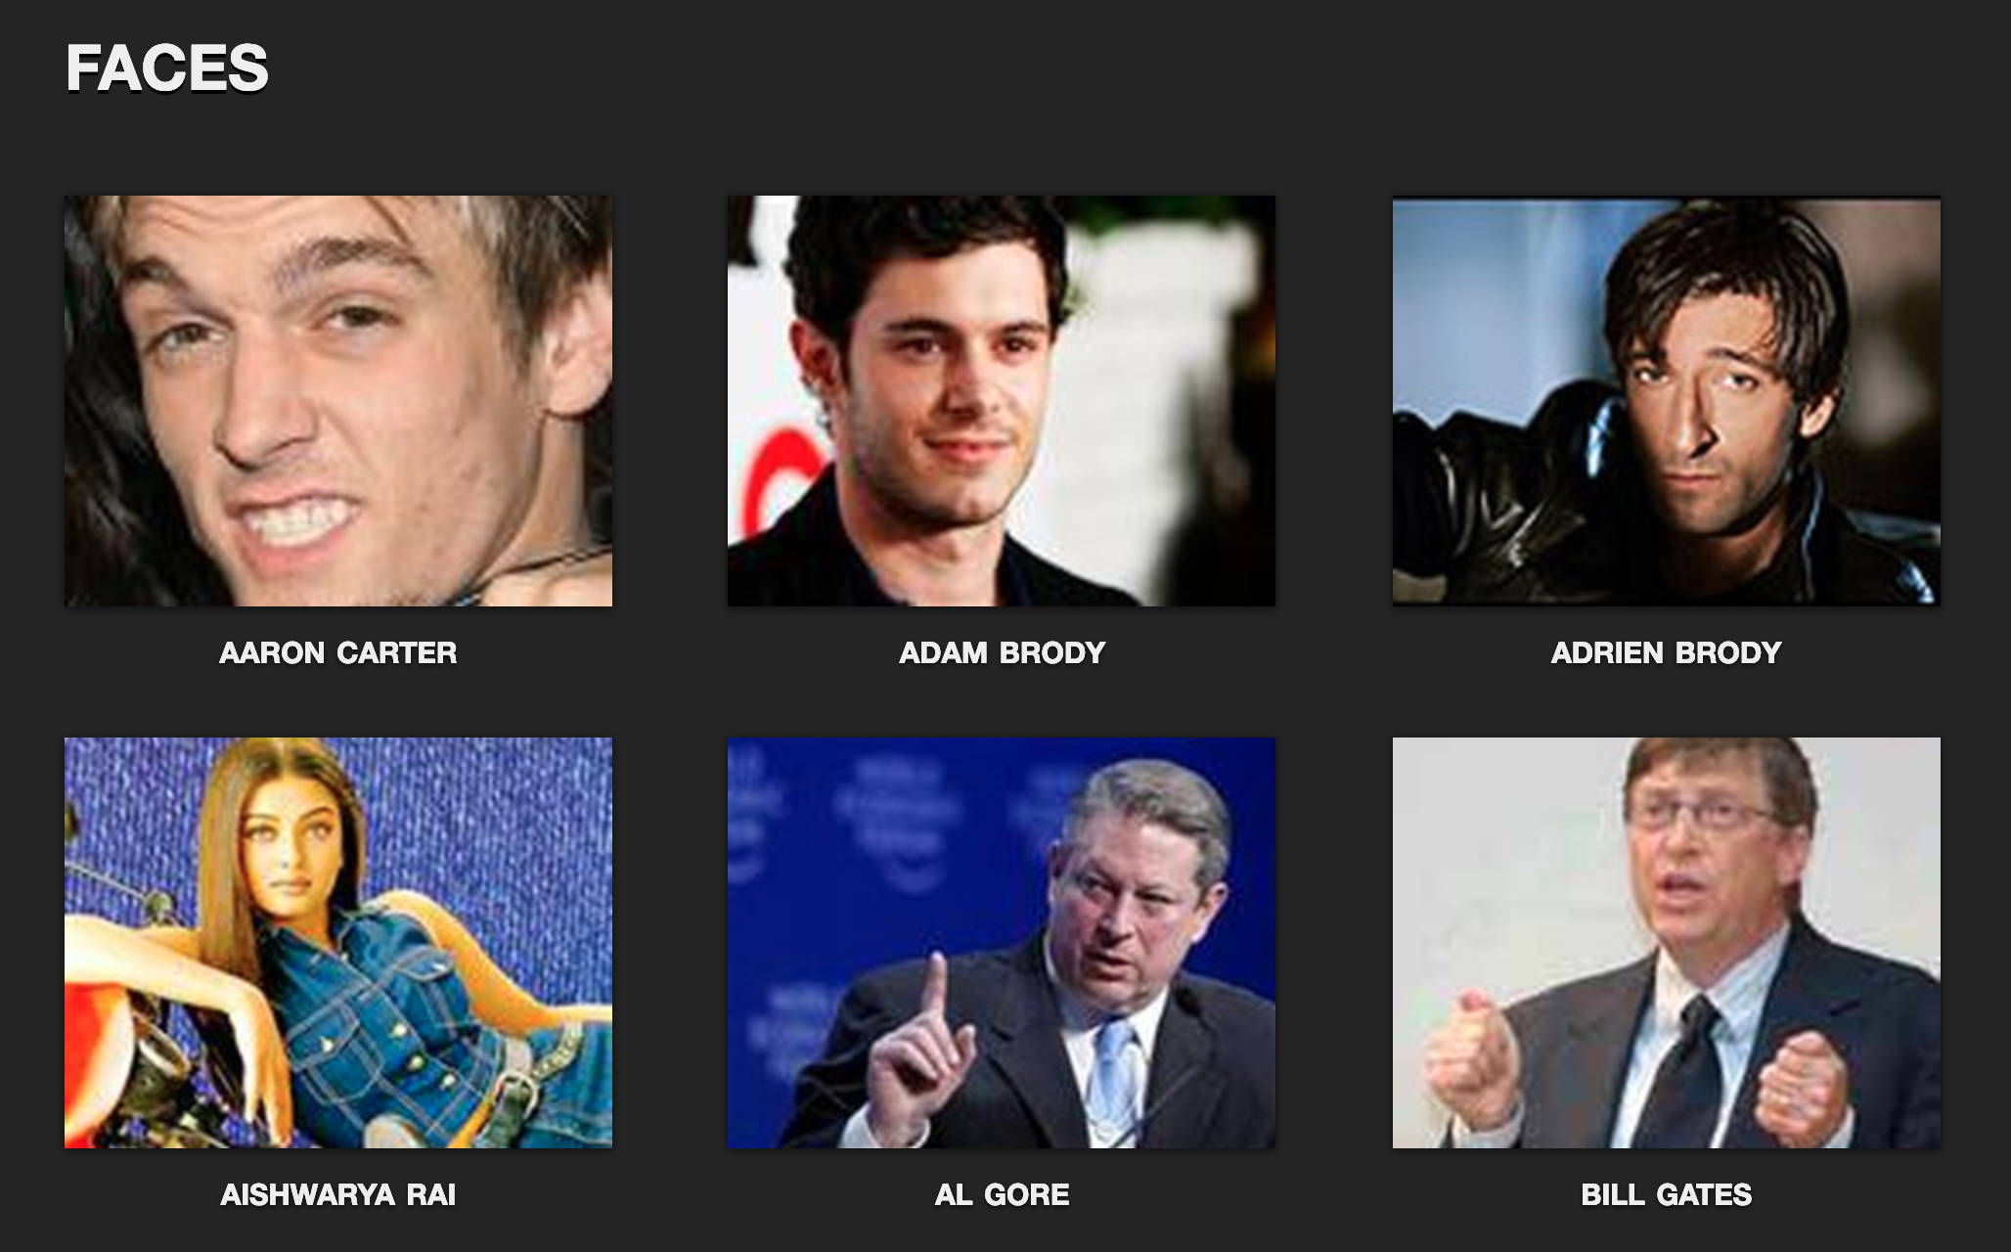















Photo gallery organized by faces
this project
“faces”
Database
EXIF
Tags, Descriptions, etc …
Work in progress
Unordered set of images

