Slide 1


2
20
DES&AES Encryption Algorithm
reporter：王君可 17300240009

Slide 2
01 / Target && Content
目录
CONTENTS
02 / Process && Implementing
03 / Results && Analysis
04 / Summary && Thoughts

Slide 3
1
PART ONE
Target && Content

Slide 4
Goal of the Experiment
1. Implementing DES algorithm 2. Understanding usage of AES algorithm
CONTENTS

Slide 5
Content of the experiment
Create 16 subkeys, each of which is 48-bits long.
1.1 use the PC-1 to permutate the key:64bits->56bits 1.2 shift the key and use PC-2 to generate subkeys
2. Encode each 64-bit block of data. 2.1 use IP to map M to L0 and R0:
2.2 use round function to encrypt:
3. use AES in OpenSSL
CONTENTS

Slide 6
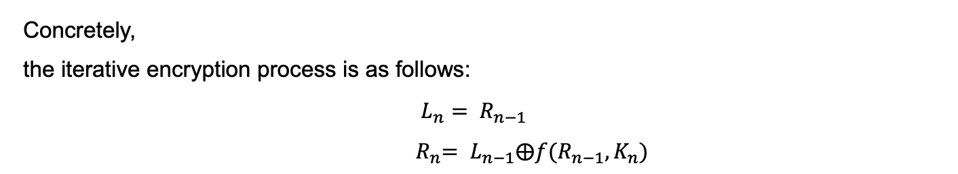
Content of the experiment
Concretely,
the iterative encryption process is as follows:
$$L_{n}= R_{n−1}$$
${ R}_{n}= L_{n−1}⨁f(R_{n−1}, K_{n})$
CONTENTS
The f function is as follows:

Slide 7
2
PART ONE
Process && Implement

Slide 8
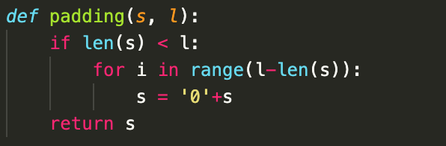
Implementing DES Encryption algorithm:
CONTENTS
Implement the padding function to extend a string s to the fixed length l

Slide 9
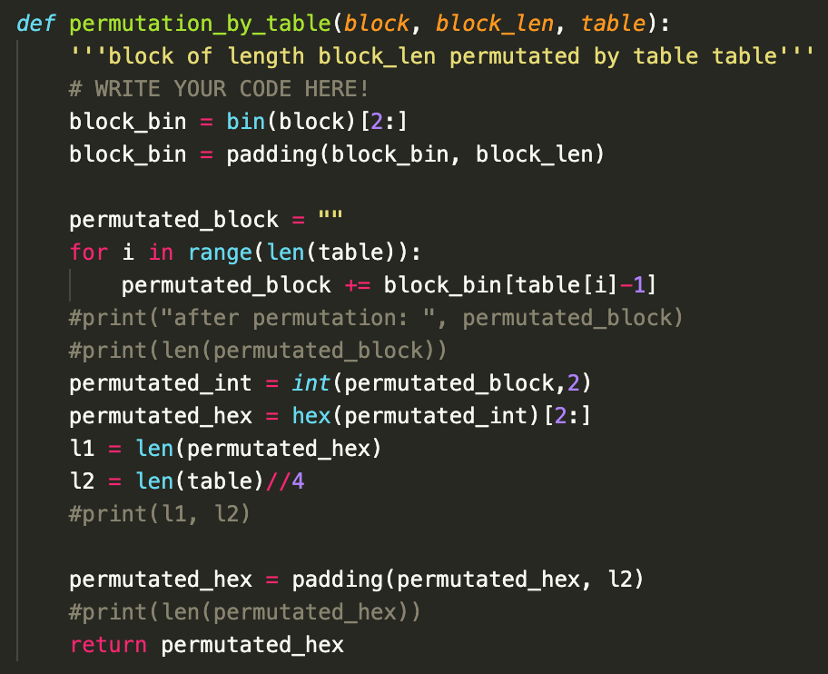
Implementing DES Encryption algorithm:
☞ input: block, block length, table
☞ output: a hex string
Firstly, padding the block to block length;
Secondly, transfer the int value to binary string;
Finally, use the given table to map permutate the block. Each number in the table is the index of the output string.
CONTENTS

Slide 10
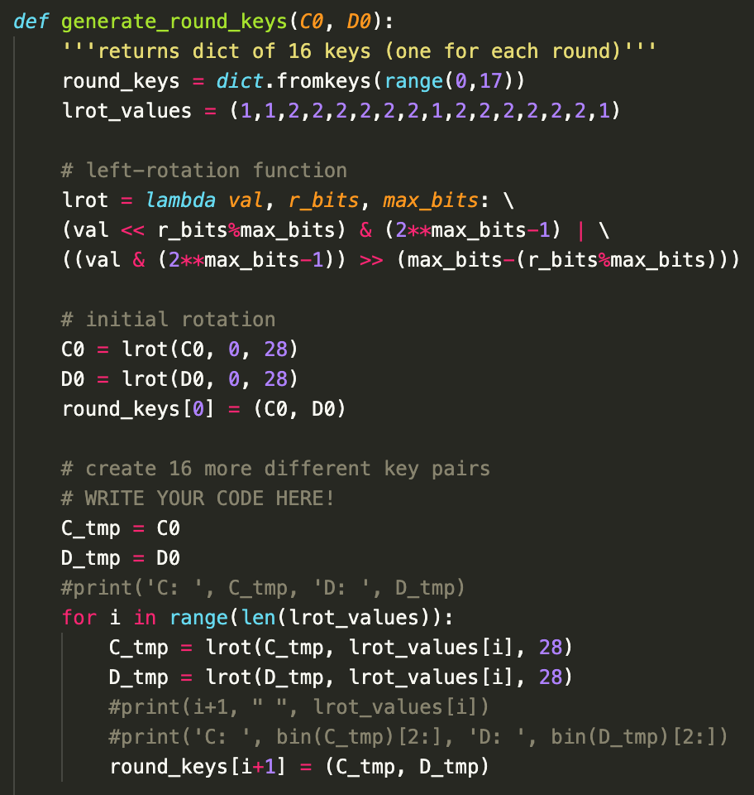
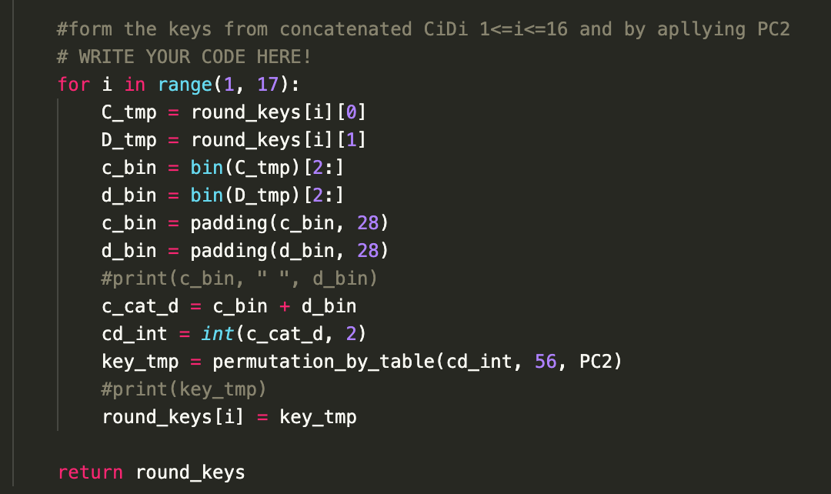
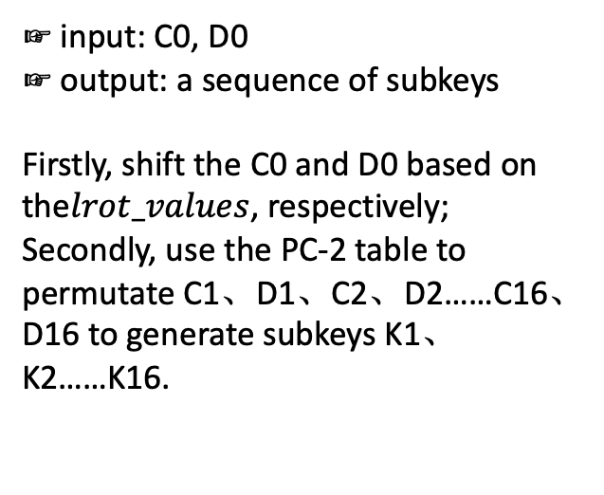
Implementing DES Encryption algorithm:
☞ input: C0, D0
☞ output: a sequence of subkeys
Firstly, shift the C0 and D0 based on the$lrot_values$, respectively;
Secondly, use the PC-2 table to permutate C1、D1、C2、D2……C16、D16 to generate subkeys K1、K2……K16.
CONTENTS

Slide 11
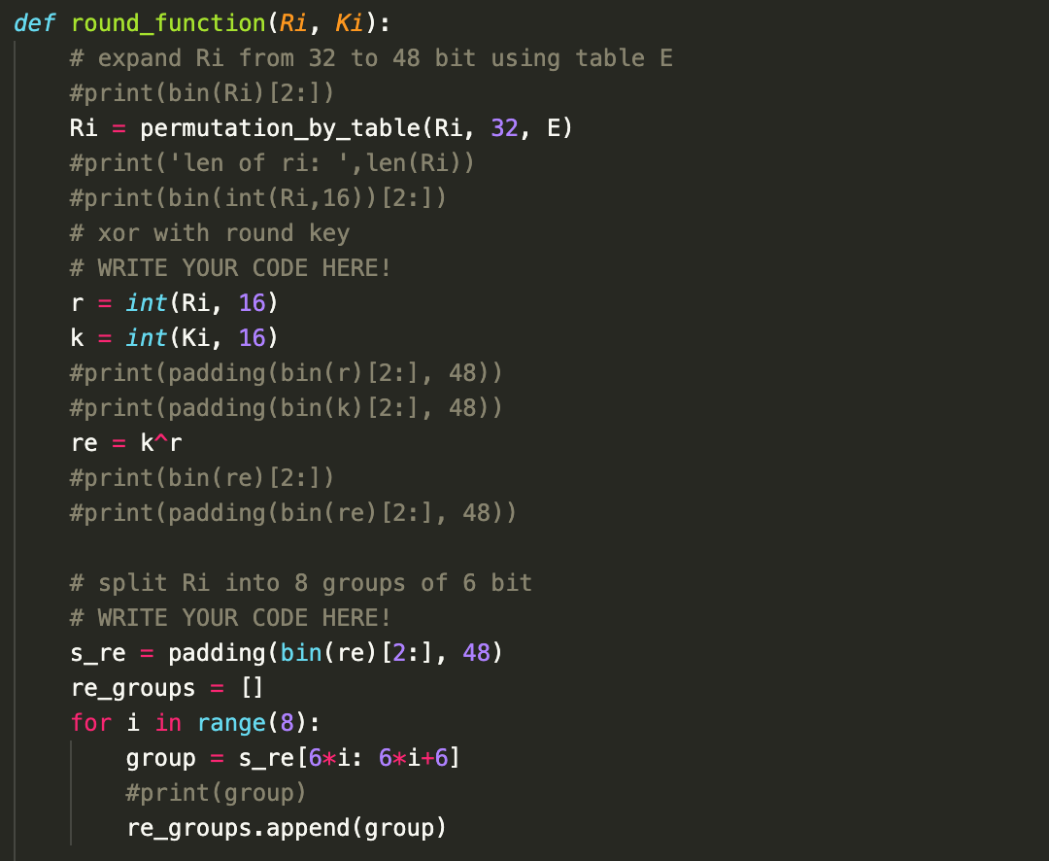
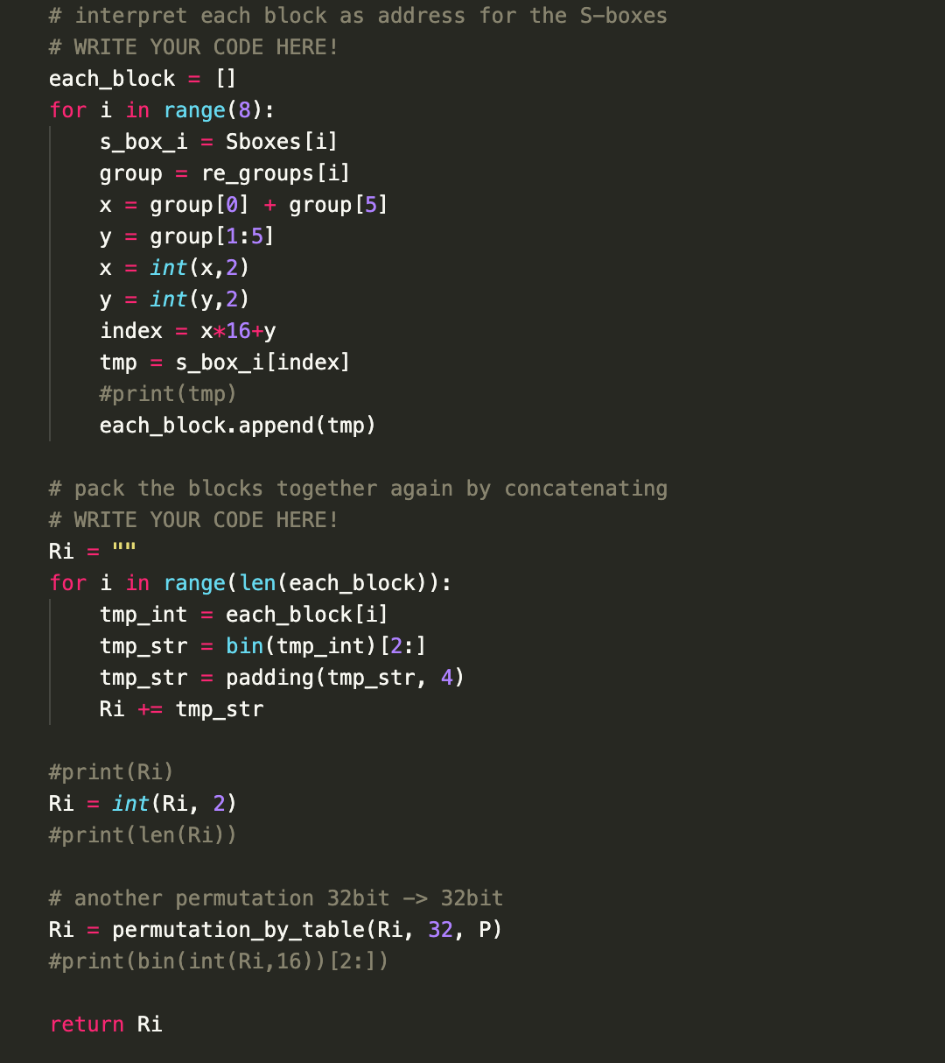
Implementing DES Encryption algorithm:
☞ input: Ri, Ki
☞ output: the transferred Ri
Firstly, use E table to permutate the Ri;
Secondly, calculate the XOR of Ri and Ki;
Thirdly, separate the value to 8 groups and use the S-boxes to map each group to 4 bits;
Finally, concatenate the 8 groups and use the P table to permutate.
CONTENTS

Slide 12
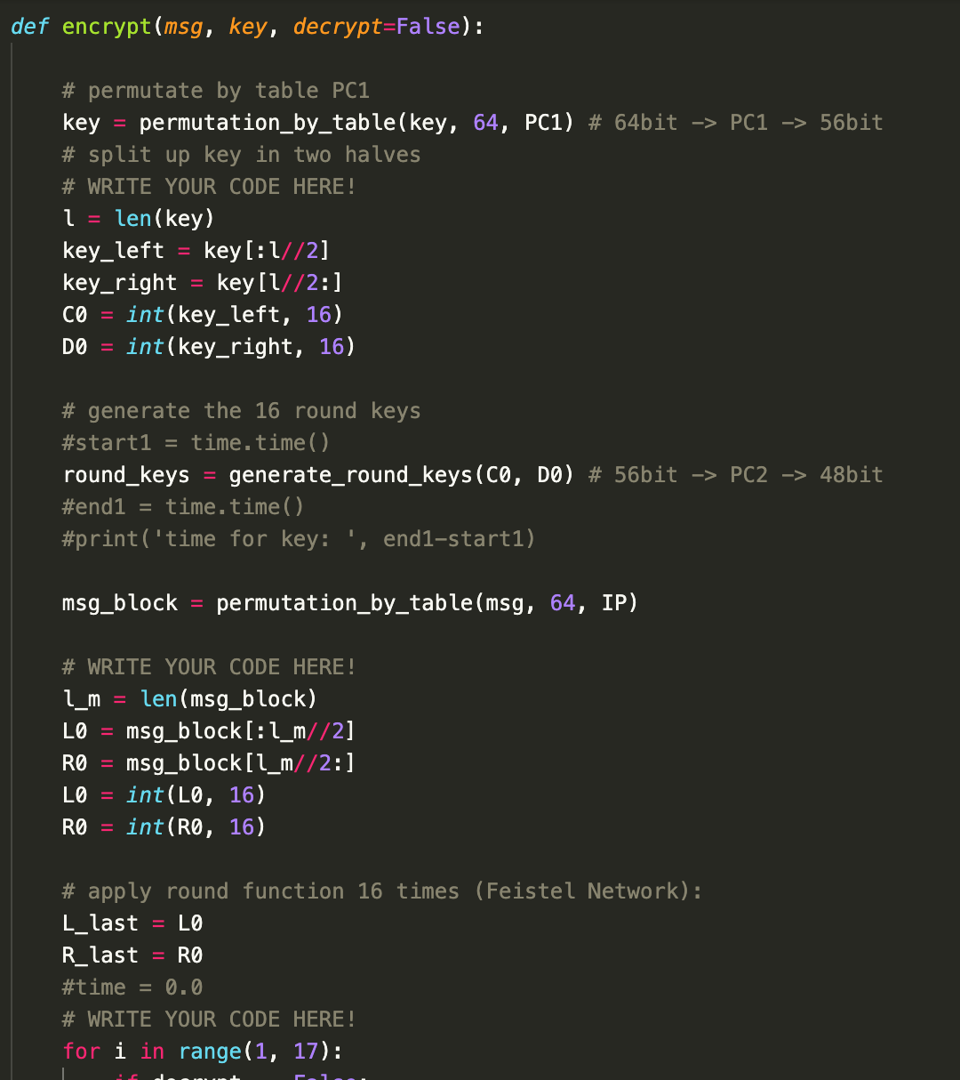
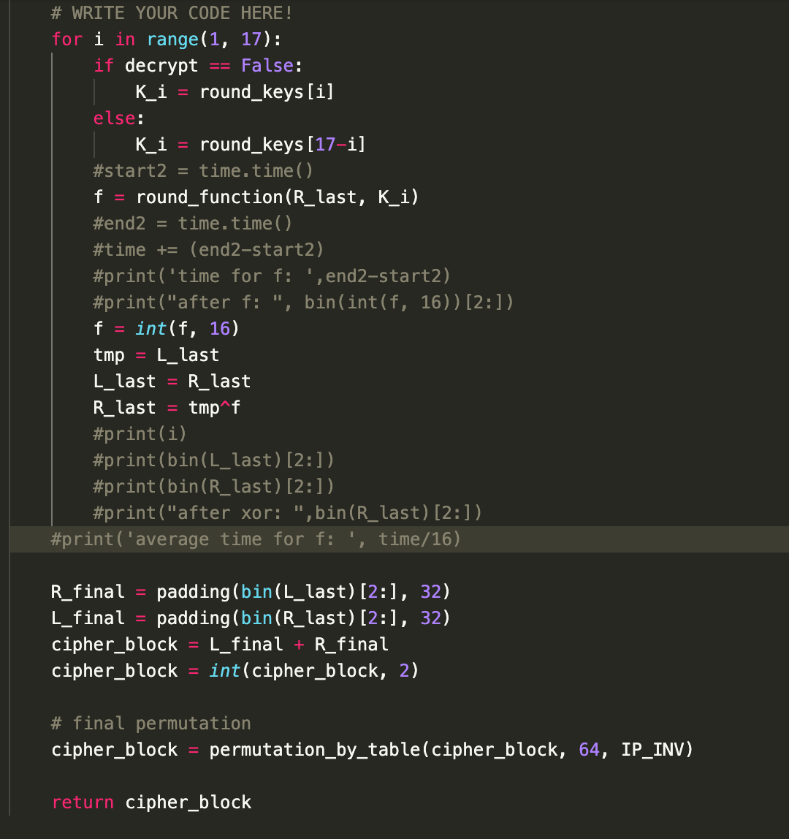
Implementing DES Encryption algorithm:
CONTENTS
Firstly, generate the subkeys; then permutate message with IP; use the f function to iteratively encrypt Ri and Li; finally, transpose R and L and use IP-INV to permutate it.

Slide 13
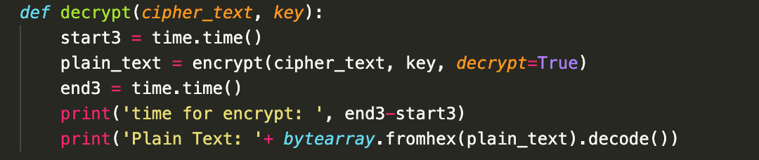
Implementing DES Encryption algorithm:
CONTENTS
The process of decryption is the same with encryption, the only difference is when encrypting, we use Ki for epoch i, but when decrypting, we use K15-i for epoch i.

Slide 14
3
PART ONE
Results && Analysis

Slide 15

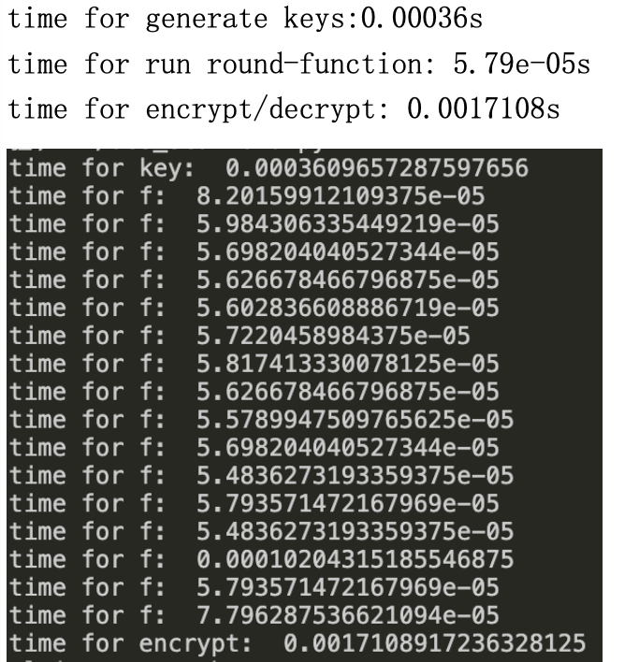
Decrypted plaintext:
Time cost:
CONTENTS

Slide 16

Decrypted plaintext using AES using OPENSSL:
CONTENTS

Slide 17
4
PART ONE
Summary && Thoughts

Slide 18
Summary
➣ By implementing the DES algorithm, in-depth understanding of the DES encryption algorithm of encryption and decryption process, including the round function of the implementation of the machine system, the implementation of the key mechanisms, the encryption process;
➣ The biggest difference between the encryption and decryption process of DES is the difference in the key, the use of encryption is the I bit Ki, decryption is k17-i
➣ By implementing a process that the algorithm security would be largely depends on S box, box, P E box design, so that in the specific use of if this a few box is general, is totally dependent on key (according to the secret in a key is completely in this way, but decrypt the words 2 ^ 64 with the modern computer should not impossible)
➣ OPENSSL provides us with powerful encryption and decryption interface
CONTENTS

Slide 19
possible improvements for experiment and some thoughts:
✓ Where C1, D1, C2 are generated by shifting when subkeys are generated... I'm going to move it by 1 bit, and then I'm going to move it by 2 bits, so my guess is that the sum is going to be 28 bits, which is the number of C/D bits, so I'm going to make sure that I'm using the length of 28, but I'm not going to reuse the subkeys
✓ The data units used throughout the data encryption process are mainly int integers and hexadecimal strings, binary strings, and perhaps using 2 for strings can simplify code and speed up encryption
✓ The reason why DES why 16 rounds, my guess is that C/D is 28 bits, so the largest number less than 28 but an integer power of is 16
CONTENTS

Slide 20
2
20
Thanks for watching.

