Slide 1


2
20
RSA Encryption and Decryption
reporter：王君可 17300240009

Slide 2
01 / Target && Content
目录
CONTENTS
02 / Process && Implementing
03 / Results && Analysis
04 / Summary && Thoughts

Slide 3
1
PART ONE
Target && Content

Slide 4
Goal of the Experiment
implement the RSA encryption
understand factoring the public key to decrypt the RSA
3. understand the common modulus attack to decrypt the RSA
CONTENTS

Slide 5
Content of the experiment
1. implement the RSA encryption
1.1 key generation
1.2 encryption & decryption
2. breaking RSA
2.1 factoring the public key
2.2 common modulus attack
CONTENTS

Slide 6
2
PART ONE
Process && Implement

Slide 7
1. Implementing the RSA encryption and decryption algorithm

Slide 8
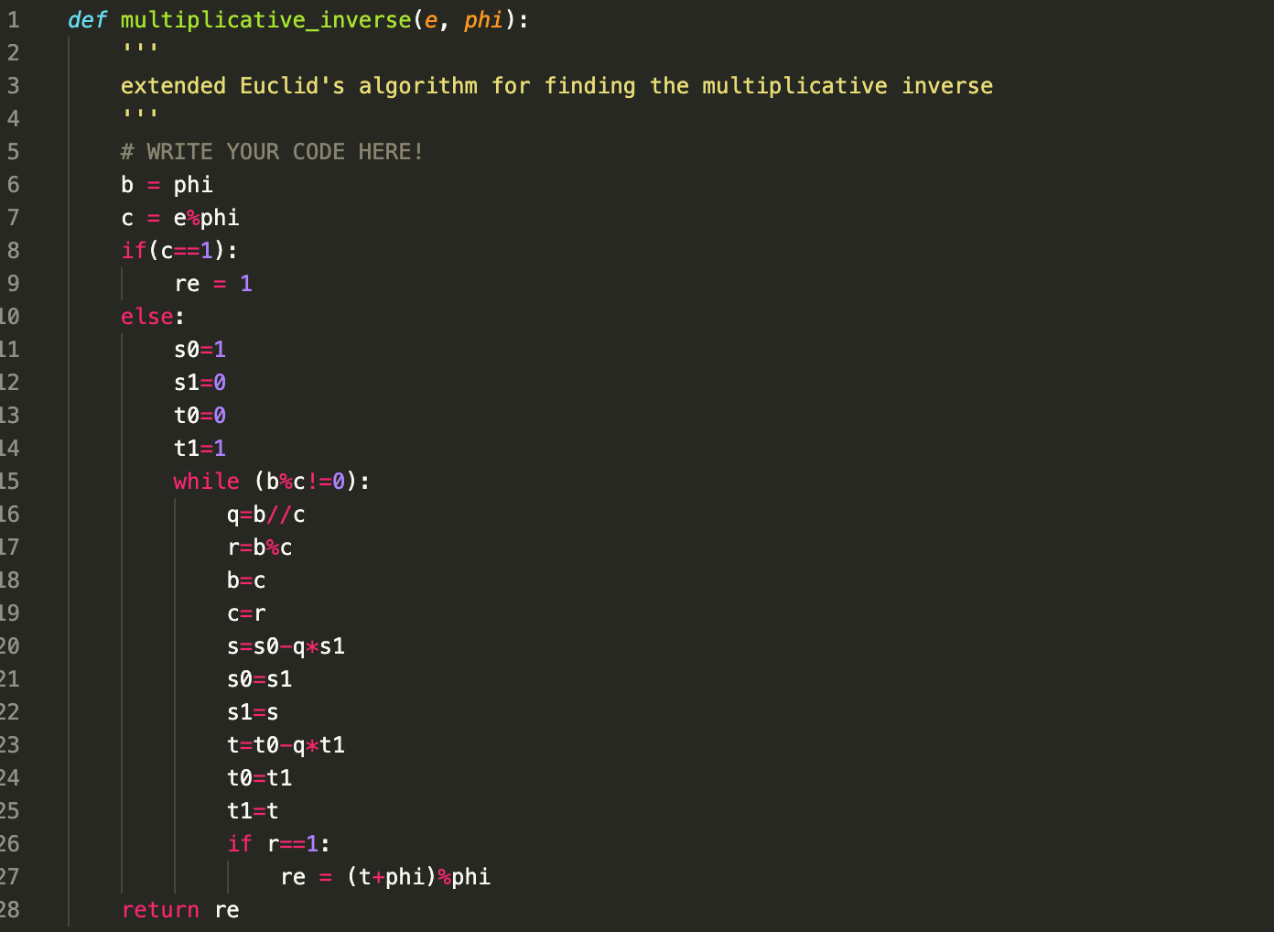
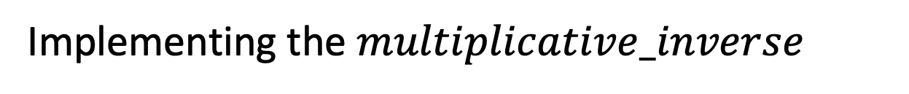
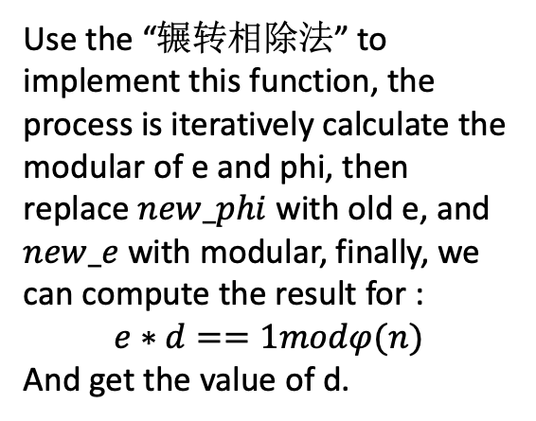
Implementing the $multiplicative_inverse$
Use the “辗转相除法” to implement this function, the process is iteratively calculate the modular of e and phi, then replace $new_phi$with old e, and $new_e$with modular, finally, we can compute the result for :
$$e∗d==1modφ(n)$$
And get the value of d.

Slide 9
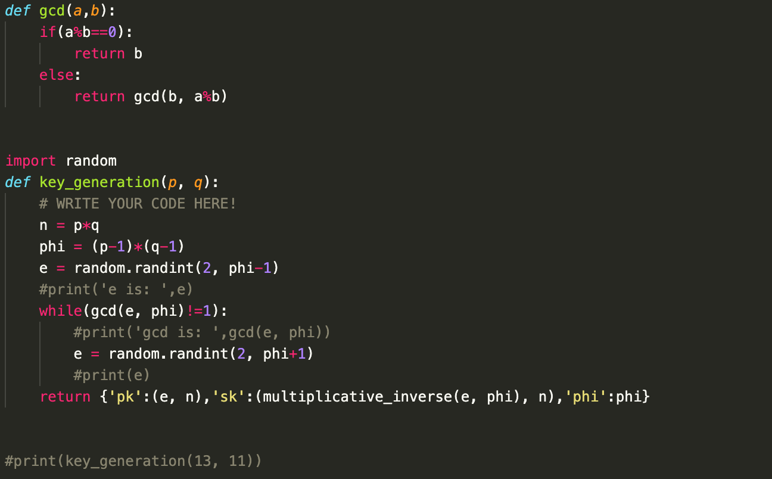
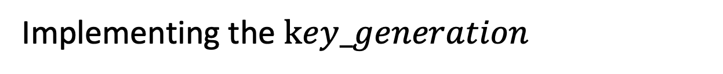
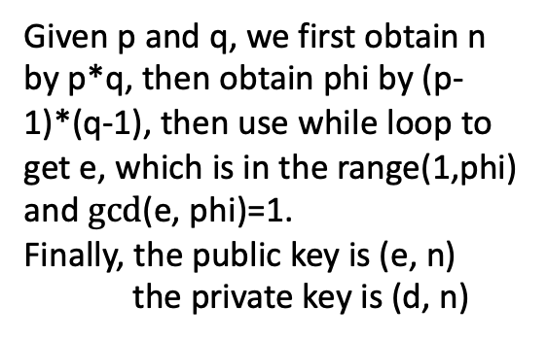
Implementing the $key_generation$
Given p and q, we first obtain n by p*q, then obtain phi by (p-1)*(q-1), then use while loop to get e, which is in the range(1,phi) and $gcd$(e, phi)=1.
Finally, the public key is (e, n)
the private key is (d, n)

Slide 10
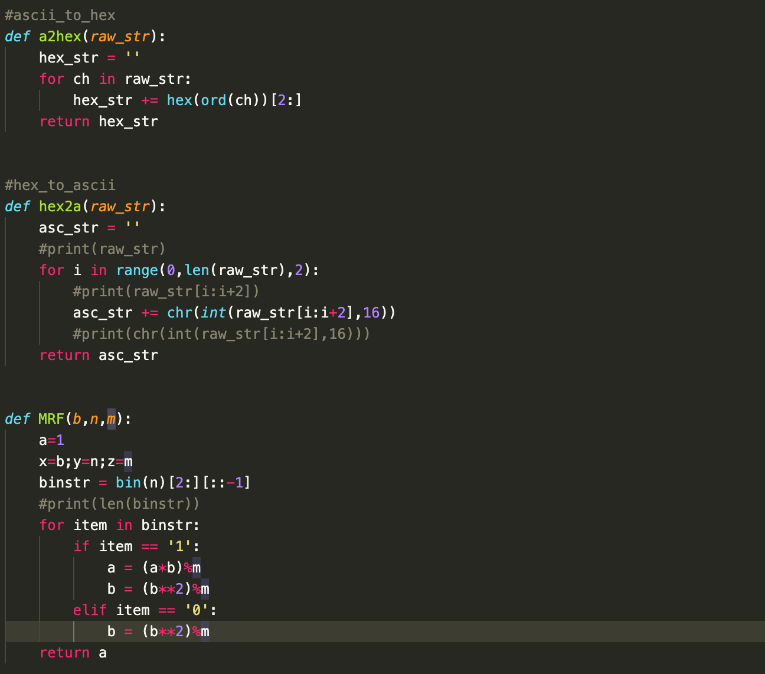
Implementing the a2hex&&hex2a&&MRF
Use a2hex to transfer a string to hex-string and hex2a to transfer a hex-string to string
Use MRF function to simplify the complexity of exponential calculation.

Slide 11
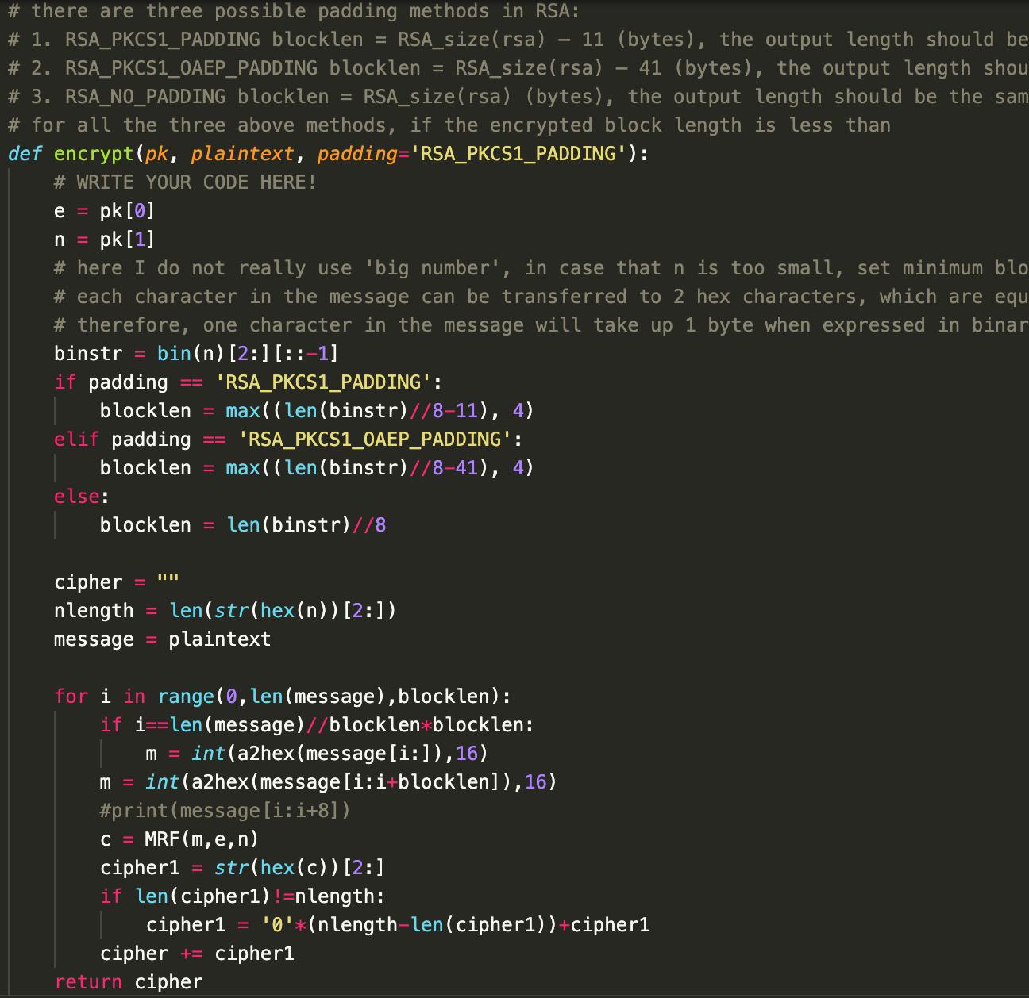
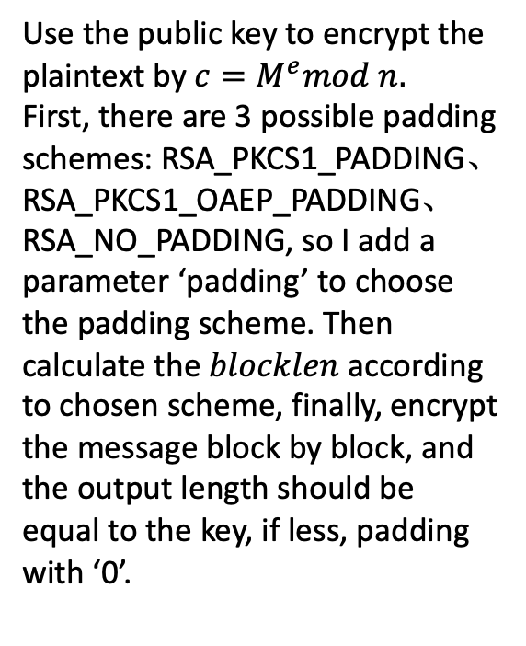
Implementing the encrypt
Use the public key to encrypt the plaintext by $c=M^{e}mod n.$
First, there are 3 possible padding schemes: RSA_PKCS1_PADDING、 RSA_PKCS1_OAEP_PADDING、
RSA_NO_PADDING, so I add a parameter ‘padding’ to choose the padding scheme. Then calculate the $blocklen$ according to chosen scheme, finally, encrypt the message block by block, and the output length should be equal to the key, if less, padding with ‘0’.

Slide 12
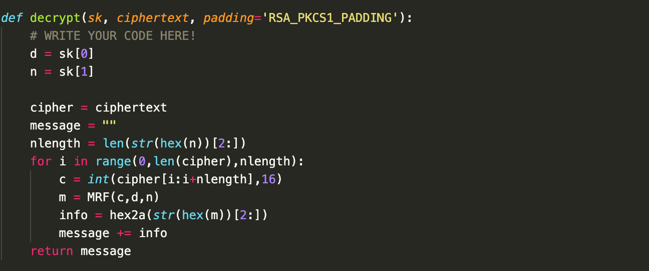
Implementing the decrypt
The inverse process of encryption, because we padding the block length to the length of key, we decrypt block by block

Slide 13
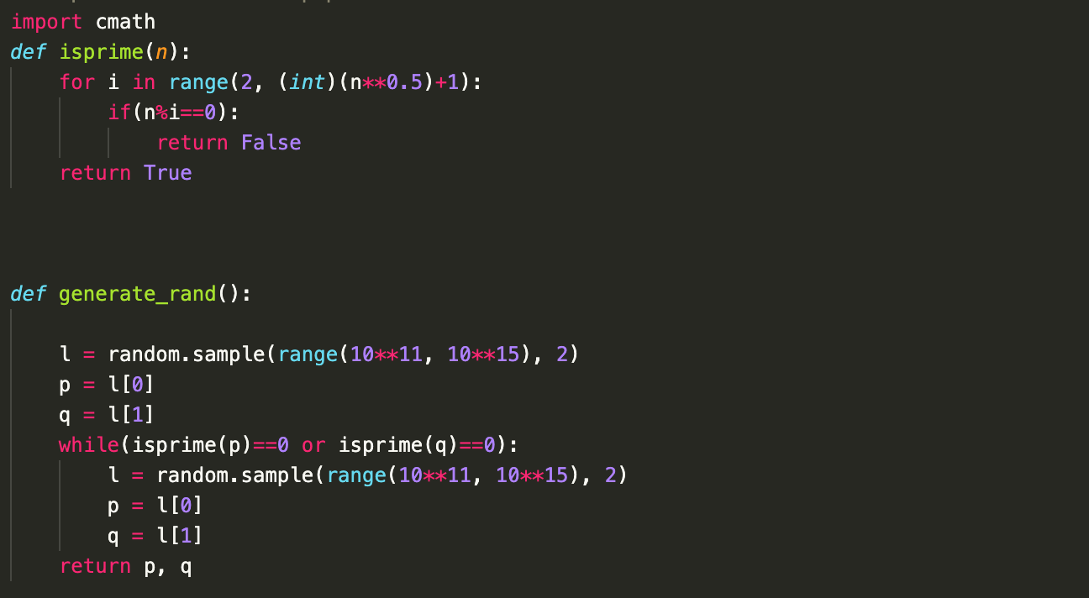
$$Implementing the isprime() and generate random value$$
I also add two functions to pipeline the encryption and decryption process .

Slide 14
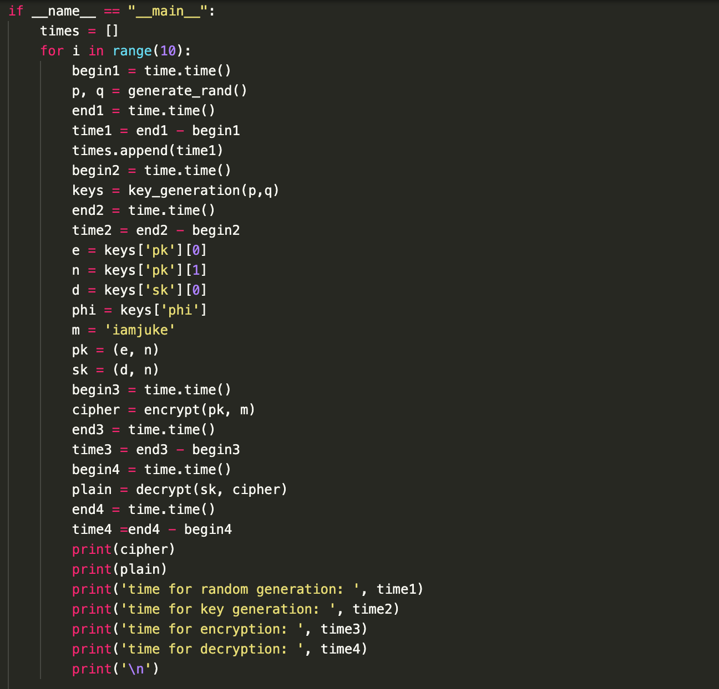
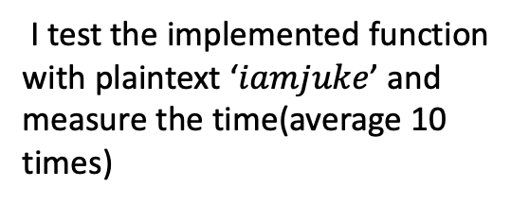
$$Implementing the main function$$
I test the implemented function with plaintext ‘$iamjuke$’ and measure the time(average 10 times)

Slide 15
2. Using decompose modular method to crack RSA encryption algorithm

Slide 16
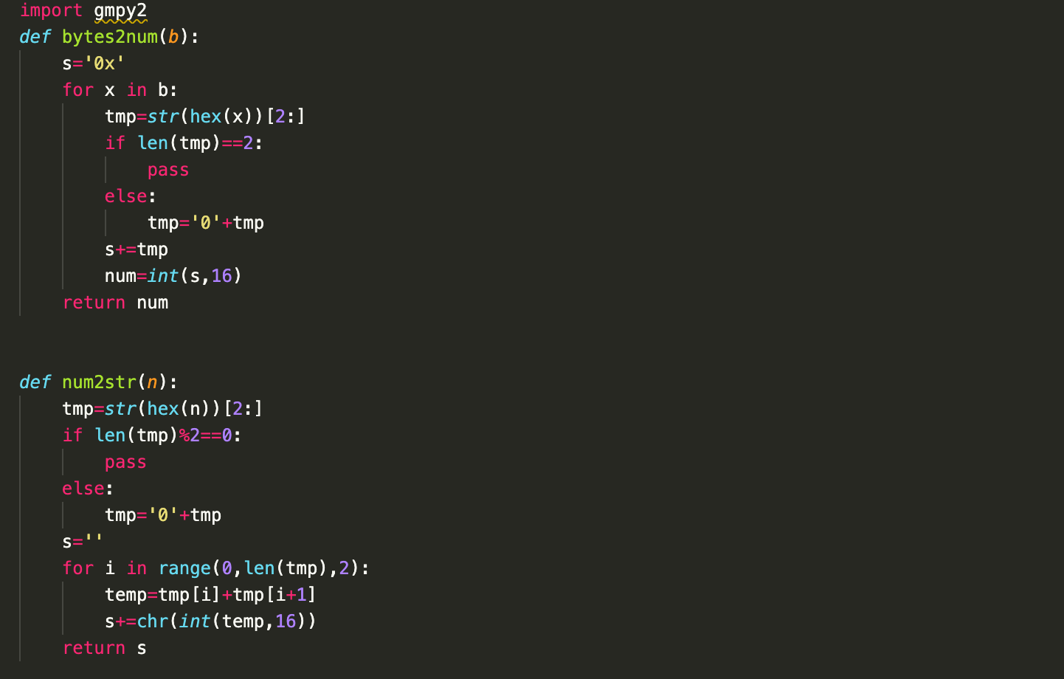
Implementing the transfer function
Transfer from bytes string to number and from number to ASCII, respectively.

Slide 17
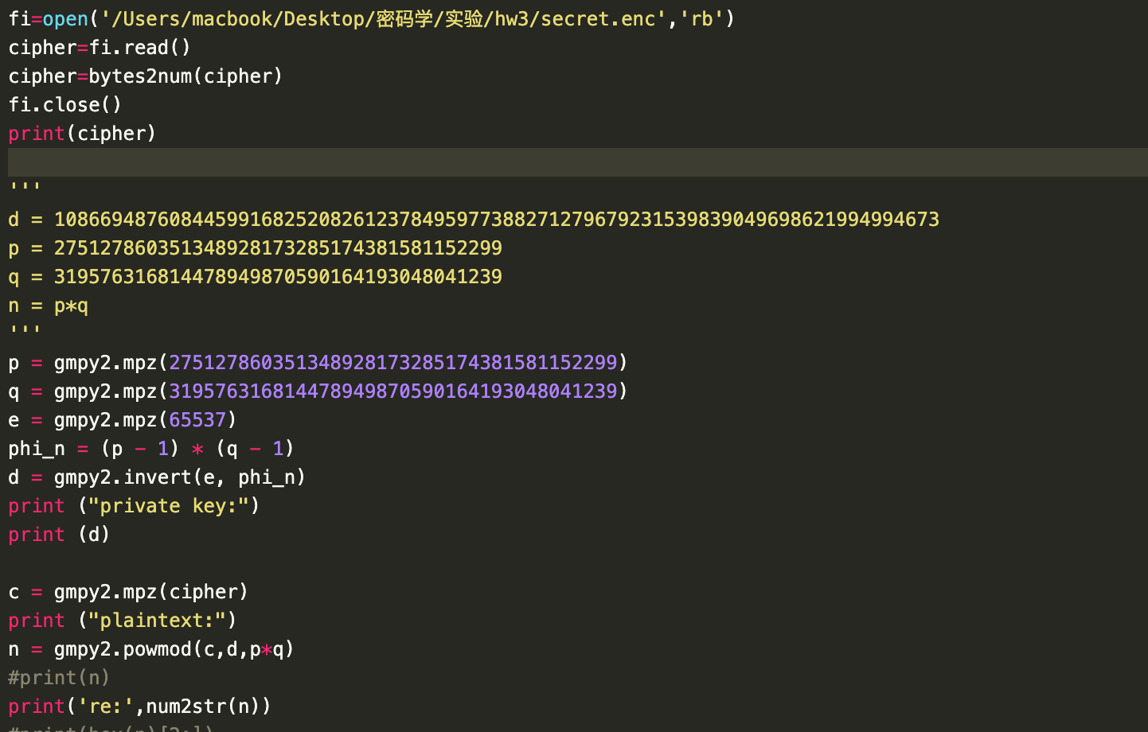
Implementing the crack process
Firstly, we read the ciphertext and transfer it to numbers;
Then we factorize n into p times q, and get d from invert function;
Finally, we decrypt RSA and transfer the output to ASCII.

Slide 18
3. Using common modular method to crack RSA encryption algorithm

Slide 19
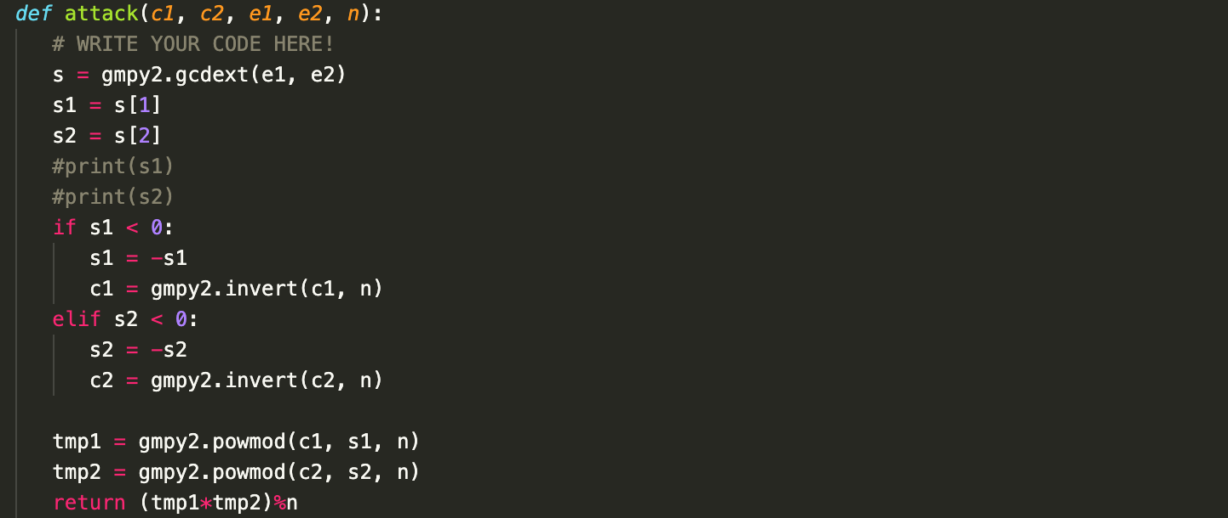
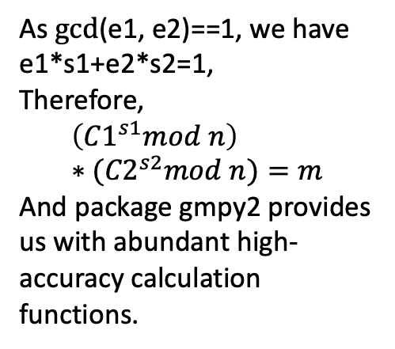
Implement the attack
As $gcd$(e1, e2)==1, we have
e1*s1+e2*s2=1,
Therefore,
$$\left({C1}^{s1}mod n\right)∗{(C2}^{s2}mod n)=m$$
And package gmpy2 provides us with abundant high-accuracy calculation functions.

Slide 20
3
PART ONE
Results && Analysis

Slide 21
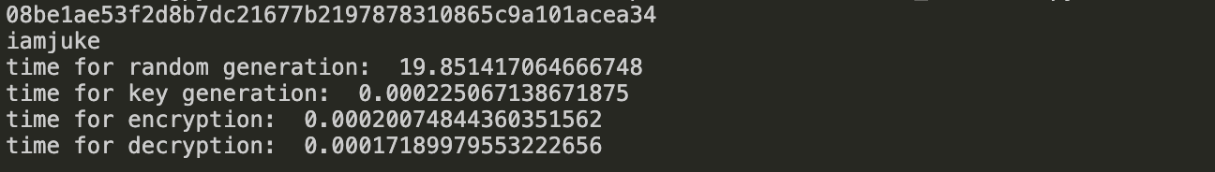
Result
Use ‘iamjuke’ as plaintext, the ciphertext is:
and by implementing the decryption function, we obtain the ‘iamjuke’, which is the same with plaintext.

Slide 22
Time cost:
Experiment | Time(s)
Random value generation | 141.886209 (average of 10 times)
Key generation | 0.00030398
encryption | 0.00018000
decryption | 0.00015997
CONTENTS
The random value generation is time-costly, because judging whether a big number (10^9~10^11) costs much time.

Slide 23
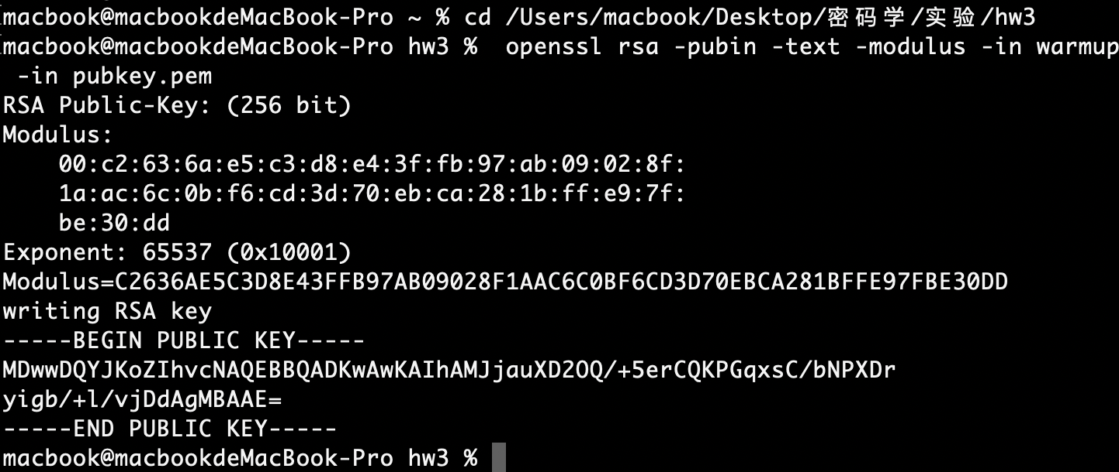
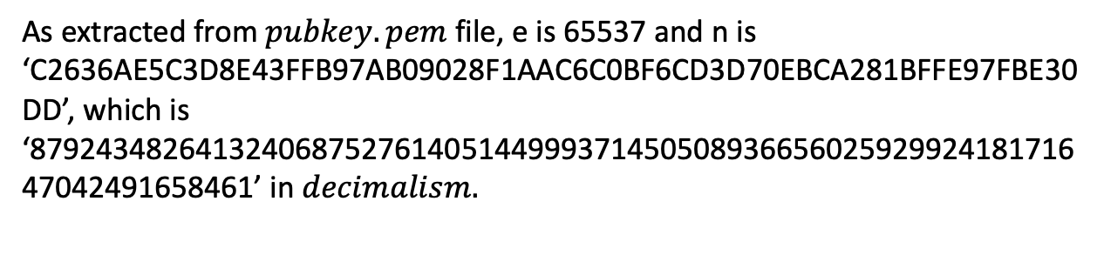
result
As extracted from $pubkey.pem$file, e is 65537 and n is ‘C2636AE5C3D8E43FFB97AB09028F1AAC6C0BF6CD3D70EBCA281BFFE97FBE30DD’, which is ‘87924348264132406875276140514499937145050893665602592992418171647042491658461’ in $decimalism.$

Slide 24
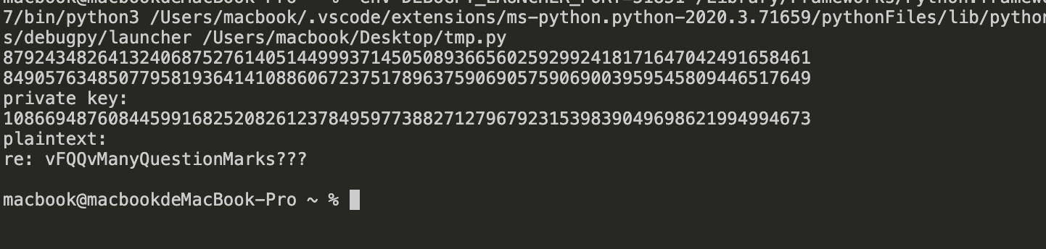
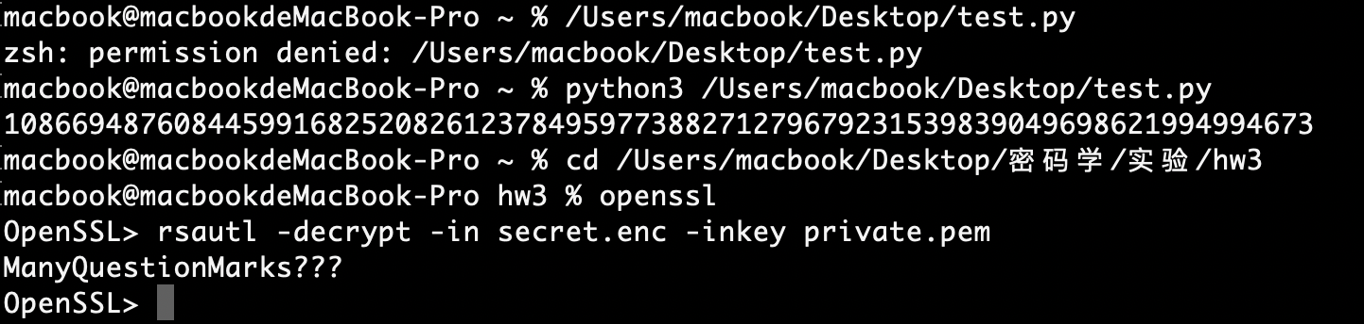
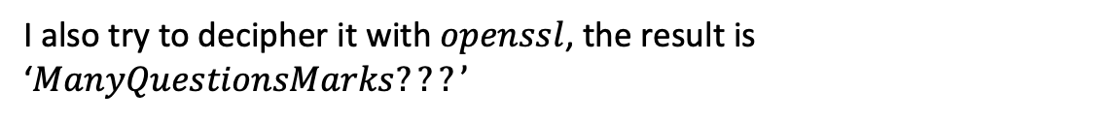
result
Firstly, I decipher the message with self-implemented function.
I also try to decipher it with $openssl$, the result is ‘$ManyQuestionsMarks???’$

Slide 25
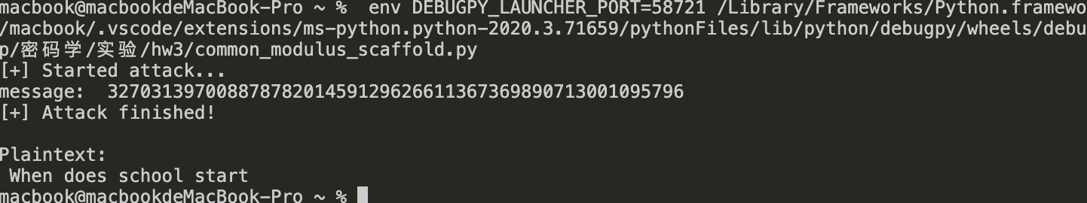
result
The decryption result using common modular is “When does school start”.
What’s worth mentioning is that I first get the value s1:-6 and s2:7, then s1<0, so I transfer s1 to 6, and transfer c1 by gmpy2.invert(c1,n)

Slide 26
4
PART ONE
Summary && Thoughts

Slide 27
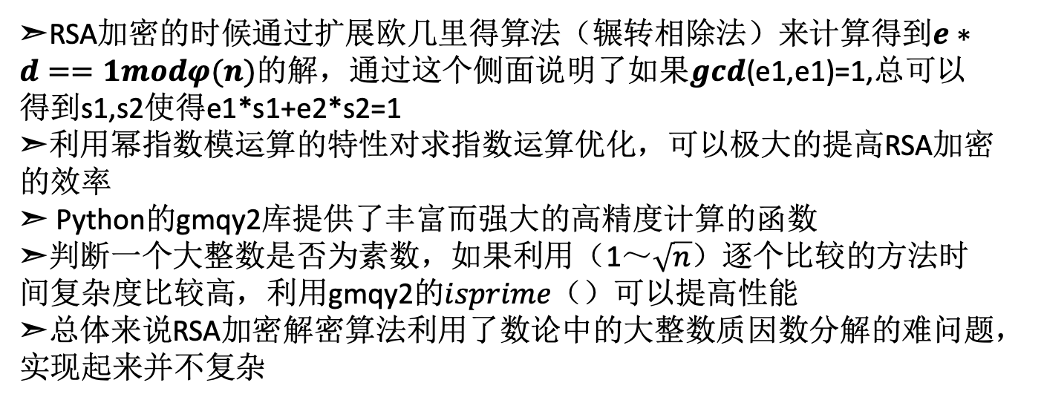
Summary
➣RSA加密的时候通过扩展欧几里得算法（辗转相除法）来计算得到$e∗d==1modφ(n)$的解，通过这个侧面说明了如果$gcd$(e1,e1)=1,总可以得到s1,s2使得e1*s1+e2*s2=1
➣利用幂指数模运算的特性对求指数运算优化，可以极大的提高RSA加密的效率
➣ Python的gmqy2库提供了丰富而强大的高精度计算的函数
➣判断一个大整数是否为素数，如果利用（1～$\sqrt{n}$）逐个比较的方法时间复杂度比较高，利用gmqy2的$isprime（）$可以提高性能
➣总体来说RSA加密解密算法利用了数论中的大整数质因数分解的难问题，实现起来并不复杂
CONTENTS

Slide 28
Summary
➣关于利用分解模数破解RSA的方法，需要借助一些外部的工具分解大的整数，对解密需要的信息少，但是对计算能力要求高
➣关于公共模数破解的方法，要求e1\e2互质、使用相同的模数，这一点要求比较高，需要的信息也多，但是需要的计算能力较弱。
➣总的来说破解RSA的难度比较高，所以RSA相对来说是一种较为安全的加密方案
CONTENTS

Slide 29
2
20
Thanks for watching.

