Slide 1
INFOSYS SPRINGBOARD VIRTUAL INTERNSHIP 7.0
SP
SupportPilot
AI-Powered Customer Support & Ticket Resolution Platform
Automating ticket intake, RAG knowledge retrieval, confidence-based triage, agent collaboration, and enterprise workflow management across four end-to-end delivery milestones.
TEAM 1
SOURCE REPOSITORY
github.com/ananyaravikumar548/Infosys_Support-AI-Ticket-Management-

Slide 2
EXECUTIVE OVERVIEW
Introduction to SupportPilot
Platform Purpose
SupportPilot is an enterprise-grade AI customer support platform engineered to automate ticket intake, intelligent triage, vector knowledge retrieval (RAG), confidence-gated human escalation, and controlled ticket closure. Built for high-volume enterprise environments, it unifies customer interaction, agent resolution workflows, and executive analytics.
1
2
3
Multi-Persona Ecosystem
Lifecycle Automation
Core Objective
Customized portals for Customers (intake & tracking), Agents (AI-assisted workspace), Managers (workload, SLA & Jira sync), and Admins (confidence thresholds & RBAC).
End-to-end automation from intent detection and RAG document search, to auto-drafting, SLA tracking, agent validation, and customer confirmation.
Slashing Mean Time to Resolution (MTTR) by up to 75%, eliminating agent burnout on repetitive L1 tickets, and providing 100% SLA and audit visibility.
02

Slide 3
INDUSTRY BOTTLENECKS
Practical Challenges in Traditional Support
!
High Ticket Volume
~
Repetitive Requests
x
Manual Classification
Unfiltered inbound queues cause severe backlog build-up during peak operational hours.
Agents spend over 60% of their workday typing identical answers to standard L1 queries.
Human categorization errors lead to incorrect queue routing and ping-pong reassignment.
Avg. 48h response delay
Wasted operational budget
25% misrouting rate
S
Slow Prioritization
?
Knowledge Search Effort
T
SLA Breach Risks
Critical production outages get buried under minor general inquiry tickets.
Agents context-switch across disconnected docs, PDFs, and internal wikis.
Lack of real-time timer tracking and proactive escalation triggers causes missed SLAs.
High customer churn risk
~15 min spent per ticket
Frequent contract penalties
03

Slide 4
CORE THESIS
Problem Statement
“Traditional customer support systems rely heavily on manual triage, leading to delayed response times, poor resource allocation, agent burnout, and inconsistent resolution quality. Organizations urgently require an intelligent, automated management platform to streamline workflows and maintain high customer satisfaction.”
High
Degraded
Poor
High Response Time
Degraded Productivity
Poor Experience
Manual intake creates backlogs and extends customer wait times.
Agents spend 40% of time searching scattered knowledge bases.
Inconsistent responses directly harm customer trust and retention.
04

Slide 5
DIAGNOSTIC ANALYSIS
Problem Findings & Audit Results
1
2
3
4
Manual Friction
Context Lag
Knowledge Silos
Limited Visibility
Excessive manual effort required for sorting and initial categorization.
Delayed understanding of ticket urgency and underlying customer intent.
Difficulty retrieving relevant past solutions and documentation.
Poor tracking of ticket progress, SLA breaches, and agent performance.
05

Slide 6
TECHNICAL BLUEPRINT
Solution Architecture
Users: Customer • Support Agent • Manager • Administrator
React Frontend (Tailwind CSS, Recharts) | Django REST Framework API (JWT Auth)
AI ORCHESTRATOR ENGINE
Classification
& Priority
Sentiment
Analysis
RAG Retrieval
Engine
Confidence
Validator
Auto Resolution Pathway (High Confidence)
Human Escalation Pathway (Low Confidence)
MongoDB Atlas
Jira Integration
Email Automation
Analytics Engine
06

Slide 7
PARADIGM SHIFT
Proposed Solution & Transformation
Traditional Process
SupportPilot Paradigm
Manual Triage: Slow manual ticket tagging
AI Classification: Instant priority & sentiment
Search Friction: Agents hunt across docs
RAG Retrieval: Sub-second knowledge match
Static SLA: Unmonitored breach risks
Real-Time SLA: Automated escalation alerts
Repetitive Work: No automated resolutions
Human-in-Loop: Smart confidence validation
07

Slide 8
FEATURE OVERVIEW
Core Platform Functions
1
2
3
4
Ticket Creation
AI Classification
Priority & Severity
Sentiment Analysis
Multi-channel customer portal intake.
Category & intent tagging.
Automated urgency rating.
Customer mood detection.
5
6
7
8
RAG Knowledge
AI Resolution
SLA Monitoring
Analytics
Contextual vector lookup.
Auto response drafting.
Real-time breach alerts.
Performance dashboards.
08

Slide 9
END-TO-END PIPELINE
System Workflow
1
→
2
→
3
→
4
→
5
Login &
Intake
AI
Classification
RAG
Search
AI
Resolution
Confidence
Gate
PATH A: High Confidence (>85%)
PATH B: Low Confidence (<85%)
Auto-sent to customer → Customer Confirmation → Closed
Escalated to Support Agent → Review & Send → Closed
Lifecycle Reopen State: Resolved → Reopened by Customer → In Progress → Final Resolution
09

Slide 10
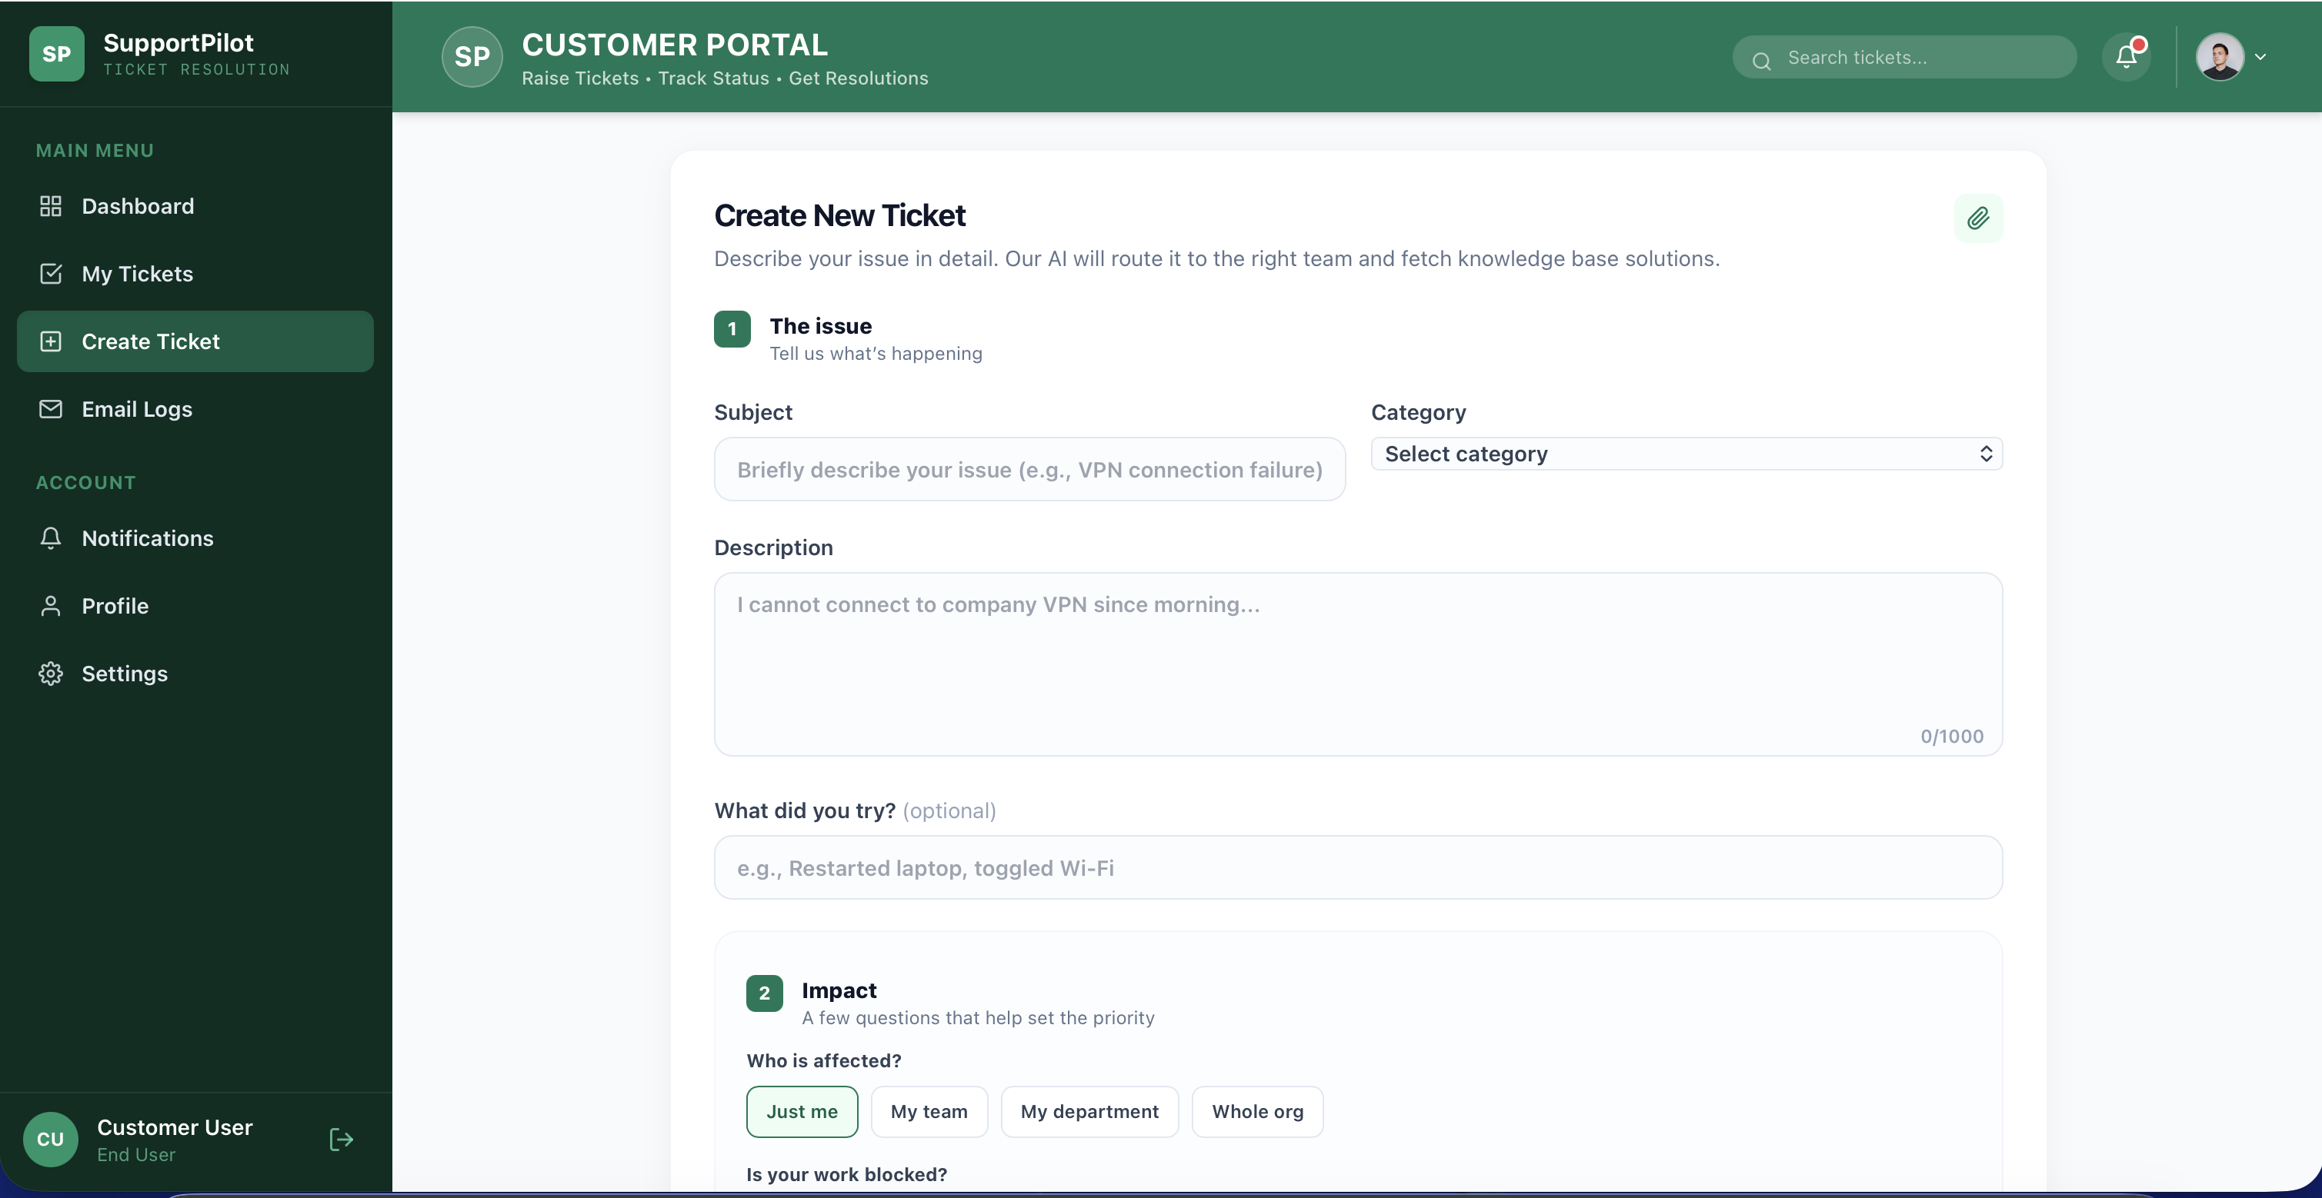
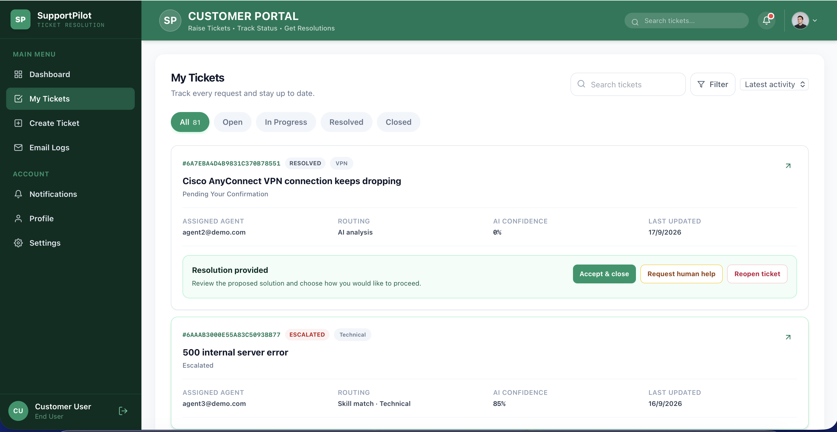
PRODUCT WALKTHROUGH
Customer Portal — Raise & Track Tickets
Create New Ticket — AI-Guided Intake Form
My Tickets — Status, AI Confidence & Actions
1
Guided Intake
2
Live AI Confidence
3
One-Tap Resolution
Subject, description, category, and impact fields feed directly into AI classification and severity scoring.
Every ticket shows its routing method and AI confidence score at a glance.
Customers can Accept & Close, Request Human Help, or Reopen a ticket directly from the list.
10

Slide 11
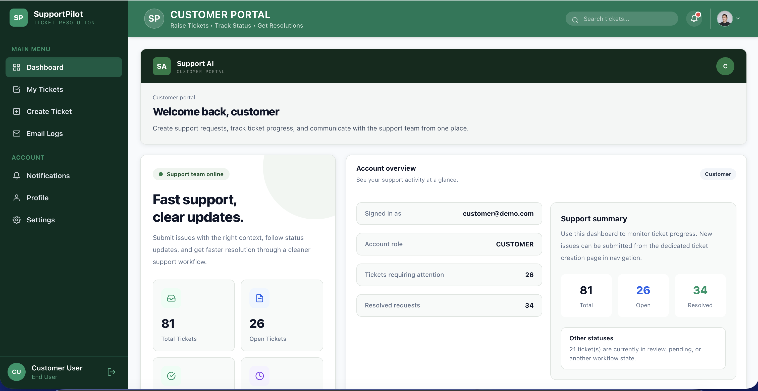
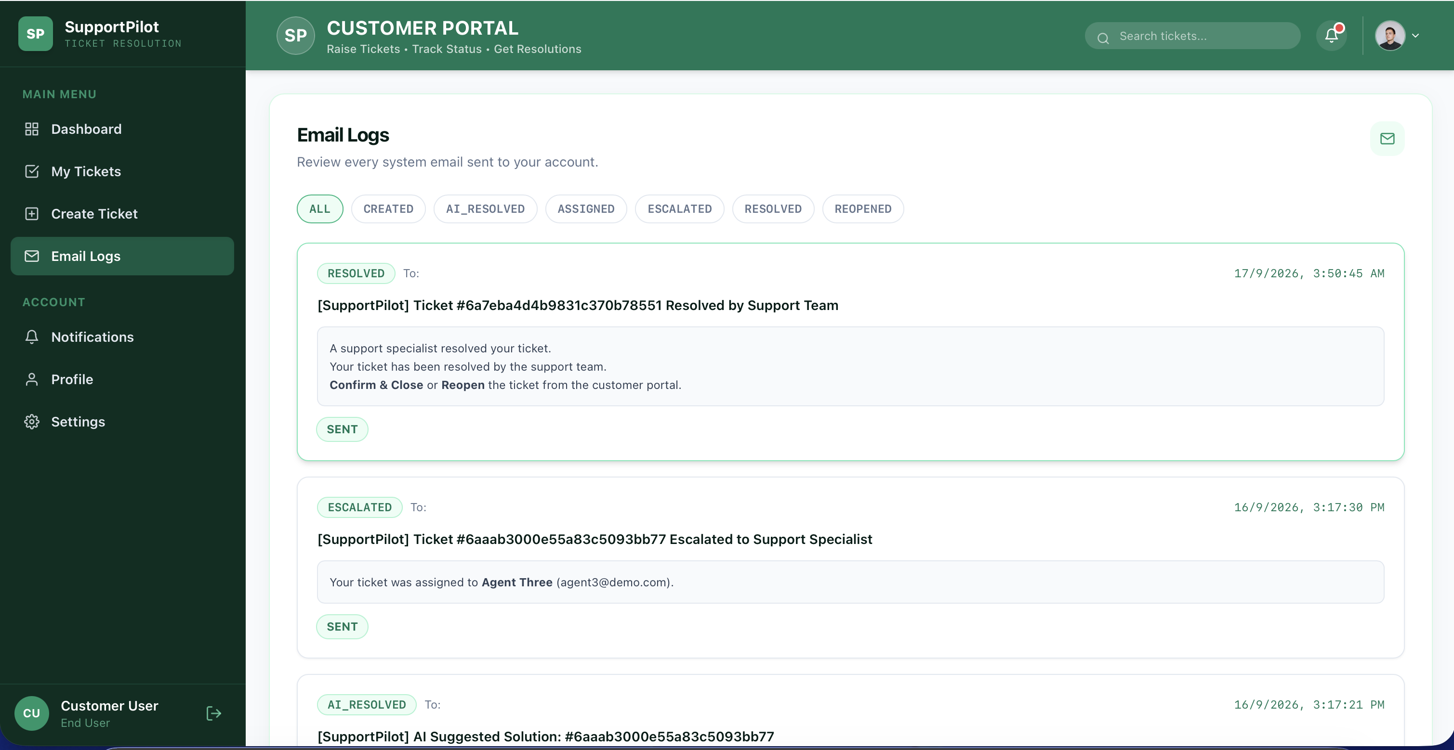
PRODUCT WALKTHROUGH
Customer Portal — Dashboard & Notifications
Account Dashboard — Ticket Summary at a Glance
Email Logs — Full Notification History
1
Real-Time Overview
2
Automated Notifications
3
Full Audit Trail
Total, open, and resolved ticket counts update instantly for the signed-in customer.
Resolved, escalated, and AI-resolved emails are sent automatically at every workflow step.
Every customer communication is logged with delivery status for complete transparency.
11

Slide 12
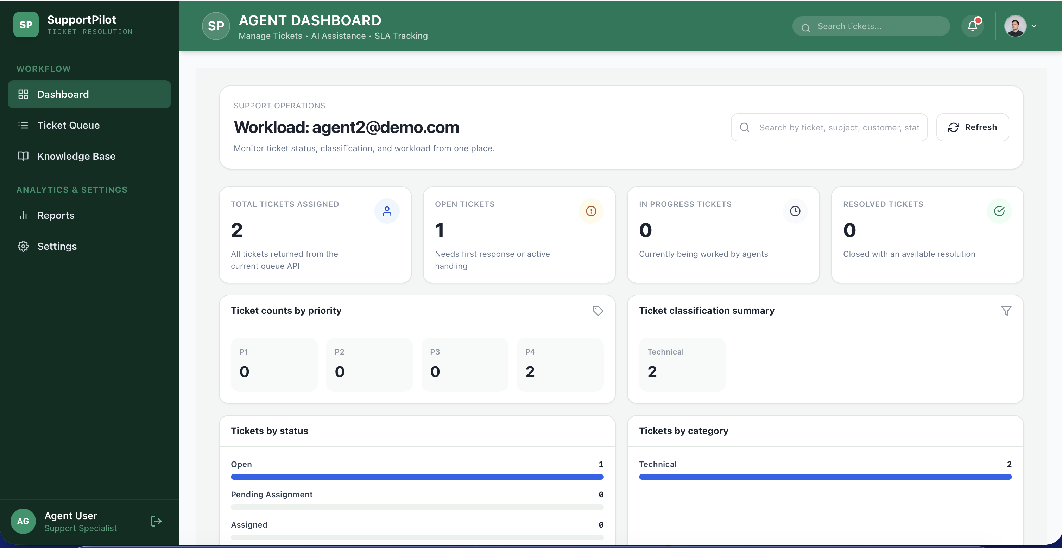
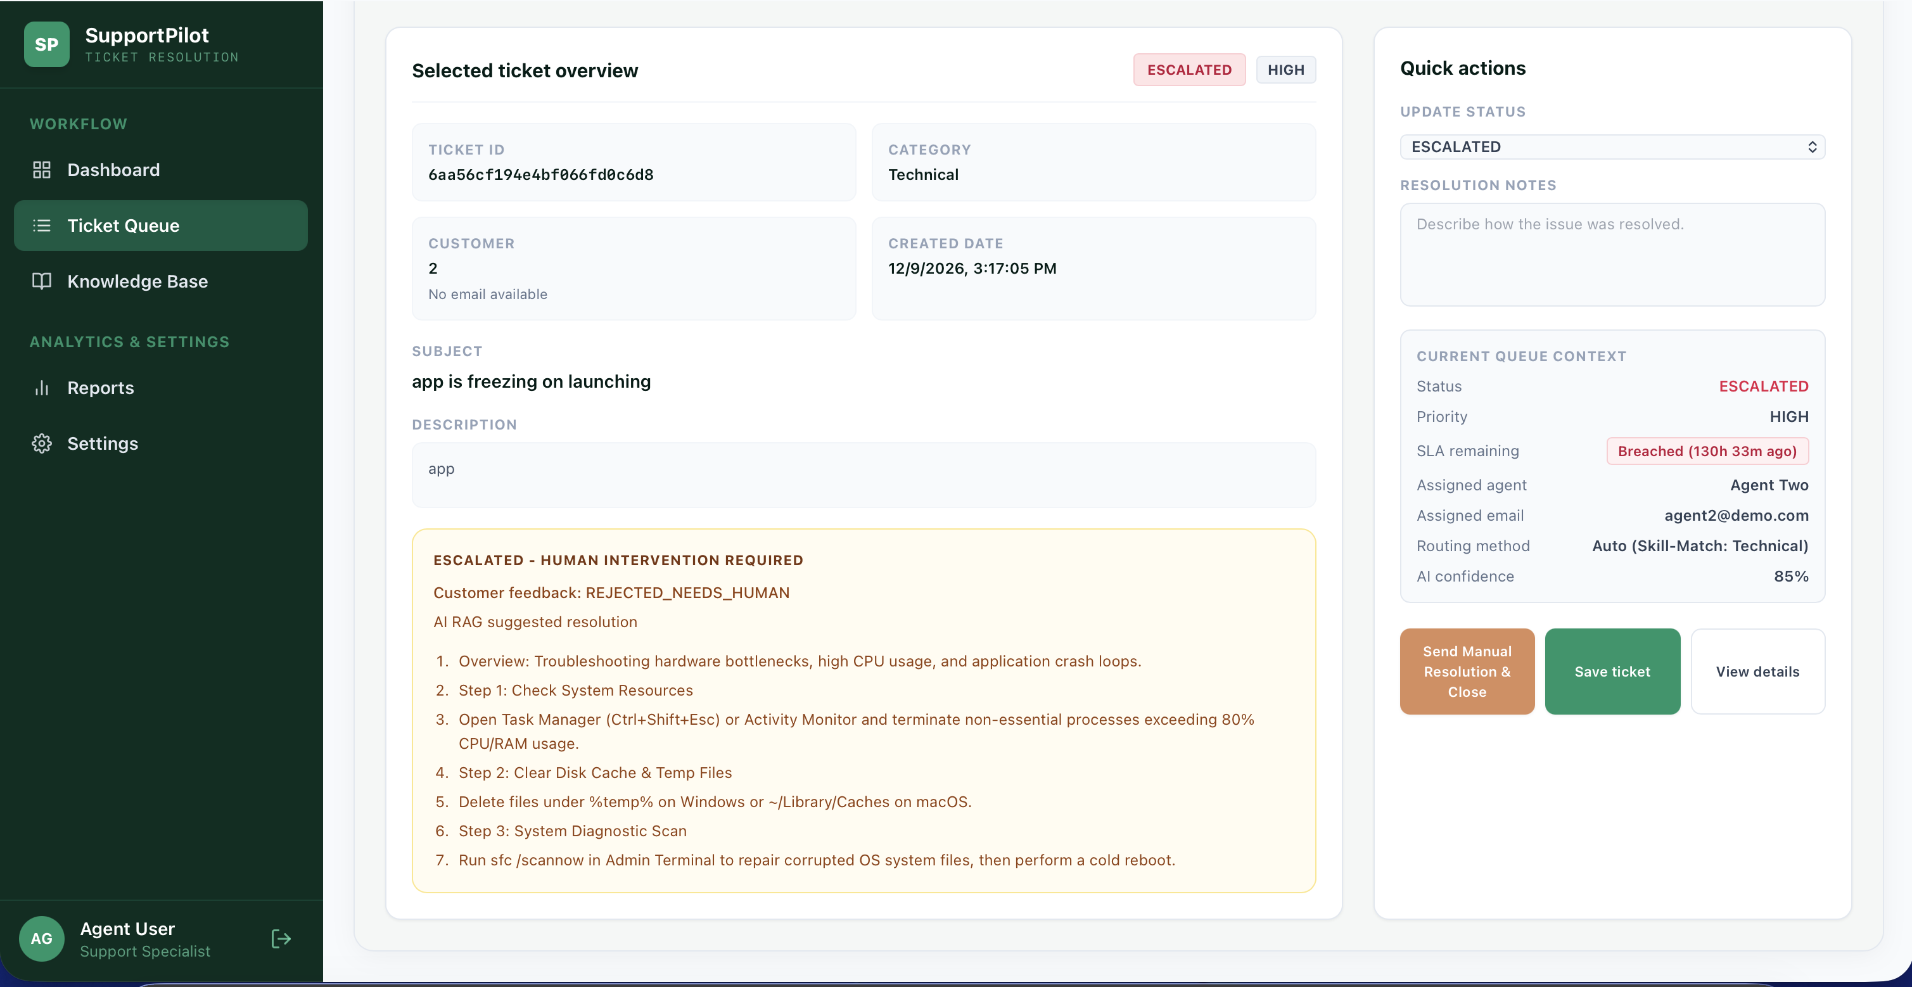
PRODUCT WALKTHROUGH
Support Agent Portal — AI-Assisted Resolution
Agent Dashboard — Workload & Classification Summary
Ticket Detail — AI (RAG) Suggested Resolution
1
Workload at a Glance
2
Grounded AI Suggestions
3
One-Click Actions
Open, in-progress, and resolved ticket counts broken down by priority and category.
RAG-generated, step-by-step resolutions shown alongside SLA status and AI confidence.
Agents can send the AI resolution, respond manually, or escalate the ticket instantly.
12

Slide 13
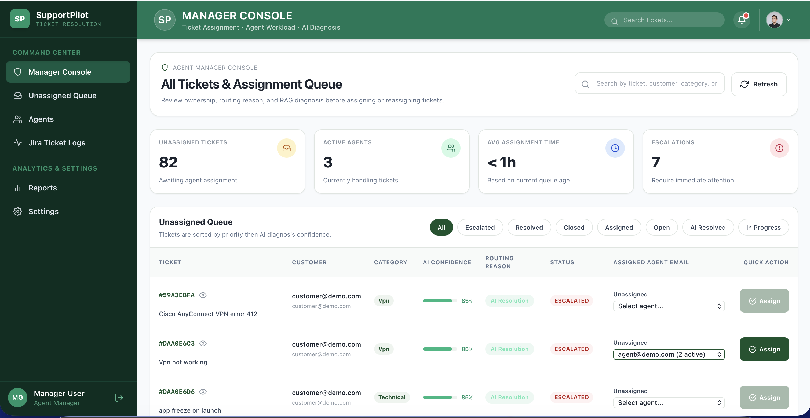
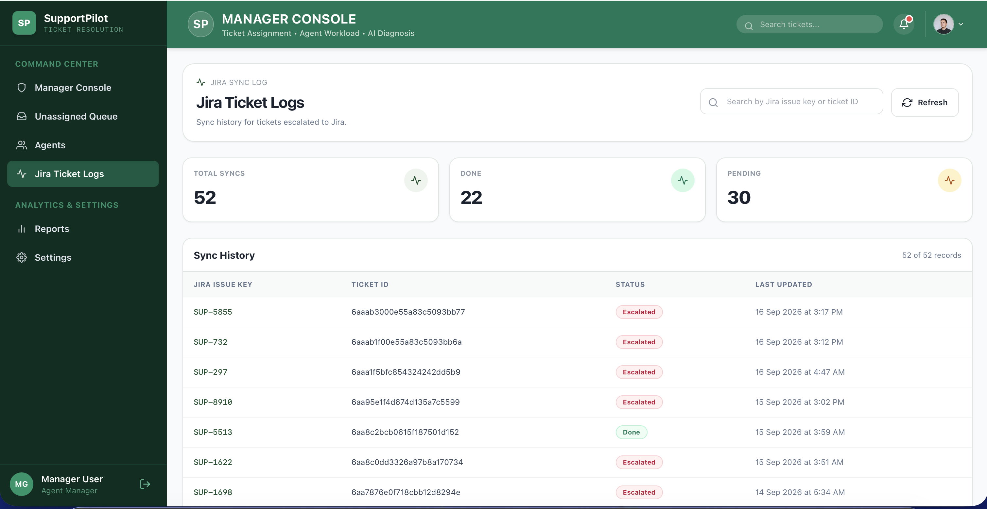
PRODUCT WALKTHROUGH
Manager Console — Assignment & Jira Sync
Assignment Queue — AI Confidence & Routing Reason
Jira Ticket Logs — Two-Way Sync History
1
Smart Assignment
2
Escalation Visibility
3
Jira Sync Trail
Unassigned tickets sorted by priority and AI diagnosis confidence before routing to an agent.
Active agents, average assignment time, and open escalations are tracked live.
Every escalated ticket's sync status (Done / Pending) is recorded with a timestamp.
13

Slide 14
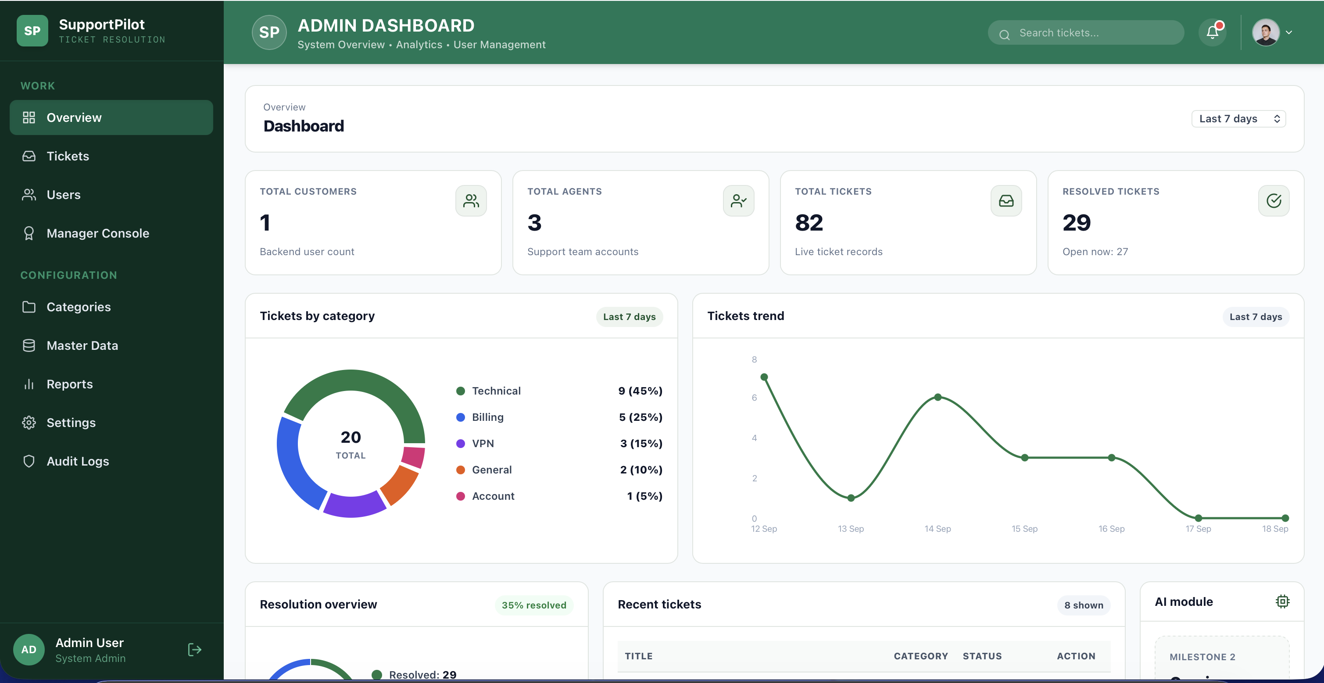
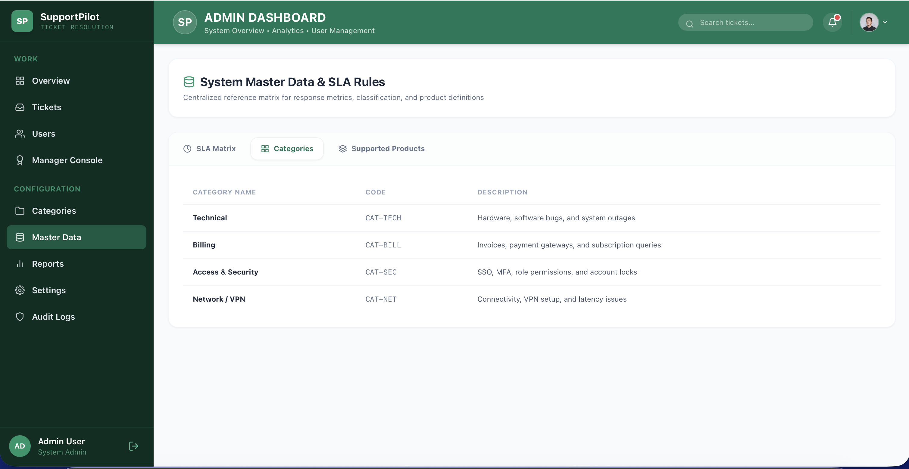
PRODUCT WALKTHROUGH
Admin Portal — Analytics & Configuration
Admin Dashboard — Platform-Wide Analytics
Master Data — Categories & SLA Rules
1
Executive Visibility
2
Centralized Configuration
3
Governed Automation
Ticket volume, resolution rate, and category trends visible in a single dashboard.
Categories, the SLA matrix, and routing rules are all managed from one console.
Confidence thresholds and escalation rules stay Admin-controlled rather than hard-coded.
14

Slide 15
ARCHITECTURE STACK
Enterprise Technology Stack & Libraries
1
Frontend UI Stack
2
Backend API Server
3
Database & Storage
Responsive multi-dashboard interface
RESTful API architecture with CORS & Auth
Dynamic document storage for tickets & logs
React.js, Tailwind CSS, FontAwesome Icons, Recharts, Axios
Python 3.11, Django, Django REST Framework, JWT Tokens
MongoDB Atlas Cloud, PyMongo / MongoEngine Schema
4
AI & Vector RAG Engine
5
Ecosystem Integrations
6
Cloud Deployment
Multi-stage prompt & context retriever
Automated issue filing & customer emails
Continuous delivery via Git & GitHub
LLM Integrations, Embedding Search, Sentiment Classifier
Jira REST API v3 Sync, SMTP Email Automation Framework
Vercel (Frontend CDN), Render Web Service (Backend)
15

Slide 16
MEASURABLE VALUE
Project Impact & Operational Benchmarks
75%
10x
<1s
100%
Repetitive Work Cut
Faster Triage Speed
Knowledge Retrieval
SLA Audit Visibility
Automating L1 query response handling and standard troubleshooting steps.
Instant category, severity, and customer sentiment classification upon submission.
Vector similarity search pinpointing exact documentation across large corpora.
Proactive countdown monitoring, breach prevention, and manager alerts.
16

Slide 17
8-WEEK MILESTONES
Key Project Deliverables & Outcomes
MILESTONE 1
Weeks 1–2
MILESTONE 2
Weeks 3–4
Ticket Processing & Classification
Knowledge Retrieval & Resolution Generation
Designed MongoDB schemas, Django REST authentication, RBAC, PII-safe preprocessing, and the fast/LLM classification, severity, priority, and SLA engine.
Built the knowledge base ingestion pipeline, hybrid vector + keyword RAG retrieval with reranking, and citation-enforced AI-drafted resolutions.
MILESTONE 3
Weeks 5–6
MILESTONE 4
Weeks 7–8
Multi-Agent Workflows & Integrations
AI Validation, Agent Collaboration & Closure
Implemented the Diagnosis → Retrieval → Resolution → Escalation agent orchestrator, two-way Jira sync, and automated SMTP notifications.
Delivered confidence-based routing, the agent review queue, customer confirmation/reopen flow, controlled closure, and live analytics dashboards.
17

Slide 18
STAKEHOLDER VALUE MATRIX
Comprehensive Stakeholder Benefits
1
For Customers
2
For Support Agents
Near-instant answers to routine queries, 24/7 self-service accuracy, transparent stage tracking, and seamless single-click ticket reopening if solutions require further clarification.
Elimination of manual repetitive responses, instant AI-drafted context & step-by-step documentation, automatic Jira issue creation, and focus on high-value complex tasks.
3
For Support Managers
4
For Enterprise Organization
Real-time visibility into queue backlogs, automatic team workload balancing, instant SLA breach alerts, and quantitative insights into team resolution performance.
Dramatically lowered operational cost per ticket, scalable support architecture without linear headcount growth, and improved customer satisfaction (CSAT) scores.
18

Slide 19
VISION & SCALE
Real-World Enterprise Impact & Future Roadmap
Real-World Enterprise Impact
Future Technology Roadmap
SupportPilot equips IT service desks, SaaS platforms, and enterprise support centers to process thousands of daily support queries smoothly. By resolving standard L1 queries autonomously and elevating human agents into specialized problem solvers, organizations achieve rapid resolution times and predictable support SLAs.
MS Teams & Slack Support Bots
→
→
Predictive AI SLA Breach Alerts
→
Multilingual Generative Translation
→
Automated KB Gap Detection
→
Conversational Voice AI Agent
→
Automated System API Remediation
19

Slide 20
INFOSYS SPRINGBOARD VIRTUAL INTERNSHIP 7.0 • FINAL REVIEW
SupportPilot
“Smarter Support. Faster Resolution. Superior Customer Experience.”
SupportPilot successfully delivers an end-to-end AI-assisted customer support platform featuring automated triage, RAG knowledge retrieval, confidence-gated escalation, multi-agent orchestration, Jira integration, and executive SLA analytics — developed, tested, and deployed live across four milestones during the 8-week Infosys Springboard Virtual Internship 7.0.
TEAM 1
SOURCE CODE REPOSITORY
github.com/ananyaravikumar548/Infosys_Support-AI-Ticket-Management-

