Slide 1

HOSPITAL MANAGEMENT SYSTEMS
GROUP - 16
Aslı Türkoğlu - 20180808012
Arzu Dabanıyastı - 20180808032
Ceyda Elmas - 20180808037
Melike Tekin - 20190808031
Hümeyra Köseoğlu - 20180808015

Slide 2
OUTLINE
Mission Statement
Fact-Finding Techniques
General Rules
E-R Diagram
Normalization Tables
MySQL Queries
Interface

Slide 3

MAIN PURPOSES OF
OUR HOSPITAL MANAGAMENT SYSTEM

Slide 4
MISSION STATEMENT
To help manage the information related to health care and aids in the job completion of healthcare providers effectively, and following a simple and as uniform way as possible for data entry.

Slide 5
FACT-FINDING TECHNIQUES
RESEARCH
We investigated the problems we were experiencing on the internet. We looked at how others were solving similar problems and were inspired by them.
EXAMINING DOCUMENTATION
We examined various types of flowcharts, diagrams and database systems design.

Slide 6
GENERAL RULES
User will enter to website via user_TRID and Password.
We have other types of people working at the hospital (Customer's request). Only doctors whose branch is pathology and admins can enter the test results.
Every clinic has one admin.
The patient can add an appointment, update the appointment date and delete the appointment.
The doctor may request a test, and add a diagnosis and a prescription according to the test result.
Doctors cannot register themselves, admin adds or deletes the doctor from the system according to clinics.
Added appointments go to the admin's page. Admin approves or not.

Slide 7
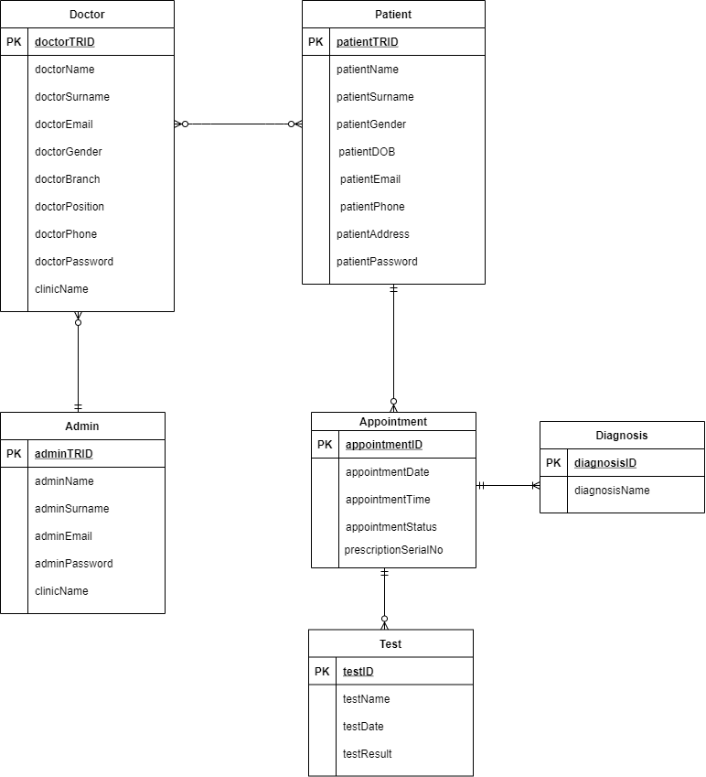
E-R DIAGRAM

Slide 8
For the user interface part, the customer wants from us:
1. A list of all doctors that have seen a certain patient
2. A list of all patients and the number of appointments they have had in the past year
3. A way to change the date of an appointment
4. A way to add a new doctor to the database
5. A way to remove an appointment from the system

Slide 9
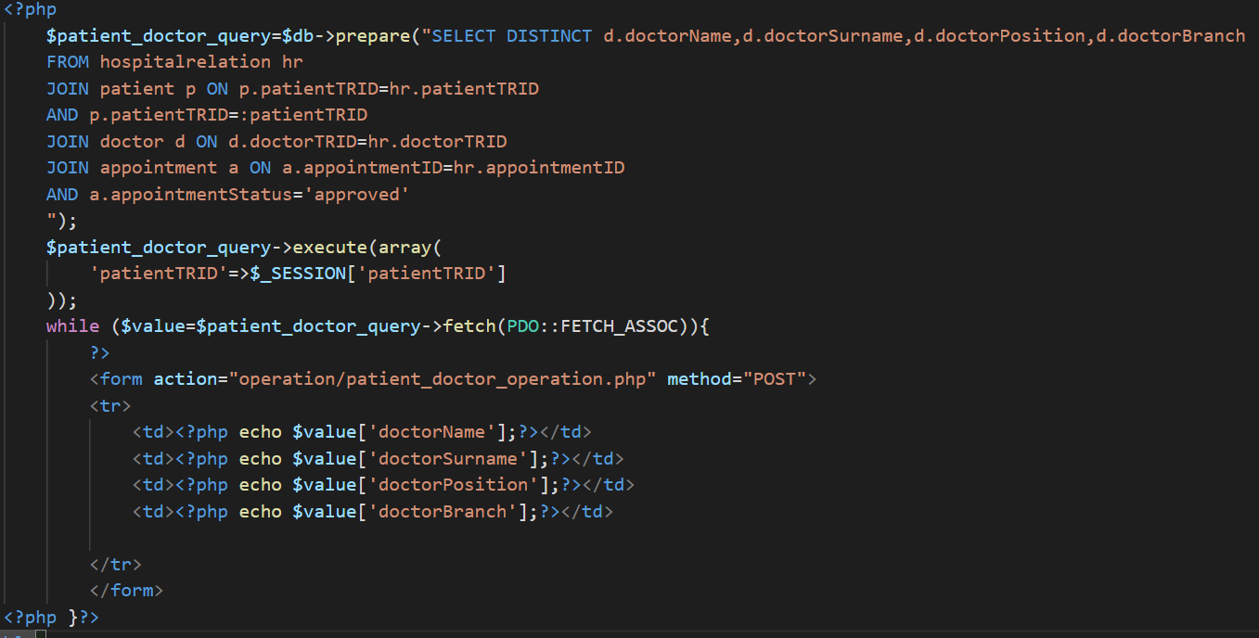
A LIST OF ALL DOCTORS THAT HAVE SEEN A CERTAIN PATIENT

Slide 10
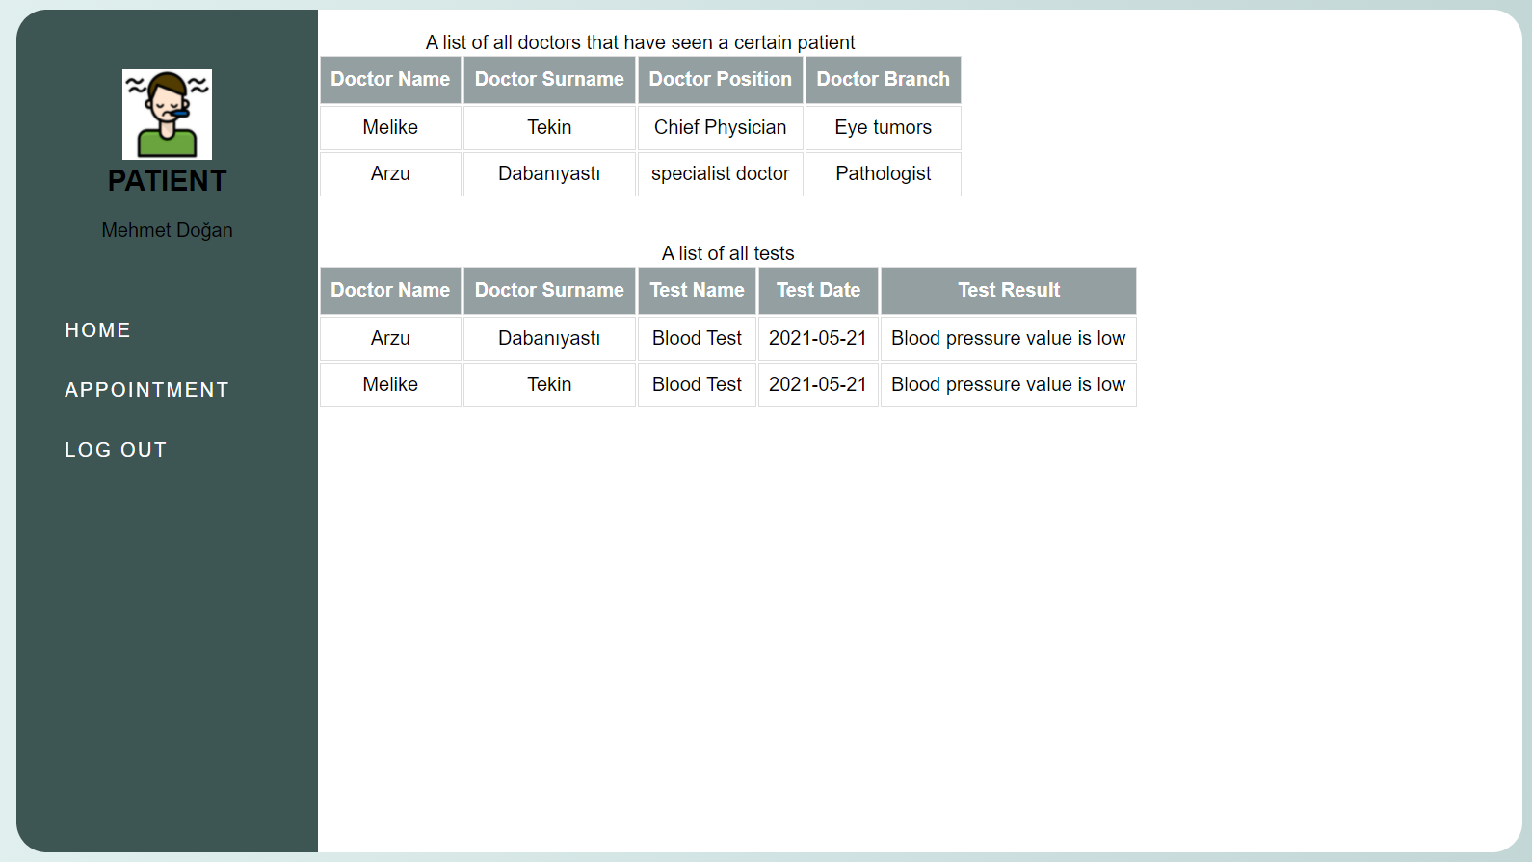

Slide 11
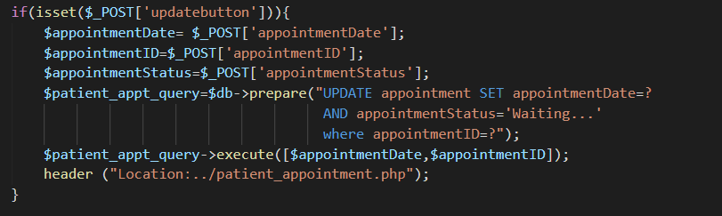
A WAY TO CHANGE THE DATE OF AN APPOINTMENT

Slide 12
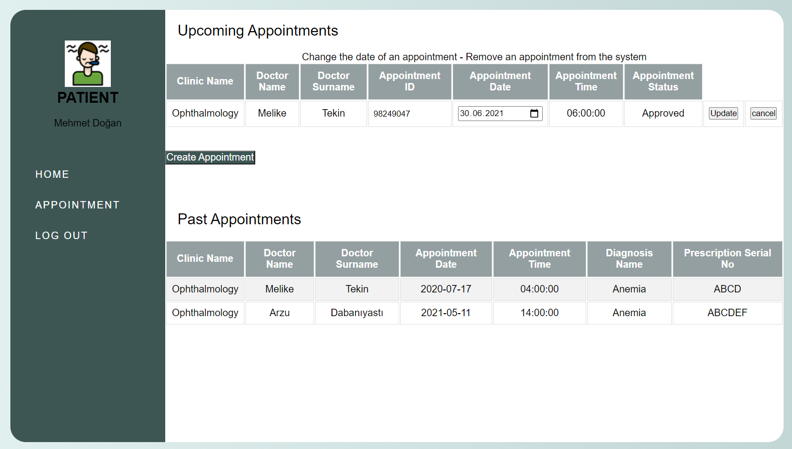

Slide 13
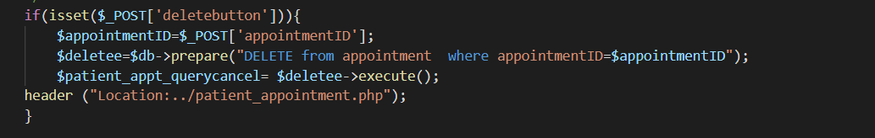
A WAY TO REMOVE AN APPOINTMENT FROM THE SYSTEM
ALTER TABLE `hospitalrelation` ADD CONSTRAINT `FK_patientAppointmentID` FOREIGN KEY (`appointmentID`) REFERENCES `appointment`(`appointmentID`) ON DELETE CASCADE ON UPDATE RESTRICT;

Slide 15
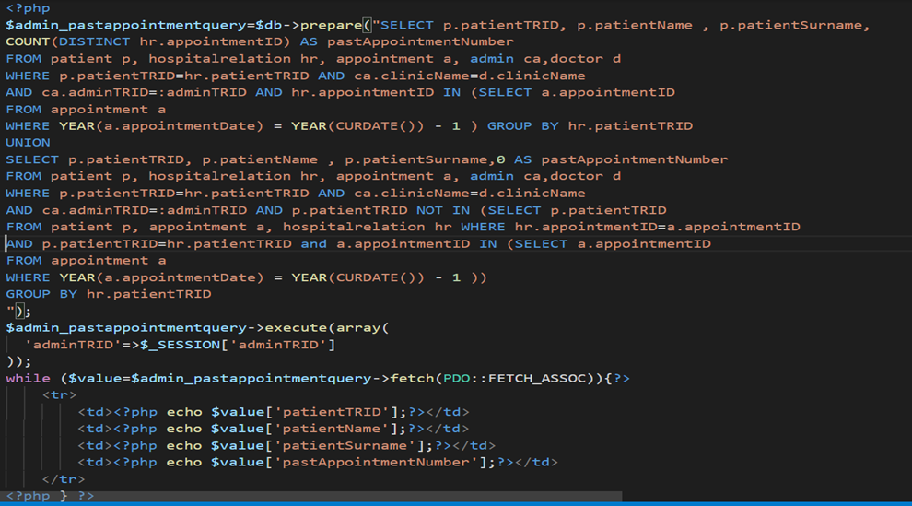
A LIST OF ALL PATIENTS AND THE NUMBER OF APPOINTMENTS THEY HAVE HAD IN THE PAST YEAR

Slide 16
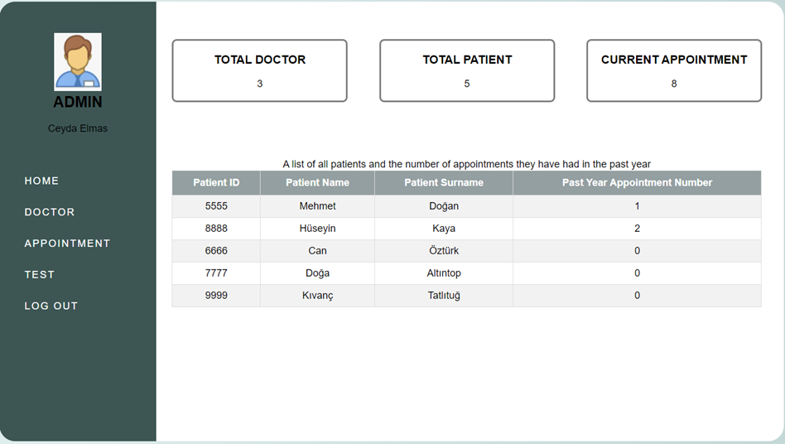

Slide 17
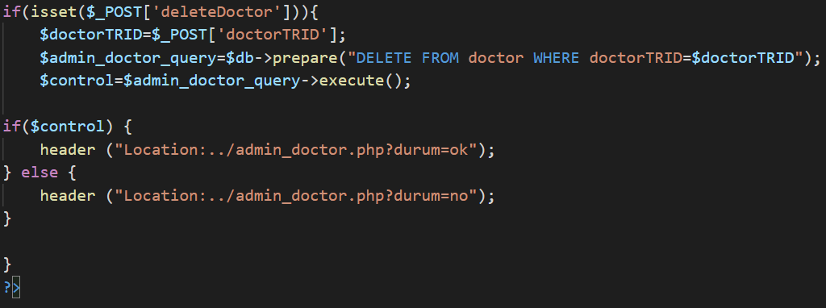
A WAY TO REMOVE A DOCTOR FROM THE SYSTEM
ALTER TABLE `hospitalrelation` ADD CONSTRAINT `FK_adminDoctorTRID` FOREIGN KEY (`doctorTRID`) REFERENCES `doctor`(`doctorTRID`) ON DELETE CASCADE ON UPDATE RESTRICT;

Slide 18
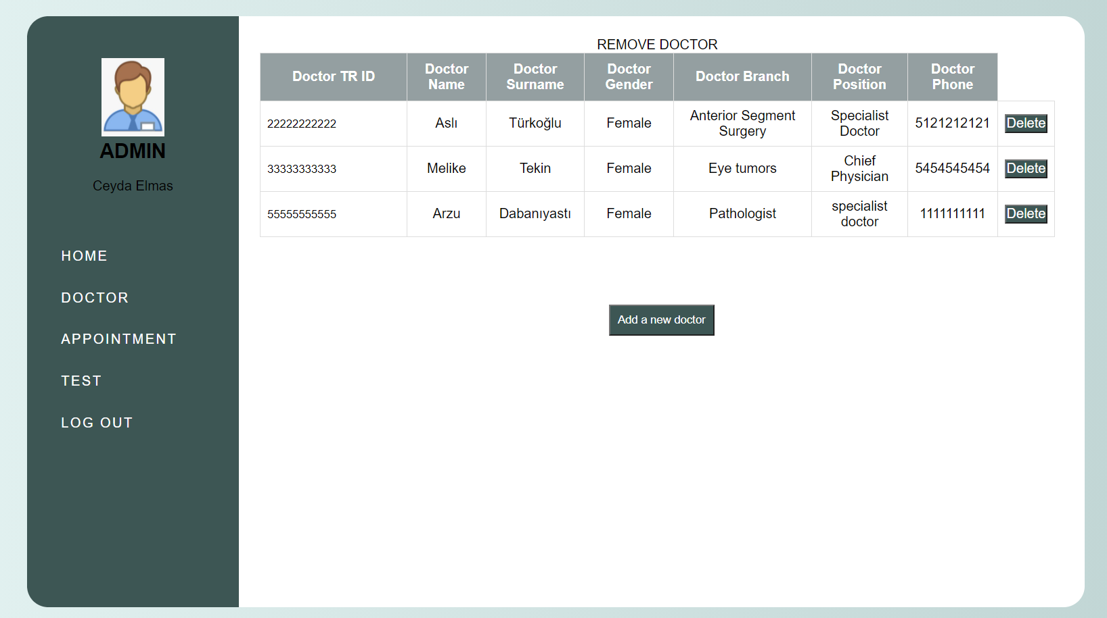

Slide 19
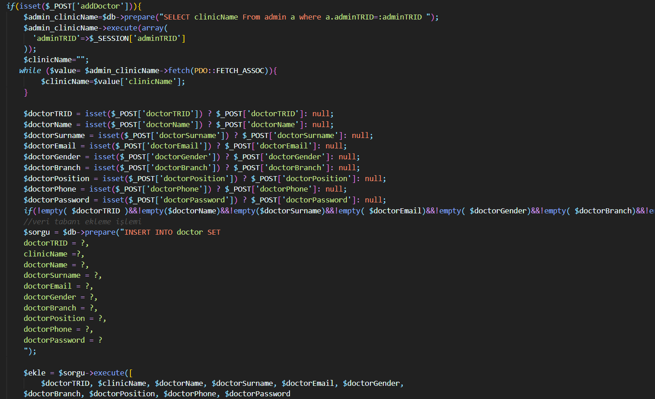
A WAY TO ADD A NEW DOCTOR TO THE DATABASE

Slide 20
