Slide 1
Start Your Financial Journey with us

Slide 2
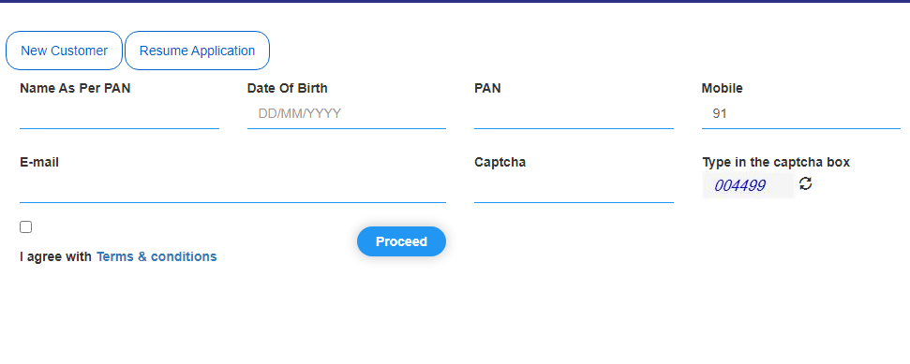
Step-1 Click on this link – Open Account available on Our Website Enter you details click on proceed

Slide 3
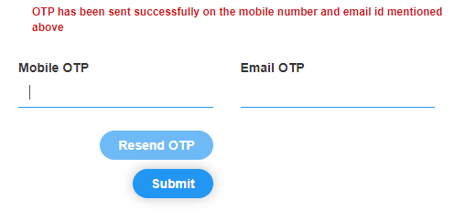
Step-2 Enter the OTP received on your mobile no and email

Slide 4
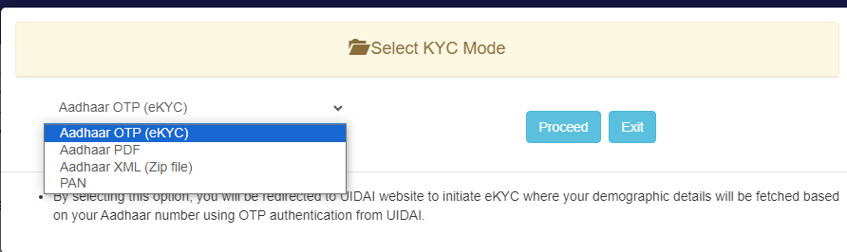
Step-3 Select Aadhaar OTP(eKYC)

Slide 5
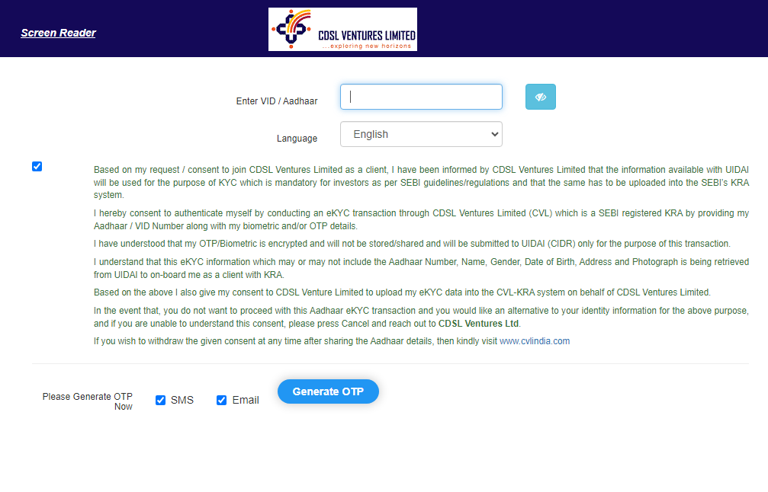
Step-4 Enter Aadhaar Number and click on Generate OTP

Slide 6
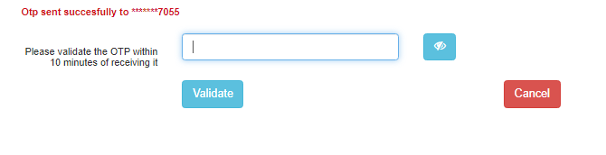
Step-5 Enter OTP and click on validate

Slide 7
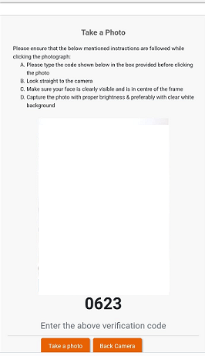
Step-6 Click a photo and upload

Slide 8
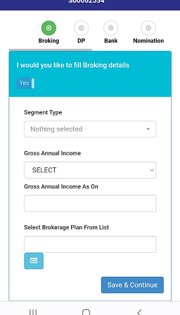
Step-7 Select Segment, Gross Income Details, Annual Income Date and Brokerage Plan. Click Save And Continue

Slide 9
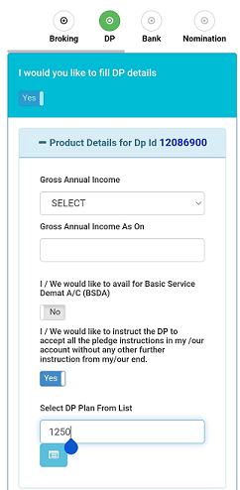
Step-8 Select Annual Income Range and Annual Income

Slide 10
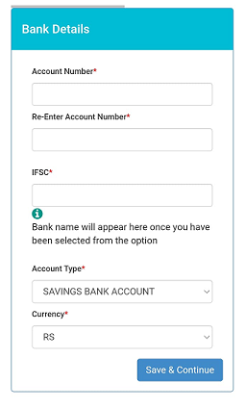
Step-9 Enter Bank Details and click on save and continue

Slide 11
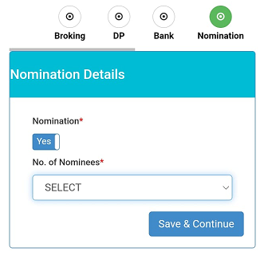
Step-10 Enter Nomination Detail and Click on Save & Continue

Slide 12
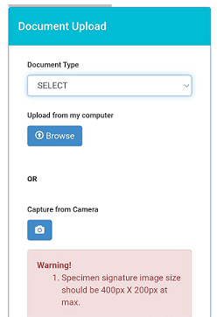
Step-11 Upload Copy of PAN Card, Signed Cancelled Cheque And Signature

Slide 13
Congratulations! You have successfully completed the documentation process for opening an account with SSIIL. The SSIIL team will now verify the details provided and grant final approval.
Apart from this Online facility you can also download the form and send to us along with the documents mentioned in the form.

