Slide 1


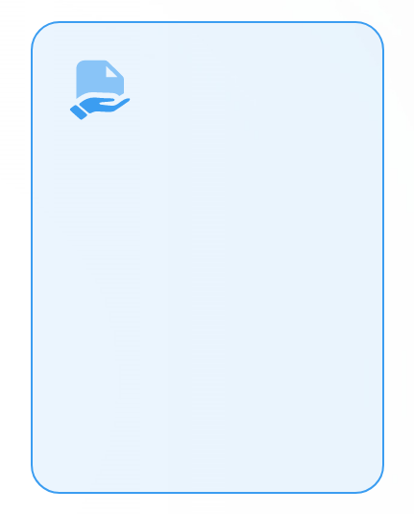
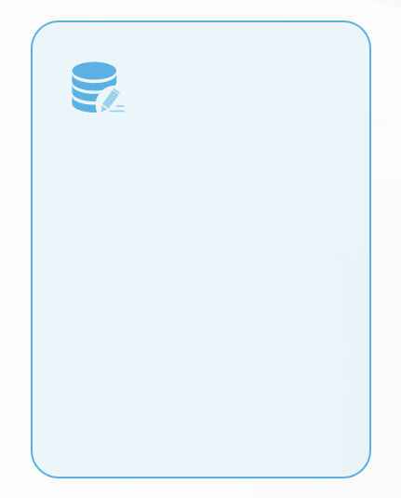
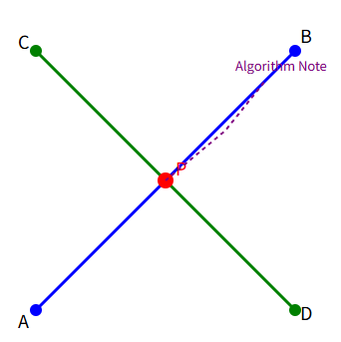

叉积在方向判断中的应用
叉积与方向关系
判断左右侧
叉积的正负值揭示了向量间的方向关系，正表示左转，负表示右转，零则意味着共线。
通过计算叉积，可以快速判断一个点相对于线段的位置，是在线段左侧还是右侧。
应用于线段相交
利用叉积判断线段端点相对于另一线段的位置，是实现线段相交算法的关键。

Slide 2
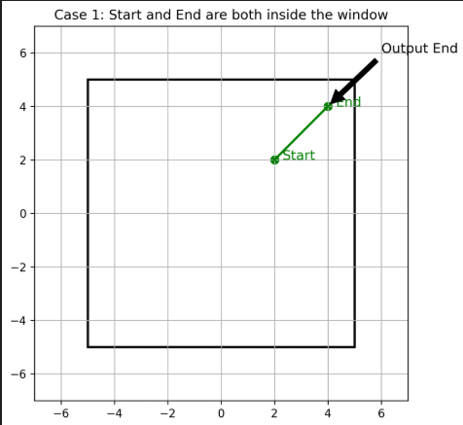
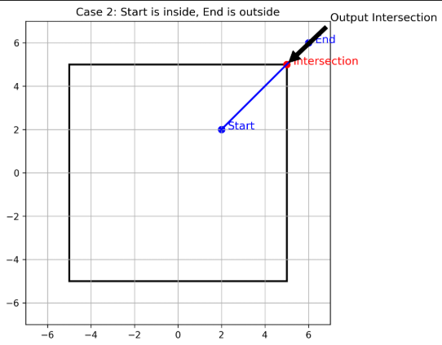
Detailed analysis of four cutting situations
Case 2: Export clipping
Case 1: Internal traversal
When both ends of a polygon edge are in the window, the endpoint is retained directly to reflect integrity.
If one end point is inside the window and the other is outside the window, calculate the intersection point and output it to achieve accurate cropping.

Slide 3
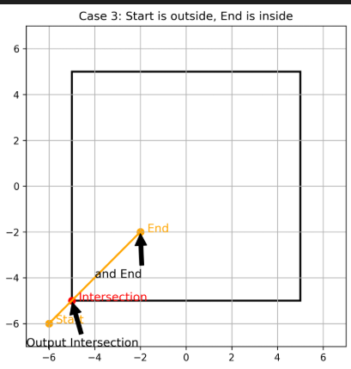
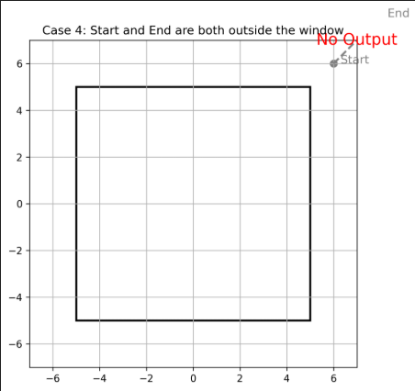
Detailed analysis of four cutting situations
Case 3: Entry cropping
Case 4: Completely excluded
From the window out to the inside, output the intersection first and then the endpoint to ensure smooth boundary transition.
Both ends are outside the window. Ignore this side to avoid invalid data interference.

Slide 4

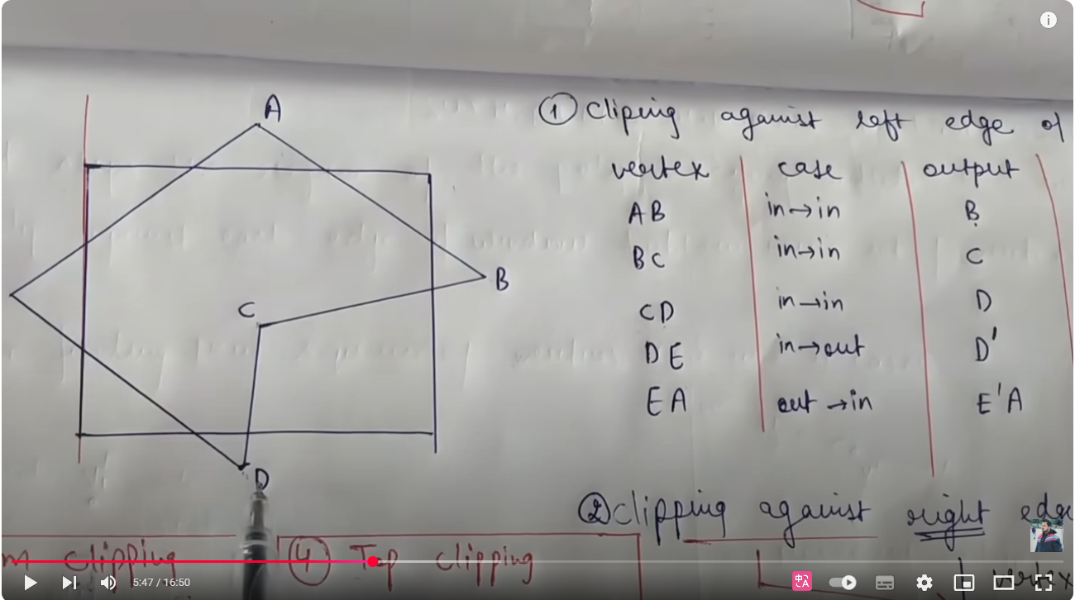

Slide 5
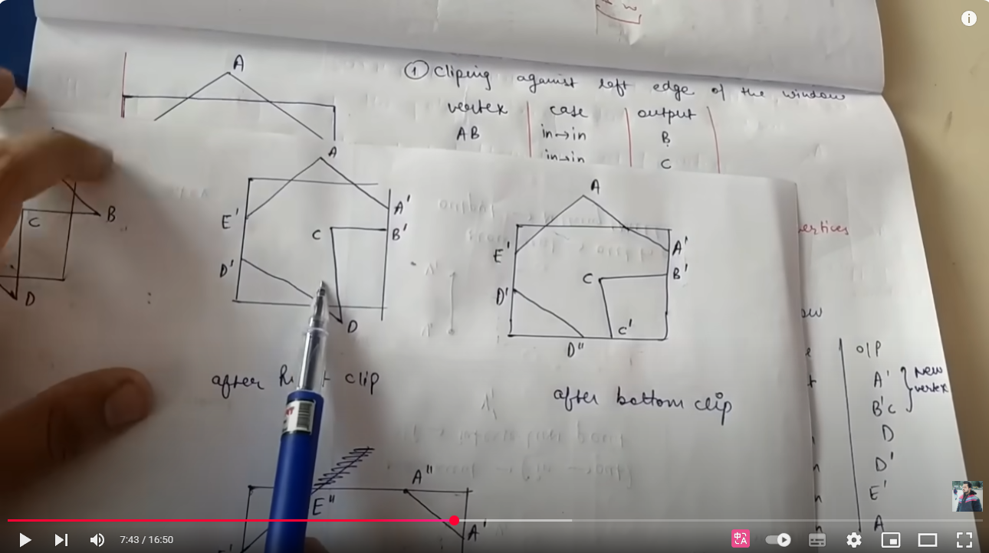

Slide 6
