Slide 1
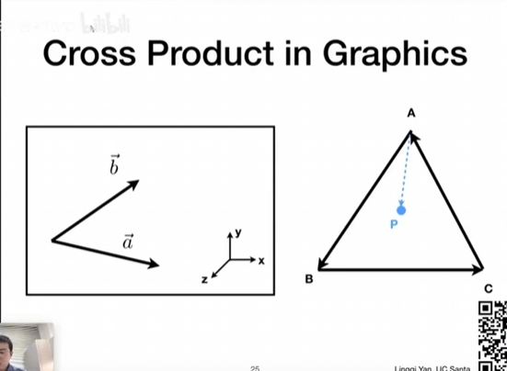
Cross Product Theorem

Slide 2

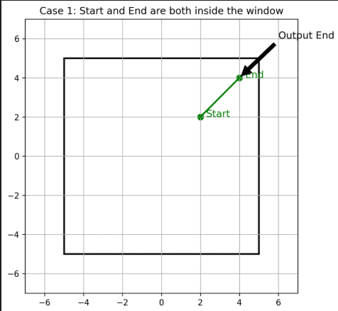
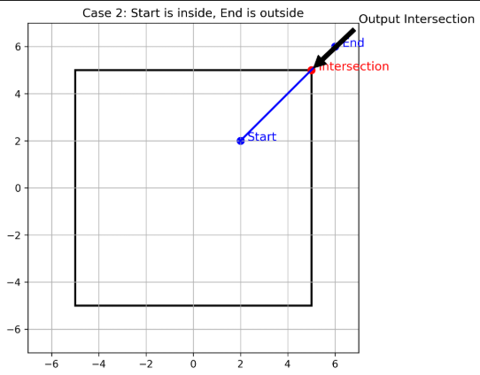
Sutherland-Hodgemand Polygon Clipping
Detailed analysis of four cutting situations
Case 2: Export clipping
Case 1: Internal traversal
When both ends of a polygon edge are in the window, the endpoint is retained directly to reflect integrity.
If one end point is inside the window and the other is outside the window, calculate the intersection point and output it to achieve accurate cropping.

Slide 3
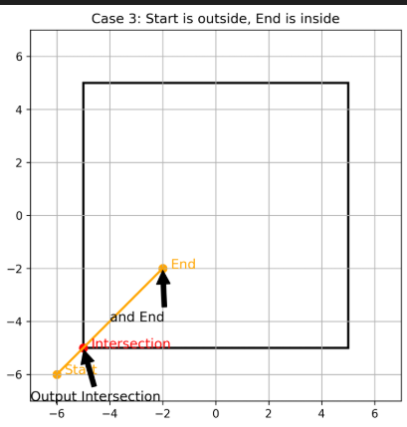
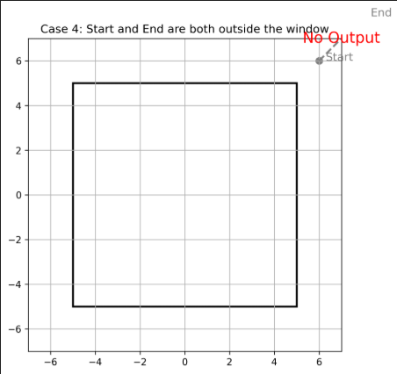
Sutherland-Hodgemand Polygon Clipping
Detailed analysis of four cutting situations
Case 3: Entry cropping
Case 4: Completely excluded
From the window out to the inside, output the intersection first and then the endpoint to ensure smooth boundary transition.
Both ends are outside the window. Ignore this side to avoid invalid data interference.

Slide 4

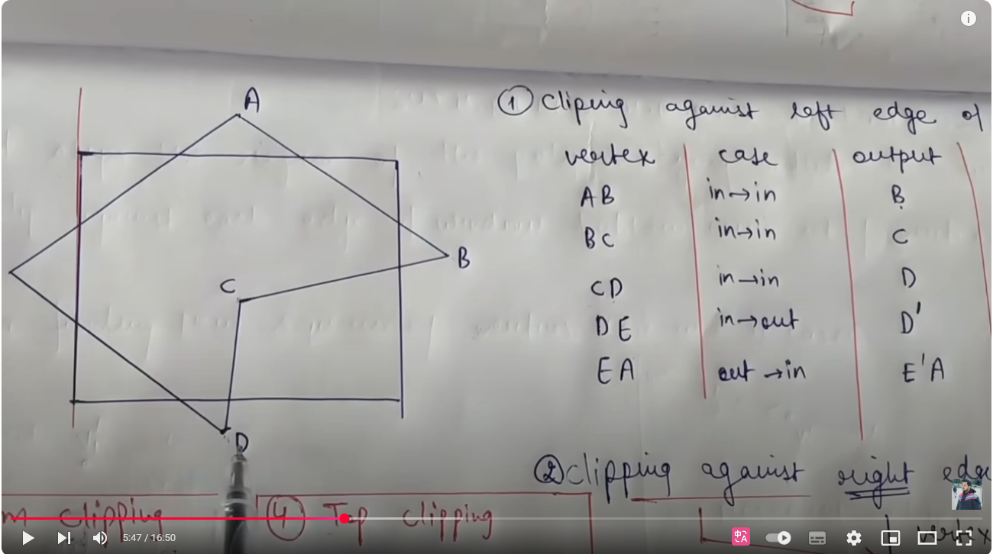
Sutherland-Hodgemand Polygon Clipping

Slide 5
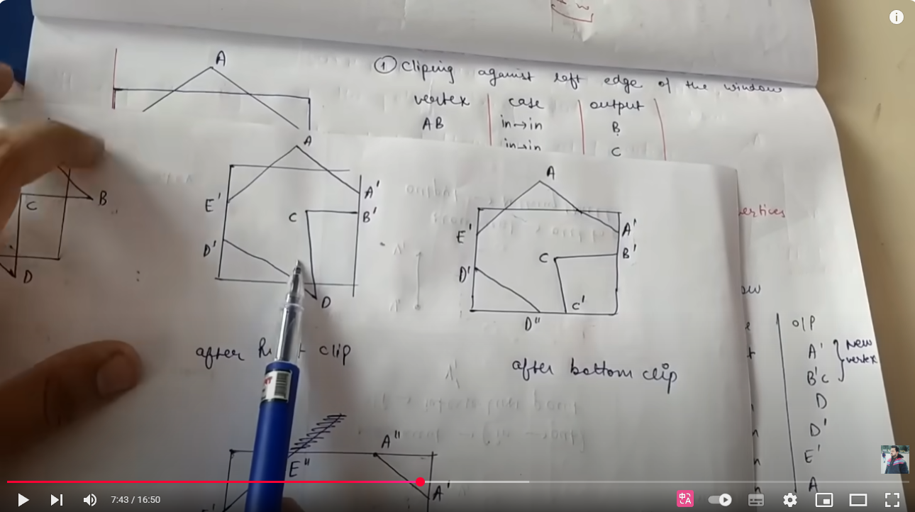
Sutherland-Hodgemand Polygon Clipping

Slide 6
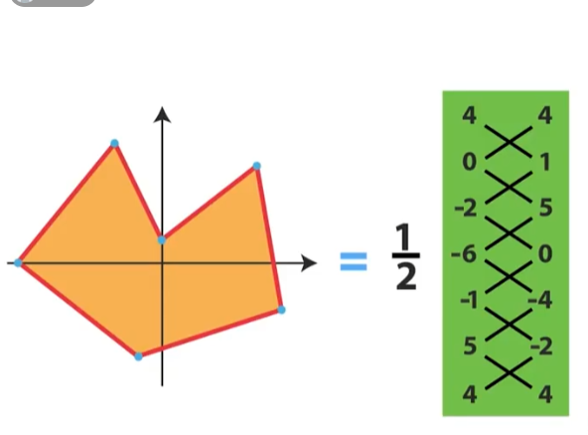
ShoeLaces Polygon Area

Slide 7
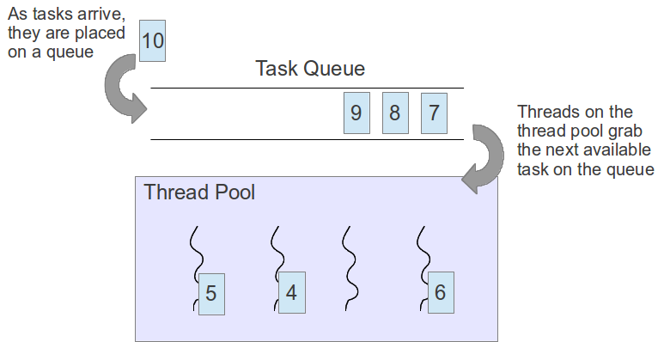
Thread Pool

