Slide 1

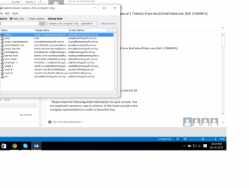
V8 PROJECT PROGRESS PHOTO’S AS AT 1ST JUL 2016
tester
29 June 2016
Project Director's Office
1

