Slide 1





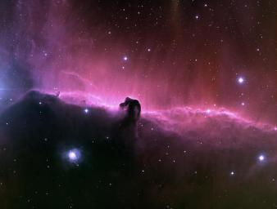

UNDERGROUND TUNNEL PROJECT PROGRESS PHOTO’S AS AT 24TH JUN 2016
MUZIUM NEGARA PROJECT PROGRESS
ww
wede
yj6uj6
wrfr
egt5
y6yh
22 June 2016
Project Director's Office
1

Slide 2
UNDERGROUND TUNNEL PROJECT PROGRESS PHOTO’S AS AT 24TH JUN 2016
MUZIUM NEGARA PROJECT PROGRESS
yj6uj6
22 June 2016
Project Director's Office
2

