Slide 1
OAKTREE ATLAS
Inside this guide
• What it does
• How to run a search
• Reading your results
• Comparing sites
• Plain-English glossary
Expansion Advisor
A simple guide to finding your next branch
For restaurant & café operators in Riyadh
No technical knowledge required.

Slide 2
GETTING STARTED
What is the Expansion Advisor?
It is your location scout. You tell it about your brand and where your current branches are. It then looks across hundreds of commercial sites in Riyadh and tells you which ones are the best places to open next — and why.
Finds sites for you
Ranks them 1–15
Explains every result
Protects your branches
Scans the whole city so you
don't have to drive around
scouting blindly.
Sorts the best candidates
to the top with a clear
score out of 100.
Shows the reasons a site is
strong or risky in plain
language.
Warns you when a new site
is too close to a store
you already run.
The big idea: instead of guessing, you make expansion decisions backed by data on demand, competition, rent, and your own branch network.
Oaktree Atlas · Expansion Advisor User Guide
1

Slide 3
THE CORE IDEA
The 5 questions it answers for every site
1. Is there demand?
Are there enough people and customers nearby to keep you busy?
2. Is the market crowded?
How many competitors like you are already in the area? (We call open space “whitespace”.)
3. Does it fit my brand?
Does the size, location and style suit how you operate — quick-service, dine-in, delivery or café?
4. Do the numbers work?
Is the likely rent sensible compared to the sales the area can support?
5. Will it hurt my own stores?
Is it far enough from your existing branches so they don't steal each other's customers?
Oaktree Atlas · Expansion Advisor User Guide
2

Slide 4
STEP 1 · TELL IT ABOUT YOUR BRAND
Running a search in 5 easy steps
1
Open the Expansion Brief form It's the panel on the left when you open the Expansion Advisor.
2
Enter your brand basics Brand name, food category (e.g. Burger, Coffee, Shawarma), and your service model: QSR, Dine-in, Delivery-first or Café.
3
Set the size you need A minimum and maximum space in square metres (for example 100–500 m²).
4
Add your existing branches Optional but recommended — so it can keep new sites a safe distance away.
5
Press “Run Search” Sit back. In moments you get a ranked shortlist of the best sites.
Tip: in Advanced settings you can also set price tier, average check, and how much you care about parking, frontage and visibility.
Oaktree Atlas · Expansion Advisor User Guide
3

Slide 5
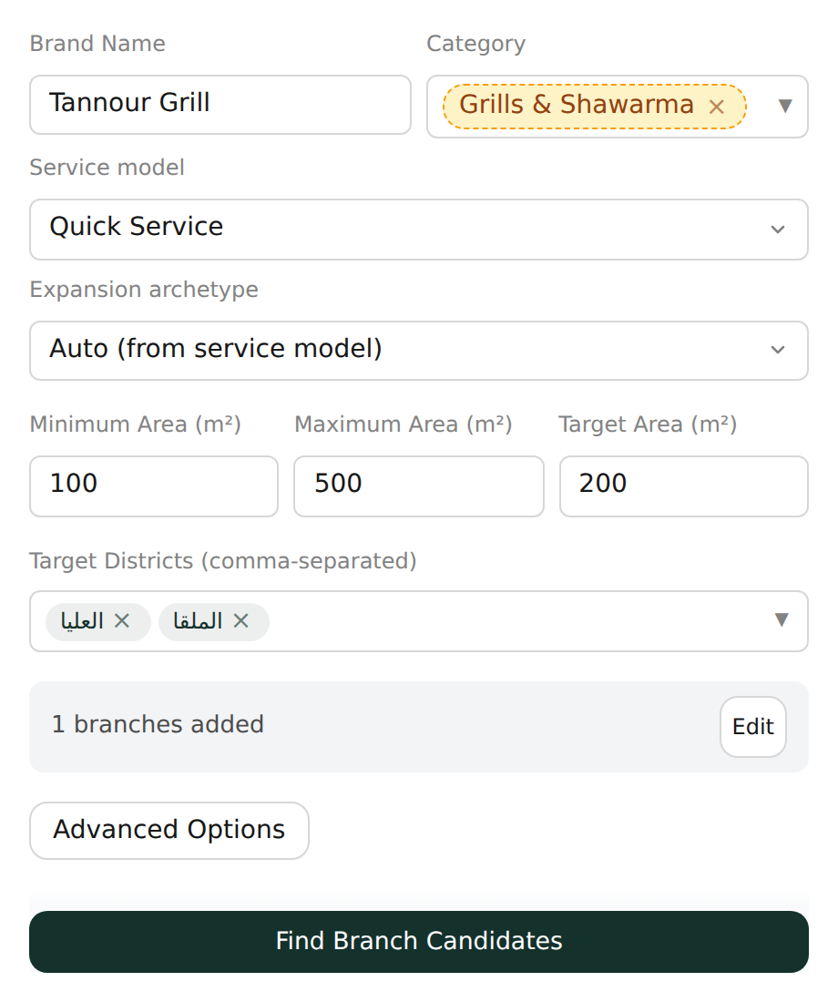
STEP 1 · THE REAL SCREEN
This is the brief form you fill in
Everything the Advisor needs fits on one short form. Fill it in once and press the button at the bottom.
Brand & category Who you are and what you sell.
Service model QSR, dine-in, delivery-first or café.
Area range The smallest and largest unit you'd take.
Target districts Optional — pick areas or leave blank for all.
Existing branches Add them so the Advisor protects your stores.
Real Expansion Advisor screen · sample Riyadh data
Oaktree Atlas · Expansion Advisor User Guide
4

Slide 6
STEP 2 · READ YOUR RESULTS
What the Advisor gives you back
You receive a ranked shortlist of up to 15 sites. Each one comes as a card you can tap to open.
Rank & Score Higher is better. 100 is a perfect match.
#1
Al Olaya · commercial unit
Example candidate site
Confidence (A–D) How sure we are. A = strong data, D = rough estimate.
Score 87 / 100
Confidence Grade A
Gate status Pass ✓
Estimated rent ~ SAR 480,000 / yr
Area 220 m²
Tier Premier
Gate status A quick safety check — Pass, Unknown, or Fail.
Estimated rent Likely yearly rent for the unit.
Tier Premier = best fit, Standard, or Exploratory.
Oaktree Atlas · Expansion Advisor User Guide
5

Slide 7
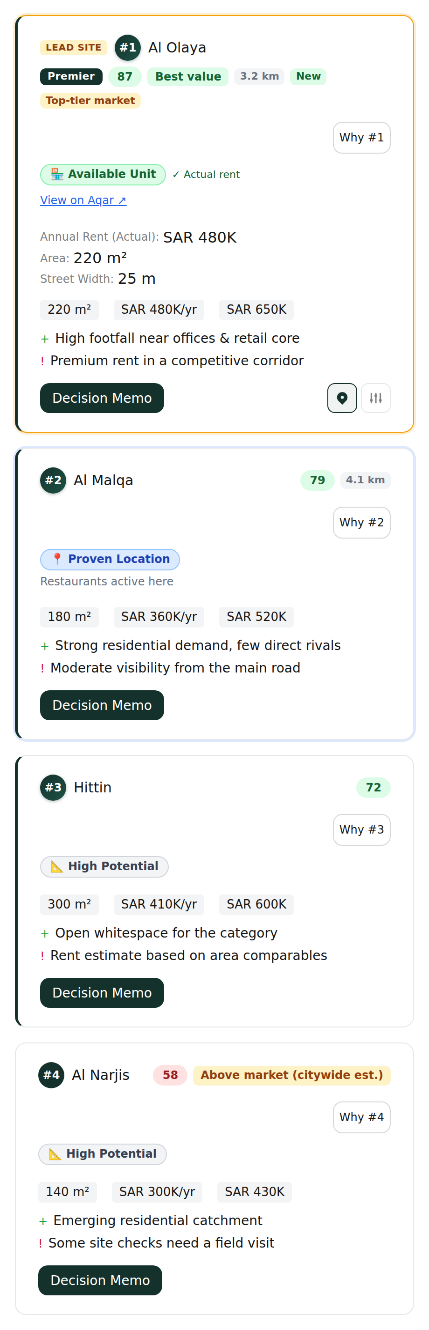
STEP 2 · THE REAL SCREEN
Your ranked shortlist of sites
Each site is a card, sorted best-first. The coloured tags give you the headline at a glance.
Rank & score #1, #2, #3 … with a score out of 100.
Lead Site / Premier Flags the standout, highest-quality sites.
Pass / data grade Confidence grade and the safety-check result.
Rent & size Annual rent, area and fit-out at a glance.
+ / ! lines One key strength and one key risk per site.
Real Expansion Advisor screen · sample Riyadh data
Oaktree Atlas · Expansion Advisor User Guide
6

Slide 8
UNDERSTANDING RESULTS
The traffic-light safety check (“Gates”)
Before a site reaches you, the Advisor runs quick safety checks — like zoning, distance from your branches, and whether the numbers add up. The result is a simple traffic light.
PASS
UNKNOWN
FAIL
All checks cleared.
Some data is missing.
A key check failed.
A low-risk site.
Safe to shortlist and
visit in person.
No blocking problems,
but do your own checks
before committing.
For example: wrong zoning,
or too close to a branch
you already run.
Oaktree Atlas · Expansion Advisor User Guide
7

Slide 9
STEP 3 · GO DEEPER
Open a site to see the full story
Tap any card and the detail panel opens:
Demand thesis Why customers are here — people nearby and competitor presence.
“View Decision Memo”
Cost thesis Likely rent and fit-out costs, and how they compare to similar sites.
A short written recommendation, like an analyst wrote it for you:
• Headline verdict — strong fit / consider carefully
• Key evidence — the main supporting facts
• Risks — what to watch out for
• Market research — delivery & district trends
• Best use case — how the site works best
Score breakdown How the score is built from demand, competition, fit and economics.
Top positives & risks The 2–3 best reasons to go — and the main things to watch.
Comparable competitors Nearby restaurants in your category, with their ratings.
Perfect for sharing with partners or investors.
Oaktree Atlas · Expansion Advisor User Guide
8

Slide 10
STEP 4 · COMPARE
Put your favourites head-to-head
Tick 2 to 6 sites and press Compare. You get a side-by-side table with a winner badge for each thing that matters — so the trade-offs are obvious at a glance.
★ Best Overall
★ Best Value
★ Lowest Rent
★ Best Economics
★ Best Brand Fit
★ Highest Demand
★ Strongest Delivery Market
★ Most Whitespace
★ Lowest Cannibalization
★ Most Confident
Why this helps: rarely is one site best at everything. One may be cheapest, another may have the most customers. The badges let you pick the trade-off that fits your strategy.
Oaktree Atlas · Expansion Advisor User Guide
9

Slide 11
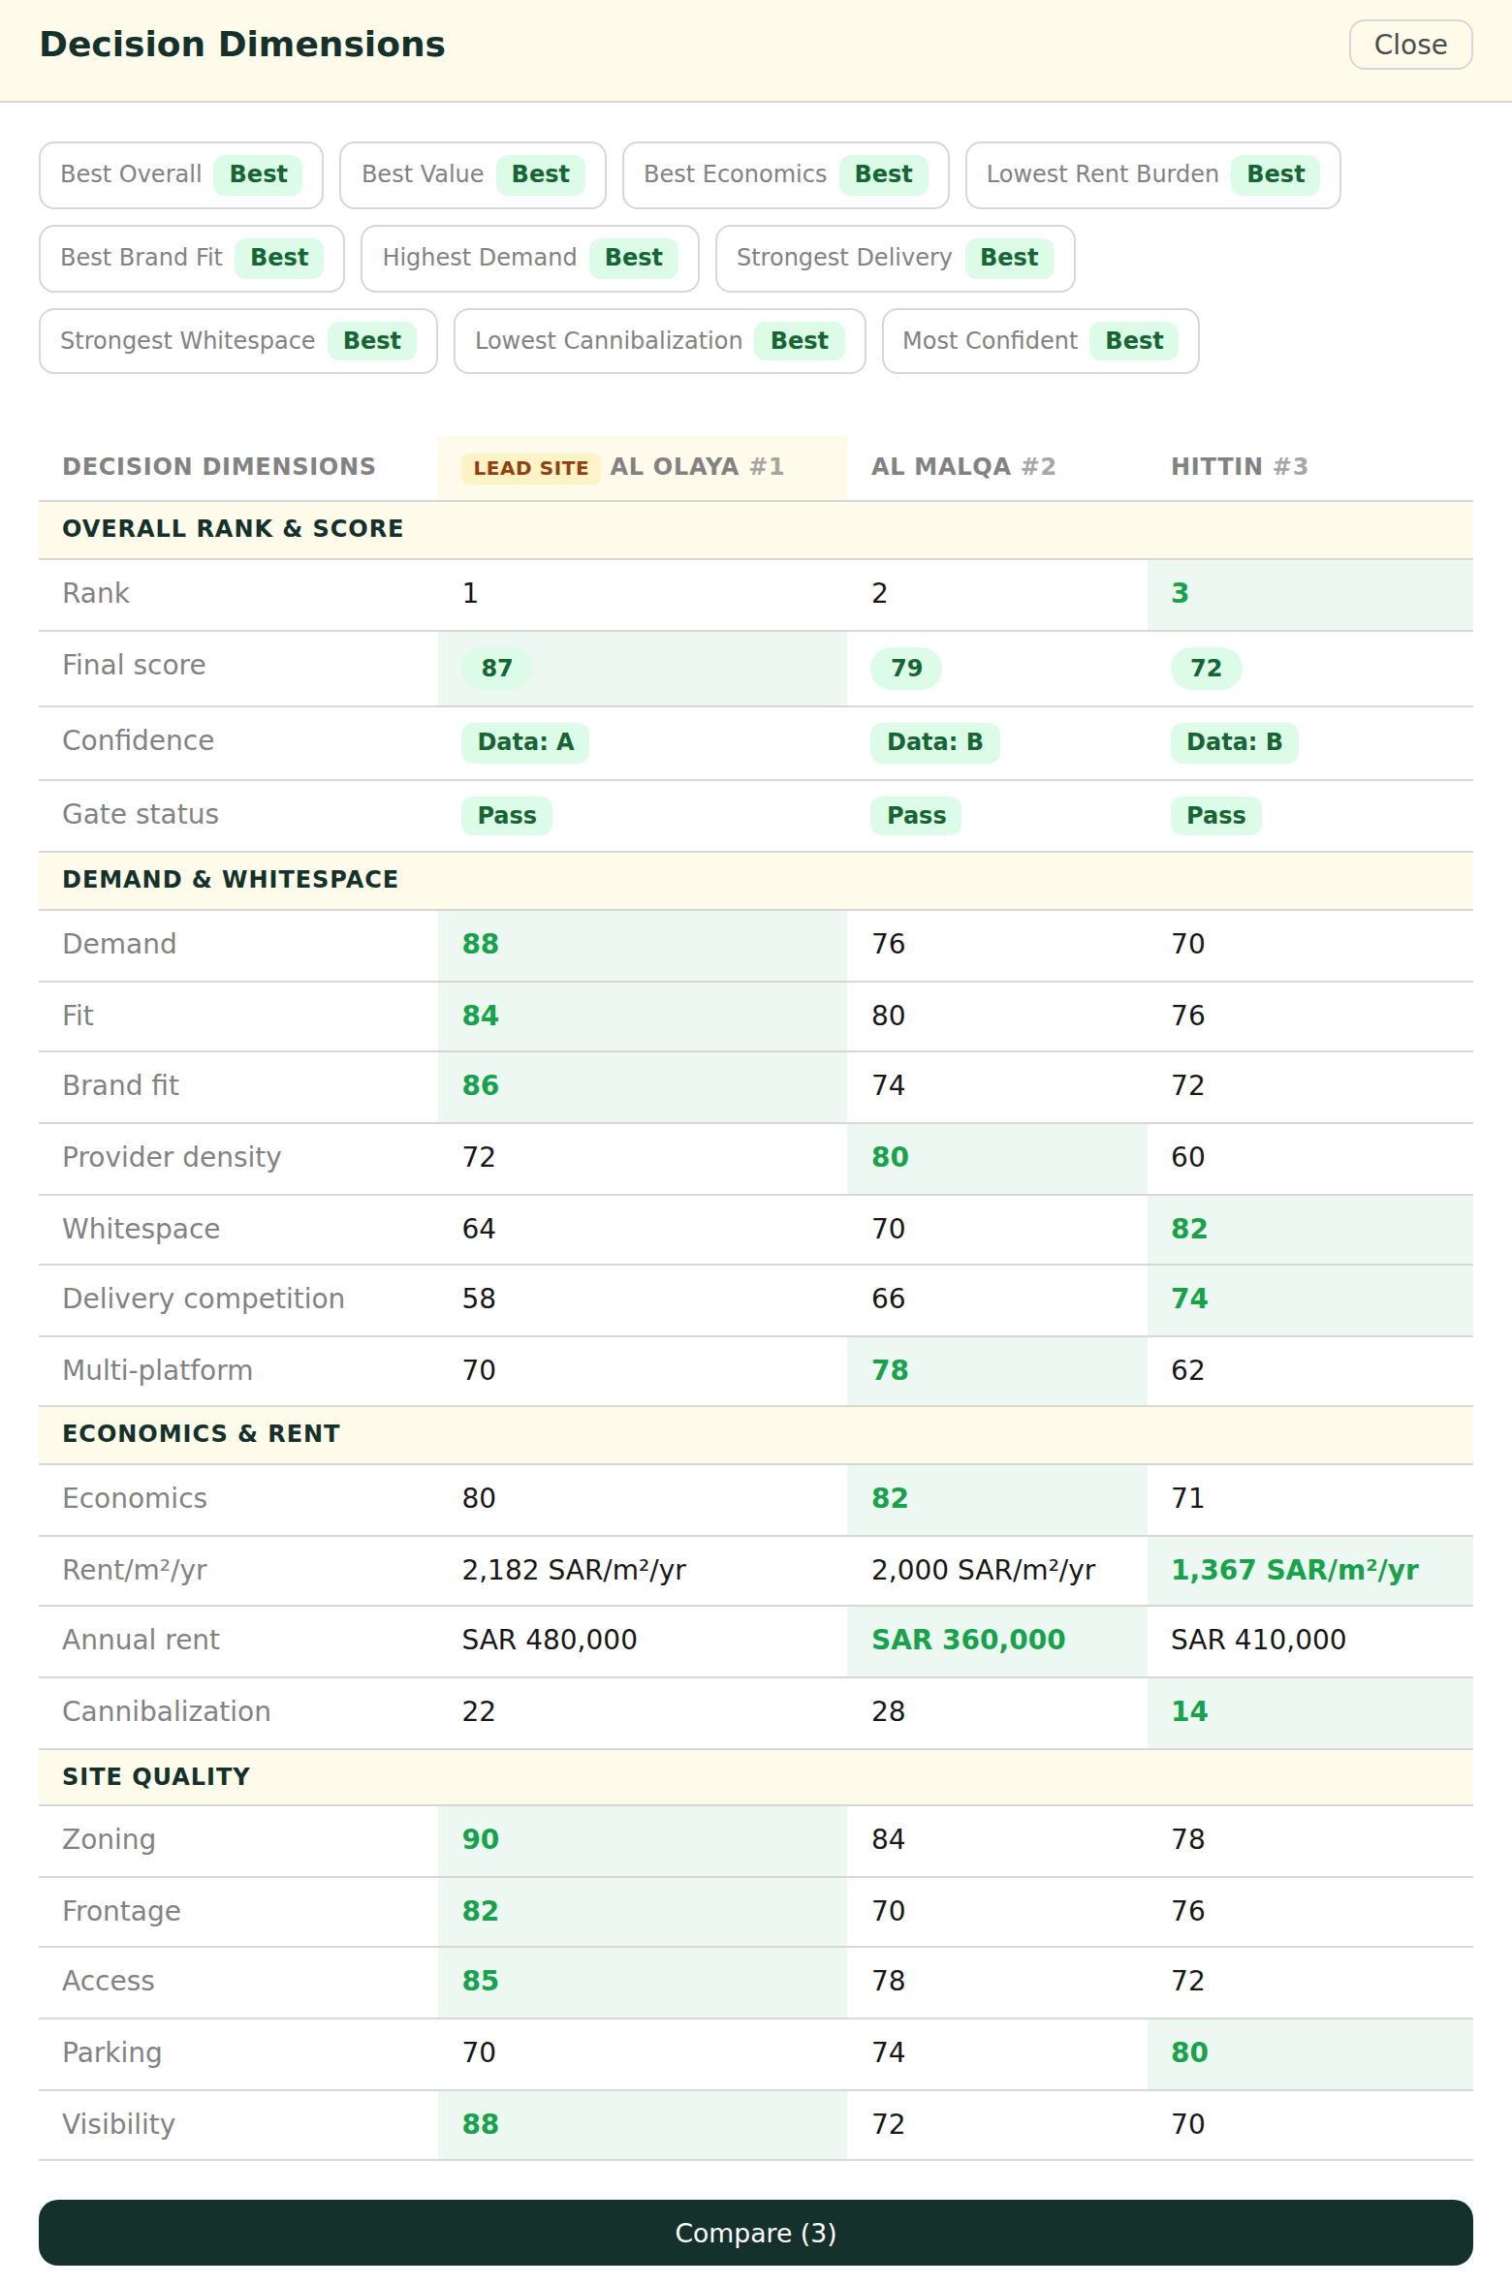
STEP 4 · THE REAL SCREEN
Sites compared side-by-side
Pick 2–6 sites and the Advisor lays them out in one table. Green cells mark the winner on each row.
Winner badges Best Overall, Best Value, Highest Demand…
Grouped rows Demand, economics, rent and site quality.
Green = best The strongest site per row is highlighted.
Lead Site tag Marks the overall front-runner.
Real Expansion Advisor screen · sample Riyadh data
Oaktree Atlas · Expansion Advisor User Guide
10

Slide 12
STEP 5 · DECIDE & SHARE
Wrap it up into a report
Executive Report
Save your search
A clean one-screen summary:
your top 3 sites, why the #1
wins, the main risk, and the
best store format.
Keep a search as a Draft or
mark it Final so you can
return to it later.
Presentation Mode
Shortlist finalists
A tidy slideshow view, ready
to show to partners,
landlords or investors
without any clutter.
Bookmark 2–6 favourite sites
as finalists to revisit and
compare another day.
Oaktree Atlas · Expansion Advisor User Guide
11

Slide 13
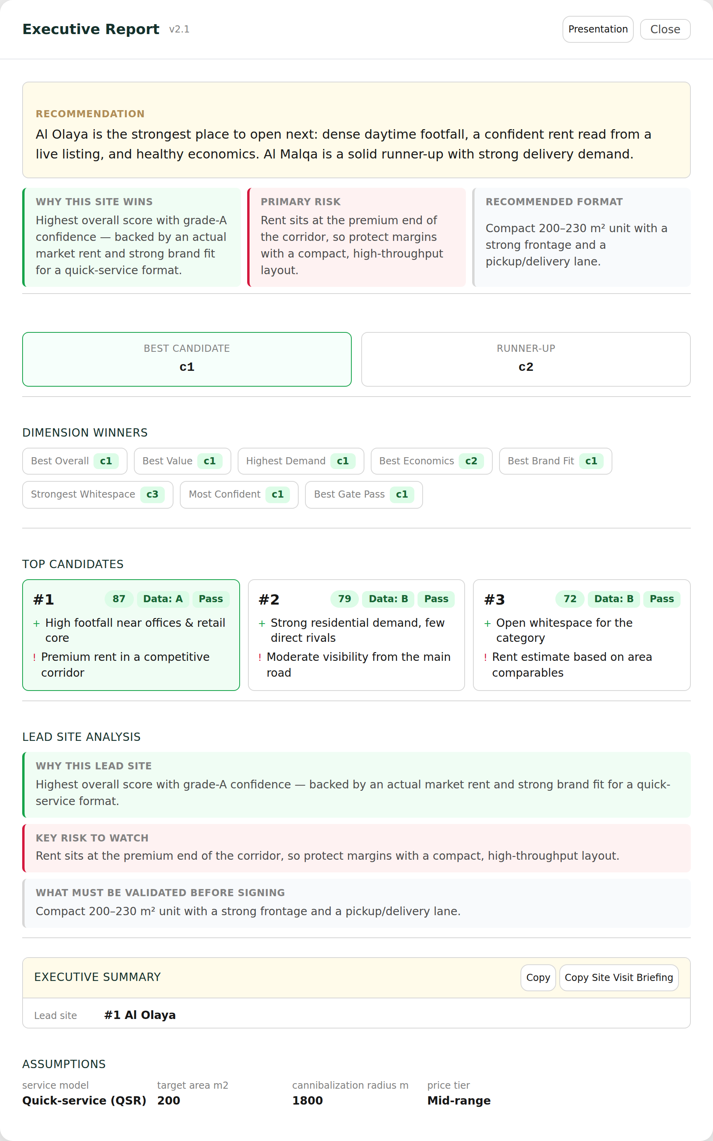
STEP 5 · THE REAL SCREEN
The one-page executive report
When you're ready to decide, the report sums everything up on one screen — ideal to share with partners.
Recommendation The headline call in one sentence.
Why it wins / risk The single biggest plus and minus.
Top candidates Your best 3 sites, side by side.
Copy & Presentation Export or switch to a clean slideshow.
Real Expansion Advisor screen · sample Riyadh data
Oaktree Atlas · Expansion Advisor User Guide
12

Slide 14
PLAIN-ENGLISH GLOSSARY
The words you'll see, explained simply
Demand How many customers are likely nearby.
Gate A pass / fail safety check on a site.
Whitespace Open opportunity — few competitors like you in the area.
Tier Quality label: Premier, Standard or Exploratory.
Brand fit How well a site matches how your brand operates.
Delivery market How active food-delivery apps are in the area.
Economics Whether the likely rent makes sense for the sales possible.
Provider density How many delivery platforms cover the area.
Cannibalization Risk a new site steals sales from your own branches.
Comparable competitors Nearby rivals in your category, with ratings.
Confidence (A–D) How reliable the estimates are. A is best.
Shortlist Your saved set of promising sites to review.
Oaktree Atlas · Expansion Advisor User Guide
13

Slide 15
A few tips to get the best results
✓
Always add your existing branches. It's the only way the Advisor can protect you from cannibalization.
✓
Be honest about your service model. A delivery-first brand and a dine-in brand get scored very differently.
✓
Start city-wide, then narrow. Leave target districts empty first to discover areas you hadn't considered.
✓
Treat “Unknown” as “go check it”. It usually means missing data, not a bad site — a quick visit settles it.
✓
Use the memo to win buy-in. It's written for partners and investors, not engineers.
Oaktree Atlas · Expansion Advisor — smarter F&B expansion in Riyadh.

