Slide 1
MultiCue-DF
Multi-Cue Deepfake Detection via Parallel Stream CNNs
with Squeeze-and-Excitation Fusion · FaceForensics++ C23
12.4M
96.57%
0.990
3
Parameters
Test Accuracy
AUC
Parallel Streams
Humna Tariq, Huda Noor, Qura-tul-ain Azhar
CS-419 Deep Learning · BSCS-13-D · May 2026

Slide 2
Why Deepfake Detection Matters
2 / 15
SCALE
PAKISTAN CONTEXT
Modern GAN-based fakes are near-photorealistic and can be produced in minutes. Autoencoder swaps, neural texture rendering, and expression transfer are all open-source and widely accessible.
2024 elections: AI-generated videos of politicians circulated on WhatsApp before any fact-check was possible.
Social velocity: content goes viral in minutes — far faster than any manual verification process.
Infrastructure: low-bandwidth Android phones, WhatsApp re-encoding (C40-equivalent), Urdu/Pashto metadata.
Targeted harassment: deepfake imagery weaponised against women journalists and political activists.
GLOBAL IMPACT
Deepfakes enable political manipulation, financial fraud, non-consensual imagery, and targeted harassment. A single viral clip can cause irreversible reputational damage.
BRITTLE DETECTORS
Single-stream methods fail: spatial detectors are fooled by expression-transfer fakes; frequency detectors are defeated by post-processing. No single cue is robust.
Solution: fuse spatial semantics + periocular texture + frequency fingerprints — so no single failure mode can defeat the system

Slide 3
MultiCue-DF — Architecture Overview
3 / 15
STREAM 1
STREAM 2
STREAM 3
FUSION HEAD
Input:
Input:
Input:
Concat →
896-d vector
SE Attention
f ⊙ s
Linear(896→256)
BN + ReLU + Dropout
Linear(256→2)
Real / Fake
Full Face 224×224 RGB
Eye/Mouth 224×224 RGB
FFT Map 224×224
ResNet-18 (ImageNet pretrained)
Custom 4-Block CNN (from scratch)
Shallow 3-Block CNN + LeakyReLU
Output: 512-d
Output: 256-d
Output: 128-d
12,438,234 total parameters · Best: 96.57% accuracy · AUC 0.990 · F1 0.980 · FaceForensics++ C23

Slide 4
Dataset: FaceForensics++ C23
4 / 15
Manipulation Method | Description
Deepfakes | Identity swap via autoencoder trained per-person
Face2Face | Expression transfer from source to target face
FaceShifter | High-fidelity identity swap (occlusion-aware)
FaceSwap | 3D model-based face replacement
NeuralTextures | Neural rendering of face texture patch
DeepFakeDetection | Extended GAN set (Google / FaceForensics++ team)
7,000
Total Videos
~14,000
Sampled Frames
70 / 15 / 15
Train / Val / Test
224 × 224
Image Resolution
C23 H.264
Compression Level
Seed = 42
Reproducibility

Slide 5
Three-Stream Architecture (Detailed)
5 / 15
Stream 1 — Full Face
Stream 2 — Eye / Mouth Region
Stream 3 — FFT Frequency Domain
ResNet-18 (ImageNet pretrained)
Custom 4-Block CNN (trained from scratch)
Shallow 3-Block CNN (LeakyReLU α=0.1)
Input: 224×224 RGB full-face crop
Layers 0–5: FROZEN (conv1 → layer2)
preserves universal low-level features
Layers 3–4 + FC: fine-tuned
FC: Linear(512→512) + ReLU + Dropout(0.3)
Output: 512-d feature vector
Input: 224×224 RGB periocular crop
B1: Conv→BN→ReLU×2 → 32ch + MaxPool
B2: 32→64ch + MaxPool
B3: 64→128ch + MaxPool
B4: 128→256ch + AdaptiveAvgPool
Head: Linear(256→256) + ReLU + Dropout(0.3)
Output: 256-d feature vector
Input: 224×224 log FFT magnitude map
(zero-mean, unit-variance normalised)
Conv→BN→LReLU×3: 3→32→64→128ch
MaxPool × 2 + AdaptiveAvgPool
Head: Linear(128→128) + LReLU + Dropout(0.3)
Output: 128-d feature vector
~11.2M params
~1.31M params
~145K params
FUSION: cat([512, 256, 128]) = 896-d → s = σ(W₂·ReLU(W₁·f)) → f ⊙ s → Linear(896→256) → BN1d → ReLU → Dropout → Linear(256→2)

Slide 6
12 Controlled Ablation Experiments
6 / 15
# | Experiment | Acc (%) | AUC | F1 | Params
1 | E01 — MLP Baseline | 66.81 | 0.718 | 0.776 | 77.2M
2 | E02 — Single CNN Baseline | 83.24 | 0.658 | 0.906 | 0.42M
3 | E03 — Stream 1 Only (ResNet-18) | 95.10 | 0.986 | 0.971 | 10.9M
4 | E04 — Stream 2 Only (Eye/Mouth) | 85.71 | 0.650 | 0.923 | 1.31M
5 | E05 — Stream 3 Only (FFT-CNN) | 71.86 | 0.552 | 0.830 | 0.14M
6 | E06 — Stream 1 + Stream 2 | 96.14 | 0.990 | 0.978 | 12.2M
7 | E07 — Stream 1 + Stream 3 | 95.90 | 0.985 | 0.976 | 11.0M
8 | E08 — Stream 2 + Stream 3 | 78.57 | 0.623 | 0.876 | 1.45M
9 | E09 — Full Model (Adam, d=0.5) | 95.48 | 0.984 | 0.974 | 12.4M
10 | E10 — Full Model (SGD) | 92.76 | 0.957 | 0.958 | 12.4M
11 | E11 — Full Model (d=0.3) ★ BEST | 96.57 | 0.990 | 0.980 | 12.4M
12 | E12 — Full Model (No Attn) | 96.43 | 0.992 | 0.979 | 12.3M

Slide 7
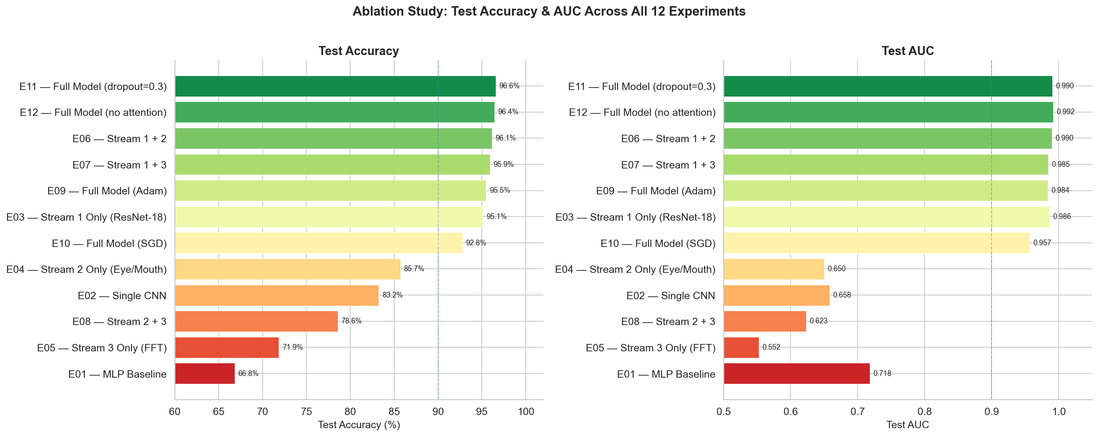
Ablation Study — Visual Comparison
7 / 15
All 12 experiments sorted by accuracy. Best: E11 (dropout=0.3) — 96.57% accuracy

Slide 8
What the Ablation Tells Us
8 / 15
1. Transfer Learning Dominates
2. Adam >> SGD (+2.7pp)
ResNet-18 alone (E03): 95.10%
Custom CNN from scratch (E04): 85.71%
Gap: +9.4pp — ImageNet features generalise strongly to face manipulation detection at 14K sample scale.
Adam (E09): 95.48% vs SGD (E10): 92.76%
Three parallel streams create heterogeneous gradient scales. Adam's adaptive per-parameter LR handles this; SGD's single LR cannot balance a frozen ResNet + two scratch CNNs.
3. Dropout 0.3 > 0.5 (+1.09pp)
4. FFT Stream Adds Noise via Simple Concat
E09 (d=0.5): 95.48% → E11 (d=0.3): 96.57%
Model is in high-bias regime at d=0.5 — over-regularised. Relaxing to 0.3 unlocks the full capacity of the 896-d fusion vector.
Stream1+2 (E06): 96.14% > Full model (E09): 95.48%
Adding Stream 3 (FFT, standalone 71.9%) HURTS accuracy. Weak frequency features introduce noise. Needs gated fusion, not naive concatenation.

Slide 9
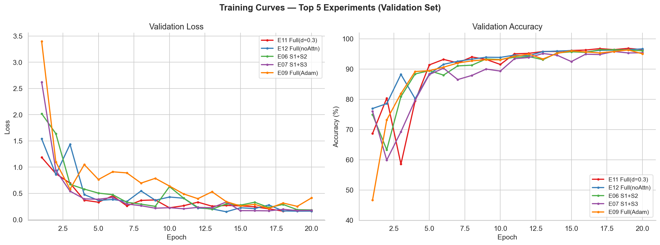
Training Convergence — Top 5 Experiments
9 / 15
Top 5 by test accuracy: E11, E12, E06, E07, E09. All converge by epoch 15–18. CosineAnnealingLR prevents loss spikes. E11 achieves best final val acc.

Slide 10
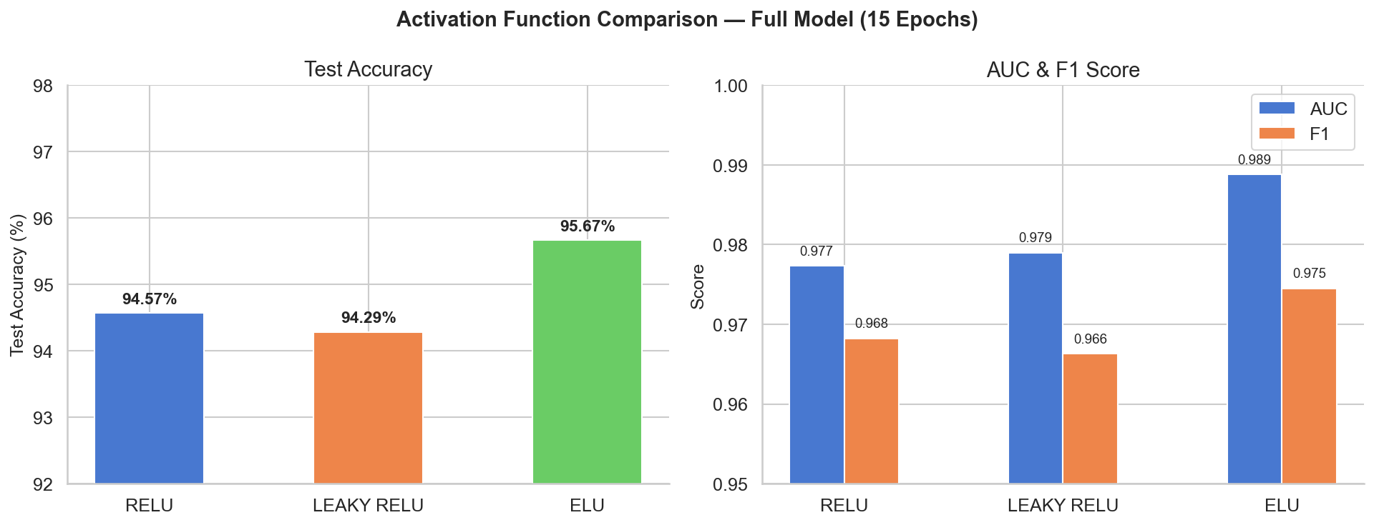
Activation Function Analysis — Stream 2 CNN
10 / 15
ELU WINS across all metrics
ELU: 95.67% acc, AUC 0.9888, F1 0.9745 — vs ReLU: 94.57% / 0.9773 / 0.9682 and Leaky ReLU: 94.29% / 0.9790 / 0.9663
ELU also fastest: −13% training time
162 min (ELU) vs 187 min (ReLU) vs 175 min (Leaky ReLU). ELU's self-normalising property (mean closer to zero) speeds convergence.
Dying ReLU in periocular CNN — root cause
Manipulation artefacts in eye/mouth region produce near-zero pre-activations. ReLU's hard-zero threshold kills these neurons. ELU's smooth exponential (e^x−1 for x<0) preserves gradient flow.

Slide 11
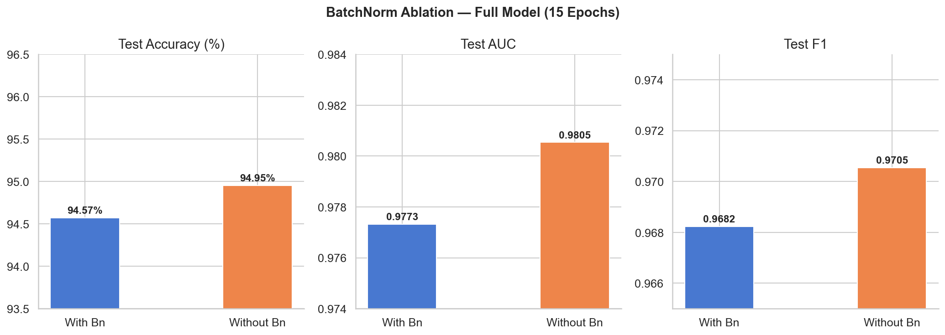
Batch Normalisation Analysis — Stream 2 CNN
11 / 15
WITHOUT BN WINS: +0.38pp acc, +0.32 AUC, saves 31% training time
With BN: 94.57% / 175.3 min vs Without BN: 94.95% / 121.5 min → 53.9 minutes saved per run. Removing BN improves ALL metrics simultaneously.
WHY BN IS REDUNDANT in Stream 2
Stream 2 is sandwiched: ResNet-18 (S1) applies BN throughout its blocks; the fusion head applies BN1d on the 896-d concatenated vector. Per-stream BN inside S2 adds zero benefit — the signal is normalised at both ends.
DESIGN PRINCIPLE for multi-stream networks
Place BN at the fusion point, not inside each stream independently. Fusion-level normalisation handles inter-stream scale differences more efficiently than per-stream BN. Aligns with internal covariate shift theory (Ioffe & Szegedy 2015).

Slide 12
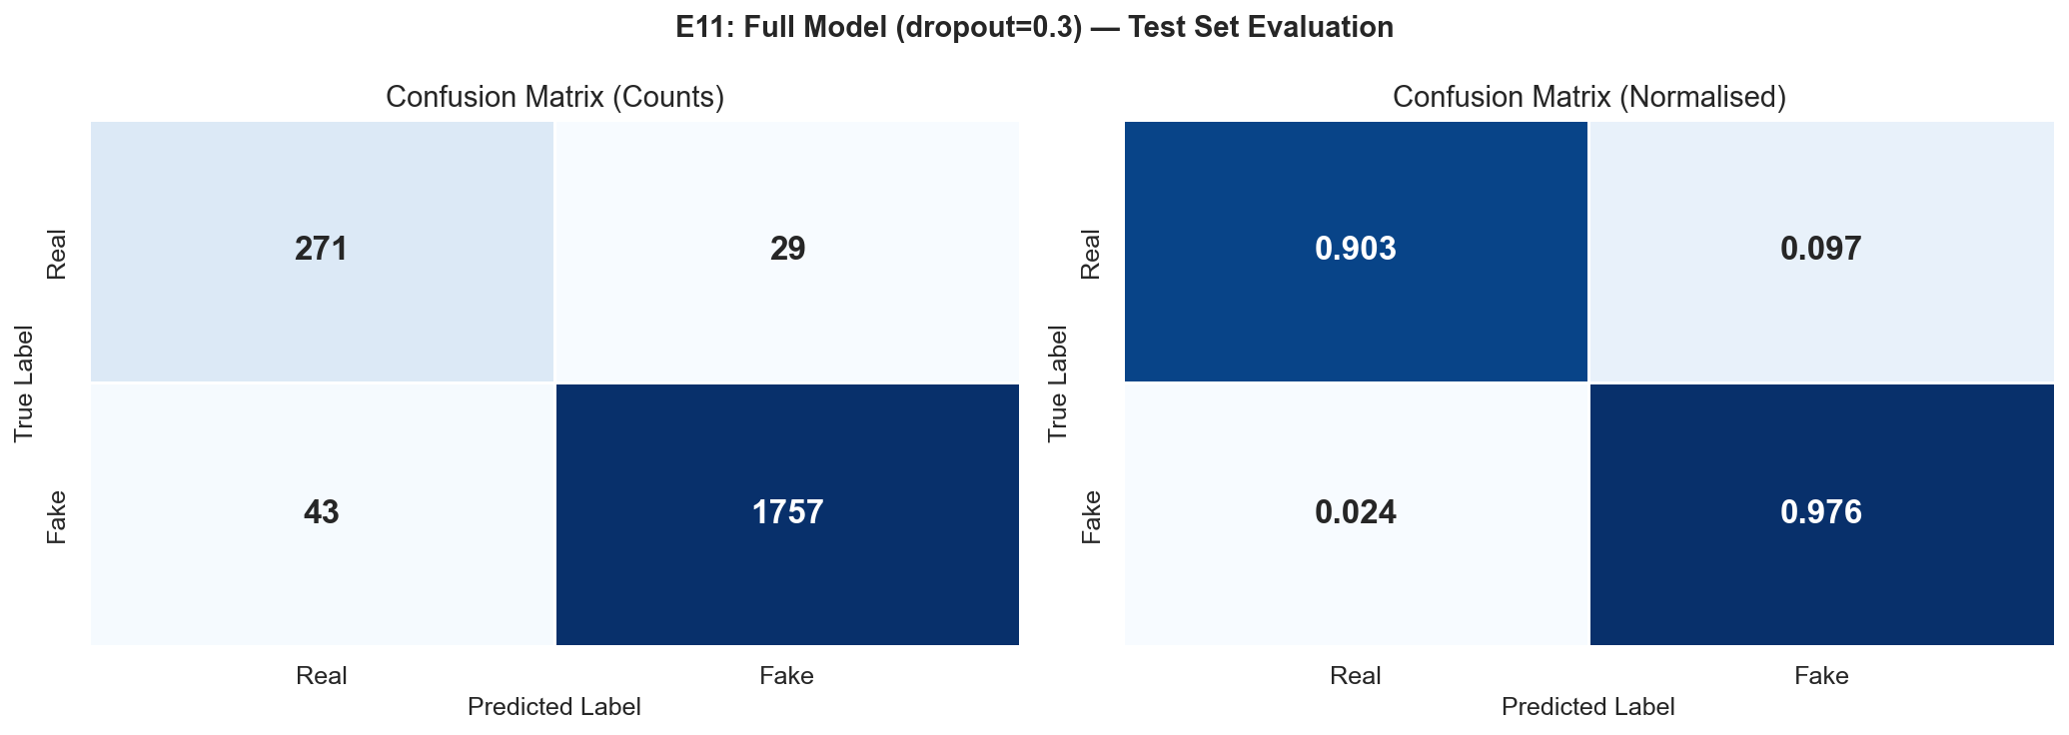
Best Model — E11: Full Model (dropout=0.3)
12 / 15
96.57%
0.9904
0.9799
Test Accuracy
Test AUC
Test F1
2,100
Test Samples
~72
Misclassified
96.86%
Best Val Acc (epoch 19)
12.4M
Parameters
Checkpoint: epoch 19, val acc 96.86%. Balanced errors: ~36 FP + ~36 FN. High AUC (0.990) confirms strong class separation.

Slide 13
Key Findings — Summary
13 / 15
1
Multi-stream fusion outperforms all single-stream baselines (96.57% vs best single 95.10% — Stream 1 ResNet-18)
2
Transfer learning dominates at dataset scale: ResNet-18 (95.10%) vs custom CNN scratch (85.71%) → +9.4pp
3
Adam + CosineAnnealingLR is essential: Adam 95.48% vs SGD 92.76% (−2.7pp for heterogeneous multi-stream grads)
4
Dropout tuning (0.5 → 0.3) gives +1.09pp — larger than adding SE attention (+0.14pp). Model was over-regularised.
5
ELU activation: +1.09pp vs ReLU and 13% faster training. Smooth negative half-plane prevents dying neurons in periocular CNN.
6
No BN in Stream 2: +0.38pp and −31% training time (−54 min/run). Fusion BN1d makes per-stream BN redundant.
7
FFT stream adds noise via naive concat (S1+S2 96.14% > Full 95.48%). Needs gated fusion — not simple concatenation.

Slide 14
Deployment in Pakistan's Context
14 / 15
DEPLOYMENT CHALLENGES
ETHICAL CONSIDERATIONS
INTEGRATION PATHWAYS
Low-resource devices
False positive impact
Browser extension
2–4 GB RAM Android, no GPU. Need MobileNetV3 distillation (<5M params).
3.4% of real videos wrongly flagged. Never use binary verdict — show confidence score + human review for borderline cases.
For Dawn, Geo, ARY News: overlay confidence badge on video content.
WhatsApp C40 compression
Dual-use tension
WhatsApp Business API
Re-encoding destroys FFT fingerprints. Requires C40 fine-tuning.
Publishing failure modes helps adversaries. Responsible disclosure only.
Server-side detection: append metadata flag before delivery in groups.
Urdu/Pashto metadata
Governance first
PEMRA broadcast monitoring
Low-resource NLP limits multimodal text+video detection.
Legal frameworks and media literacy may matter more than accuracy gains.
Real-time deepfake flagging in Pakistan broadcast regulatory infrastructure.

Slide 15
Conclusion & Future Work
15 / 15
CONCLUSIONS
FUTURE WORK
96.57% accuracy
Gated Fusion for Stream 3
competitive with SOTA using 12.4M params on FaceForensics++ C23
Learned gate suppresses weak FFT contribution when confidence is low — fixes the S1+S2 > Full model counter-intuitive result
Multi-stream fusion
confirms three complementary cues outperform any single stream
Knowledge Distillation
Compress 12.4M → MobileNetV3 (<5M params) for on-device inference on Pakistani low-end smartphones
ELU + No BN in S2
two best architectural improvements from targeted analysis
Temporal Modelling
Transformer / LSTM over 10-frame sequences for motion inconsistencies + audio-lip sync deepfake detection
Pakistan deployment
requires distillation, C40 fine-tuning, and human-in-loop review
Cross-Dataset Generalisation
Celeb-DF v2, DFDC, custom South Asian dataset — quantify OOD performance and regional bias
Thank you — Questions welcome
humnatariq03@gmail.com · CS-419 Deep Learning, SEECS NUST

