Slide 1
C01 — Football Event Intelligence
Chelsea’s high-regain game is strong —
but not demonstrably distinctive
Decision deck · 2023/24 FA Women’s Super League
Opportunity
Win it high
Attack
Danger
→
→
→
Opponent controlled possession
in own defensive third
Regain starts in
attacking final third
Shot or successful box entry
within 15 seconds
≥ 0.10 total xG
within 15 seconds
Decision: maintain the current high-regain approach; do not increase pressing intensity from this evidence alone.
Source: StatsBomb Open Data / Hudl Open Data · frozen 2023/24 FA WSL match universe

Slide 2
The analysis separates opportunity from outcome
Raw counts alone cannot tell us whether Chelsea are genuinely distinctive.
1
2
3
4
Opportunity
→
High regain
→
Post-regain attack
→
Dangerous attack
One opponent possession with controlled possession in its own defensive third.
Live-play possession change beginning at x ≥ 80 for the defending team.
A shot or successful penalty-area entry within 15 seconds.
At least 0.10 total StatsBomb xG within the same 15-second window.
Exposure denominator
Frequency
Conversion
Quality
Primary comparison
Chelsea FCW ↔ Manchester City WFC + Arsenal WFC
Peers were selected from final league performance, independently of the regain results. All 12 teams remain league context.
Key discipline: uncertainty and definition sensitivity are tested before the coaching recommendation is made.

Slide 3
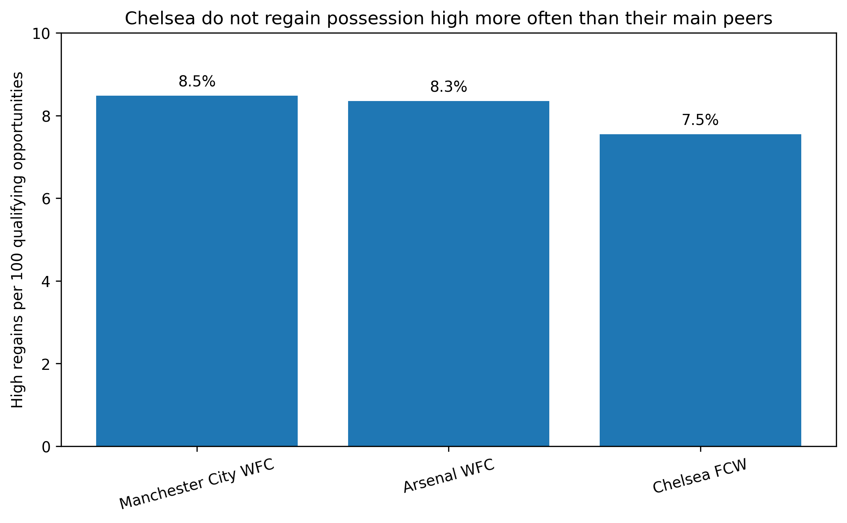
Chelsea do not win possession high more often than their main peers
Opportunity adjustment removes the misleading effect of different exposure.
What changes after exposure adjustment?
Chelsea faced 1,245 qualifying opportunities — more than City (1,155) or Arsenal (1,185).
Chelsea: 7.6%
Observed differences vs City and Arsenal are small; first-pass intervals and whole-match bootstrap checks both include no meaningful difference.
Decision implication: do not describe high-regain frequency as a Chelsea competitive advantage.

Slide 4
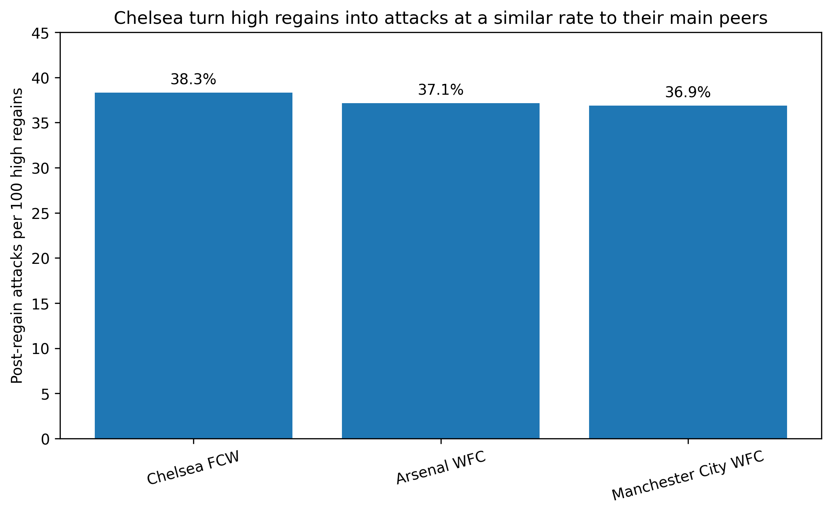
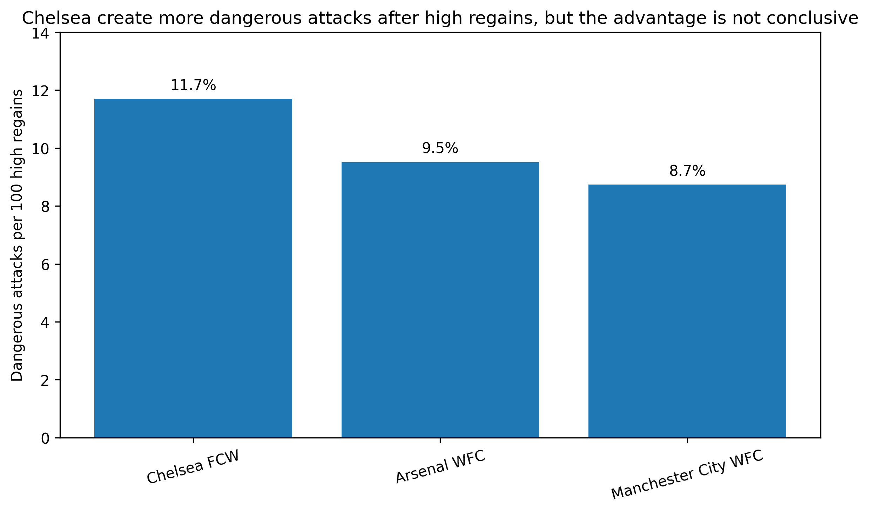
The strongest Chelsea signal appears after the regain — but it is not conclusive
Conversion is similar; dangerous-attack rate is higher descriptively, with substantial uncertainty and definition sensitivity.
38.3%
Chelsea post-regain attack rate
≈ peers
11.7%
Dangerous attacks per high regain
vs 9.5% Arsenal / 8.7% City
Not robust
Intervals include no difference; Chelsea’s relative position changes across 10/15/20s and 0.10/0.20/0.30 xG definitions.

Slide 5
Recommendation: maintain the press; investigate post-regain execution
The evidence is strong enough to reject a “press more because Chelsea are uniquely good at this” story — not strong enough to justify a tactical overhaul.
Do now
Do not infer
✓
Maintain the current high-regain approach.
×
That Chelsea should increase pressing intensity because their high-regain frequency is uniquely strong.
✓
Use high regains as one part of the attacking model, not a proven standalone competitive advantage.
×
That the observed dangerous-attack advantage is a proven or causal effect.
✓
Target video review at the first actions after regaining the ball high.
×
That event data alone explains the tactical mechanism behind individual regains.
Next evidence: first pass/carry · forward options · positioning · speed of exploitation · targeted video review

