Slide 1
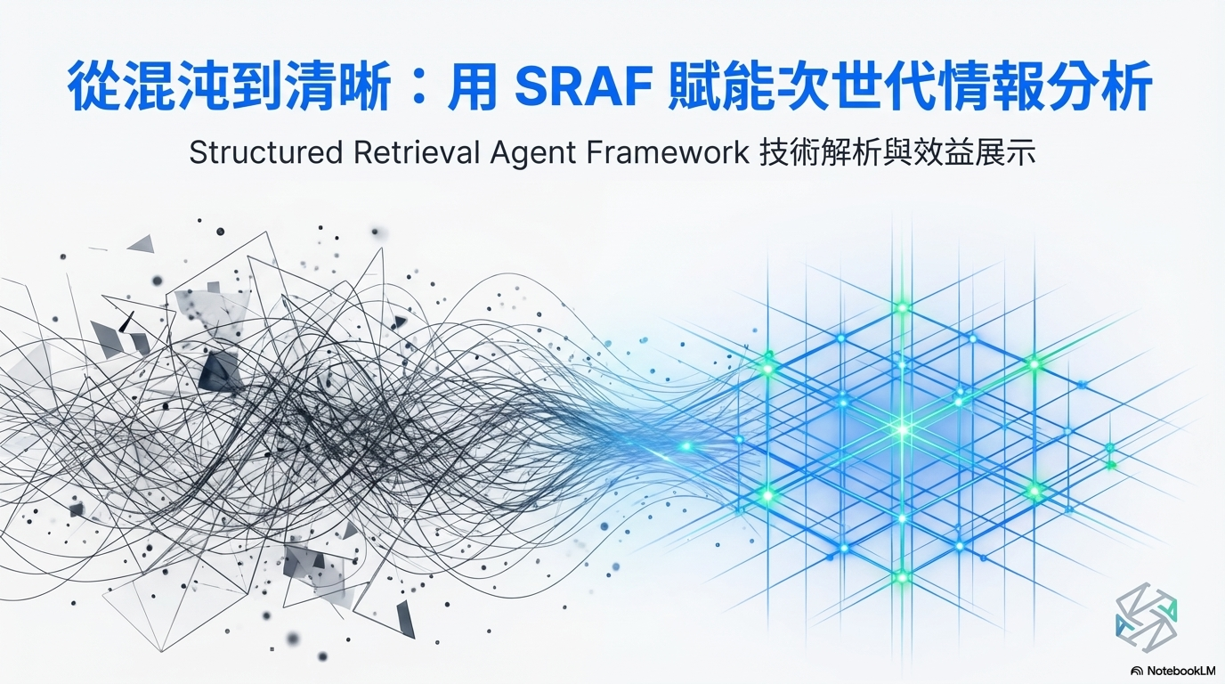
Notes:
大家好，我是James，今天要跟貴方分享我們最近自研的一個結構化RAG框架的一些開發狀況。我們將這個框架命名為Structured Retrieval Agent Framework。
Hello everyone, I’m James. Today, I’m excited to share with you the latest progress of our in-house developed structured RAG framework. We call this framework the Structured Retrieval Agent Framework, or SRAF for short.

Slide 2
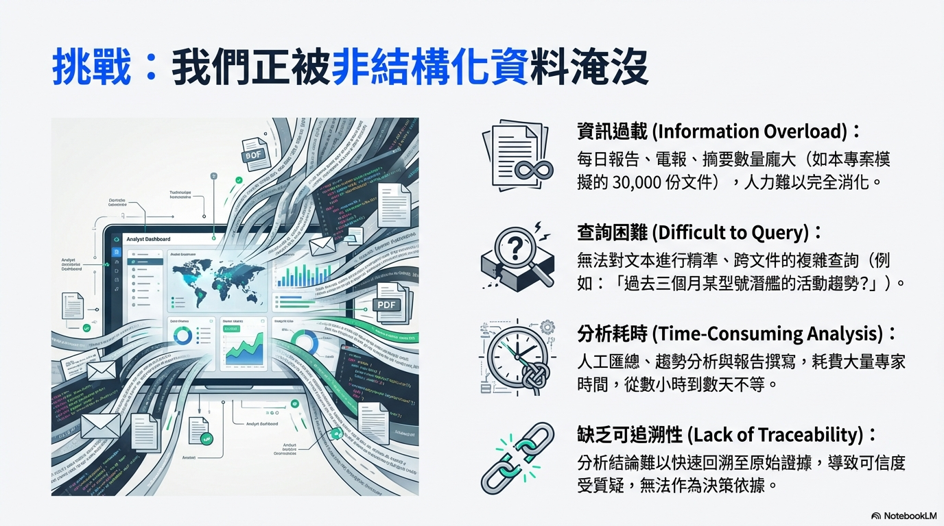
Notes:
在文本資料分析的實際情境中，我們面臨的一大挑戰是大量的非結構化資料淹沒分析人員，造成了幾個工作上的痛點，例如資訊量龐大、檢索不易、分析耗時以及原始證據的整理成本。
In real-world text analysis scenarios, one of the biggest challenges we face is being overwhelmed by massive amounts of unstructured data. This creates several key pain points in our workflow, including information overload, difficulty in retrieval, time-consuming analysis, and the high cost of organizing and tracing back to original evidence.

Slide 3
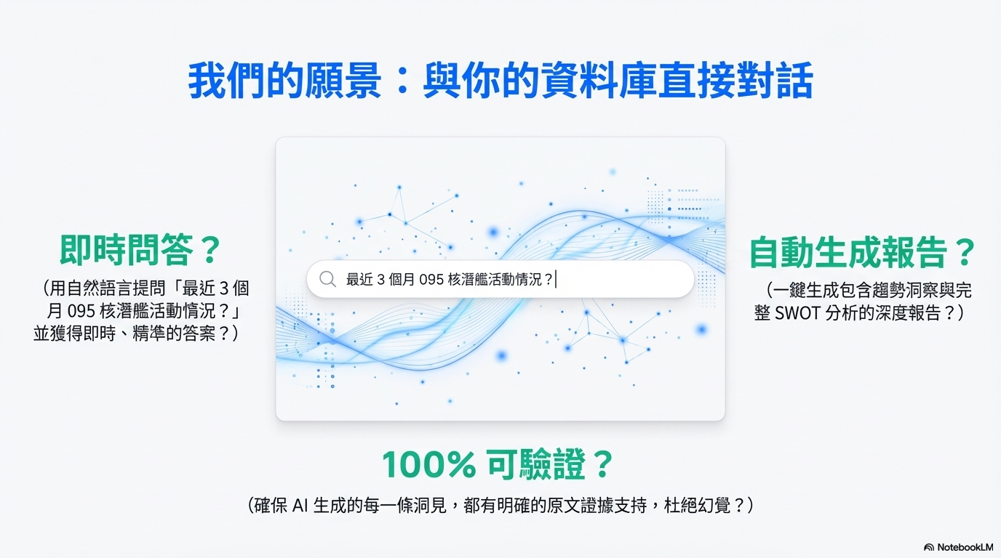
Notes:
我們希望能夠用大語言模型做為引擎，驅動自動化分析代理人。達到針對使用者的提問，自動分析關鍵字，自動檢索，提取關鍵證據，自動生成報告。並且為了便於使用者可便利地進行檢核，在報告後附上相關證據片段資訊。
Our goal is to use large language models as the core engine to power an automated analysis agent. For any user query, the system can automatically identify key concepts, perform retrieval, extract relevant evidence, and generate a structured report. To ensure usability and trust, we also attach supporting evidence snippets to each result, allowing users to easily verify the findings.

Slide 4
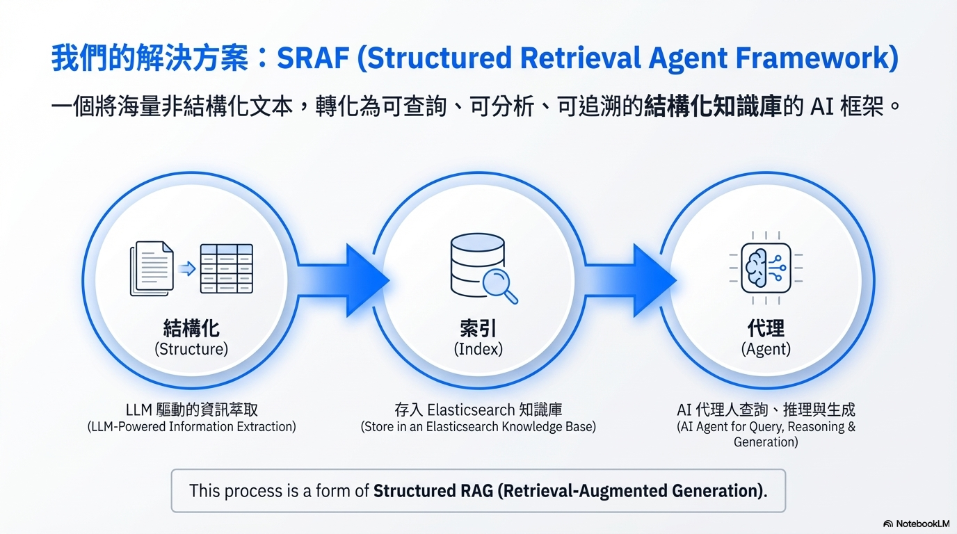
Notes:
我們自研的解決方案命名為Structured Retrieval Agent Framework，這個框架的概念在於將巨量非結構化的文本資料，運用LLM自動化資訊萃取，轉化為結構化的型式，存入資料庫，建立一個可查詢的結構化知識庫，讓AI代理人可以進行查詢與綜整等動作。
Our in-house solution is called the Structured Retrieval Agent Framework. The core idea behind this framework is to transform massive volumes of unstructured text into structured data using LLM-powered information extraction. This structured data is then stored in a database to build a queryable knowledge base, enabling AI agents to efficiently retrieve, analyze, and synthesize information.

Slide 5
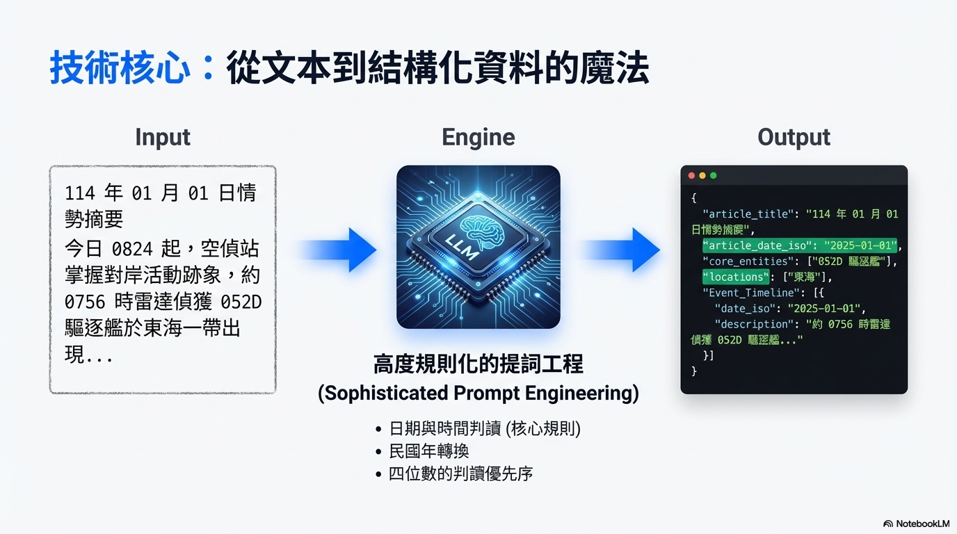
Notes:
接著進一步說明自動化結構化的概念，以畫面上所示的這個範例為例，輸入是結構化的一大段文本，我們可以利用LLM搭配精心設計的提詞模板，輸出JSON格式的結果，接續串接程式導入結構化文本資料庫。在這個過程裡，可以抽取各式各樣需要的欄位，例如文章日期、事件日期、事件地點等應用需求所需的欄位屬性。
Next, let me further explain the concept of automated structuring. Using the example shown on the screen, we start with a large piece of unstructured text as input. By combining LLMs with carefully designed prompt templates, we can generate structured output in JSON format. This output can then be seamlessly integrated into a structured text database through downstream processing.
Throughout this process, we can extract a wide range of fields based on application needs, such as publication date, event date, location, and other relevant attributes.

Slide 6
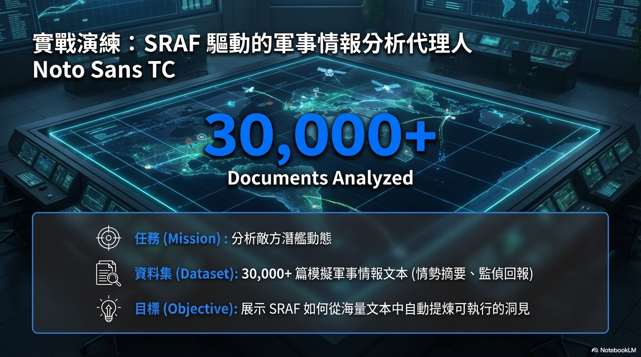
Notes:
具體而言，我們也運用了一些模擬生成的文本跟網頁爬蟲得到的文本資料進行了基本的效能驗測。例如：使用ChatGPT生成的3萬篇的軍事情報文本，等一下會看到ChatGPT生成的文本範例。
To evaluate the system in practice, we conducted baseline performance testing using both synthetically generated text and data collected from web crawlers. For example, we generated around 30,000 military intelligence documents using ChatGPT. Later, I’ll show you a sample of this generated content.

Slide 7
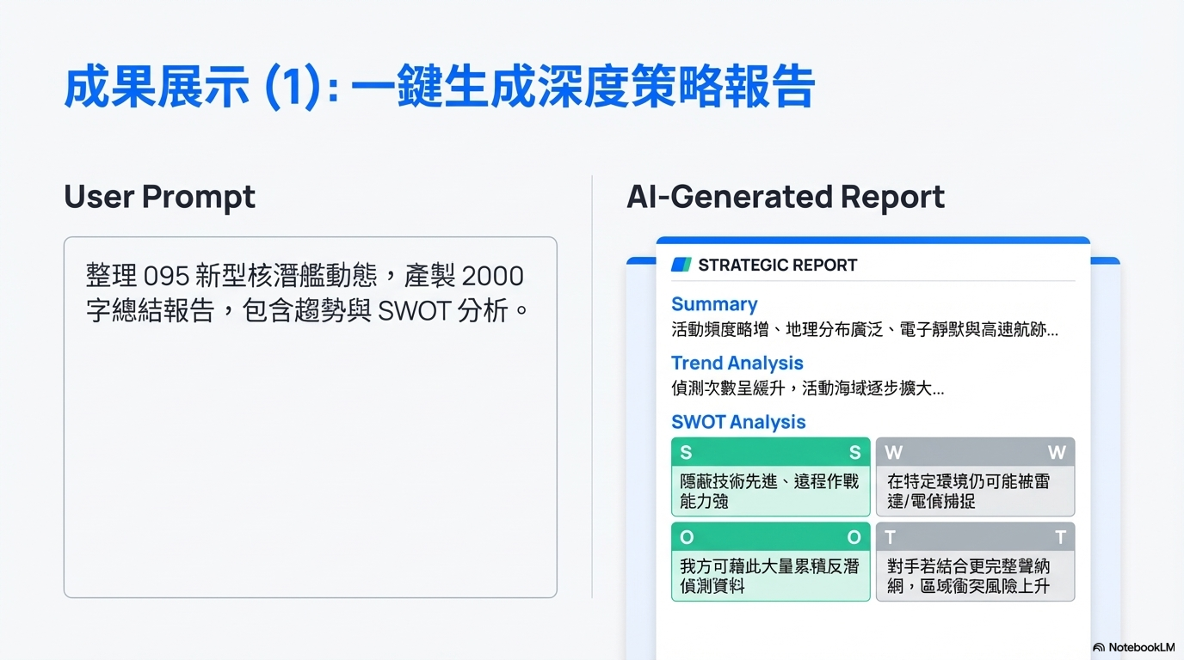
Notes:
接下來可以看到基於剛剛的這個模擬資料，AI代理人的一個實際產出效果的例子，在整個過程中，使用者只要以自然語言的方式輸入提問跟需求，AI代理人就可以自動地完成訂定檢索關鍵字、去資料庫拉資料回來、檢核篩濾結果，最後生成綜整報告。
Next, based on the simulated data we just introduced, you can see an example of the actual output generated by the AI agent. Throughout the entire process, the user simply provides a query in natural language. The agent then automatically determines the search keywords, retrieves relevant data from the database, validates and filters the results, and finally generates a synthesized report.

Slide 8
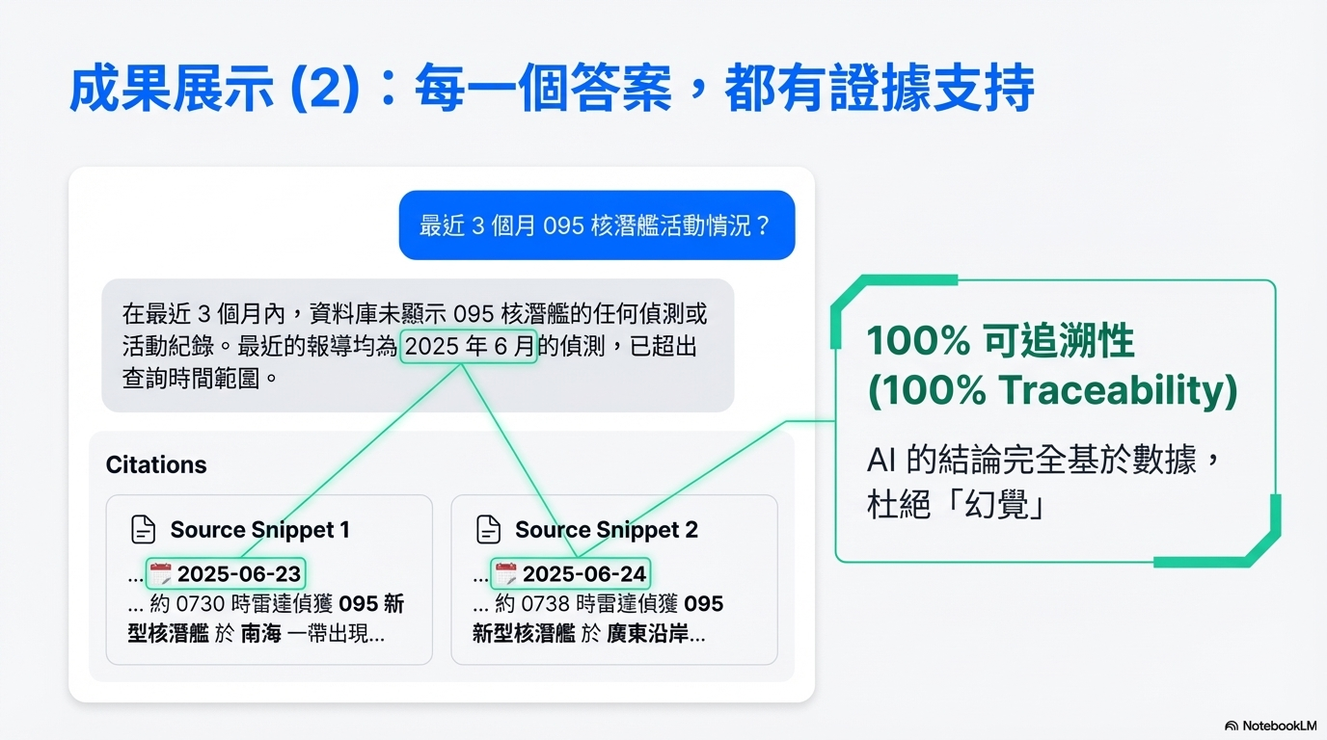
Notes:
如我們所知的，LLM生成應用的一大重點是要避免AI幻覺造成的傷害，提供可驗證的資訊讓使用者可以初略地評估生成結果的正確性是很重要的議題，因此，在我們的系統成品中，也會羅列採用的資料庫證據片段在報告結尾，供使用者參考。
當然，如果參考的證據片段太多，例如超過兩百條，以現有的開源模型效能而言，在統計等精確任務時，仍然可能會有錯誤計數的問題。但至少透由提供證據片段的功能，使用者有機會快速檢核。
As we know, one of the key challenges in LLM applications is avoiding AI hallucinations. That’s why it’s important to provide verifiable information, so users can quickly check whether the results are reliable.
In our system, we address this by listing the supporting evidence retrieved from the database at the end of each report, allowing users to review and validate the findings.
Of course, when the number of referenced evidence snippets becomes very large—for example, exceeding 200 entries—current open-source models may still encounter issues with precise tasks such as accurate counting or statistical aggregation. However, by providing these evidence snippets, users still have a practical way to quickly verify the results.

Slide 9
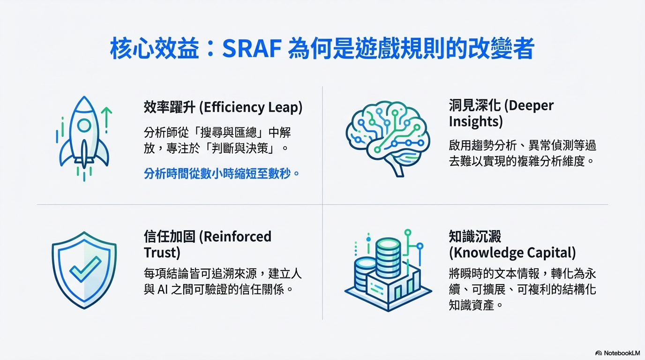
Notes:
藉由這樣由結構化到產出報告的一條龍框架，我們可以得到幾個主要的效益，第一個是作業效率提升，原本人類分析需要進行資料搜索、整理、閱讀、挑選重點、編寫等一連串的動作，可能要耗費數個小時，但透由這個框架，使用者只要花一點時間輸入提問，然後放著讓代理人做事，自己去倒杯咖啡，幾分鐘後回來時，一份概要的分析報告就完成了。
With this end-to-end framework—from structured data processing to report generation—we can achieve several key benefits.
The first is a significant improvement in operational efficiency. Traditionally, human analysts need to go through a series of steps, including searching for data, organizing it, reading through materials, identifying key points, and writing reports finally. This process can take several hours.
With our framework, however, users only need to spend a short moment entering their query, then let the agent handle the rest. They can step away—grab a cup of coffee—and within just a few minutes, a concise analytical report is ready.

Slide 10
Notes:
第二個效益是當報告撰寫來源的引用證據片段較多，事項比較繁雜時，對人類而言，可能會產生比較高的分析負荷，運用這個框架可以使用AI自動觀察一些細節的變化，提供觀察到具特殊性的事項，供分析人員參考。
第三個是透由結構化資料庫的證據片段及日期等結構欄位，可以讓使用者便利地去驗證AI生成結果的正確性，提升使用者信心。
第四個是透過自動結構化的程序，將原本繁雜大量的非結構文本資料萃取出精華關鍵的部份，存到結構化資料庫中，為其他潛在的應用累積資產。
The second benefit is reducing the analytical burden on human analysts. When a report involves a large number of evidence sources and complex details, it can be mentally demanding. With this framework, AI can automatically detect subtle patterns and highlight noteworthy or unusual findings, providing valuable insights for analysts to review.

Slide 11
Notes:
The third benefit is easier to verify the results. By leveraging structured evidence snippets and fields such as timestamps, users can more easily validate the accuracy of AI-generated results.
The fourth benefit is knowledge accumulation. Through automated structuring, a large amount of unstructured text are distilled into essential insights and stored in a structured database. This not only supports current use cases but also builds a valuable data asset for future applications.

Slide 12
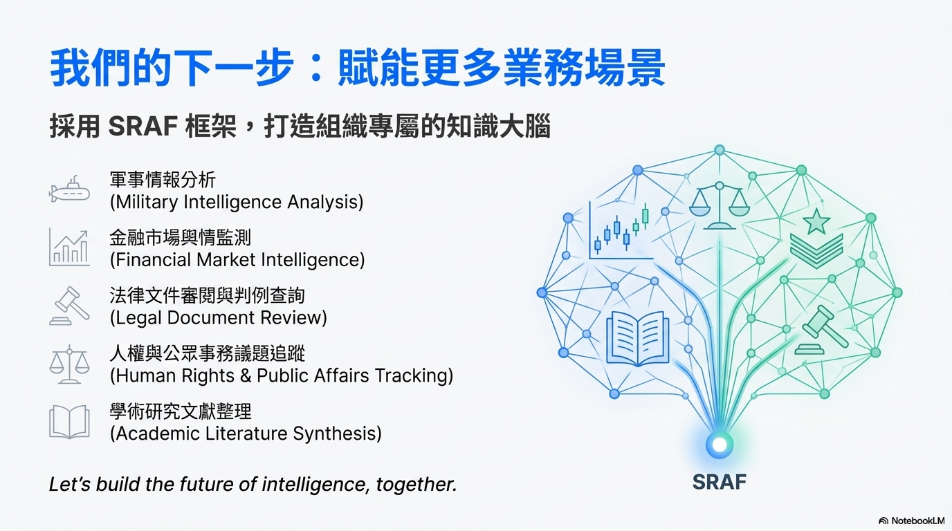
Notes:
目前這個框架還處於應用研發前期階段，雖然已經應用一些模擬或爬蟲文本的資料庫做了一些效果評估，但實務應用的部份仍處於尋找合適標的的階段，剛剛我們有提到模擬生成的軍事文本效果案例，另一個爬蟲文本資料庫是聯合國新聞網的最新消息區的四萬五千篇新聞，輸出報告word檔有在前次提供貴方的附件檔案裡。以上是目前我們的研究概況提報，謝謝。
At this stage, the framework is still in the early phase of application development. While we have already conducted initial evaluations using simulated data and a dataset collected from web-crawling, real-world deployment is still in the process of identifying suitable use cases.
As mentioned earlier, we demonstrated results using synthetic data. In addition, we have also built a dataset of around 45,000 news articles crawled from the United Nations News website. The generated report, in Word format, was included in the attachments we previously shared with your team.
That concludes our current research overview. Thank you for your attention.

Slide 13
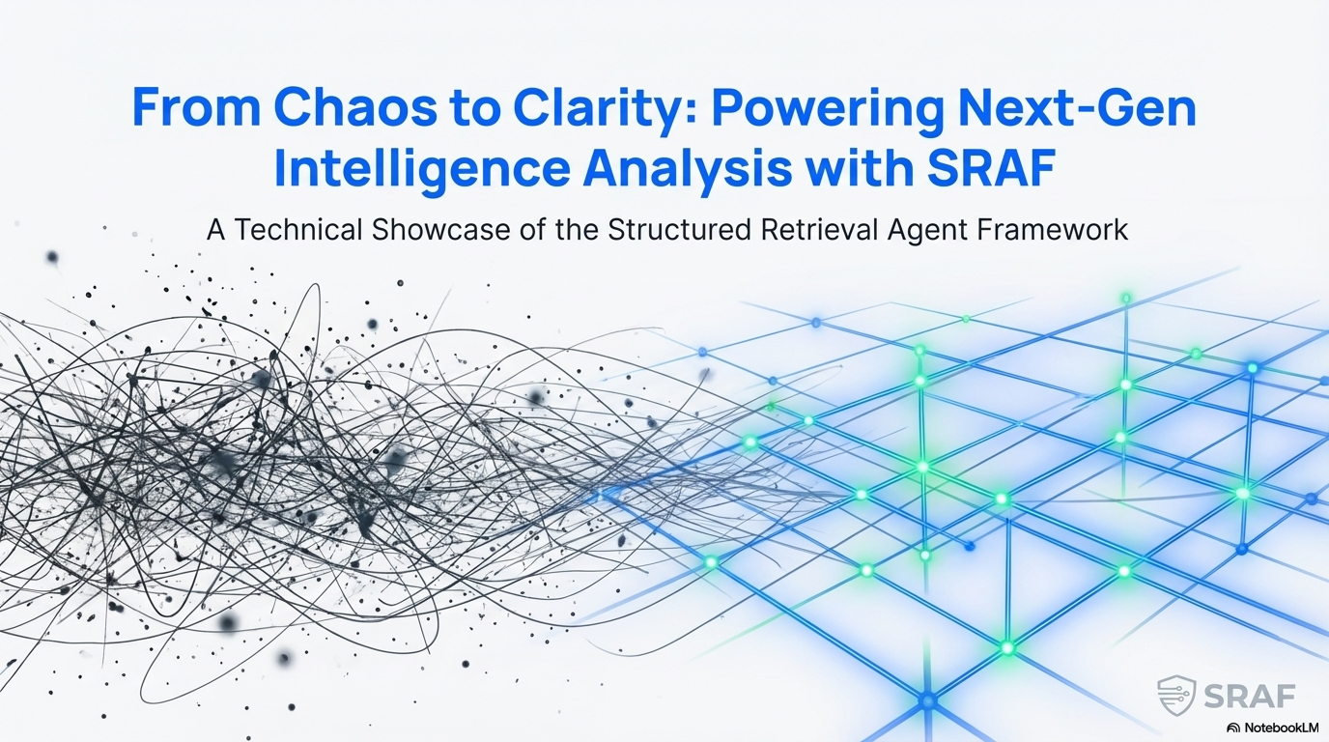

Slide 14
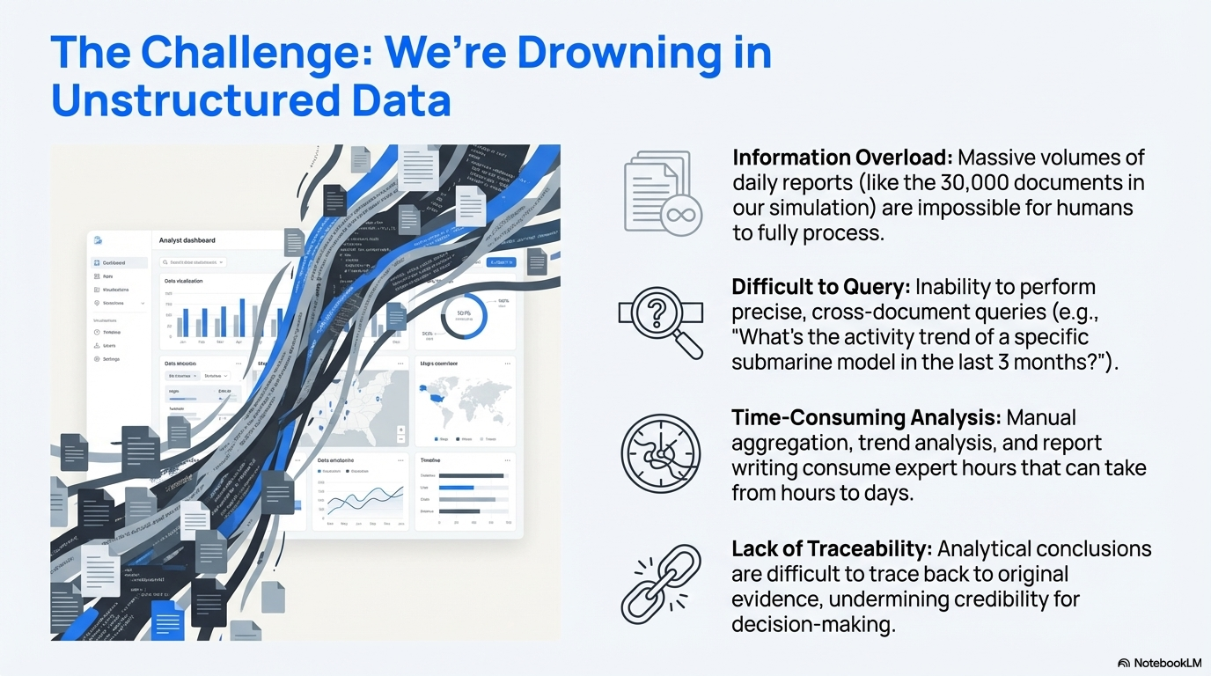

Slide 15
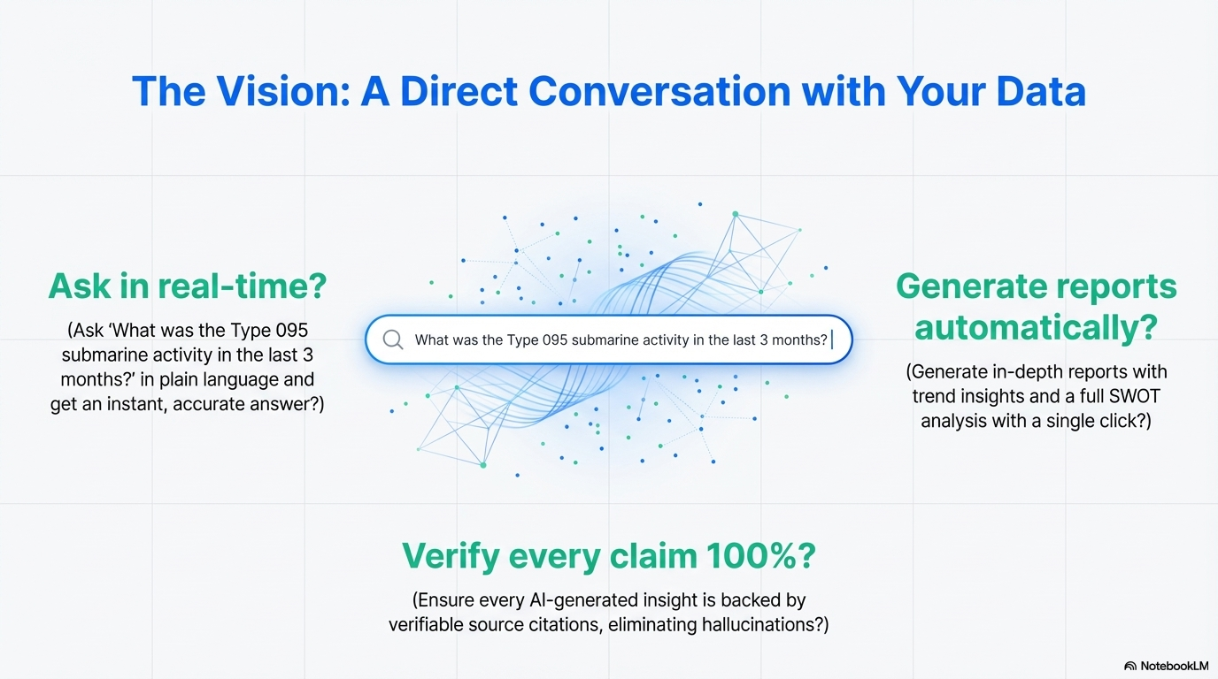

Slide 16
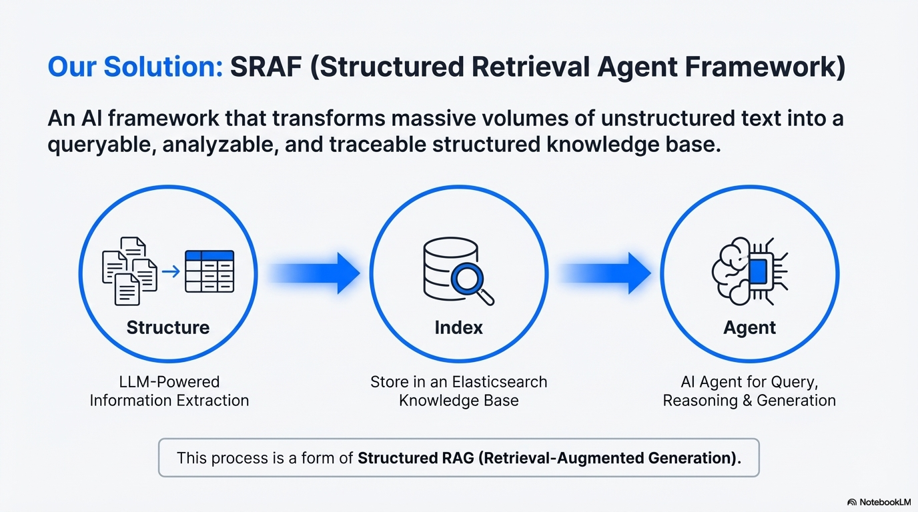

Slide 17
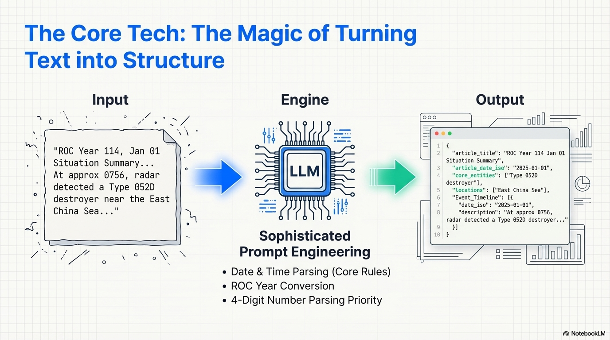

Slide 18
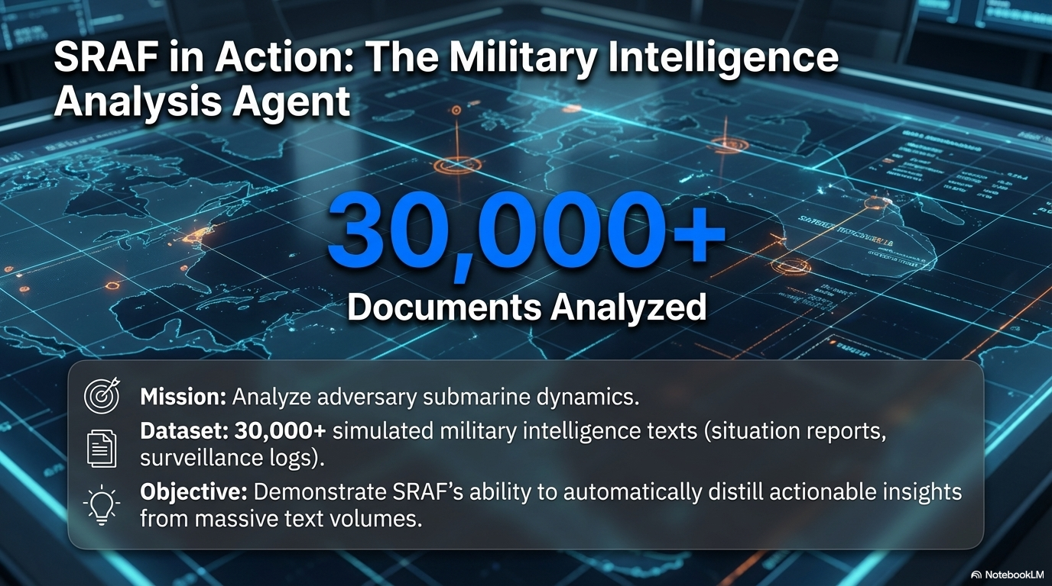

Slide 19
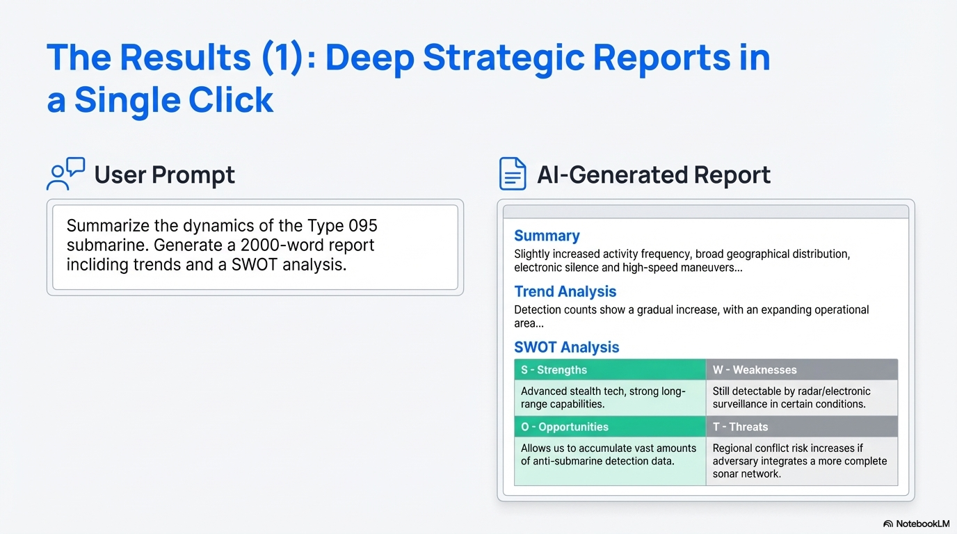

Slide 20
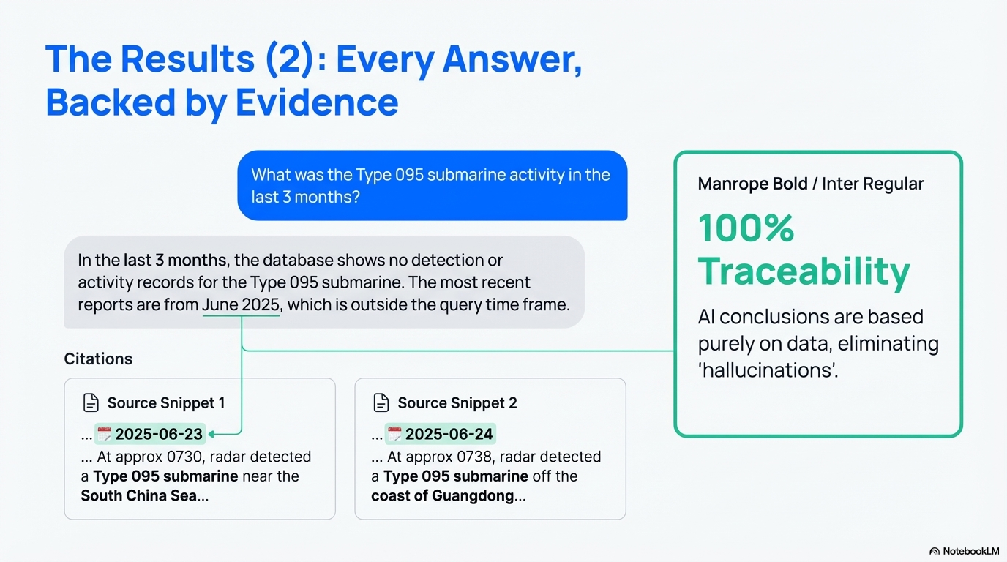

Slide 21
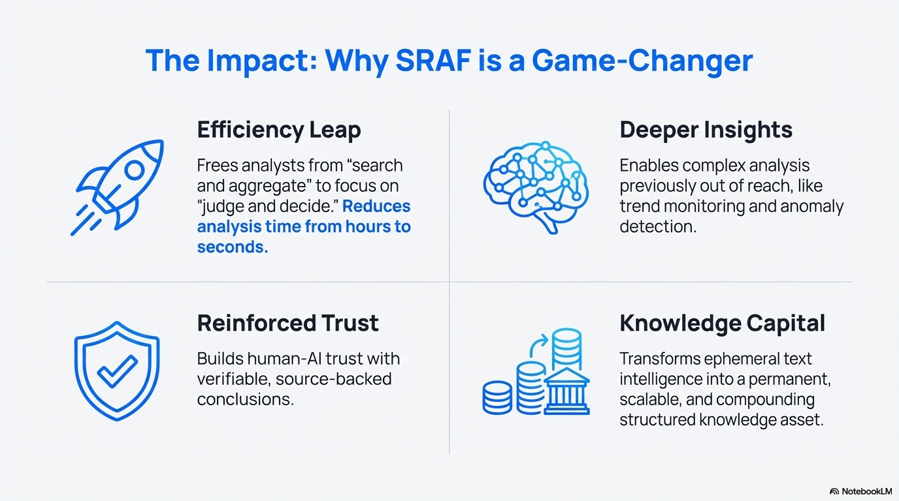

Slide 22
