Slide 1
Solvelt
One platform to get all answer specially for students and teachers.

Slide 2
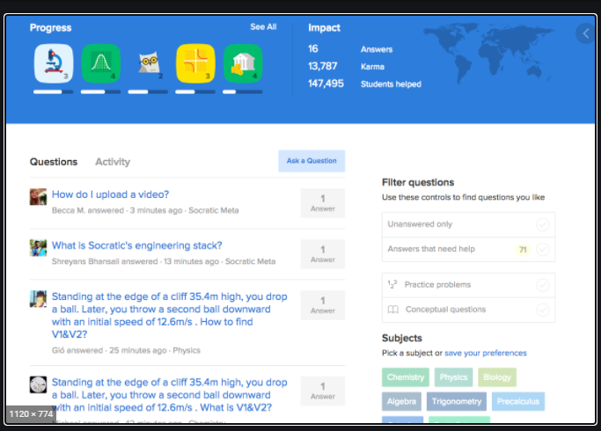
Reference

Slide 3
Users
Admin
Supervisor
End User

Slide 4
Admin
Have access to everything.
Special access over questions.
Can mark user’s answers as FEATURED.
Can add/delete questions/answers.

Slide 5
Supervisor
Can review questions. (Mark their vote)
Special access over questions.
Can make user’s answers as FEATURED.
Can add/delete answers.

Slide 6
End user
Can see questions and answers
Can add question/answers
Mark vote on answers.

Slide 7
Tables
Users
Question
Answers

Slide 8
Users table
UserId(P) | AccessLevel
GUID | ENUM(INT)
Access Levels
Admin = 1
Supervisor = 2
User = 3

Slide 9
Questions table
QuestionId(P) | UserId(FK) | QuestionTitle | QuestionDescription | AnswerCount
GUID | GUID | STRING | STRING | INT

Slide 10
Answers table
AnswerId(P) | QuestionId(FK) | AnswerTitle | AnswerDescription
GUID | GUID | STRING | STRING

