Slide 1
Solvelt
One platform to get all answer specially for students and teachers.

Slide 2
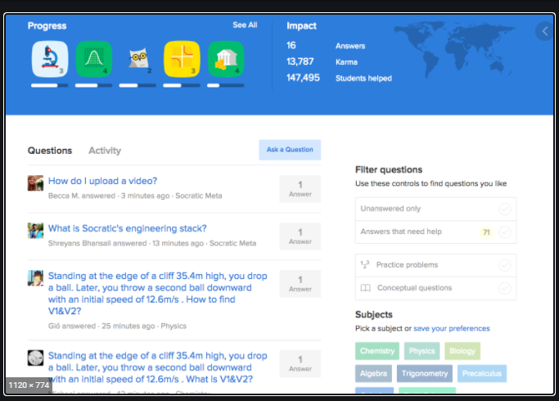
Reference

Slide 3
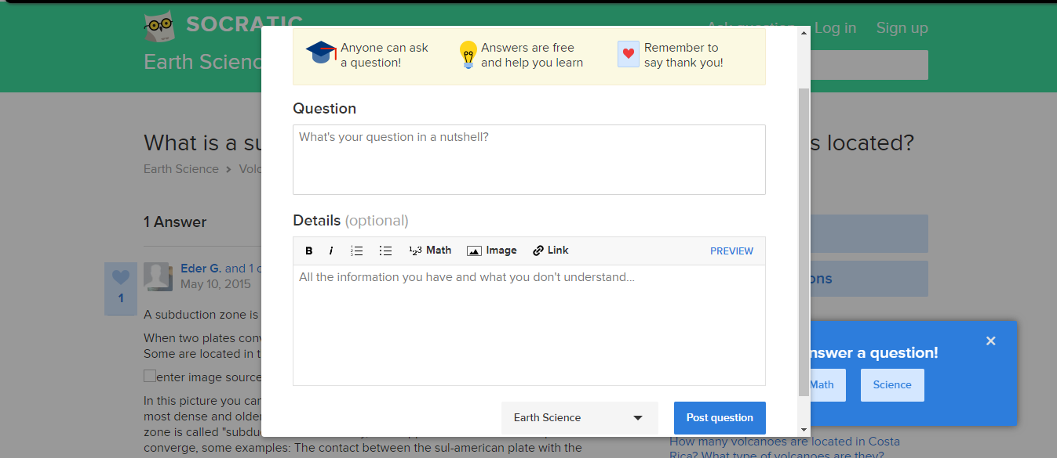
Reference

Slide 4
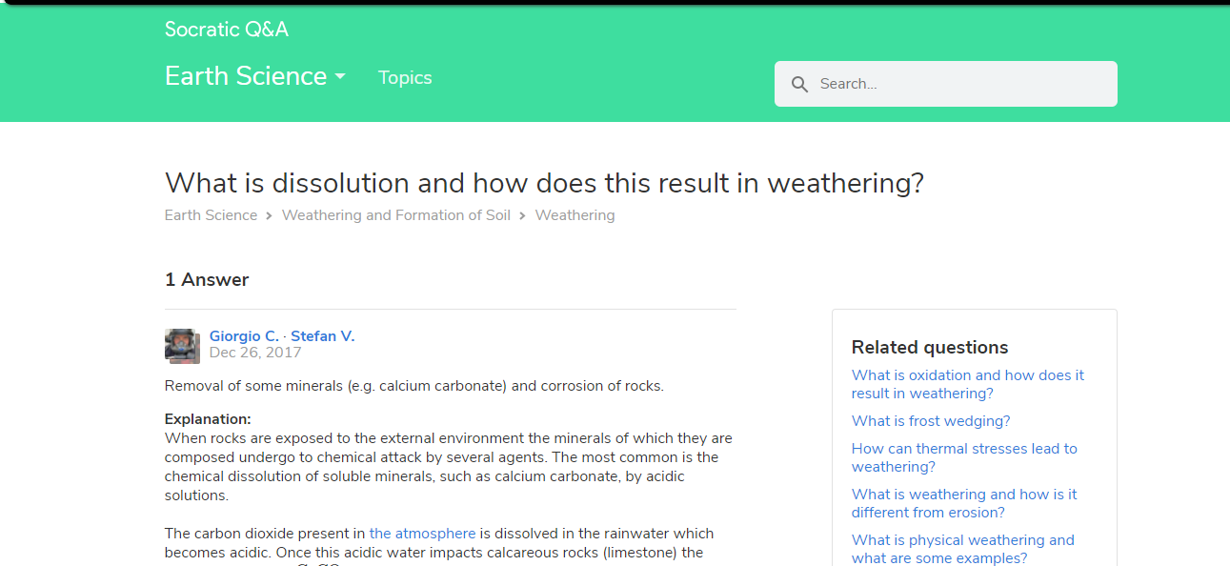
Reference

Slide 5
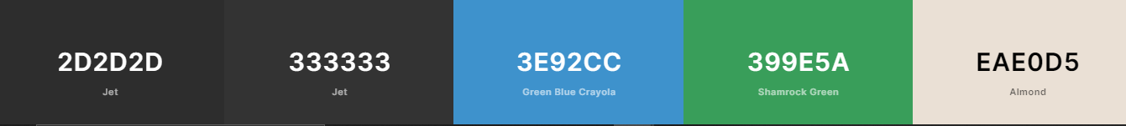
Color palette

Slide 6
Users
Admin
Supervisor
End User

Slide 7
Admin
Have access to everything.
Special access over questions.
Can mark user’s answers as FEATURED.
Can add/delete questions/answers.

Slide 8
Supervisor
Can review questions. (Mark their vote)
Special access over questions.
Can make user’s answers as FEATURED.
Can add/delete answers.

Slide 9
End user
Can see questions and answers
Can add question/answers
Mark vote on answers.

Slide 10
Tables
Users
Question
Answers
Subject
Subject Subcategory

Slide 11
Users table
UserId(P) | AccessLevel
GUID | ENUM(INT)
Access Levels
Admin = 1
Supervisor = 2
User = 3

Slide 12
Questions table
QuestionId(P) | UserId(FK) | SubjectId(FK) | SubCategoryId(FK) | QuestionTitle | QuestionDescription | AnswerCount | Timestamp
GUID | GUID | GUID | GUID | STRING | STRING | INT | DateString

Slide 13
Answers table
AnswerId(P) | QuestionId(FK) | AnswerDescription | UserId | Timestamp
GUID | GUID | STRING | GUID | DATESTRING

Slide 14
Subject table
SubjectId(P) | SubjectName | SubjectDescription
GUID | STRING | STRING

Slide 15
Subject SUBCATEGORY table
SubCategoryId(P) | SubjectId(FK) | SubCategoryName | SubCategoryDescription
GUID | GUID | STRING | STRING

