Slide 1
Riemannian Continuous Normalizing Flows
Presented by Dinghuai Zhang, 2022.10

Slide 2



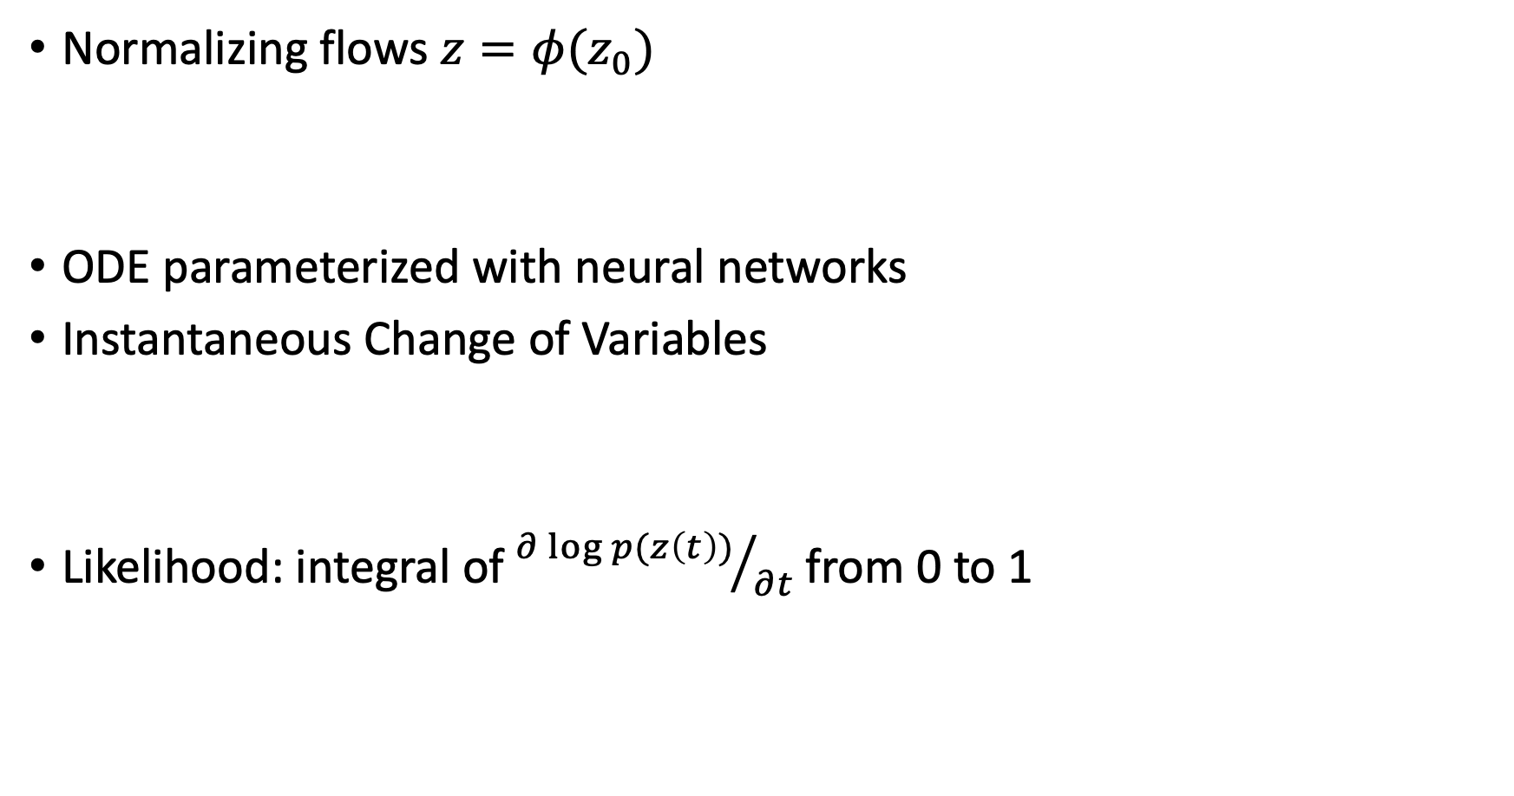
(Continuous) Normalizing Flows
Normalizing flows $z=φ(z_{0})$
ODE parameterized with neural networks
Instantaneous Change of Variables
Likelihood: integral of ${∂\log{p(z\left(t\right))}}/{∂t}$ from 0 to 1

Slide 3
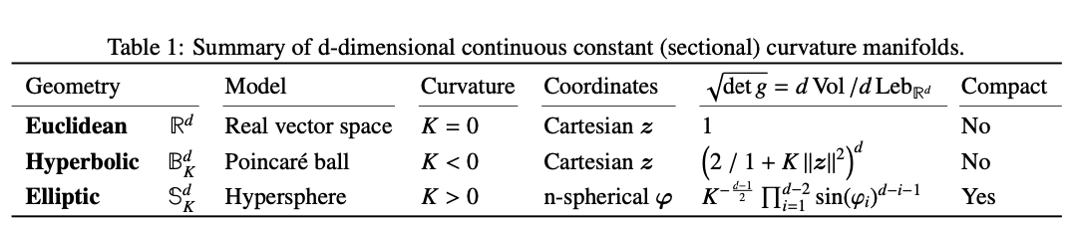
Riemannian manifold
Euclidean space has standard identity metric matrix
Three typical Riemannian space with different curvatures & metrics

Slide 4
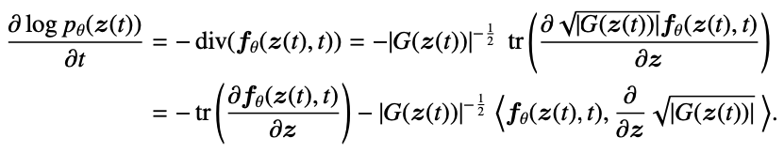

Instantaneous change of variables on Riemannian manifold
Hutchison estimator of the matrix trace
Integration for likelihood calculation

Slide 5

Vector field
Incorporate geometry into input layer
geodesic distance layer (generalized linear layer)
Projection output layer
To constrain the output onto the manifold
Rescale by metric matrix norm
Training
Given data: maximum likelihood
Given target probability: reverse KL

Slide 6
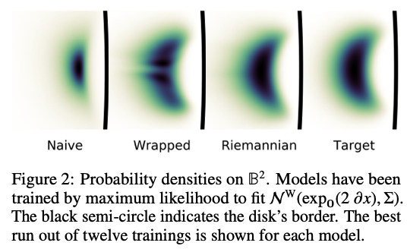
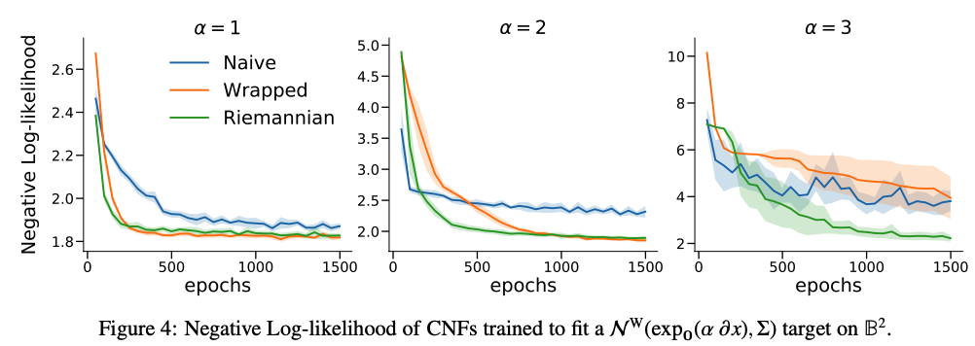
Experiments on Poincare disks

Slide 7
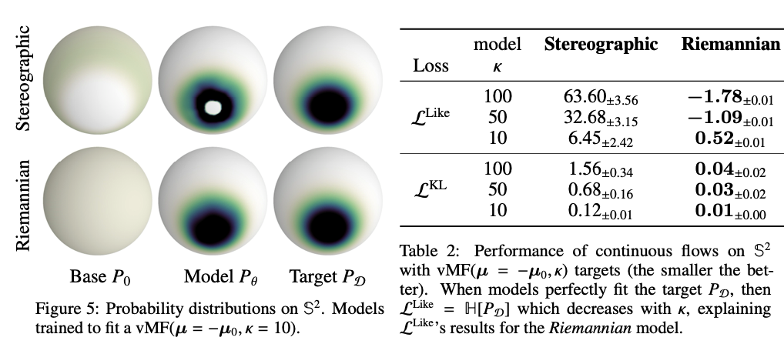
Experiments on sphere

Slide 8
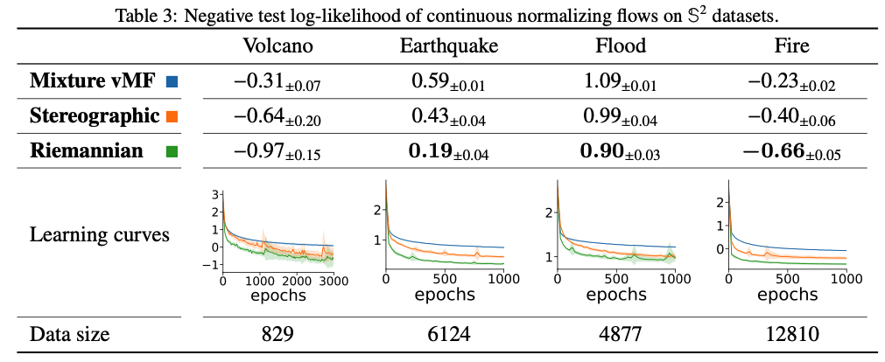
Experiments on sphere

Slide 9
Thanks!

