Slide 1
The Power Spherical distribution
Nicola De Cao, Wilker Aziz

Slide 2
Background
Data representation
Euclidean space
Hypersphere

Slide 3
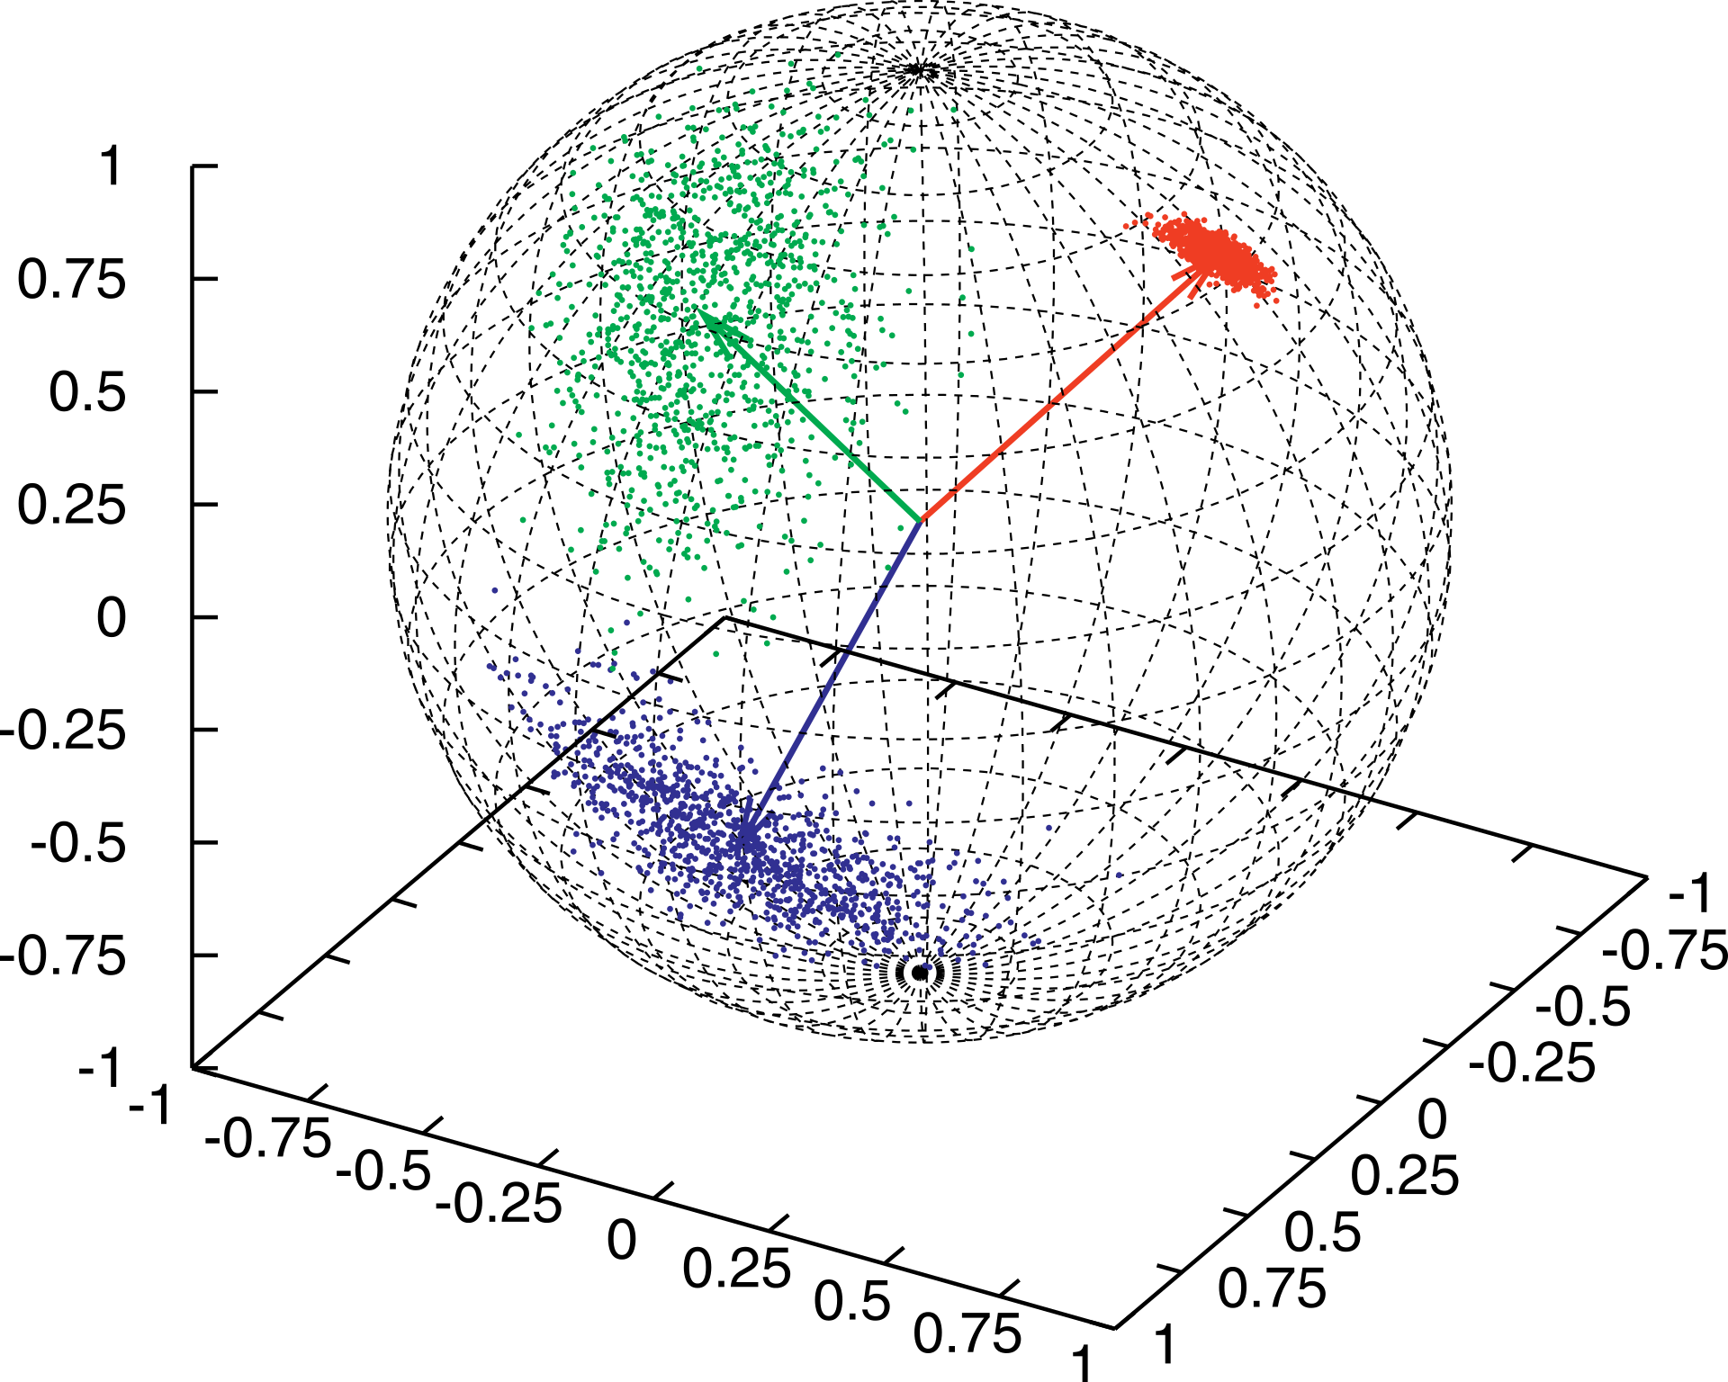
Directional distribution
Directional data
Direction more important than magnitude
Distribution on hypersphere

Slide 4
Overview
Hyper sphere
Von Mises-Fisher distribution
Power spherical distribution
Experiments

Slide 5
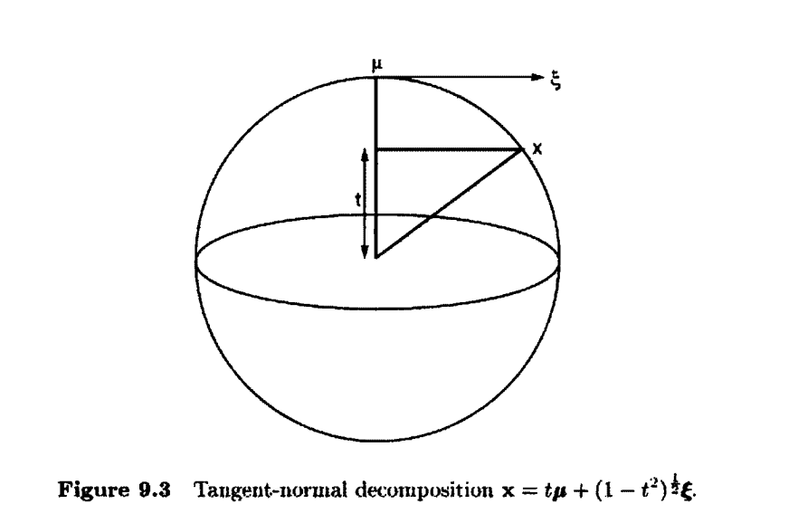
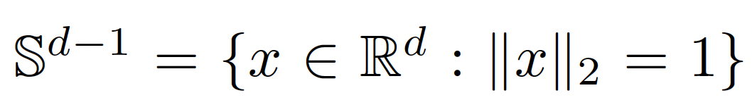

Hyper Sphere
Generation of circle and sphere
Definition:
Tangent-normal decomposition:

Slide 6

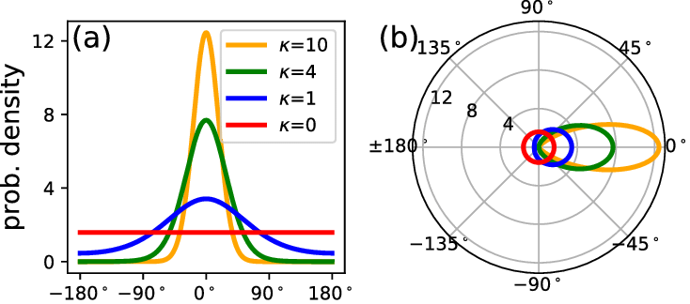
Von Mises-Fisher Distribution
Normal distribution on spheres
Definition:

Slide 7
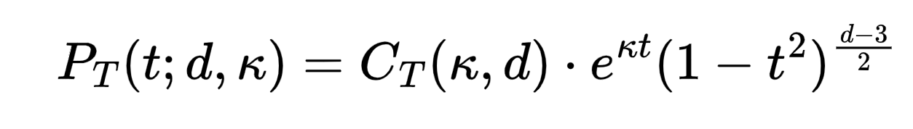
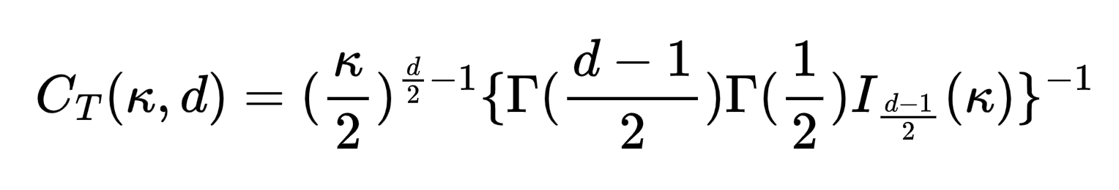
Problem of vMF distribution
Marginal distribution
Problems
Marginal distribution is slow to compute and unstable
No closed-form cdf

Slide 8
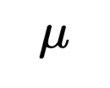

Solution
New distribution share basic properties of vMF, but not drawbacks
Rotationally symmetric about
Can be expressed in terms of a marginal distribution
Marginal has closed-form and stable cdf

Slide 9
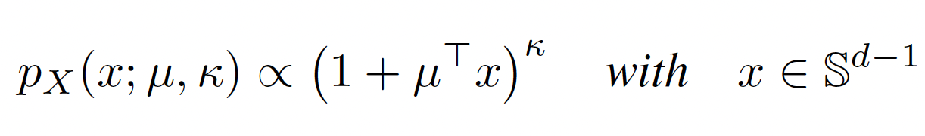
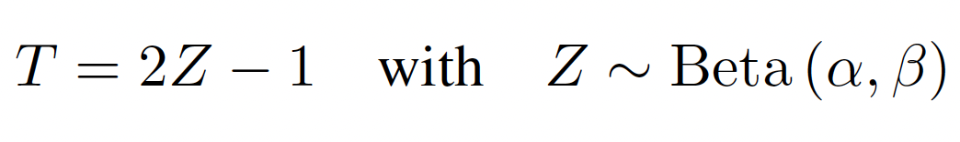
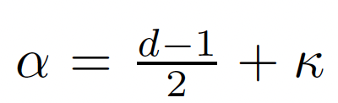
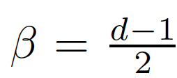
Power Spherical Distribution
Definition:
Marginal:
Advantage:
Fast sampling
Not require rejection sampling
Allow reparametrization trick

Slide 10
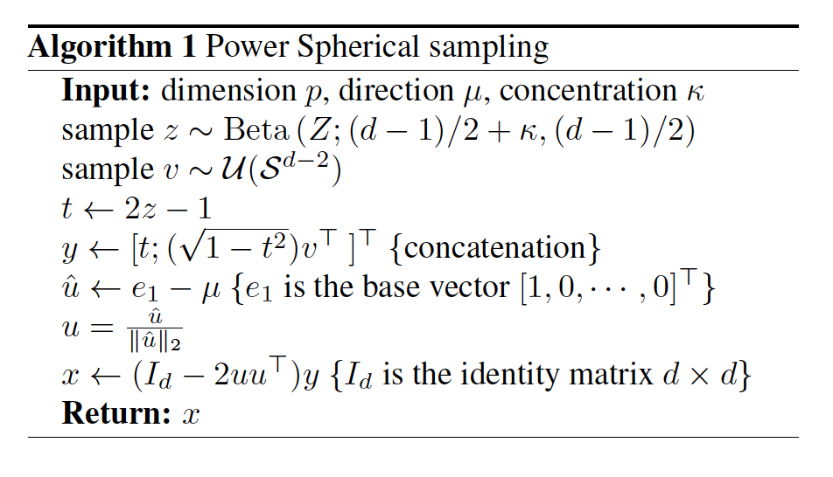
Sampling Algorithm

Slide 11
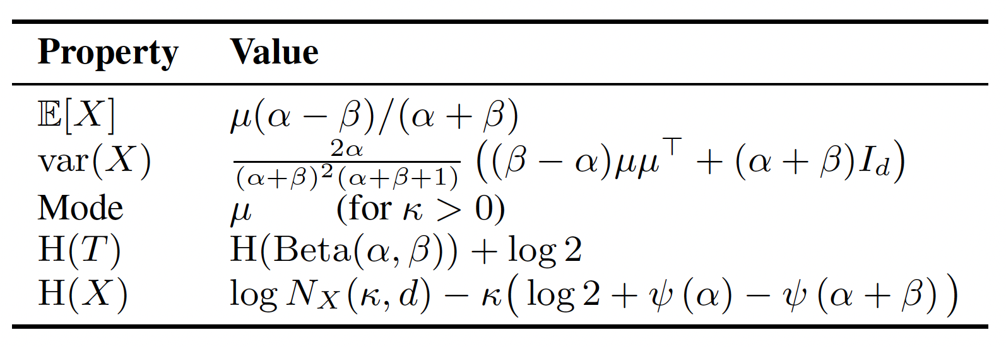
Propreties

Slide 12

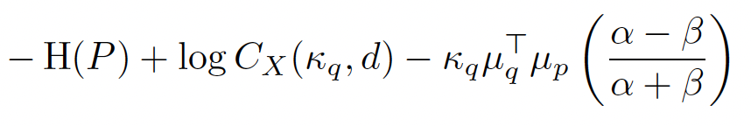
KullbackLeibler divergence
With uniform:
With vMF:

Slide 13
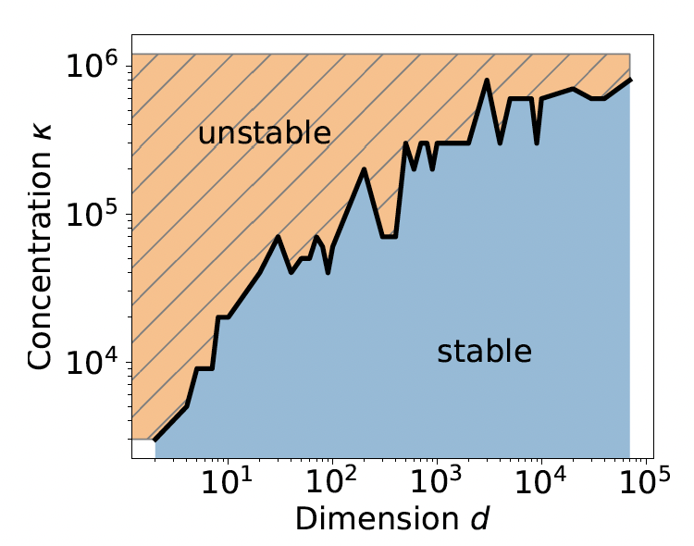
Experiment: stability
Mark stable if return NaN (not a number)
No NaN for Power Sphererical Distribution

Slide 14
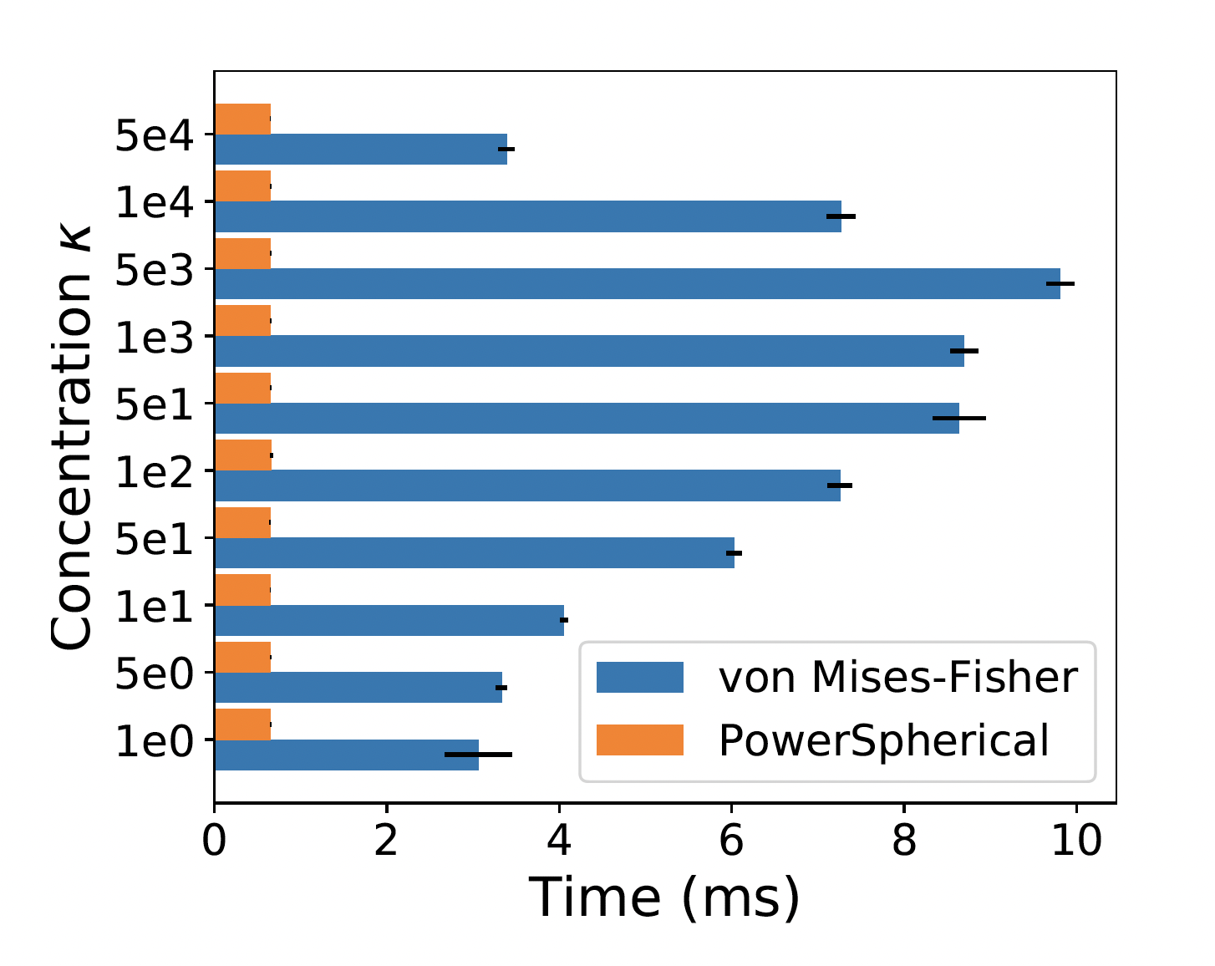
Experiment: efficiency

Slide 15
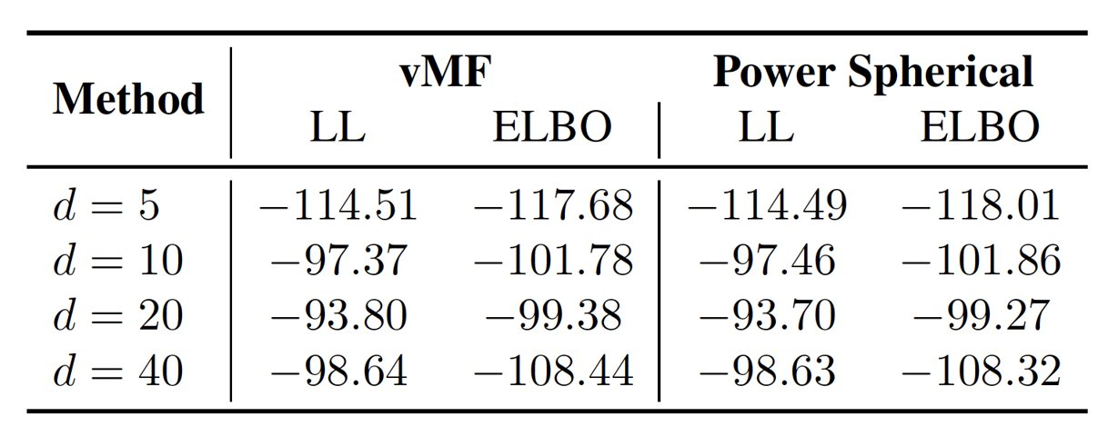
Experiment: Variational inference
Employ variational autoencoders on MNIST dataset
Optimize the ELBO for 100 epochs for dimension 5, 10, 20, 40
Faster and similar to vMF

