Slide 1
Hyperspherical Variational Auto-Encoders
Tim R. Davidson, Luca Falorsi, Nicola De Cao, Thomas Kipf, Jakub M. Tomczak
University of Amsterdam
Presenter: Sarvjeet Singh

Slide 2
TL;DR
Goal of the paper: Explore alternate prior on the latent space in VAEs
Why: Gaussians dist. prior on latent space can’t work when the latent space has hyperspherical structure
Proposed solution: Proposes vMF distribution on latent space
Results: Experiments show that under certain constraints/assumptions their solution, S-VAE, works better compared to N-VAE

Slide 3
Overview
Motivation
Background: vMF dist., Rejection sampling reparametrization
Method
Experiments
Conclusion
Discussion

Slide 4
Motivation
Limitations of Gaussian distribution
Low dimensions:
Heavy concentration around µ
This is problematic when the space is divided into multiple clusters
High dimensions:
Resemble a uniform distribution on the surface of a hypersphere
Gauss dist. is defined based on L2 norm that suffers from the curse of dimensionality (non-euclidean distance is more preferable)

Slide 5
Motivation
2. Manifold mapping constraint
Consider the data lying in a small M-dimensional manifold M, embedded in a much higher dimensional space
Latent space Z
If two spaces, M and Z, have fundamentally diff structure (dim(M) < dim(Z)):
The VAE could just leave most of the latent space empty, leading to bad samples.
If we increase the weight of KL loss term it’ll occupy all the latent space, but this will create instability and discontinuity
So, it is worth studying a posterior distribution on manifold different than the Euclidean space

Slide 6
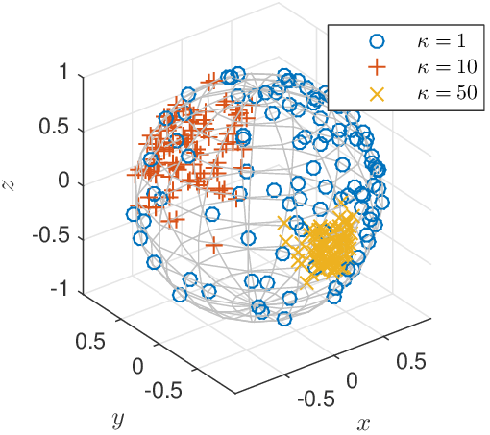
Background: vMF Dist.
VON MISES-FISHER DISTRIBUTION
Why is it needed? Applications?
Directional data: Gene/protein structures, wind currents, compass, etc.
How does it look like?
Prob. Density:

Slide 7
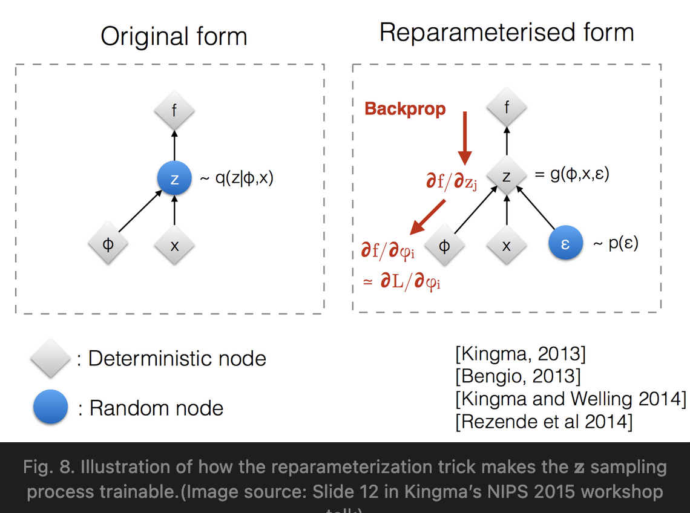
Background: N-VAE vs S-VAE
N-VAE
ELBO:
Reparameterization trick:
S-VAE
ELBO:
Reparameterization trick:
Unfortunately, there is no (known) breakdown of z in terms of deterministic terms along with a stochastic term
Reinforce

Slide 8
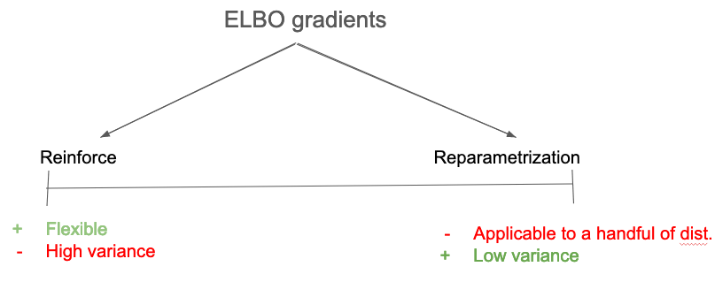

Slide 9
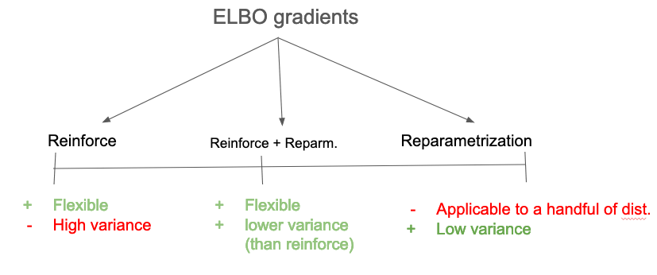

Slide 10
Bkg: Rejection Sampling
is target dist. and too complicated to sample
Find another simple density
and a scaling fxn

Slide 11
Bkg: Rejection Sampling
- Notice that sampling is from
- So, find r such that it can be reparametrized
we can show that
It makes sampling easy (lesser computational)

Slide 12
Bkg: Reparameterization Gradients through Rejection Sampling
If we can write
Reparametrized
Reinforce
Why didn’t we do this with
-> Sampling from it is too complicated

Slide 13

Method: Reparameterization of vMF
Gradient:
$$+$$
Reparametrized
Reinforce

Slide 14
Method: Reparameterization of vMF

Slide 15
Experiments and Results
4 Experiments:
Toy data with hyperspherical latent space (sanity check)
Evaluation of expressiveness: MNSIT
Semi-supervised learning for a classification task
Graph link prediction task

Slide 16
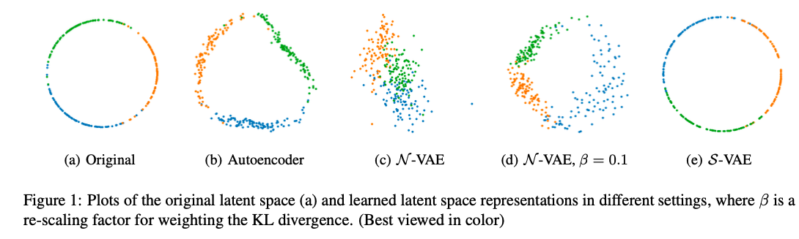

Exp1: Toy data with hyperspherical latent space (sanity check)
Artificial data ($R^{100}$) with latent space of mix of 3 vMFs on a $S^{1}$ hyperspherical
Qualitatively:

Slide 17
Exp2: Evaluation of expressiveness
MNSIT:
Unsure about its latent space structure (if it’s hyperspherical or not)
Compare N-VAE and S-VAE on the following:
Marginal log likelihood (LL)
ELBO
Reconstruction error (RE)
KL divergence

Slide 18
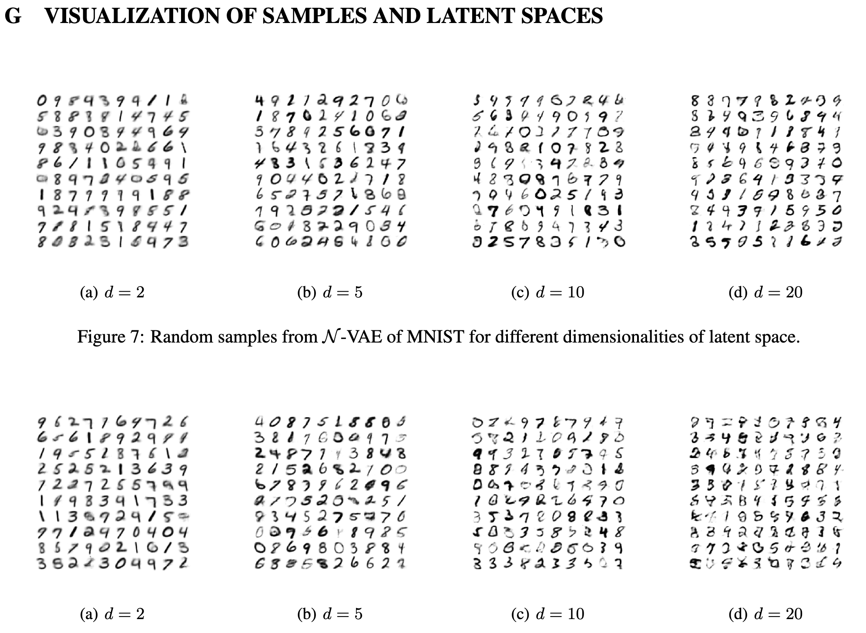
Exp2: Evaluation of expressiveness

Slide 19
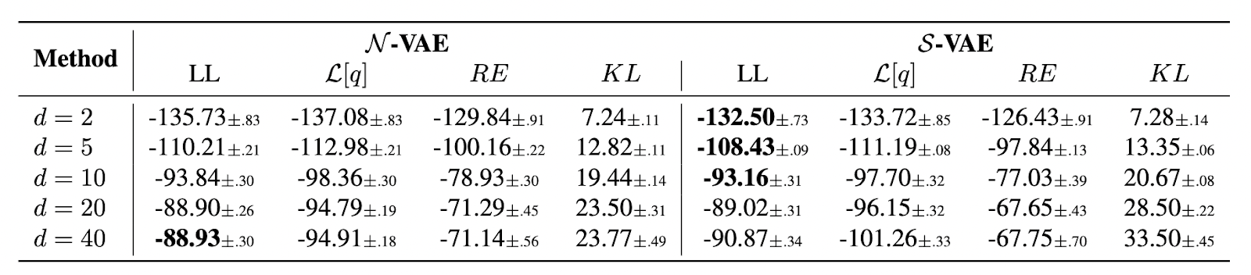
Exp2: Evaluation of expressiveness
Mean and standard-deviation over 10 run
Highlighted only statistically significant (p < 0.01)
Conclusion:
As dimensionality increases, the Gaussian distribution starts to approximate a hypersphere.
Gaussian posterior becomes more expressive than the vMF due to the higher number of variance parameters
S-VAE works better only for small dim (d < 20) of the latent space. So, unless latent space is supposed to be low dim, it is at disadvantage

Slide 20
Exp3: Semi-supervised learning for a classification task
Trained KNN clf. on the latent space of a learned VAE on MNSIT
Compared N and S versions of 2 VAE models:
M1
M1 + M2 (two cascaded/stacked VAEs)

Slide 21
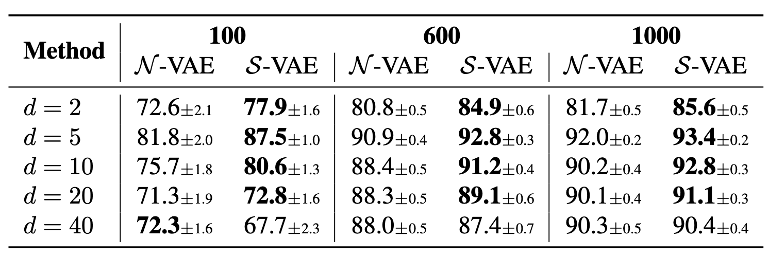
Exp3: Semi-supervised learning for a classification task
Trained KNN clf on the latent space of a learned M1 VAE on MNSIT
Conclusion:
Better performance than the N -VAE (for d = 20 was unexpected).
Although the log- likelihood might be comparable (exp1) for higher dimensions, the S-VAE latent space better captures the cluster structure

Slide 22
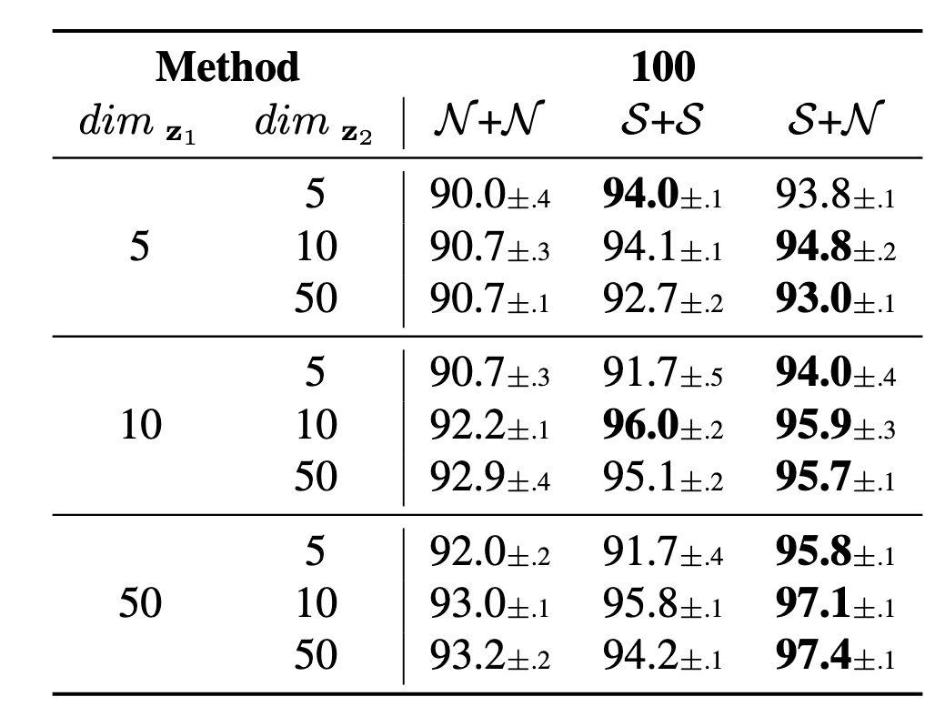
Exp3: Semi-supervised learning for a classification task
Trained KNN clf on the latent space of a learned M1 VAE on MNSIT
Conclusion:
N+N < S+S
S+S < S+N

Slide 23
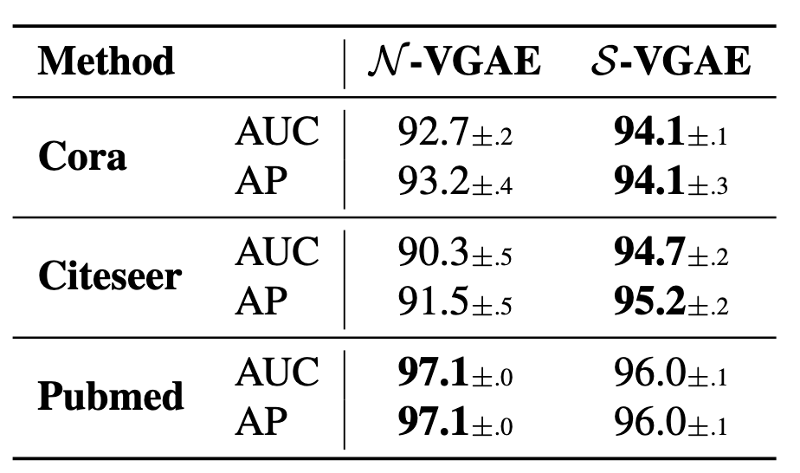
Exp4: Graph link prediction task
Link prediction task on three popular citation network datasets: Cora, Citeseer and Pubmed
Trains VGAE in an unsupervised fashion on a masked version of these datasets where some of the links have been removed
The log-probability of a link is computed as the dot product of two embeddings

Slide 24
Exp4: Graph link prediction task
Conclusion:
Shows advantage of learning embs. in non-Euclidean space
S-VAE is better for Cora and Citeseer, but not for Pubmed:
The Pubmed dataset is significantly larger and hence more complex
N -VAE has a larger number of variance parameters for the posterior distribution, which might have played an important role in better modeling the relation- ships between nodes.
Further hypothesize that not all graphs are necessarily better embedded in a hyperspherical space and that this depends on some fundamental topological properties of the graph

Slide 25
Conclusion
Important problem: Questions Gaussians dist. prior on latent space
Proposes vMF distribution on latent space and derive ELBO grad equation
Hit and trial for finding the right prior for latent space
Comments:
Sign of life: the method works for toy and small datasets
Only works for small dim prior on latent space
Doesn’t work for complex dataset like Pubmed yet
Would have been interesting to see just Reinforce based results too

Slide 26
Thanks!

Slide 27
