Slide 1


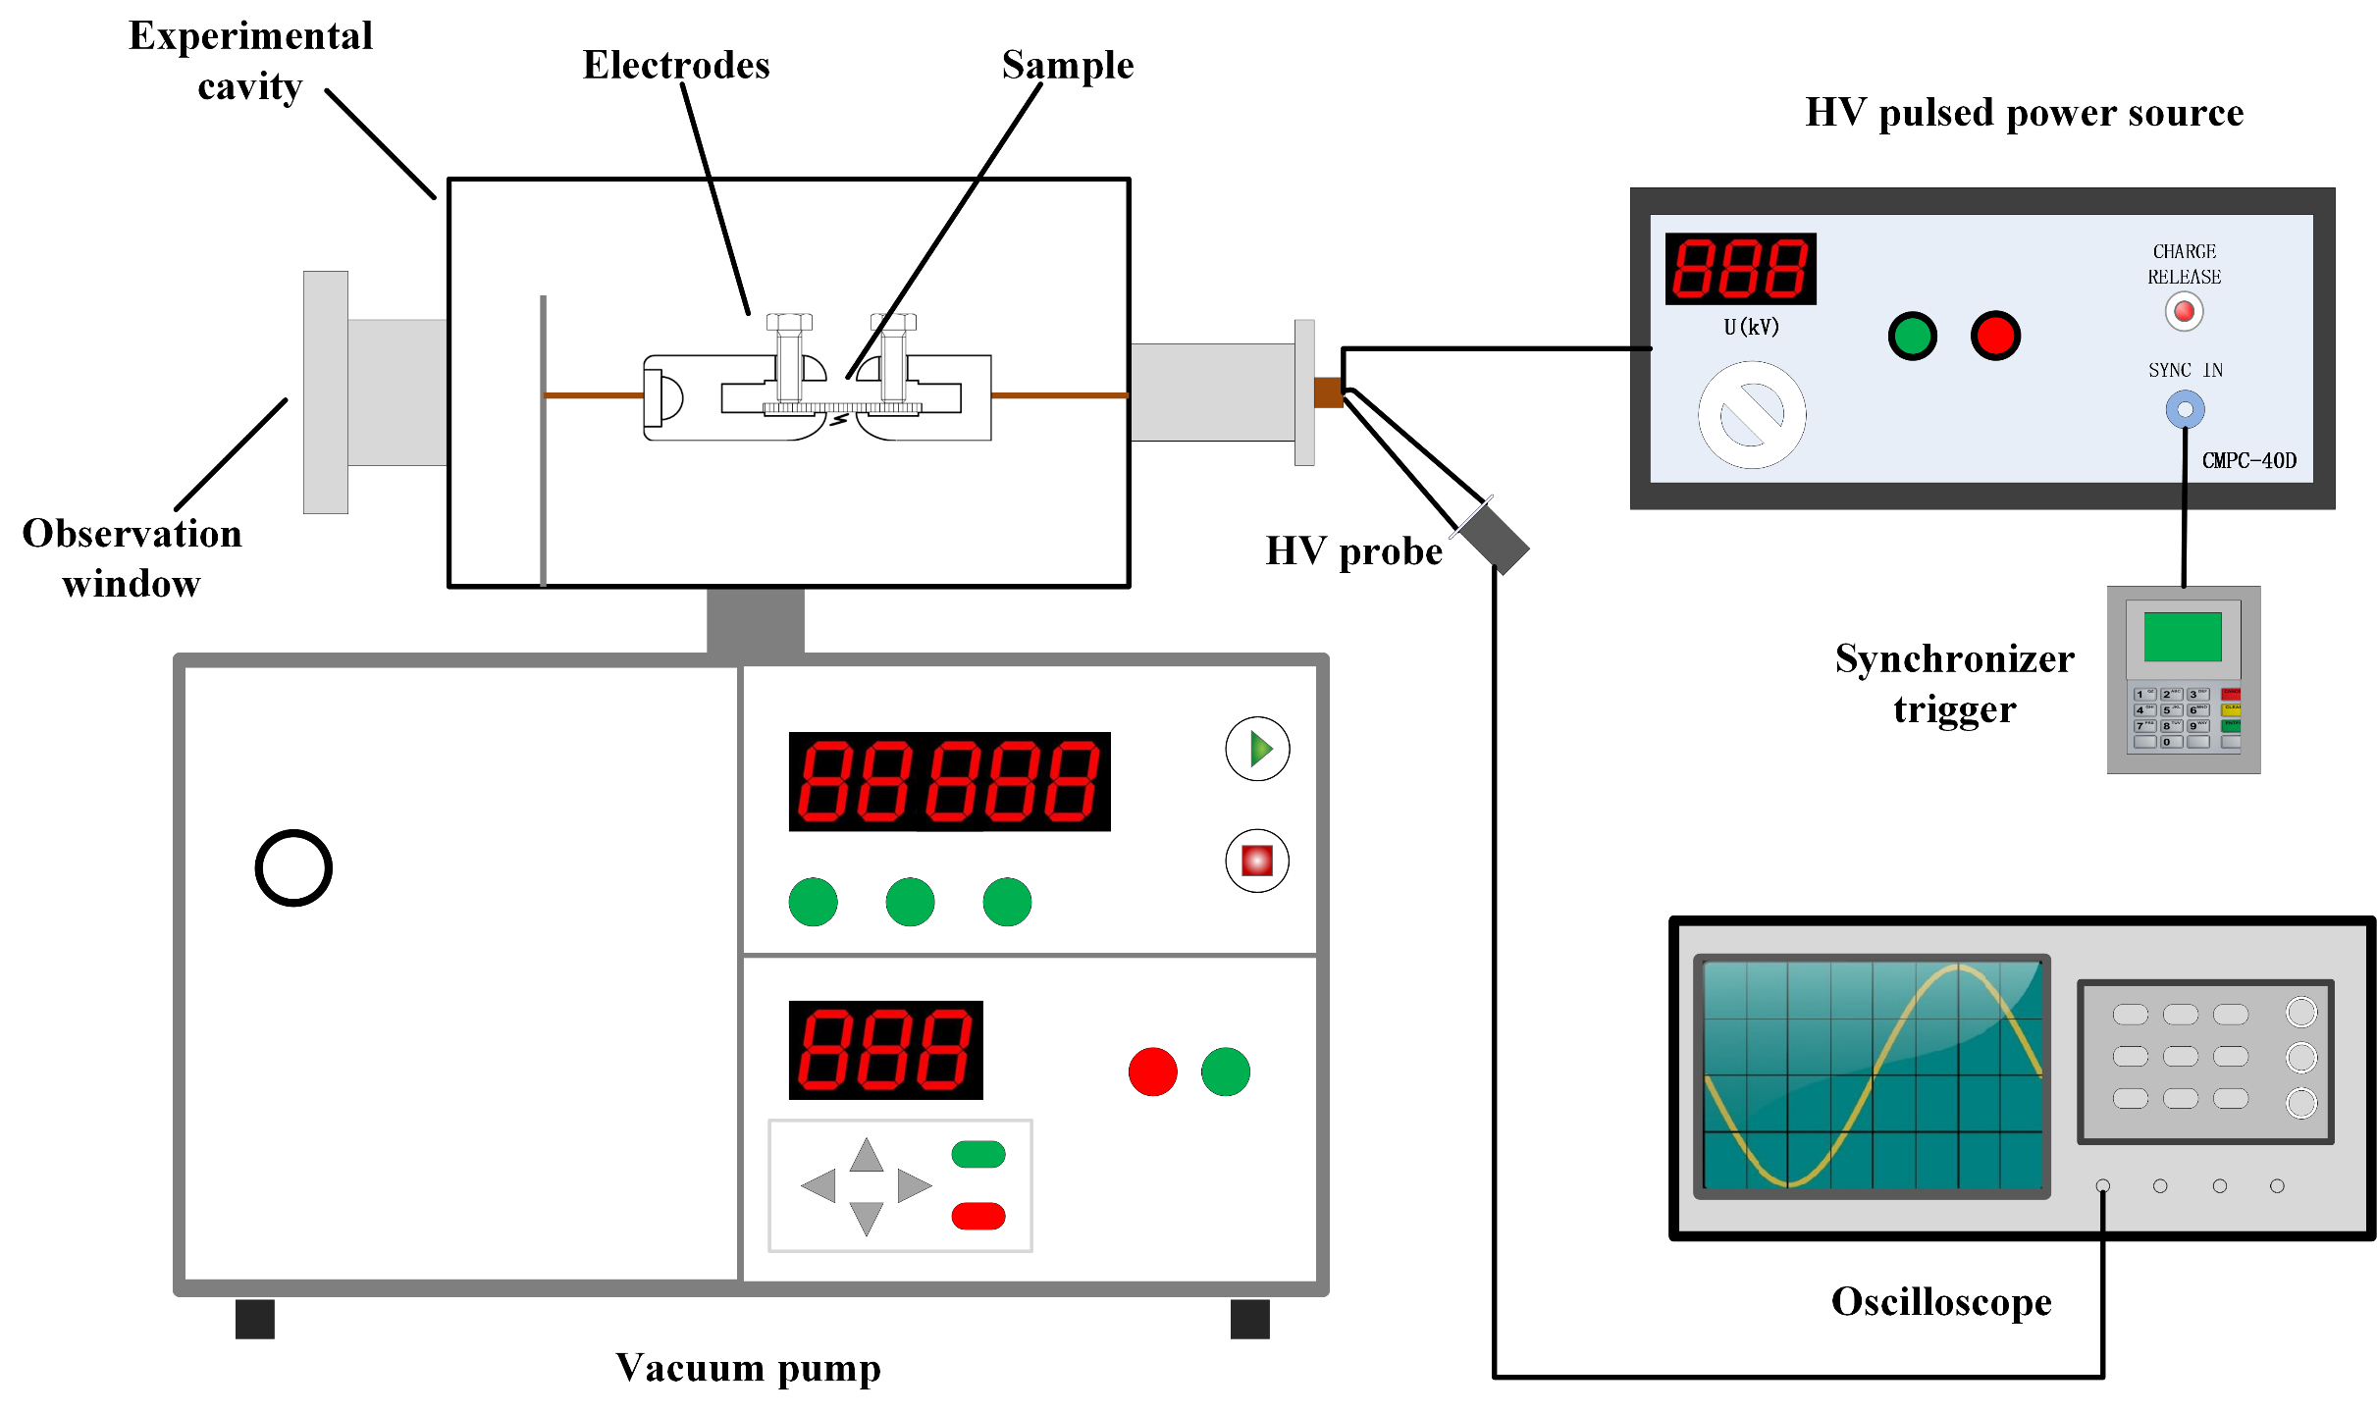
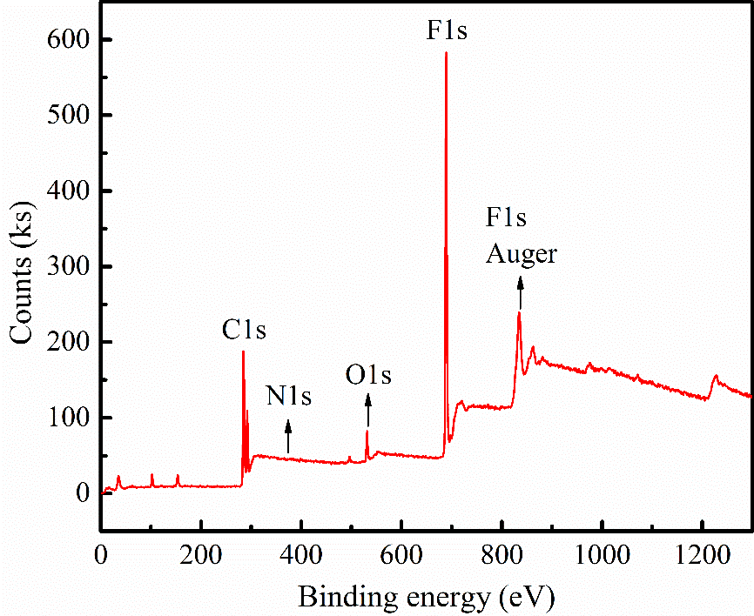
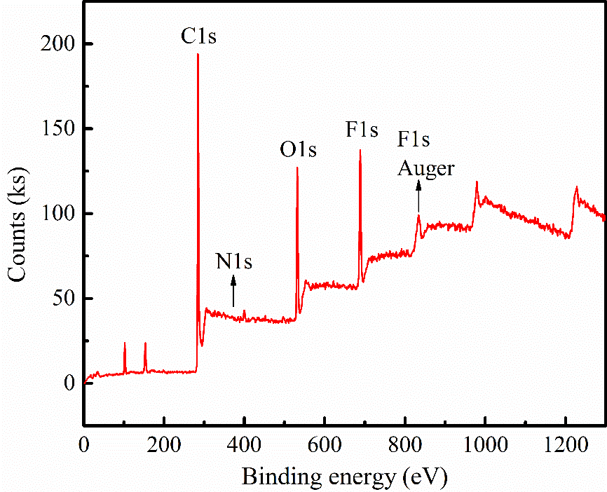
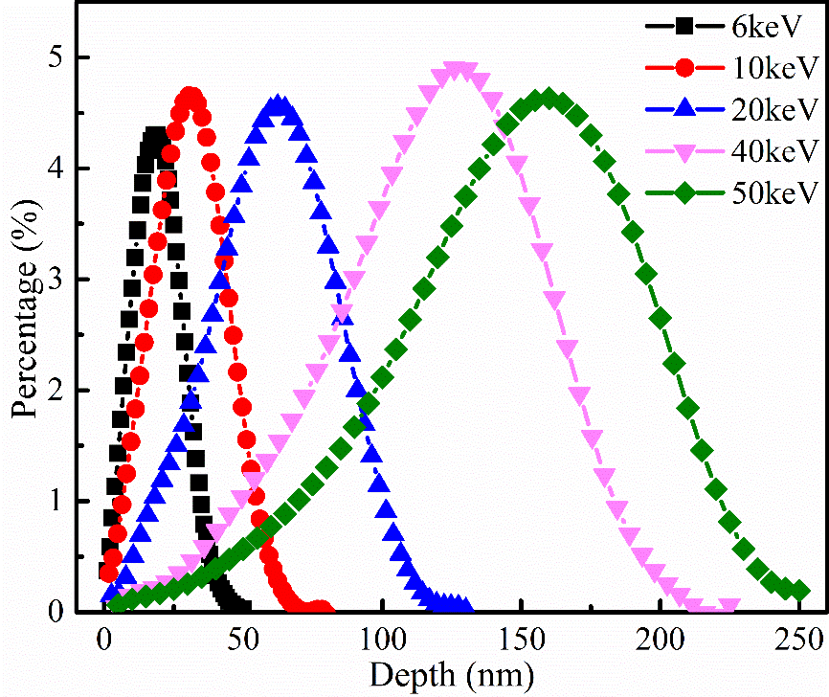
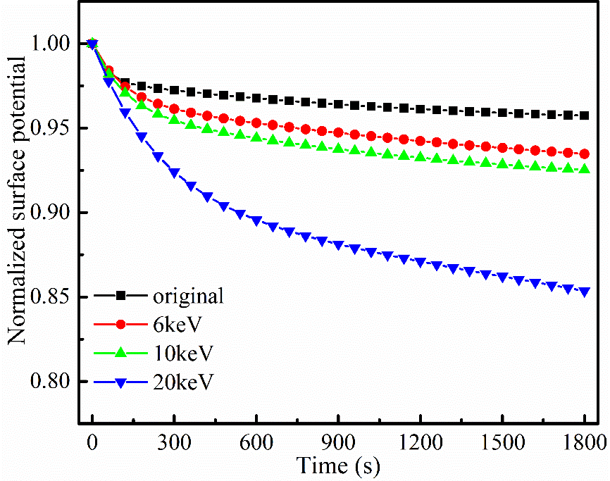
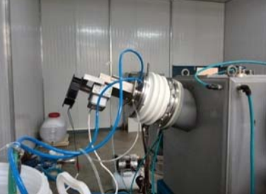
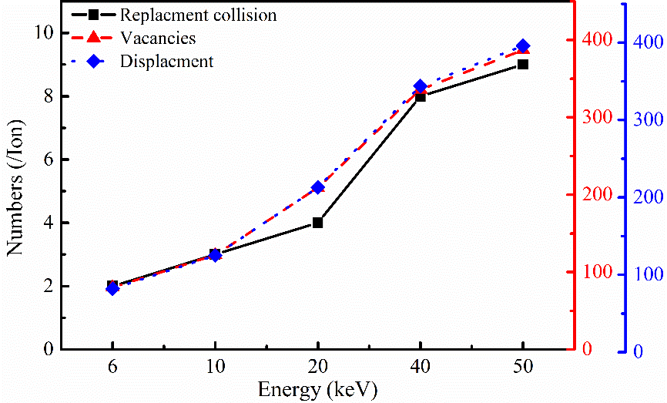
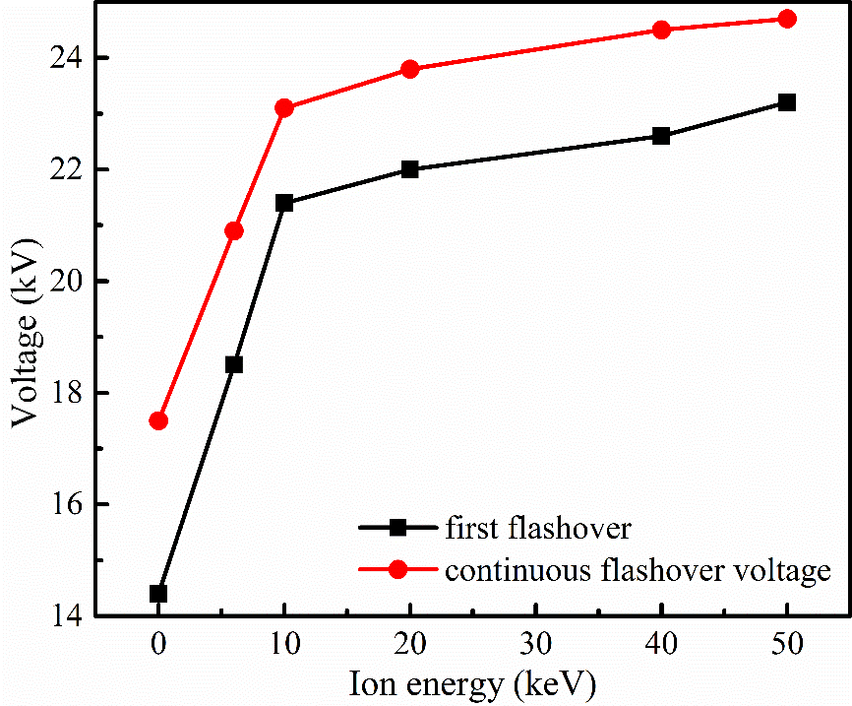
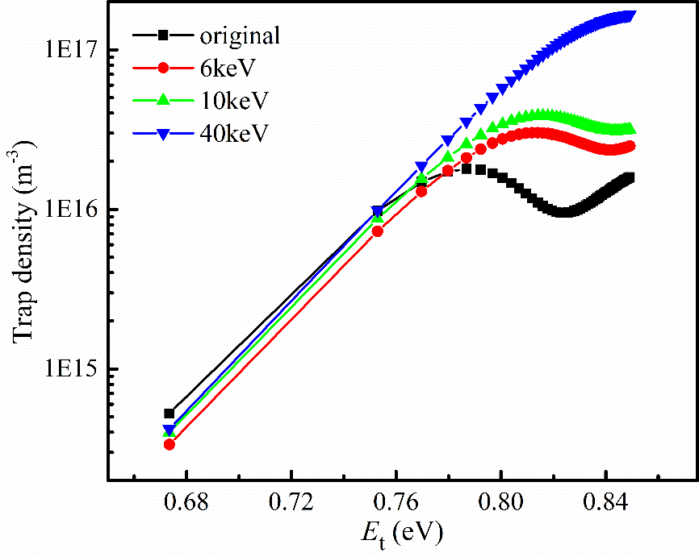
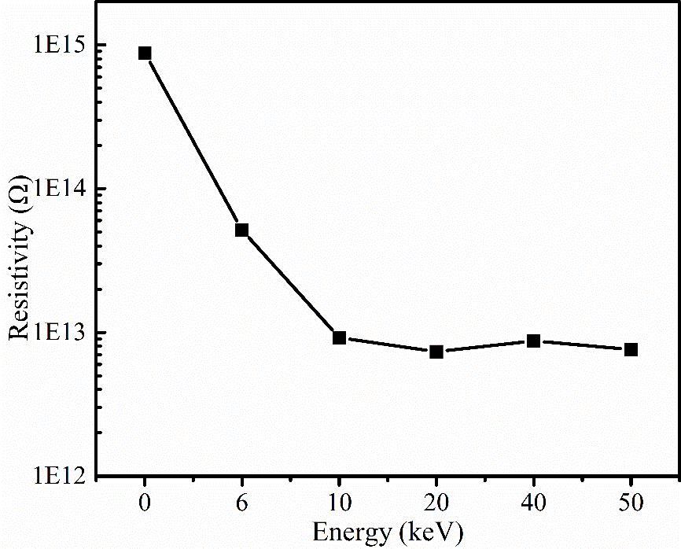
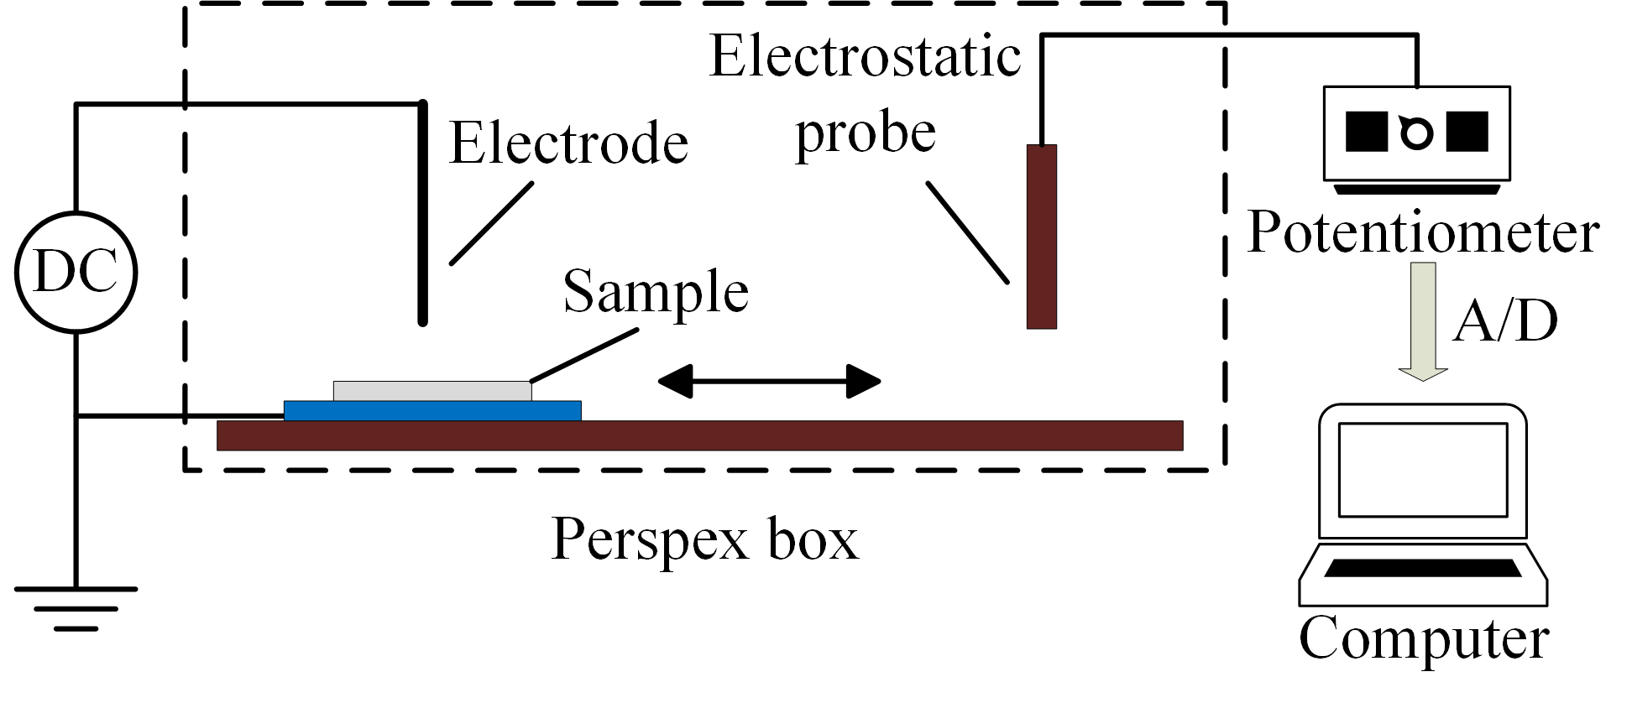
No#420
Study on Surface Flashover Properties of PTFE by Ion Implantation
21th IEEE International Pulsed Power Conference, Brighton, UK June 18–22, 2017
Weikang Zhao^{1,2,3}, Rong Xu^{1,3}, Chengyan Ren^{1,3}, Jue Wang^{1,3}, Ping Yan^{1,3}
¹ Institute of Electrical Engineering, Chinese Academy of Science
² University of Chinese Academy of Sciences
³Key Laboratory of Power Electronics and Electric Drives, Chinese Academy of Sciences Beijing 100190, China
Introduction
Surface flashover across the insulators is the major limitation of the performance for the high voltage system.
The initial velocity can be calculated by simulation of the launch process.
The surface flashover properties of PTFE modified by nitrogen ion implantation are investigated in vacuum.
Simulation
(a) original sample
(b) modified sample
XPS analysis spectrum
Experimental setup
Sample preparation
Measurements
Surface flashover system
The properties of PTFE samples before and after N ion implantation are analyzed with XPS spectroscopy, megger, surface potential measurement system and surface flashover system.
Distribution of different energy ions in depth direction
Experimental results
Decay curves of surface potential under
different ion energy
Nitrogen ion implantation system
Sample is PTFE with a thickness of 5 mm and an area of 30 mm×50 mm.
The injection time is 1 hour. And the injection energies are 6 keV, 10 keV, 20 keV, 40 keV and 50 keV, with the incident angle of 90°.
Relationship between material damage and
injection energy
Variation of surface flashover voltage with implanted energy of ion beam
Conclusion
After N ion implantation, the flashover voltage of PTFE increases remarkably. And the stability of flashover is also improved.
The flashover voltage of PTFE increases with the increase of the injection energy.
The decrease of surface resistivity and the increase of trap energy and its density caused by ion implantation are main reasons for the improvement of the PTFE’s flashover characteristics.
Surface trap density distribution of samples
The continuous flashover voltage of PTFE increases about 41% implanted by N ion.
The surface resistivity decrease by two orders of magnitude after ion implantation.
Surface trap density and energy increase with N ion implantation.
Surface potential measurement system
Relation between resistivity of PTFE and ion energy
*Contact: Weikang Zhao, Institute of Electrical Engineering, CAS, Beijing China 100190 Email: zhaoweikang@mail.iee.ac.cn

