Slide 1
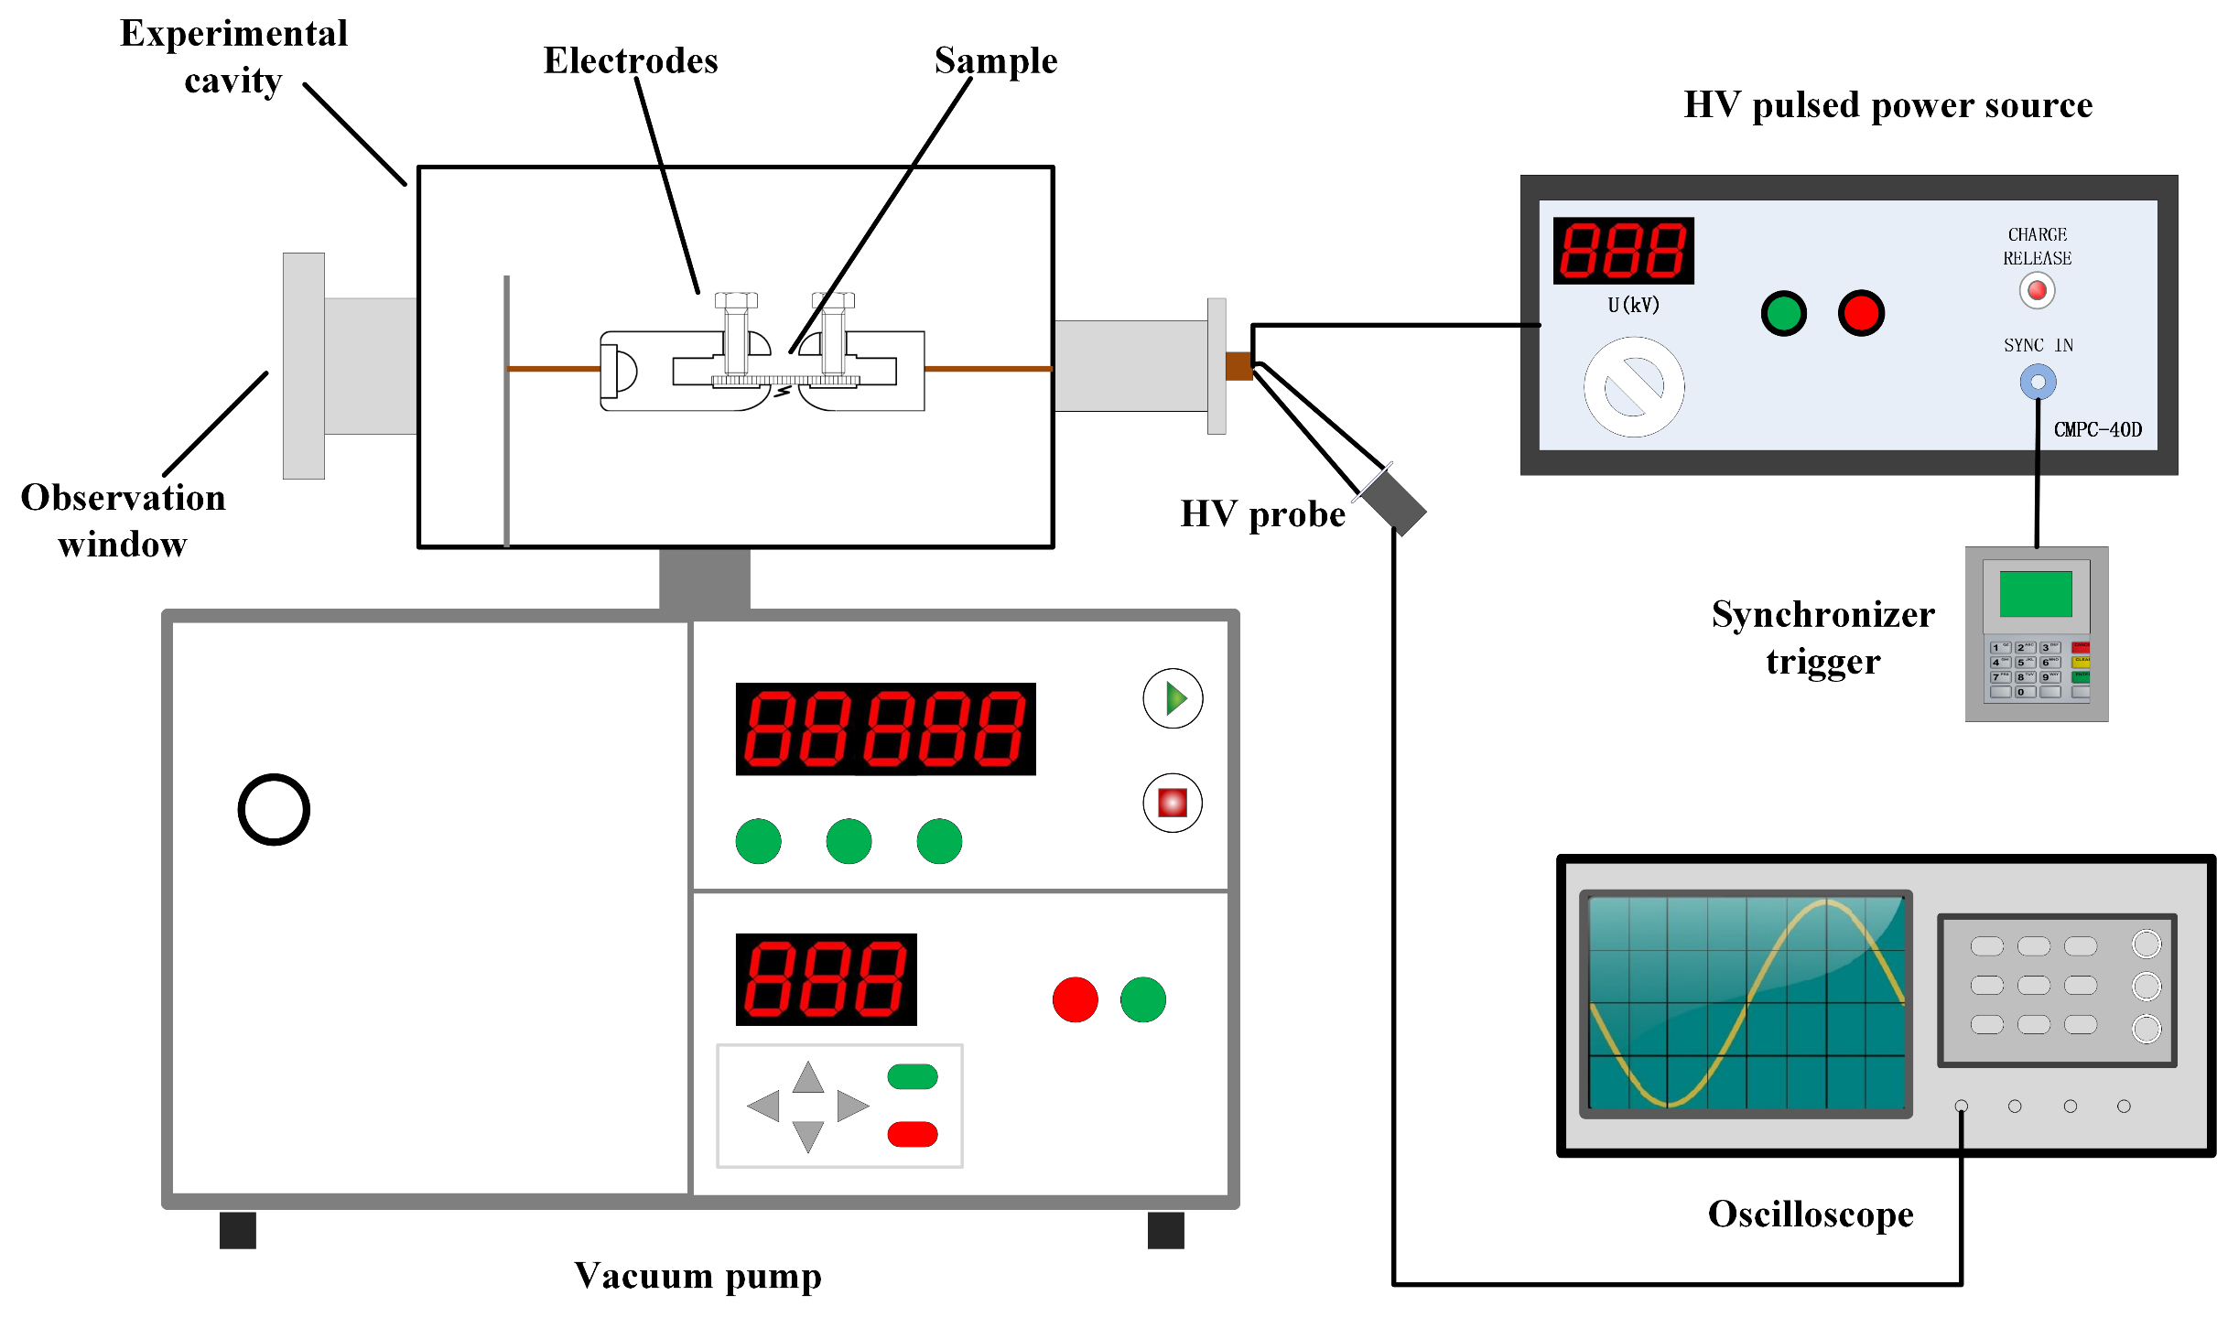


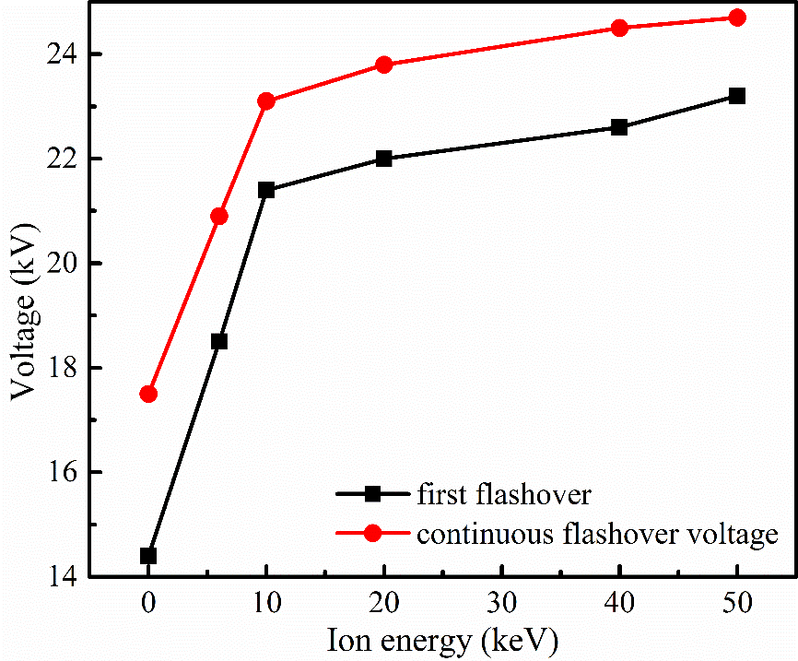






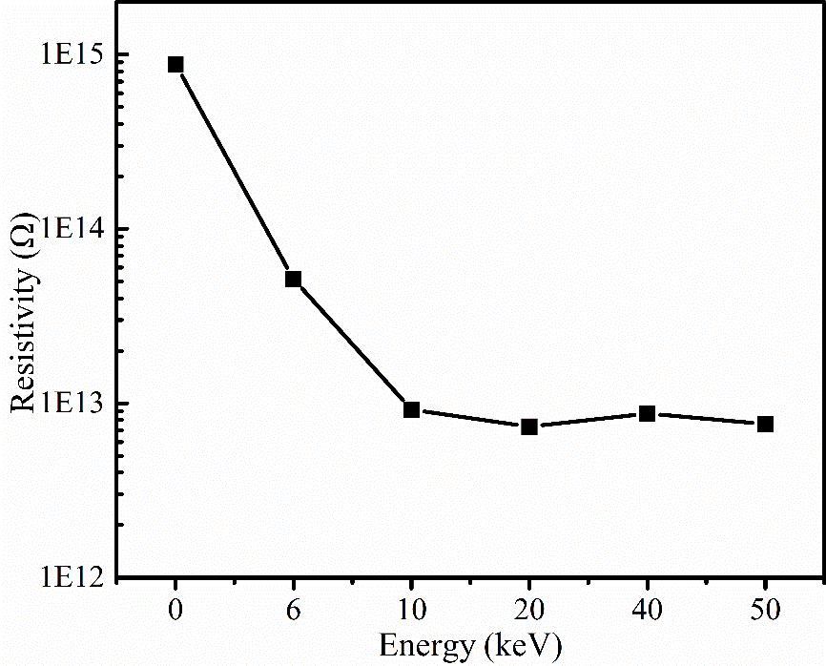



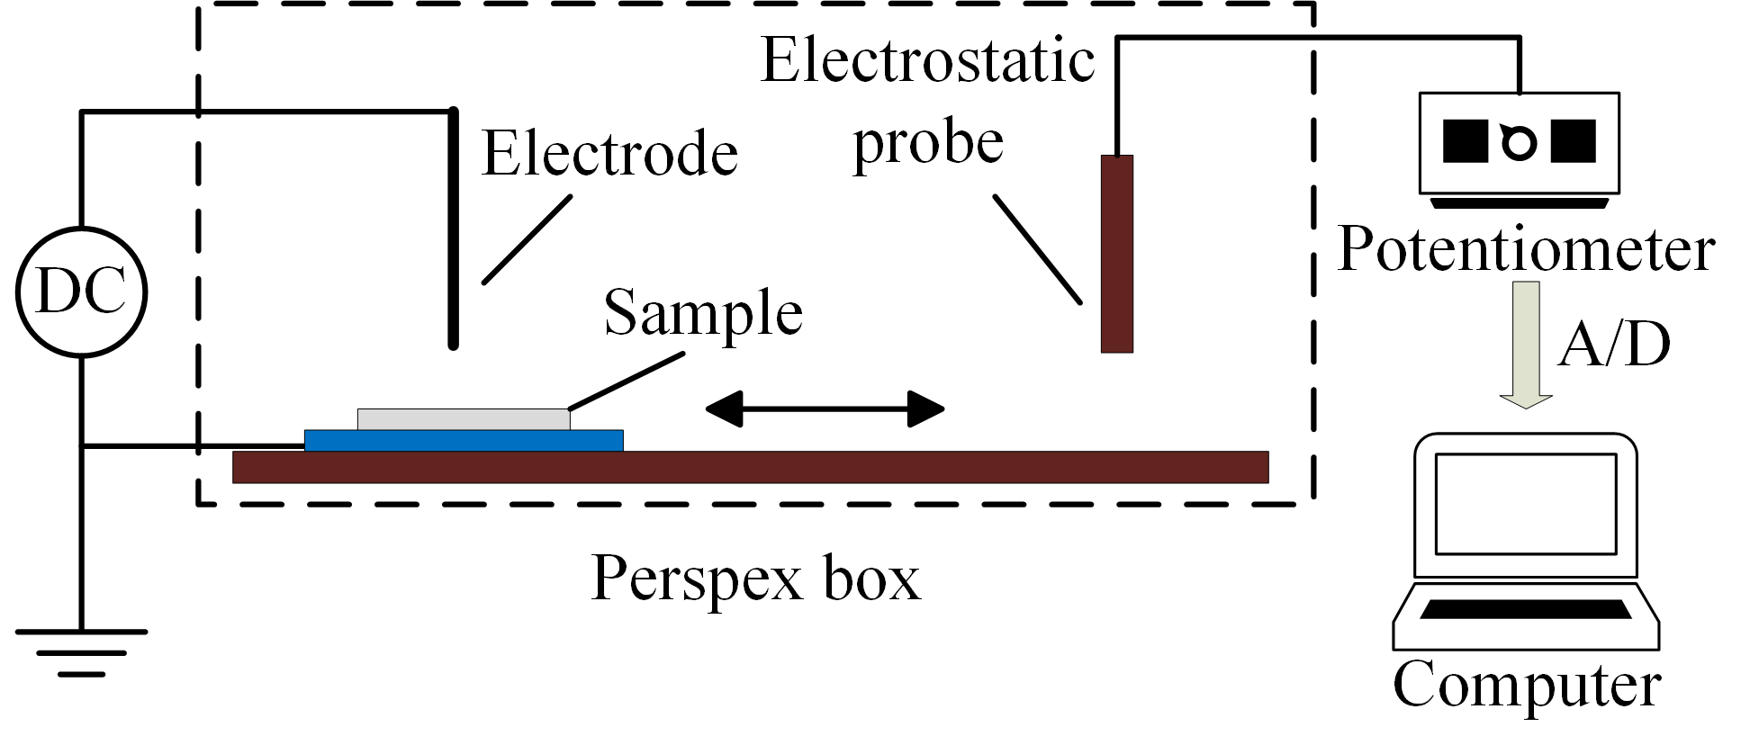
No#104
21th IEEE International Pulsed Power Conference, Brighton, UK June 18–22, 2017
Initial Velocity Prediction based on Radial Basis Function (RBF) Neural Network
Weikang Zhao^{1,2,3}, Rong Xu^{1,3}, Chengyan Ren^{1,3}, Jue Wang^{1,3}, Ping Yan^{1,3}
¹ Institute of Electrical Engineering, Chinese Academy of Science
² University of Chinese Academy of Sciences
³Key Laboratory of Power Electronics and Electric Drives, Chinese Academy of Sciences Beijing 100190, China
Introduction
Precise speed control through current is the advantage of EML over the traditional emission method. It is absolutely meaningful to find a method to predict the initial velocity, as it is the basics of speed control.
The initial velocity can be calculated by simulation of the launch process while the simulation duration could be hours if more factors are considered.
A new prediction strategy based on RBF neural network is presented in this paper. The method is easy to apply and expand based on the machine learning framework. Once the model has completed training, each initial velocity prediction can be completed in constant time.
Surface flashover system
RBF Neural Network Building and Training
Sample preparation
Measurements
The properties of PTFE samples before and after N ion implantation are analyzed with XPS spectroscopy, megger, surface potential measurement system and surface flashover system.
Experimental results
The structure of the RBF neural network
Variation of surface flashover voltage with implanted energy of ion beam
The first layer is the input layer. An input vector x is used as input to all radial basis functions.
The second layer is the hidden layer with a non-linear RBF activation function, and the function is commonly taken to be Gaussian.
We’ve got the data set including the mass of the armature, , the acceleration distance, the current time integration and the initial velocity through a simulation system, the accuracy of which has been verified experimentally.
We take as input feature vector and the initial velocity as target variable.
The input of RBF neural network is a 400*3 matrix and the output is a 400*1 matrix and a model predicting initial velocity is obtained.
Relation between resistivity of PTFE and ion energy
Surface potential measurement system
*Contact: Nan Hu, Institute of Electrical Engineering, CAS, Beijing China 100190 Email: hunan@mail.iee.ac.cn

Slide 2


