Slide 1




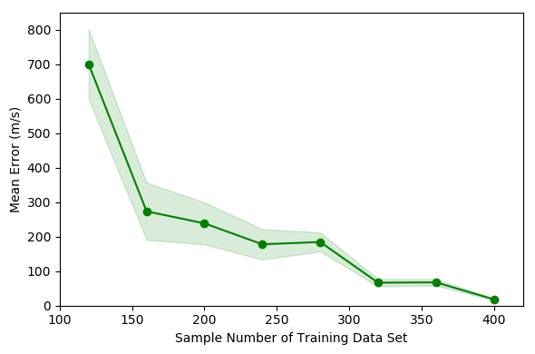




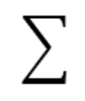

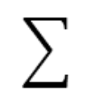

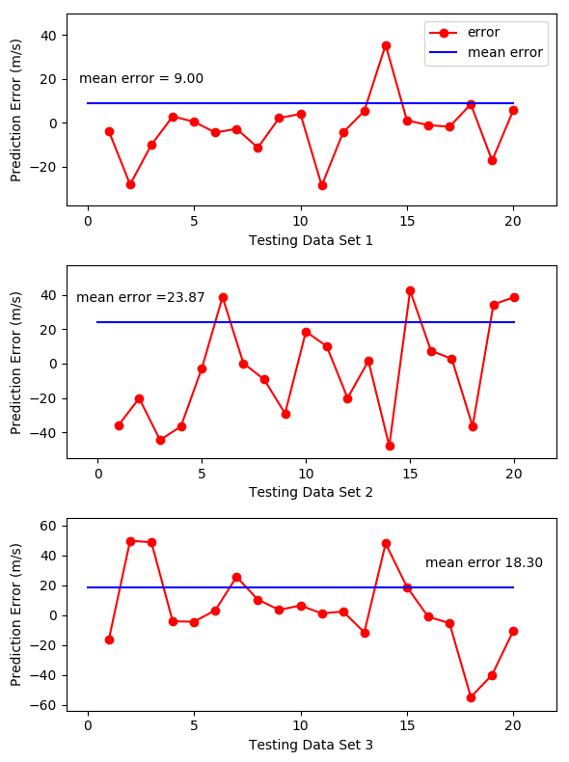
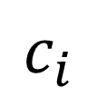

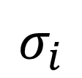
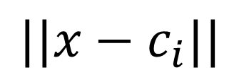
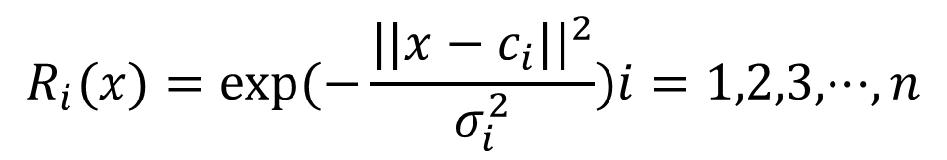
No#104
21th IEEE International Pulsed Power Conference, Brighton, UK June 18–22, 2017
Initial Velocity Prediction based on Radial Basis Function (RBF) Neural Network
Nan Hu^{1,2,3}, Weiqun Yuan^{1,3}, Rong Xu^{1,3}, Ducheng Zheng^{1,2,3}, Ping Yan^{1,3}, Ying Zhao^{1,3} and Wenping Cheng^{1,3}
¹ Institute of Electrical Engineering, Chinese Academy of Science
² University of Chinese Academy of Sciences
³Key Laboratory of Power Electronics and Electric Drives, Chinese Academy of Sciences Beijing 100190, China
Introduction
Precise speed control through current is the advantage of high current linear motor over the traditional emission method. It is absolutely meaningful to find a method to predict the initial velocity, as it is the basics of speed control.
The initial velocity can be calculated by simulation of the launch process while the simulation duration could be hours if more factors are considered.
A new prediction strategy based on RBF neural network is presented in this paper. The method is easy to apply and expand based on the machine learning framework. Once the model has completed training, each initial velocity prediction can be completed in constant time.
We take as input feature vector and the initial velocity as target variable.
The input of RBF neural network is a 400*3 matrix and the output is a 400*1 matrix and a model predicting initial velocity is obtained.
Experimental results
The average error is the average of the absolute value of the error, so it is a positive number.
The shaded part is 0.1 times the standard deviation of the prediction error.
When the number of training samples reaches 400, the average prediction error on the test set reaches a minimum of 18.3 m/s, and the standard deviation is 25.76 m/s.
The optimal model has 160 hidden layer neurons and the spread of radial basis functions is 0.93
RBF Neural Network Building and Training
RBF Neural Network Building
Data Set and Model Training
Error changing with different number of training data
The structure of the RBF neural network
The first layer is the input layer. An input vector x is used as input to all radial basis functions.
The second layer is the hidden layer with a non-linear RBF activation function, and the function is commonly taken to be Gaussian.
The output of each RBF unit is as follows . In the equation, is the input vector, is the center of the ith Gaussian function, indicates the Euclidean norm on the input space, is the width of the ith RBF unit, n is the number of the neurons in the hidden layer.
The output of the network is a scalar function of the input vector
INPUT AND OUTPUT OF MODEL
Sample number | Features |  |  | Target
 | mass of the armature (g) | acceleration distance (m) | current time integration (kA·ms) | initial velocity (m/s)
1 | 9.64 | 2.47 | 209.58 | 2303.60
2 | 8.11 | 2.17 | 162.43 | 2996.28
3 | 12.54 | 2.42 | 221.11 | 3220.46
…
460 | 11.20 | 2.24 | 232.64 | 1744.46
Prediction error on 3 testing data sets
Conclusion
The maximum average error in the test is 23.87 m/s (1.12%).
Training model takes 3.6 and 2.4 seconds, the prediction of the 20 samples of the test set takes 0.3 seconds.
The use of the RBF neural network model for the prediction of the initial velocity in the high current linear motor is very accurate and efficient.
We’ve got the data set including the mass of the armature, the acceleration distance, the current time integration and the initial velocity through a simulation system, the accuracy of which has been verified experimentally.
A training set with 400 samples and 3 testing sets with 20 samples are split from the data set above.
*Contact: Nan Hu, Institute of Electrical Engineering, CAS, Beijing China 100190 Email: hunan@mail.iee.ac.cn

