Slide 1


Slide 2

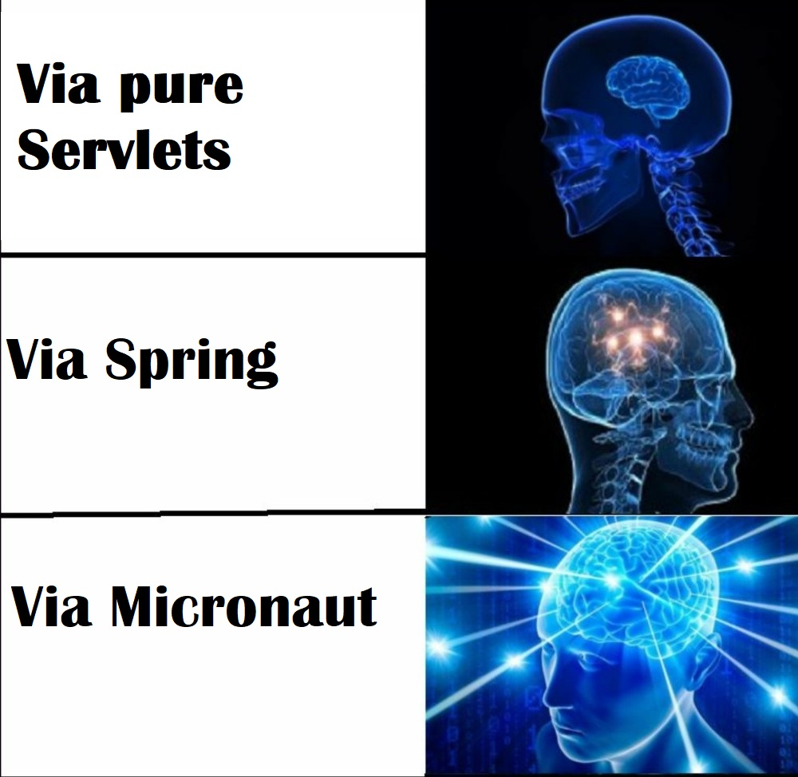
Creating Web-App

Slide 3
Why micronaut?
Ease of Installation: micronaut has its own CLI
Micronaut CLI command line interface for generating projects and services. Application generation commands are:
create-app NAME - Creates an application
create-cli-app NAME - Creates a CLI application
create-function-app NAME - Creates a Cloud Function
create-grpc-app NAME - Creates a gRPC application
create-messaging-app NAME - Creates a messaging application

Slide 4
Why micronaut?
Natively Cloud Enabled
Service discovery: Eureka, Consul or ZooKeeper service discovery servers are being supported
Kubernetes container runtime is supported by default.
Client side load balancing: Netflix Ribbon can be used for load balancing
Distributed Configuration
Distributed Tracing
Serverless functions
Circuit breaker support, Retry mechanism

Slide 5
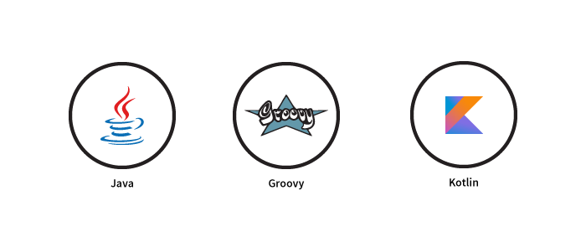
Why micronaut?
Language Support

Slide 6
Why micronaut?
Messaging Systems support
Apache Kafka
RabbitMQ
ActiveMQ

Slide 7
Why micronaut?
Security
Micronaut supports below security mechanisms by default:
Authentication Providers
Security Rules
IP Pattern Rule
Secured Annotation
Intercept URL Map
Built-In Endpoints Security
Authentication Strategies
Basic Auth
Session Authentication
JSON Web Token
Built-In Security Controllers
Retrieve the Authenticated User
Security Events

Slide 8
Why micronaut?
Management & Monitoring
Micronaut inspired from the Grails, Spring Boot and Micronauts management dependency add support to monitor your applications via endpoints, the special URIs that returns details about the state of your application and health.
Creating Endpoints
Built-In Endpoints

Slide 9
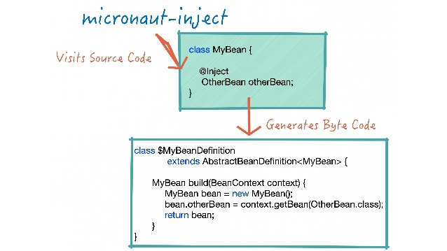
How Does DI work in MICRONAUT

Slide 10
Bean Scopes INTO MICRONAUT
Scope | Defenition
Singleton | Singleton scope indicates only one instance of the bean should exist
Context | Context scope indicates that the bean should be created at the same time as the ApplicationContext (eager initialization)
Infrastructure | Infrastructure scope represents a bean that cannot be overridden or replaced using @Replaces because it is critical to the functioning of the system.
Prototype | Prototype scope indicates that a new instance of the bean is created each time it is injected
ThreadLocal | ThreadLocal scope is a custom scope that associates a bean per thread via a ThreadLocal
Refreshable | Refreshable scope is a custom scope that allows a bean’s state to be refreshed via the /refresh endpoint.
RequestScope | RequestScope scope is a custom scope that indicates a new instance of the bean is created and associated with each HTTP request

Slide 11
Conditional beans
At times you may want a bean to load conditionally based on various potential factors including the classpath, the configuration, the presence of other beans etc.
The Requires annotation provides the ability to define one or many conditions on a bean.

Slide 12
DAO with micronaut
Micronaut also has the built-in support for the defaults that automatically allow configuring your favorite data access toolkit and the APIs to make it easy to write your own integrations.
MongoDB
Hibernate
Cassandra
Redis
Neo4j

Slide 13

JPA, Hibernate and more

Slide 14
API Versioning
Micronaut supports API versioning via a dedicated @Version annotation.
By default Micronaut has 2 out-of-the-box strategies for resolving the version that are based on an HTTP header named X-API-VERSION or a request parameter named api-version, however this is configurable.

Slide 15
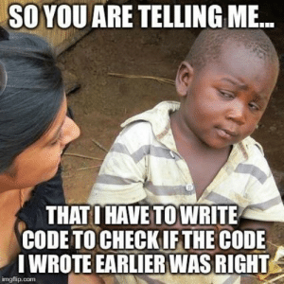
Testing into micronaut

Slide 16
Testing into micronaut
Support jUnit and Mockito.
Has own MicronautTest framework, which includes a pretty simple set of extensions for JUnit 5, Spock, Kotest and KotlinTest:
Automatically start and stop the server for the scope of a test suite
Use mocks to replace existing beans for the scope of a test suite
Allow dependency injection into a test instance

Slide 17
web-sockets into micronaut
Micronaut features dedicated support for creating WebSocket clients and servers. The io.micronaut.websocket.annotation package includes a set of annotations for defining both clients and servers.

Slide 18
drawbacks
Longer compilation time;
Bigger size of jar;
No possibilities to Monitoring & Management over JMS;
Not compatible with all frameworks that use reflection under the hood;
Not convenient error handling.

Slide 19
MICRONAUT VS QUARKUS
Property | Micronaut | Quarkus
First commit | 2017-03-16 | 2018-06-22
Supported languages | Java, Groovy, Kotlin | Java, Scala, Kotlin
Build Tools | Gradle, Maven | Gradle, Maven
Bootstrap phases | Compilation - Runtime | Augmentation – Static init – Runtime init
Test against native image | No | @SubstrateTest
Computability with Spring Cloud Config | Yes | No
Bean validation | Via Introspection | Via Reflection

Slide 20
Q&A
You are welcome to ask any questions related this topic.

Slide 21
USEFUL LINKS
https://docs.micronaut.io/latest/guide/index.htm Micronaut documentation
https://micronaut-projects.github.io/micronaut-starter/latest/guide/ Micronaut CLI documentation
https://micronaut-projects.github.io/micronaut-test/latest/guide/ MicronautTest framework documentation

Slide 22
Дзякуй за ўВАГУ
Да пабачэння!

