Slide 1
Multimedia Authoring Tools

Slide 2
An authoring system is a program which has pre-programmed elements for the development of interactive multimedia presentations.
Authoring tools provide an integrated environment for binding together the different elements of a Multimedia production.
Multimedia Authoring Tools provide tools for making a complete multimedia presentation where users usually have a lot of interactive controls.

Slide 3
Multimedia presentations can be created using:
¸ simple presentation packages such as PowerPoint
¸ powerful RAD tools such as Delphi, .Net, JBuilder;
¸ true Authoring environments, which lie somewhere in between in terms of technical complexity.

Slide 4
Authoring systems vary widely in:
¸ Orientation
¸ Capabilities, and
¸ Learning curve

Slide 5
Authoring Vs Programming
There is big distinction between authoring and programming.
Authoring | Programming
Assembly of multimedia | Involves low level assembly of multimedia
High level graphical interface design | Construction and control of multimedia
Some high level scripting e.g. lingo, ActionScript | Involves real languages like C and Java

Slide 6
Characteristics of Authoring Tools
¸ integrate text, graphics, video, and audio to create a single multimedia presentation
¸ control interactivity by the use of menus, buttons, hotspots, hot objects etc.
¸ publish as a presentation or a self-running executable; on flash, Intranet, WWW
¸ be extended through the use of pre-built or externally supplied components, plug-ins etc
¸ let you create highly efficient, integrated workflow
¸ have a large user base.

Slide 7
Multimedia Authoring Paradigms
The authoring paradigm, or authoring metaphor, is the methodology by which the authoring system accomplishes its task.
¸ Scripting Language
¸ Icon-Based Control Authoring Tool
¸ Card and Page Based Authoring Tool
¸ Time Based Authoring Tool
¸ Tagging Tools

Slide 8
Scripting Language
Closest in form to traditional programming.
The paradigm is that of a programming language, which specifies:
– multimedia elements,
– sequencing of media elements,
– hotspots (e.g links to other pages),
– synchronization, etc.
Usually use a powerful, object-oriented scripting language
Multimedia elements and events become objects that live in a hierarchical order
Most authoring tools provide visually programmable interface in addition to scripting language

Slide 9
…Scripting Language
Examples
The Apple’s HyperTalk for HyperCard,
Asymetrix’s OpenScript for ToolBook and
Lingo scripting language for Macromedia Director
ActionScript for Macromedia Flash

Slide 10
Iconic/Flow Control Tools
multimedia elements and interaction cues (or events) are organized as objects in a structural framework.
Provides visual programming approach to organizing and presenting multimedia
The core of the paradigm is the icon palette. You build a structure and flowchart of events, tasks, and decisions by dragging appropriate icons from icon palette library.
These icons are used to represent and include menu choice, graphic images, sounds, computations, video, etc.

Slide 11
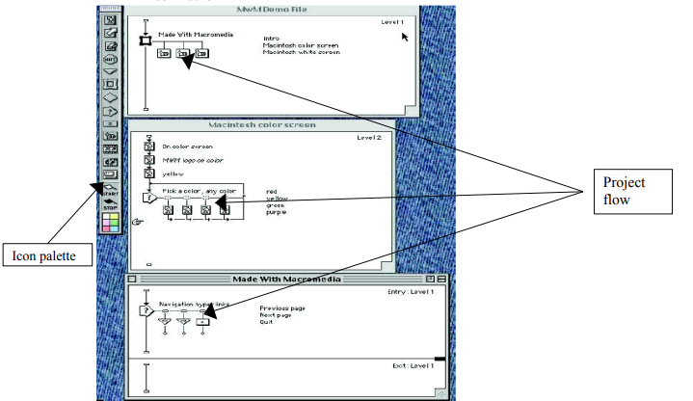
… Iconic/Flow Control Tools
Authorware
IconAuthor

Slide 12
Card and page Based Tools
elements are organized as pages of a book or a stack of cards.
The authoring system lets you link these pages or cards into organized sequences. You can jump, on command, to any page you wish in a structured navigation pattern.
Well suited for Hypertext applications, and especially suited for navigation intensive applications.
Extensible via XCMDs (External Command) and DLLs (Dynamic Link Libraries).
Each object may contain programming script that is activated when an event occurs.

Slide 13
… Card and page Based Tools
HyperCard (Macintosh)
SuperCard(Macintosh)
ToolBook (Windows), etc.

Slide 14
Time Based Authoring Tools
In these authoring systems elements are organized along a time line with resolutions as high as 1/30th second.
Sequentially organized graphic frames are played back at a speed set by developer.
Other elements, such as audio events, can be triggered at a given time or location in the sequence of events.
Are the most popular multimedia authoring tool.
They are best suited for applications that have a message with beginning and end, animation intensive pages, or synchronized media application.
Examples: Macromedia Director, Macromedia Flash, Adobe AffterEffect

Slide 15
Tagging
Tags in text files (e.g. HTML) to:
¸ link to pages,
¸ provide interactivity, and
¸ Integrate multimedia elements.
Examples:
• SGML/HTML
• SMIL (Synchronized Media Integration Language)
• VRML
• 3DML
Most of them are displayed in web browsers using plug-ins or the browser itself can understand them

Slide 16
Selecting Authoring Tools
Editing Feature:
The more editors in your authoring system, the less specialized editing tools you need.
2) Organizing feature:
involves navigation diagrams, or flow charts, etc.
Some authoring tools provides a visual flowcharting facility. Such features help you for organizing the project. e.g IconAuthor, and AuthorWare use flowcharting and navigation diagram method to organize media

Slide 17
… Selecting Authoring Tools
3) Programming feature
i) Visual programming:
ii) Programming with scripting language:
iii) Programming with traditional language such as Basic or C
Some authoring tools allow to call DLL (Dynamic Link Library).
iv) Document development tools
4) Cross platform feature:
multimedia projects should be compatible with different platform like Macintosh, Windows, etc.

Slide 18
… Selecting Authoring Tools
5) Internet playability:
web is significant delivery medium for multimedia. Authoring tools typically provide facility so that output can be delivered in HTML or DHTML format.
6) Ease of learning: is it easy to learn? The designer should not waste much time learning how to use it. Is it easy to use?

