Slide 1
Data Representations

Slide 2
Data Representations
Graphic/Image Data Representation

Slide 3
Graphic/Image Data Representation
An image could be described as two-dimensional array of points where every point is allocated its own color.
Every such single point is called pixel, short form of picture element.
Image is a collection of these points that are colored in such a way that they produce meaningful information/data.
Pixel (picture element) contains the color or hue and relative brightness of that point in the image.
The number of pixels in the image determines the resolution of the image.

Slide 4
… Graphic/Image Data Representation
The number of pixels determines the quality of the image →image resolution.
Higher resolution always yields better quality.
Bitmap resolution most graphics applications let you create bitmaps up to 300 dots per inch (dpi).
A bit-map representation stores the graphic/image data in the same manner that the computer monitor contents are stored in video memory
Most graphic/image formats incorporate compression because of the large size of the data.

Slide 5
Types of images
There are two basic forms of computer graphics:
bit-maps & vector graphics
Bitmap formats are the ones used for digital photographs. Vector formats are used only for line drawings

Slide 6
Bit-map images (aka Raster Graphics)
They are formed from pixels—a matrix of dots with different colors.
Bitmap images are defined by their dimension in pixels as well as by the number of colors they represent.
For example, a 640X480 image contains 640 pixels and 480 pixels in horizontal and vertical direction respectively.
Each of the small pixels can be a shade of gray or a color.

Slide 7
… Bit-map images
To edit or modify bitmapped images you use a paint program.
Bitmap images are widely used but they suffer from a few unavoidable problems.
They must be printed or displayed at a size determined by the number of pixels in the image.
Bitmap images also have large file sizes that are determined by the image’s dimensions in pixels and its color depth.
To reduce this problem, some graphic formats such as GIF and JPEG are used to store images in compressed format.

Slide 8
Vector graphics
They are really just a list of graphical objects such as lines, rectangles, ellipses, arcs, or curves—called primitives.
Draw programs, also called vector graphics programs, are used to create and edit these vector graphics.
This format is widely used by computer-aided design programs to create detailed engineering and design drawings.
It is also used in multimedia when 3D animation is desired.

Slide 9
… Vector graphics
Draw programs have a number of advantages over paint-type programs.
¸ Precise control over lines and colors.
¸ Ability to skew and rotate objects to see them from different angles or add perspective.
¸ Ability to scale objects to any size to fit the available space. Vector graphics always print at the best resolution of the printer you use, no matter what size you make them.
¸ Color blends and shadings can be easily changed.
¸ Text can be wrapped around objects.

Slide 10
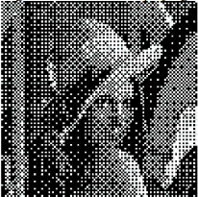
Types of Raster Images
Monochrome/Bit-Map Images
Each pixel is stored as a single bit (0 or 1)
The value of the bit indicates whether it is light or dark
A 640 x 480 monochrome image requires 37.5 KB of storage.
Dithering is often used for displaying monochrome images.

Slide 11
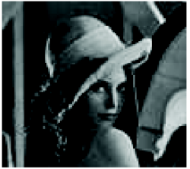
Types of Raster Images
Gray-scale Images
Each pixel is usually stored as a byte (value between 0 to 255)
This value indicates the degree of brightness of that point. This brightness goes from black to white
A 640 x 480 grayscale image requires over 300 KB of storage.

Slide 12
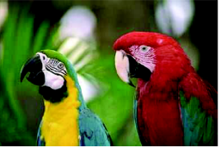
Types of Raster Images
8-bit Color Images
One byte for each pixel
Supports 256 out of the millions possible, acceptable color quality ¸ Requires Color Look-Up Tables (LUTs)
A 640 x 480 8-bit color image requires 307.2 KB of storage (the same as 8-bit greyscale)
Examples: GIF

Slide 13
Types of Raster Images
24-bit Color Images
Each pixel is represented by three bytes (e.g., RGB)
Supports 256 x 256 x 256 possible combined colors (16,777,216)
A 640 x 480 24-bit color image would require 921.6 KB of storage
Most 24-bit images are 32-bit images
The extra byte of data for each pixel is used to store an alpha value representing special effect information

Slide 14
Image Resolution
Image resolution refers to the spacing of pixels in an image and is measured in pixels per inch, ppi, sometimes called dots per inch, dpi.
The higher the resolution, the more pixels in the image.
A printed image that has a low resolution may look pixelated or made
up of small squares, with jagged edges and without smoothness.
Image size refers to the physical dimensions of an image.

Slide 15
Popular Image File Formats
Choosing the right file type for your image to save in is of vital importance.
To choose file type:
resulting size of the image → large file size or small
quality of image possible by the file type
portability of file across different platforms
Types of image file formats
[Raw image format]
Standard System Independent Formats
System Dependent Formats

Slide 16
… Popular Image File Formats
Standard System Independent Formats
GIF - Graphics Interchange Format
initially for transmitting graphical images over phone lines via modems.
Uses the Lempel-Ziv Welch algorithm (a form of Huffman Coding), modified slightly for image scan line packets (line grouping of pixels).
Limited to only 8-bit (256) color images, suitable for images with few distinctive colors (e.g., graphics drawing).
Supports one-dimensional interlacing.
Supports animation—multiple pictures per file (animated GIF)
GIFs allow single-bit transparency

Slide 17
… Popular Image File Formats
… Standard System Independent Formats
PNG - Portable Network Graphics
It is intended as a replacement for GIF in the WWW and image editing tools
GIF uses LZW compression
One version of PNG, PNG-8, is similar to the GIF format.
It can be saved with a maximum of 256 colors and supports 1-bit transparency
PNG-24 is another version of PNG, with 24-bit color support, allowing ranges of color to a high color JPG.
However, PNG-24 is in no way a replacement format for JPG, because it is a loss-less compression format which results in large file size.
Supports interlacing
PNG can be animated through the MNG extension of the format, but browser support is less for this format.

Slide 18
… Popular Image File Formats
… Standard System Independent Formats
JPEG/JPG - Photographic image compression
Created by the Joint Photographic Experts Group
Intended for encoding and compression of photographs and similar images.
Takes advantage of limitations in the human vision system to achieve high rates of compression.
Uses complex lossy compression which allows user to set the desired level of quality (compression).
. A compression setting of about 60% will result in the optimum balance of quality and file size.
Though JPGs can be interlaced, they do not support animation and transparency unlike GIF.

Slide 19
… Popular Image File Formats
… Standard System Independent Formats
TIFF - Tagged Image File Format
Stores many different types of images (e.g., monochrome, grayscale, 8-bit & 24-bit RGB, etc.)
Uses tags, keywords defining the characteristics of the image that is included in the file.
For example, a picture 320 by 240 pixels would include a 'width' tag followed by the number '320' and a 'depth' tag followed by the number '240’.
Developed by the Aldus Corp. in the 1980’s and later supported by the Microsoft.
TIFF is a lossless format.
Do not use TIFF for web images. They produce big files, and more importantly, not all web browsers will not display TIFFs.

Slide 20
… Popular Image File Formats
System Dependent Formats
Microsoft Windows: BMP
A system standard graphics file format for Microsoft Windows.
Used in Many PC Graphics programs.
It is capable of storing 24-bit bitmap images.

Slide 21
… Popular Image File Formats
… System Dependent Formats
Macintosh: PAINT and PICT
PAINT was originally used in MacPaint program, initially only for 1-bit monochrome images.
PICT is a file format that was developed by Apple Computer in 1984 as the native format for Macintosh graphics.
The PICT format is a meta-format that can be used for both bitmap images and vector images though it was originally used in MacDraw (a vector based drawing program).

Slide 22
Data Representations
Digital Audio and MIDI

Slide 23
What is Sound?
How sound is generated and perceived?

Slide 24
How to Record and Play Digital Audio
In order to play digital audio, you need a card with a Digital To Analog Converter (DAC) circuitry on it.
Most sound cards have both an ADC (Analog to Digital Converter) and a DAC so that the card can both record and play digital audio.
First, to record digital audio, you need a card which has an Analog to Digital Converter (ADC) circuitry.
The ADC is attached to the Line In (and Mic In) jack of your audio card, and converts the incoming analog audio to a digital signal

Slide 25
Digitizing Sound
Microphone produces analog signal
Computers understands only discrete(digital) entities
This creates a need to convert Analog audio to Digital audio — specialized hardware. (This is also known as Sampling)

Slide 26
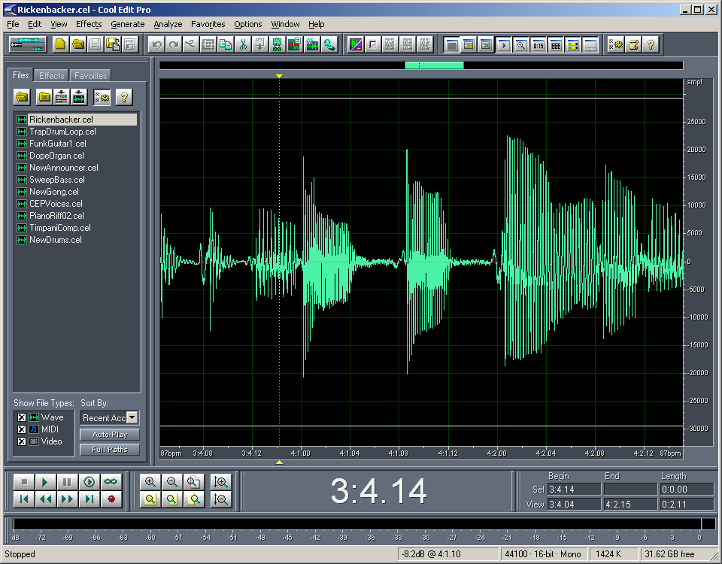
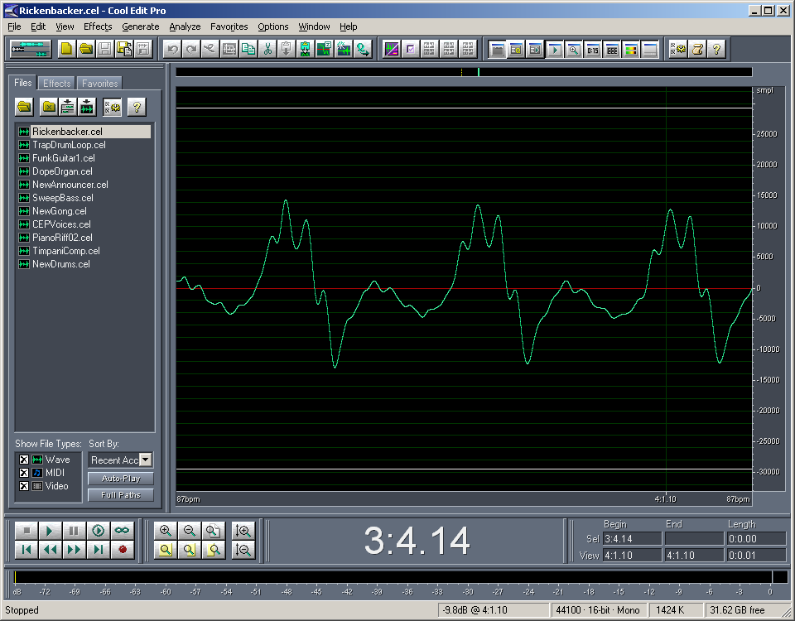
Sampling and Quantization of Audio
An Audio Signal
The rate at which a continuous wave form is sampled is called the sampling rate.

Slide 27
Sampling Audio
Any signal can be represented as the summation of sin waves.
Good sampling follows Nyquist theorem
If we have a signal with frequency components, f₁ < f₂ <…<f_{n}, what is the sampling frequency we can use?
Nyquist theorem: the necessary condition of reconstructing a continuous signal from the sampling version is that the sampling frequency is f_{s} = 2*f_{max} (where f_{max} is the highest frequency components in the signal)
Range of Human Hearing (Music): 20Hz – 20KHz
We lose high frequency response with age; Women generally have better response than men
To reproduce 20 kHz requires a sampling rate of 40 kHz
Speech (like telephony) signal frequency is 5Hz–4KHz
According to Nyquist, it would take 8,000 samples (2 times 4,000) to capture a 4,000 Hz signal perfectly.

Slide 28
Sampling Audio
Bit depth [Hz, KHz…] is the precision of the AD/DA converter for measuring amplitude or the level of the signal.
The higher the sample rate [bit] (the higher more individual measurement is taken) and bit depth, the more information is captured in the conversion process.

Slide 29
Sampling for an Audio Signal
When capturing audio covering the entire 20Hz – 20KHz range of human hearing, such as when recording music, audio wave forms are typically sampled at 44.1 KHz (CD) 48 KHz (professional audio)
Signal Period T, f = 1/T
Sampling period Ts,
fs =1/Ts
Problem: There are infinite number of possible sin waves going through the sampling points

Slide 30
Digital Audio
Music has more high frequency components than speech.
44 KHz is the sampling frequency for music.
8 kHz sampling is good enough for telephone quality speech, since all the energy is contained in the 5Hz – 4 KHz ranges.
Audio is typically recorded at 8-, 16-, and 20- bit depth. CD quality audio is recorded at 16-bit
You often hear an audio (music) which is quantized at 16 bits for each sampled data at 44 kHz.
16 bits means each sample is represented as a 16bit integer, which results in 65, 536 possible values.

Slide 31
Common Audio Formats
There are two basic types of audio files:
the traditional discrete audio file, that you can save to a hard drive or other digital storage medium,
the streaming audio file that you listen to as it downloads in real time from a network/internet server to your computer.

Slide 32
Common Audio Formats
Discrete Audio File Formats
Uncompressed
raw audio- without containerized and without compressed audio.
eg: .raw, .pcm, .sam or without any extension
Lossless
Lossy

Slide 33
Common Audio Formats
Discrete Audio File Formats
WMA
Windows Media Audio
Can handle up-to 24 bit depth and 96KHz
With both Lossless and Lossy support
If it is Lossy-WMA it is much better that MP3 (on compression)
Only windows support

Slide 34
Common Audio Formats
Discrete Audio File Formats
WAV
The WAV format is the standard audio file format for Microsoft Windows applications
It supports a variety of bit resolutions, sample rates, and channels of audio

Slide 35
Common Audio Formats
Discrete Audio File Formats
AIF/AIFF -- Audio Interchange File Format
is the standard audio format employed by computers using the Apple Macintosh operating system.
Like the WAV format, it supports a variety of bit resolutions, sample rates, and channels of audio and is widely used in software programs used to create and modify digital audio.

Slide 36
Common Audio Formats
Discrete Audio File Formats
MP3 -- Motion Picture Experts Group, Audio Layer 3 Compression.
MP3 files provide near-CD-quality sound but are only about 1/10 th as large as a standard audio CD file.
Because MP3 files are small, they can easily be transferred across the Internet and played on any multimedia computer with MP3 player software.

Slide 37
Common Audio Formats
Discrete Audio File Formats
MIDI/MID MIDI (Musical Instrument Digital Interface), is not a file format for storing or transmitting recorded sounds, but rather a set of instructions used to play electronic music on devices such as synthesizers.
MIDI files are very small compared to recorded audio file formats. However, the quality and range of MIDI tones is limited.

Slide 38
Common Audio Formats
Streaming Audio File Formats
RA/RM
ASF
MOV
MIDI

