Slide 1
SHIELD Bank Avenger Initiative
Ugochukwu Orizu | Penny Pan | Hunter Davis | Jason Murner

Slide 2

Agenda
Introduction
Recommendation
Implementation
Financials
Risk Mitigation
Conclusion

Slide 3


SHIELD is seeking to retain internationally-mobile customers
SHIELD has been operating on a regional level, giving internationally-mobile customers an inconsistent experience and making them feel isolated
The declining satisfaction from internationally-mobile customers is hurting SHIELD’s ability to generate new revenue and retain market share
How can SHIELD give tech savvy, internationally-mobile customers a consistent experience that provides them with a personalized interaction?
Introduction | Recommendation | Implementation | Financials | Risk Mitigation | Conclusion

Slide 4

Cloud-enabled omnichannel presence provides SHIELD the capabilities to service internationally-mobile customers
Personalization and communication are the keys to retaining internationally-mobile customers
1
2
Cloud storage will increase global data accessibility and storage capacity. IBM Watson analytics can be used to draw insights from this data and provide personalized recommendations
These new analytical capabilities enable SHIELD to transform both their mobile and physical presence, creating more consistent communication channels for customers
Source: EY Global Banking Outlook 2018
Introduction | Recommendation | Implementation | Financials | Risk Mitigation | Conclusion

Slide 5
Cloud storage enables SHIELD to adopt other digital strategies in addition to having its own benefits
Efficiency
Enablement
The cloud enables teams to be more agile than ever and gives banks the ability to respond quickly to changing market, customer, and technological needs
The standardization inherent in the cloud makes it easier to integrate new technologies and applications in the future
Accessibility
Cost Savings
The limitations of client server environments no longer exist, so data can be accessed around the world
Large capital expenditures and fixed costs will be avoided
Security
Cloud storage provides a high level of data protection. Data is kept in a centralized system which can only be accessed through strict authentication methods
Source: Global banking and finance, Trintech, Blend, Fintechfutures
Introduction | Recommendation | Implementation | Financials | Risk Mitigation | Conclusion
Notes:
https://www.globalbankingandfinance.com/the-benefits-of-cloud-computing-for-the-banking-financial-industry/
https://www.trintech.com/blog/cloud-solutions/how-the-banking-industry-benefits-from-cloud-computing/
https://blend.com/blog/insights/cloud-technology/
https://www.fintechfutures.com/2014/07/six-reasons-why-cloud-computing-will-transform-the-way-banks-serve-clients-and-the-five-hurdles-to-overcome/

Slide 6
Microsoft Azure is the best option for SHIELD’s Cloud solution
Global
Competitive Pricing
Established
Why Microsoft Azure?
Available in 140 countries and 54 regions, Azure has more global reach than any other cloud provider
Azure offers tiered pricing which allows SHIELD to pay only for resources utilized
More than 95 percent of Fortune 500 companies use Azure
What Data will be Collected?
Transaction History, Individual Preferences, Personal Information, Identifiers, Residential/Citizenship Status, Geographical Location
Source: Azure Microsoft
Introduction | Recommendation | Implementation | Financials | Risk Mitigation | Conclusion

Slide 7
SHIELD’s Omnichannel Banking Experience provides customers a consistent and personalized experience wherever they go
Digital & Physical
Blends customer interactions across digital and physical banking no matter where they are
Data Analysis
Impact of effective data analysis for insights into customer behaviors can be an increase in sales activity by as much as 40%
Segmentation
Allows SHIELD to pinpoint internationally-mobile customers for personalized and timely recommendations
Recommendations
Omnichannel takes the customer experience from giving clients what they expect to what they didn’t know they needed
Source: IBM Banking & Financial Markets , McKinsey
Introduction | Recommendation | Implementation | Financials | Risk Mitigation | Conclusion

Slide 8



IBM Watson Customer Insight for Banking software enables SHIELD’s Omnichannel Banking Experience
“IBM Watson Customer Insight for Banking uses advanced prebuilt industry-specific analytic models that combine predictive and cognitive capabilities.”
This software will allow SHIELD to offer personalized recommendations for customers, no matter where on earth they’re located
A customer moving from Asia to Europe can still receive information about products in their home country, making their experience consistent
SHIELD will be able to easily identify internationally-mobile customers, and take steps to ensure their needs are met
Source: IBM Watson Customer Insight for Business
Introduction | Recommendation | Implementation | Financials | Risk Mitigation | Conclusion

Slide 9
SHIELD’s Omnichannel Banking Experience will be present in both the mobile and physical worlds
Mobile Customer Experience
Physical Customer Experience
Transactions via mobile and web apps
Financial advice based on past transactions and interactions
Customer targeting and product tailoring
Easy onboarding process
Omnichannel
with SHIELD
Personalized customer support
Final sale of a new account or product
Increased communication
In-store digital kiosks
Source: IBM Banking & Financial Markets , McKinsey
Introduction | Recommendation | Implementation | Financials | Risk Mitigation | Conclusion

Slide 10
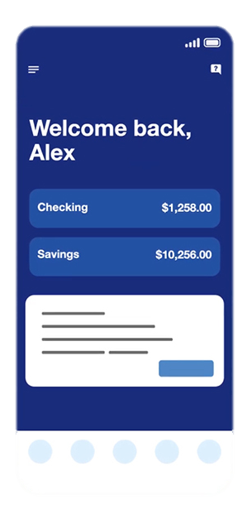
Digital initiatives will transform mobile experiences into a more consistent engagement with increased communication capabilities
Consistent
Mobile Personalization
Inclusive
Deploying the same app and webpage globally allows customers to have a consistent mobile experience regardless of location
Providing multilingual versions of the mobile experience makes it available to more customers
Communication
Frequent
Communication channels such as messaging can be opened between customers and employees in their home country
Consumers who use the app regularly will receive personalized recommendations often
Introduction | Recommendation | Implementation | Financials | Risk Mitigation | Conclusion

Slide 11
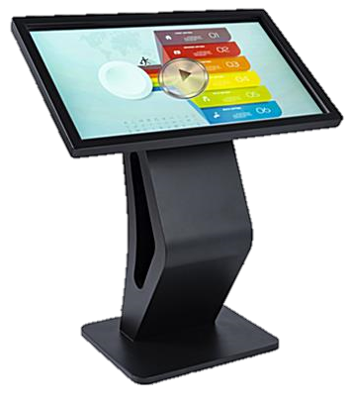
Digital initiatives will transform physical branches into internationally-welcoming environments
Comfort
Jarvis Kiosks
Personalization
Customers who are more comfortable visiting a branch can still do so without speaking the local language
IBM Watson allows the kiosk to act as an advisor who already knows you personally
Interactive
Local Tips
Interactive software can provide users advice on local banking requirements and other onboarding information
Jarvis could give advice specific to that city such as local hotspots and ATM locations
Introduction | Recommendation | Implementation | Financials | Risk Mitigation | Conclusion

Slide 12
Deliverables & Timeline
Cloud
Mobile
Physical
Contract Negotiation
Data Migration
Systems Integration
Find Developer
Find Translator
Contract Negotiation
Find Kiosk Vendor
Contract Negotiation
Installation
Employee Training
Month | 1 | 2 | 3 | 4 | 5 | 6 | 7 | 8 | 9 | 10 | 11 | 12 | 13 | 14 | 15 | 16 | 17 | 18 | 19 | 20 | 21 | 22 | 23 | 24
Cloud
M
P
Mobile
Physical
Introduction | Recommendation | Implementation | Financials | Risk Mitigation | Conclusion

Slide 13

Combining EY Expertise with SHIELD Leadership
Robert Rogers
Technology Delivery Lead
Nicholas Stark
Customer Experience Lead
Azure data migration and integration
IBM Watson integration
Kiosk implementation
Mobile app development
Technology employee training
Mobile app customer experience
Kiosk customer experience
Employee training to leverage Watson
Mark Thanos
Business Process Lead
Kathleen Hill
Global Head of Digital Innovation
Azure Cloud new processes
Leveraging IBM Watson insights
Digital Kiosk logistics
Mobile app process integration
Omnichannel experience integration
IBM Watson insights and advice
Digital Kiosk experience
Introduction | Recommendation | Implementation | Financials | Risk Mitigation | Conclusion

Slide 14
The benefits of this solution far outweigh the cost
Costs
Benefits
Cloud Implementation
$295M
3 Year Cost
Profit from New Customers
$2.27B
$687M
Omnichannel Development and IBM Watson
$327M
Profit from Existing Customers
$15M
$2.04B
Variable/Other Costs
$65M
Halt the loss of internationally-mobile customers
*Click to see calculations
3 Year NPV
*Click on box or arrow to see calculations
Introduction | Recommendation | Implementation | Financials | Risk Mitigation | Conclusion

Slide 15
Risks and Mitigations
Risks
Employee Risk
Customer Perception of Cloud Insecurity
Kiosk Acceptance
 |  | X
 | X
 |  | X
Probability
Probability
Probability
Severity
Severity
Severity
Transformation has already started, so now SHIELD should keep employees informed on the benefits of this strategy
Explain the benefits, but allow customers the choice to opt out of this storage
Extensive market research to ensure that the kiosk provides an experience customers actually want
Mitigations
Introduction | Recommendation | Implementation | Financials | Risk Mitigation | Conclusion

Slide 16
These three steps can help SHIELD stop losing internationally-mobile customers, and win new customers
Cloud storage expands capacity and increases global accessibility
1
Mobile transformation opens more communication channels and personalizes user experience
2
Physical transformation allows for a consistent global experience
3
EY can help SHIELD earn $1.35B in three years
Introduction | Recommendation | Implementation | Financials | Risk Mitigation | Conclusion

Slide 17
Appendix
Why EY
Cost of Cloud - Attribute
Cost of Cloud - Calculation
Migration Map
New Customer Profit
Existing Customer Profit
Monte Carlo/ Growth Rate Predictions
Cost Breakdown
Decision Criteria
Cloud Management
Sources
Sources Cont

Slide 18


Why EY ?
Granting SHIELD access to a vast networks of Clients, adequate support Programs and numerous opportunities for your company’s overall expansion in across disciplines, industries, services and geographical presence
Global presence
Our Member Firms are structured into over 26 Regions, which are grouped into four geographic Areas. Housing 700 office locations in over 150 countries
Strategic Alliances & Ecosystem relationships
aim to create new forms of customer value to help each client rapidly and digitally transform” partnering with over 20+ leading Firms in their respective industry
Diversification & Involvement
Consistently work with our clients to facilitate with the goal the end-to-end digital transformation needed to adapt to this new and fast-moving world.
Source: EY
| Return |

Slide 19
Cost of Cloud - Attribute
TYPE :
Blob
Massively-scalable object storage for unstructured data
Cost-effective for massive volume
Tiered storage options
Single infrastructure with global reach
Cloud Capacity of HSBC:
A petabyte is a unit of information equal to one thousand million million, or 2^50, bytes.
HSBC now has 169 petabytes of data on its servers.
ACCESS TIER:
Hot - Optimized for storing data that is accessed frequently.
REDUNDANCY:
Geo-redundant storage (GRS) is designed to provide at least 99.99999999999999% (16 9's) durability of objects over a given year by replicating your data to a secondary region that is hundreds of miles away from the primary region. If your storage account has GRS enabled, then your data is durable even in the case of a complete regional outage or a disaster in which the primary region isn't recoverable.
Source: Azure Microsoft
| Return |
Notes:
https://azure.microsoft.com/en-us/pricing/calculator/?service=machine-learning-studio

Slide 20
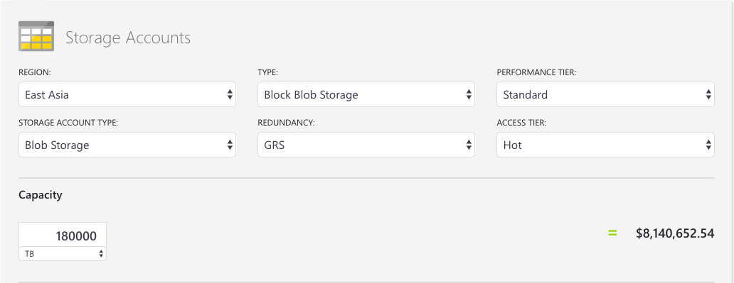
Cost of Cloud - Calculation
1 petabytes = 2⁵⁰ bytes = 2¹⁰ TB
169 × 2¹⁰ TB ≈ 180,000
Source: Azure Microsoft
| Return |
Notes:
https://azure.microsoft.com/en-us/pricing/calculator/?service=machine-learning-studio

Slide 21
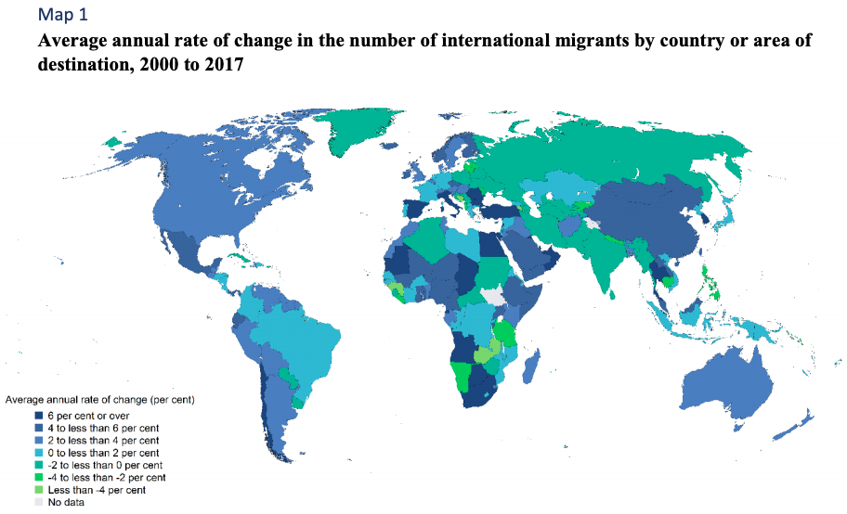
Migration Map
Source: United Nations
| Return |
Notes:
https://www.un.org/en/development/desa/population/migration/publications/migrationreport/docs/MigrationReport2017_Highlights.pdf

Slide 22
New Customer Profit Calculations
RBWM Customers | 38,000,000
RBWM Profit | 7,080,000,000
RBWM Profit Per Customer | $186.32
Expected Percentage Growth:
Year 1 | 8%
Year 2 | 10%
Year 3 | 12%
Expected New Customer Amount:
Year 1 | 3,056,112
Year 2 | 4,104,297
Year 3 | 5,033,653
Expected Profit from New Customers:
Year 1 | 569,401,920
Year 2 | 764,695,411
Year 3 | 937,849,026
Total Expected Profit from New Customers | 2,271,946,357
Discount Rate | 5%
Total NPV | $2,046,038,073
| Return |

Slide 23
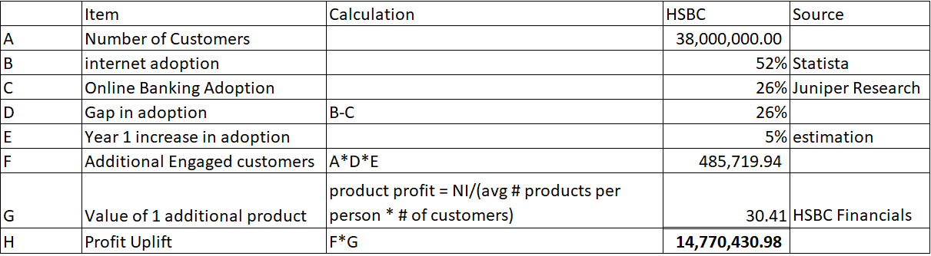
Existing Customer Profit Uplift Calculations
| Return |

Slide 24
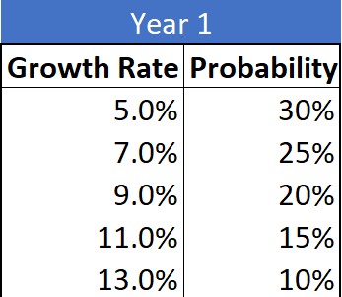
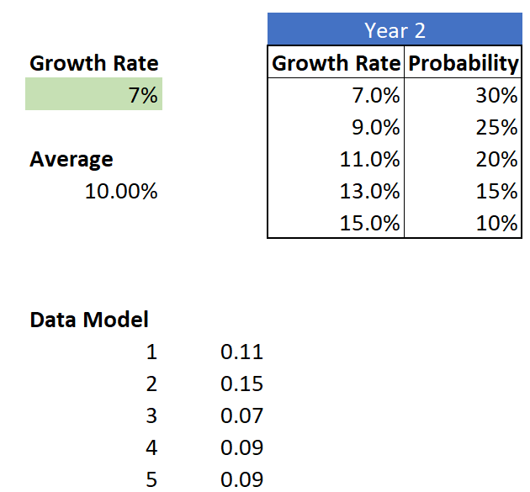
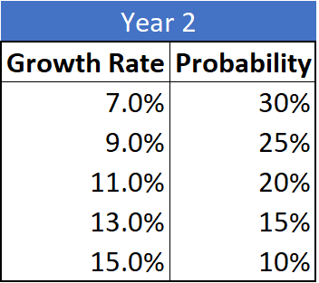
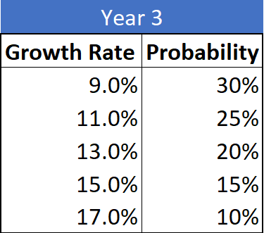
Monte Carlo and Yearly Growth Rate Predictions (New Customers)
| Return |

Slide 25
Cost Breakdown
Development Cost
Multilingual App Development | $500,000
Multilingual Site Development | $500,000
Multilingual Support | $6,000
Total | $1,006,000
Emp Training per Store
Employee Salary | $58,000
Employee Weekly | $1,115
Employees per Store | 6
Store Cost | $6,692
Number of stores serviced* | 9,500
Total Cost | $63,576,923
IBM Watson Cost
Total Customers | 38,000,000
Expected Mobile Users | 26%
Users | 10,000,000,000
Recs per user per month | 6
Total Yearly Recs | 60,000,000,000
thousands | 60,000,000
Cost per year | $24,000,000
Total cost | $72,000,000
Cost for Digital Kiosk Implementation
Kiosks | 20,540
Stores with 1 | 7,125
Stores with 2 | 1,900
Stores with 3 | 475
Total Kiosks | 12,350
Total Cost | $253,669,000
Consultant Cost
Bill Rate | $1,000
Hours | 2080
Total Cost | $2,080,000
| Return |

Slide 26
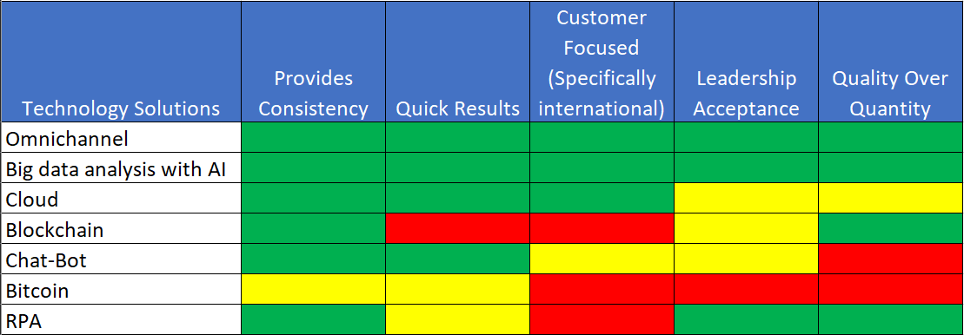
Decision Criteria
| Return |

Slide 27
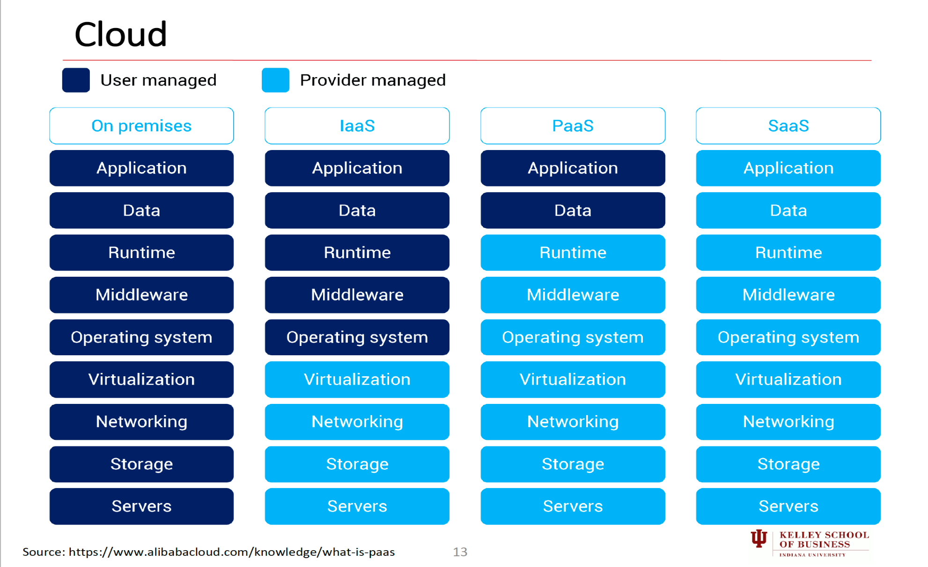
Cloud Management
Source: Alibaba cloud
| Return |

Slide 28
Sources
THE BENEFITS OF CLOUD COMPUTING FOR THE BANKING & FINANCIAL INDUSTRY, Global Banking and Finance, Retrieved August 28, 2019 from: https://www.globalbankingandfinance.com/the-benefits-of-cloud-computing-for-the-banking-financial-industry/
How the Banking Industry Benefits from Cloud Computing, Chelsea Downey & Caleb Walter, Retrieved August 28, 2019 from: https://www.trintech.com/blog/cloud-solutions/how-the-banking-industry-benefits-from-cloud-computing/
Banking on the Cloud: Why Banks Should Embrace Cloud Technology, Jon Debonis, Retrieved August 28, 2019 from: https://blend.com/blog/insights/cloud-technology/
Six reasons why cloud computing will transform the way banks serve clients – and the five hurdles to overcome, FinTech Futures, Retrieved August 28, 2019 from: https://www.fintechfutures.com/2014/07/six-reasons-why-cloud-computing-will-transform-the-way-banks-serve-clients-and-the-five-hurdles-to-overcome/
International Migration Report, United Nations, Retrieved August 28, 2019 from: https://www.un.org/en/development/desa/population/migration/publications/migrationreport/docs/MigrationReport2017_Highlights.pdf
Top 10 Strategic Technology Trends for 2019: A Gartner Trend Insight Report, David Cearley & Brian Burke, Retrieved August 27, 2019 from: https://emtemp.gcom.cloud/ngw/globalassets/en/doc/documents/383829-top-10-strategic-technology-trends-for-2019-a-gartner-trend-insight-report.pdf
Internet, Julia Murphy & Max Roser, Retrieved August 27, 2019 from: https://ourworldindata.org/internet
Eight ways FinTech adoption remains on the rise, Gary Hwa, Retrieved August 27, 2019 from: https://www.ey.com/en_us/financial-services/eight-ways-fintech-adoption-remains-on-the-rise
Big cloud-computing growth seeded by China spending, boosting Alibaba, Wallace Witkowski, Retrieved August 27, 2019 from: https://www.marketwatch.com/story/big-cloud-computing-growth-seeded-by-china-spending-boosting-alibaba-2017-11-06
Global banking outlook 2018, EY, Retrieved August 28, 2019 from: https://www.ey.com/Publication/vwLUAssets/ey-global-banking-outlook-2018/$File/ey-global-banking-outlook-2018.pdf
Azure regions, Microsoft, Retrieved August 28, 2019 from: https://azure.microsoft.com/en-us/global-infrastructure/regions/
Omnichannel banking, IBM, Retrieved August 28, 2019 from: https://www.ibm.com/industries/banking-financial-markets/resources/omnichannel-banking-paper/
The balancing act: Omnichannel excellence in retail banking, Walter Rizzi & Zubin Taraporevala, Retrieved August 28, 2019 from: https://www.mckinsey.com/industries/financial-services/our-insights/the-balancing-act-omnichannel-excellence-in-retail-banking
Synergy and disruption: Ten trends shaping fintech, Jeff Galvin, Feng Han, Sarah Hynes, John Qu, Kausik Rajgopal, & Arthur Shek, Retrieved August 28, 2019 from: https://www.mckinsey.com/industries/financial-services/our-insights/synergy-and-disruption-ten-trends-shaping-fintech
Large global bank, IBM, Retrieved August 28, 2019 from: https://www.ibm.com/case-studies/large-global-bank
Manufacturing ERP Software Comparisons by Industry, TOP 10 ERP, Retrieved August 28, 2019 from: https://www.top10erp.org/erp-software-comparison-other-industry-176
Watson Machine Learning: Pricing, IBM, Retrieved August 28, 2019 from: https://www.ibm.com/cloud/machine-learning/pricing
Weglot-Pricing, Weglot.com, Retrieved August 28, 2019 from: https://weglot.com/pricing/
How Much Does It Cost to Make an App in 2019?, Velvetech.com, Retrieved from August 28, 2019 from: https://www.velvetech.com/blog/how-much-mobile-app-cost/
Web Development Cost / Rate Comparison - Different Types of Custom Web Application Companies, Bernard Kohan, Retrieved from August 28, 2019 from: https://www.comentum.com/web-development-cost-rate-comparison.html
Budgeting for an Interactive Kiosk Project, Wirespring.com, Retrieved from August 28, 2019 from: https://www.wirespring.com/dynamic_digital_signage_and_interactive_kiosks_journal/articles/Budgeting_for_an_Interactive_Kiosk_Project-200.html
| Return |

Slide 29
Sources Cont
Global Digital Population as on July 2019. Statista. Retrieved August 27, 2019 From: https://www.statista.com/statistics/617136/digital-population-worldwide/
Digital Banking Users to reach 2 Billion this Year. Juniper Research. Retrieved August 27, 2019 from: https://www.juniperresearch.com/press/press-releases/digital-banking-users-to-reach-2-billion
| Return |

