Slide 1
The status of DSS development and actigraph validation testing
NCTU and ARL
August 12, 2014

Slide 2
Outline
Introduction
Operating processes
Setup
Home page
Fill questionnaire
Stress
Fatigue
KSS
Sleep efficiency
PSD
Upload data
Finish questionnaire

Slide 3
Introduction
We developed a Daily Sampling System (DSS) to monitor and track subjects’ daily variations in sleep patterns and perceived levels of stress and fatigue on everyday basis.
The DSS evaluated each subject’s daily levels of fatigue based on actigraphy, sleep diaries, and subjective reports and schedule subjects for experiments along a continuum of levels of fatigue.

Slide 4
Introduction
The DSS system was developed on the android smart phone, we asked subjects to fill the awake state in their phone when they woke up in the morning.
Awake state has five indexes:
Stress level
Fatigue level
Sleepy level after get up (KSS index)
Sleep efficiency receive by Readiband
Pittsburgh sleep diary (PSD) questionnaire

Slide 5
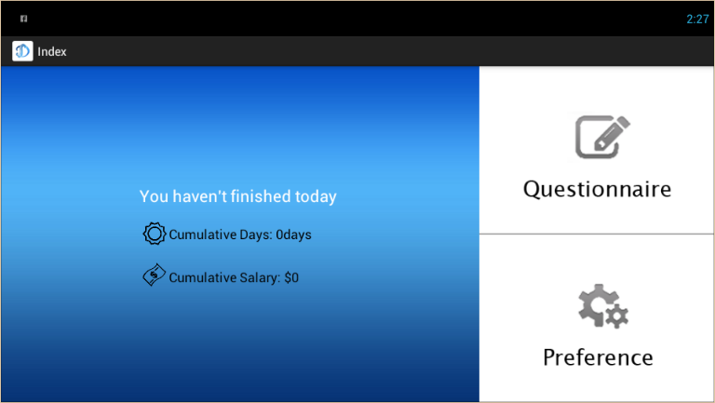
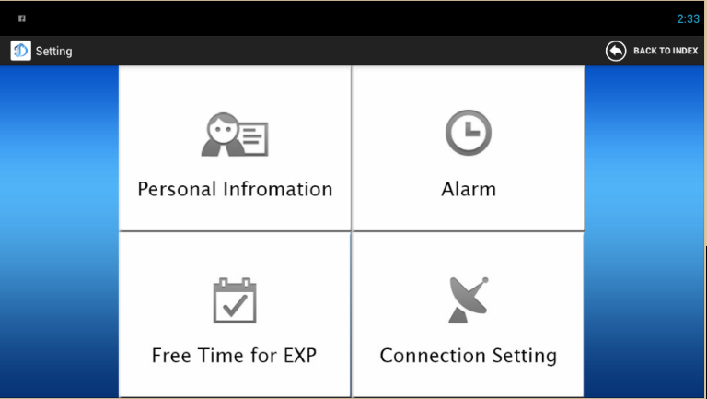
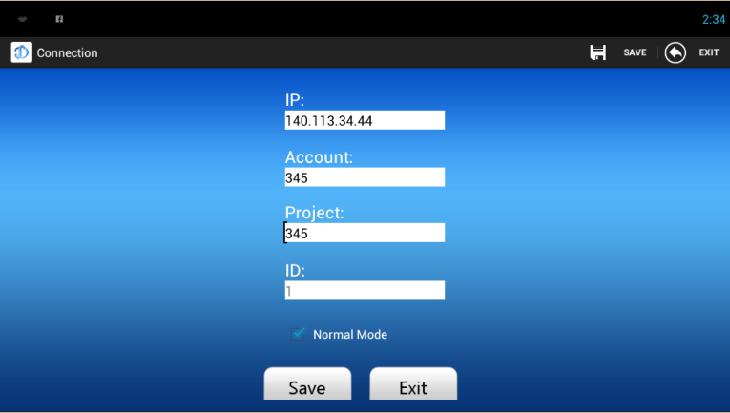
Operating processes – Setup
Subjects enter the DSS, and they have to setup some basic information and connection setting at first time.

Slide 6
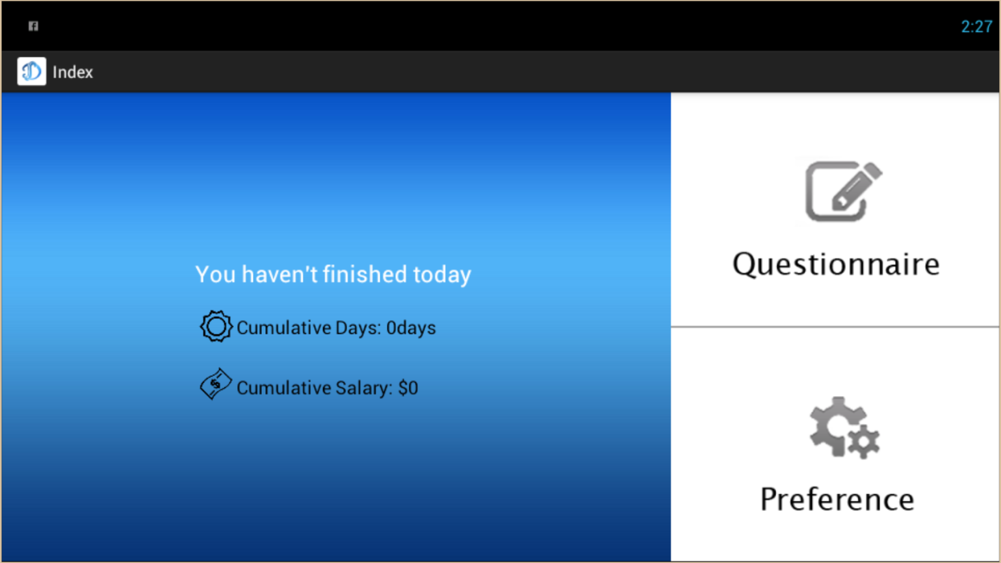
Operating processes – Home page
Subjects find out that if they did not finish their questionnaire yet, the cumulative days and cumulative salary in the home page.

Slide 7
Operating processes – Fill questionnaire
When subjects wake up in the morning, they fill five questionnaires immediately.

Slide 8
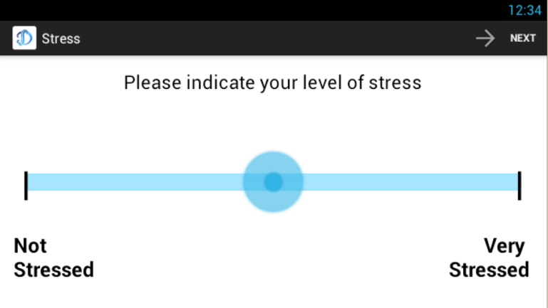
Operating processes - Stress
Fill up the feeling of stress

Slide 9
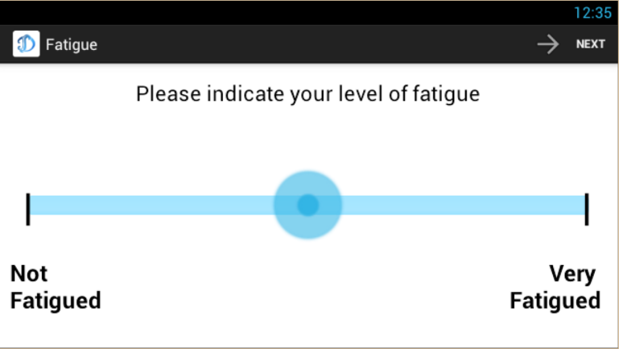
Operating processes - Fatigue
Fill up the feeling of fatigue

Slide 10
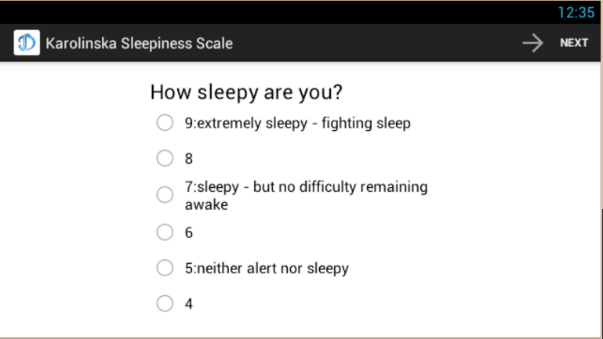
Operating processes - KSS
How sleepy you are? Here are five index.

Slide 11
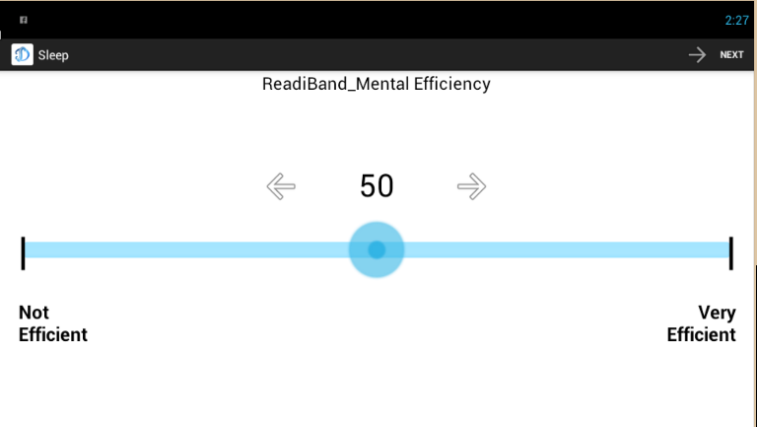
Operating processes – Sleep Efficiency
Fill the sleep efficiency value which receive by ReadiBand.

Slide 12
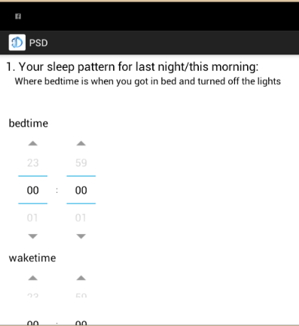
Operating processes – PSD
PSD questionnaire including:
Bedtime & Waketime
Time it took to fall asleep
The way of wake up
Wake up times when you sleep
Total number of minutes awake
The times of wake up to use bathroom
The times of awakened by noises
The times of awakened by physical complaint
The times of just woke
Sleep Quality
Mood of final wakening
Alertness in final wakening

Slide 13
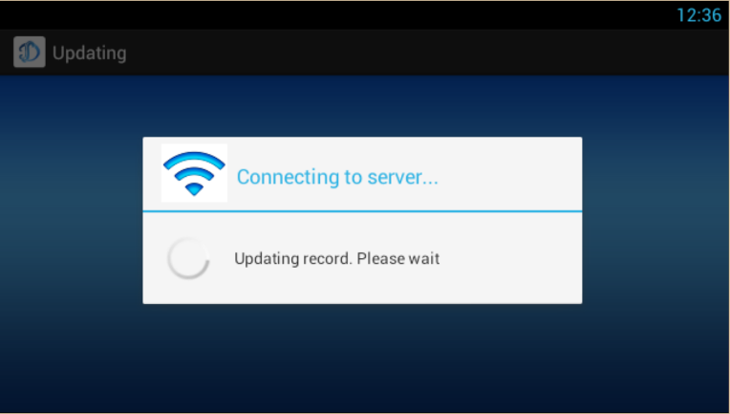
Operating processes – Upload data
When subjects finish the questionnaire, system will upload to server and update the cumulative salary. If phone disconnects with server, data will save in their phone and then upload next time.

Slide 14

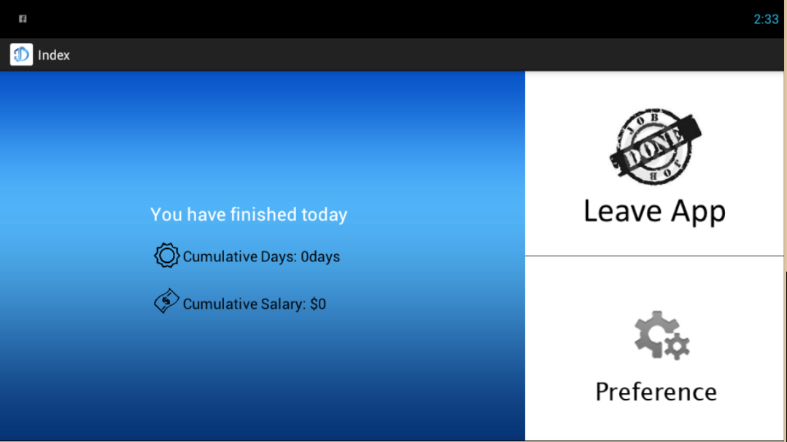
Operating processes – Finish questionnaire
When subjects finish their questionnaire today, Home page will be replaced by another one.

