Slide 1
Cross-platform application development

Slide 2

Overview of Mobile App Development
Nowadays, mobile applications are becoming more and more popular.
Users are moving from desktop to mobile experience.
For the average user, a computer is only useful for work.
The most popular operating systems are iOS and Android.

Slide 3




The Prospect of Mobile Application
Uptrend
Global users are spending more time on mobile devices.
USA
Mobile usage time increased by 60% from 6/2017 to 6/2025 (2h31 min → 4h02 min).
Challenge
25% of apps are used only once.

Slide 4

User Experience Cocept
Definition of Ux
More than just the
interface
User experience refers to a user's interaction with a product, application, or operating system.
UX is not necessarily about designing an interface with beautiful colors and easy-to-read fonts.
Influencing factors
Start time, interface, icons, interaction with device hardware.

Slide 5












User Experience Honeycomb
Desirable
Findable
Intuitive, easy to understand aesthetics.
Information is easy to navigate from anywhere.
Accessible
Useful
Disabled users also have a good experience.
Response users needs
Usable
Credible
Simple and easy to use. Short learning curve.
Do not disclose user personal information.

Slide 6





Challenges in Mobile Design
Screen limits
Content needs to be rearranged or hidden when displayed on mobile screens.
Internet speed
If the access time increases from 1s to 10s, the probability of users
abandoning increases by 123%.
Device limits
Experience changes as battery or storage capacity decreases.
Fragmentation
Different versions of operating systems make it difficult for developers.

Slide 7
10 Laws of Mobile HCI
Rule 1: Mobility
1
Mobile app design must accommodate user mobility.
2
Rule 2: Individuality
Mobile apps must create personalized experiences for each user.
Rule 3: Continuity
3
Mobile applications must ensure continuity, users are not interrupted while moving.
4
Rule 4: Simplicity
Mobile application interface should be simple and easy to use.
Rule 5: Efficiency
5
Mobile applications must meet user needs effectively.
6
Rule 6: Adaptability
Mobile applications must adapt to different mobile devices.
Rule 7: Confidentiality
7
Mobile applications must ensure the security of user information.
8
Rule 8: Connectivity
Mobile apps should connect users to useful services and information.
Rule 9: Friendliness
9
Mobile apps should be user-friendly, easy to use and learn.
10
Rule 10: Creativity
Mobile apps must deliver innovative and unique experiences to users.

Slide 8
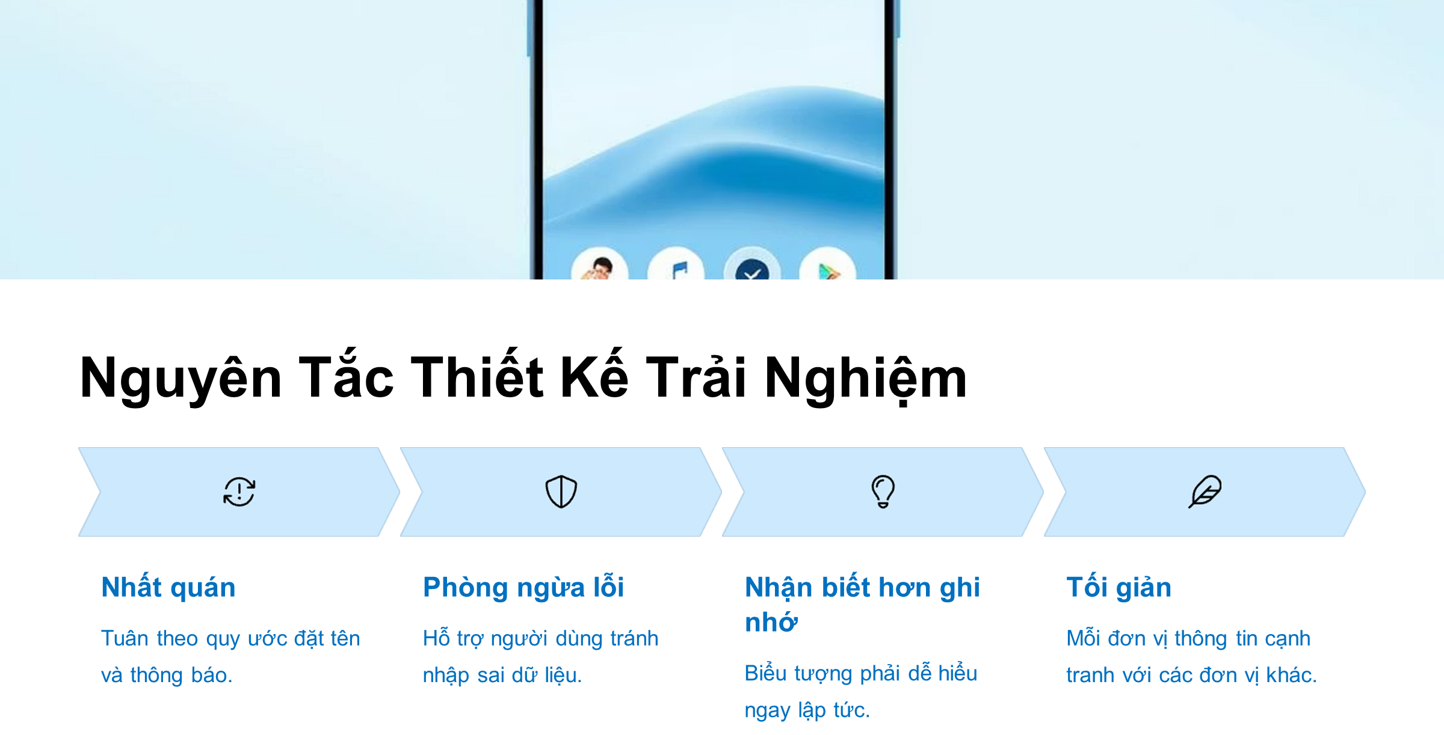
Principles of experience design
Consistent
Error prevention
Recognition over recall
Minimalism
Follow naming conventions and notifications
Help users avoid entering incorrect data
Icons must be immediately understandable.
Each unit of information competes with the others.

Slide 9
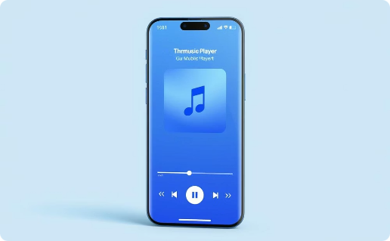
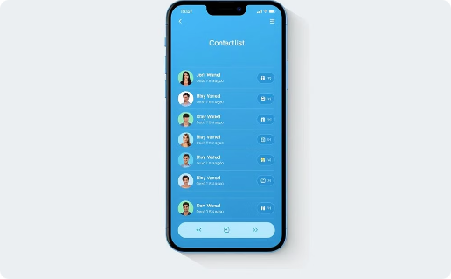
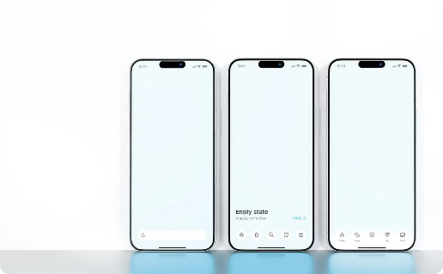
User Experience Evaluation
Music Player Interface
Contact List
Empty List
Intuitive design with easily accessible controls.
Organized logically, easy to search, and quick to access.
Display a friendly message when no data is available.

