Slide 1
Cross-Platform Application Development

Slide 2

Mobile System Architecture
Uniformity
Transparency
Portability
Data can be easily transferred between hardware, apps, and servers.
Detect and handle errors from other components.
Components can be replaced easily, reducing edit time.
Notes:
Khi nhắc đến kiến trúc cho một ứng dụng di động, ta phải quan tâm đến cả kiến trúc của phần cứng thiết bị và kiến trúc của cả hệ thống server hỗ trợ.
Cả phần cứng + ứng dụng di động + server phải tạo thành một hệ thống đồng nhất, trong suốt và khả chuyển

Slide 3
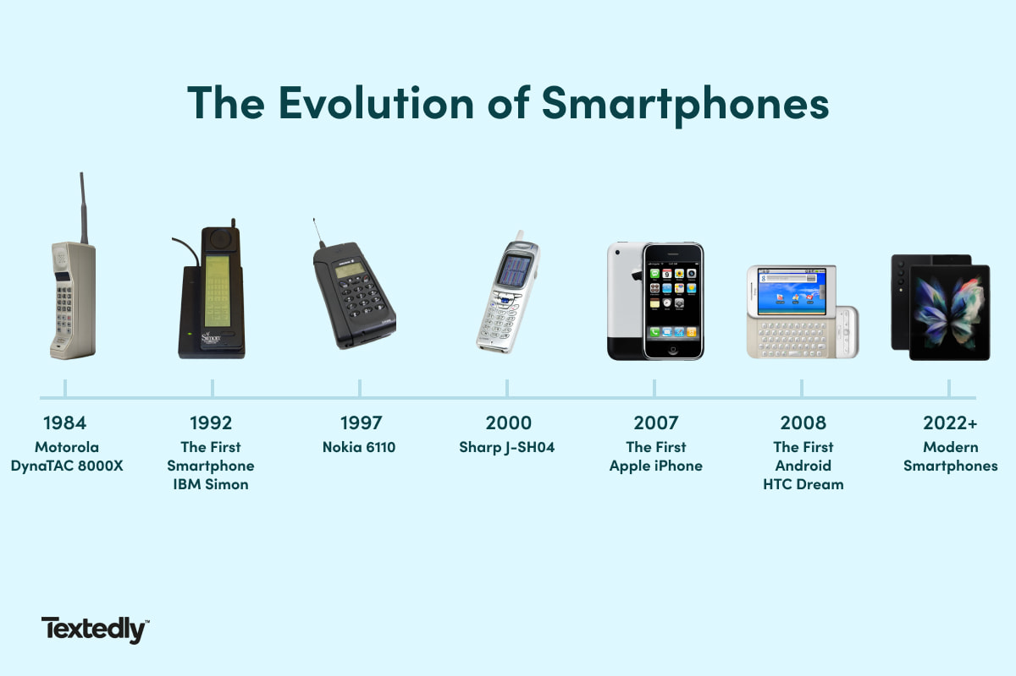
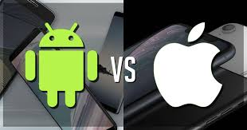
History of Mobile Programming
1
Initial stage (1973 – 1996)
Mainly basic mobile phones, no smart functions.
Large size, only has calling function.
2
Early smartphone phase (1997 – 2006)
Combination of phone and PDA.
Supports email, calendar, physical QWERTY keyboard.
Aimed at business and professional users.
3
The revolutionary period (2007 – 2009)
Full touch interface, eliminating physical keyboard.
Focus on user experience and application ecosystem.
4
The period of strong development and intelligence
(2010 – present)
Smartphones have become the center of digital life.
Integrating modern technology: AI, AR, high-end cameras, facial recognition, fingerprints, 5G...

Slide 4
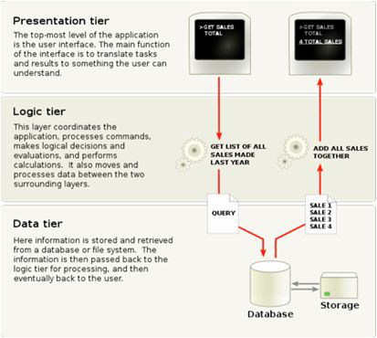
Mobile Software Architecture
MVC
MVVM
Three-Layer Architecture
Model-View-Controller: Clearly separates display, processing, and data.
Model-View-ViewModel: Supports two-way data binding, common on Android.
Presentation, business, and data layers are separated for easier maintenance.

Slide 5
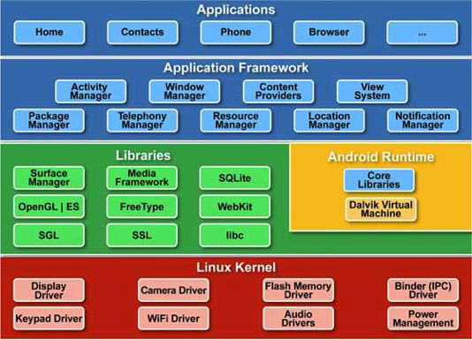
Android Application Architecture
Linux Kernel: Core processor providing hardware abstraction.
Libraries: Libraries built on the Linux kernel and Java-based libraries supporting Android.
Android Runtime: The execution “brain” of Android apps.
Application Framework: Higher-level services for apps via Java classes.
Application: User-created apps reside here.
Hệ điều hành Android

Slide 6
Kiến Trúc Ứng Dụng Android
All Android apps are written in Java (or another language if using cross-platform technology)
The executable file of an Android app has the extension APK
When it is uploaded to the Store, Google will update a signature to this executable file.
You can also use the App signing service to store your private keys.
Separate Sandbox
Private VM virtual machine
Data Sharing
Files have restricted permissions
Each app has its own process ID.
Source code runs independently per app, supporting "Write once, run everywhere" with a clear and easy-to-learn syntax.
Each application has its own process ID.
Each Android app can share data with other apps
Each app can set up data sharing with other apps
Each app can still have access to address, phone status, SMS

Slide 7
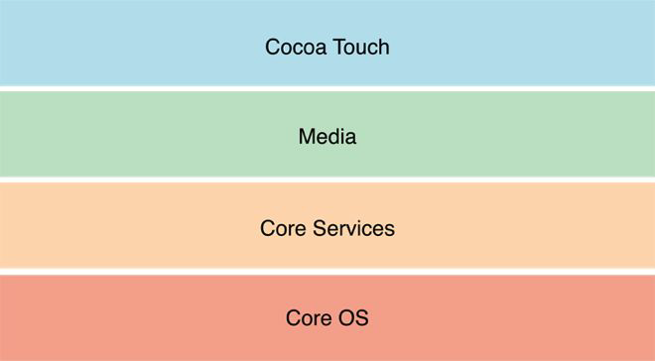
iOS Application Architecture
Cocoa Touch: Provides frameworks and APIs (application programming interface) for UI (User interface) and event handling.
Media: Manages audio, video, images, and graphics.
Core Service: Offers essential system services for higher-level frameworks.
Core OS: Handles memory, processes, file systems, security, and hardware drivers.

Slide 8

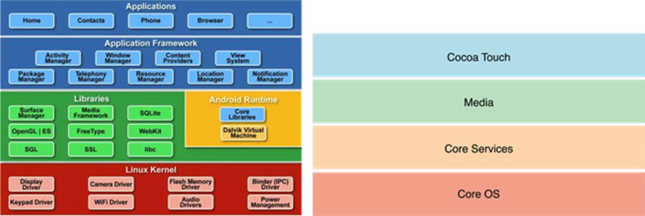
iOS Application Architecture
Differences between iOS and Android:
Each iOS layer has a specific component.
Media layer is dedicated to multimedia.
No Java VM layer needed.
iOS architecture is less transparently published than Android.

Slide 9
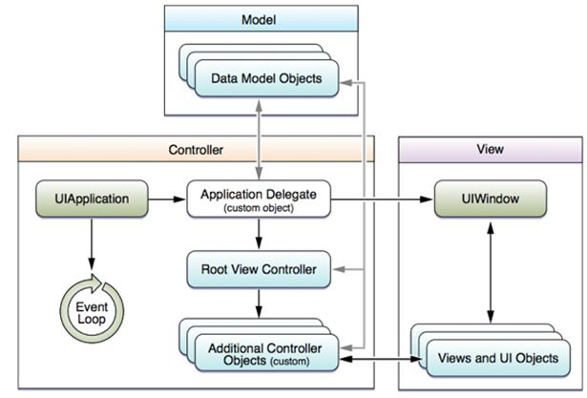
iOS Application Architecture
MVC in iOS
Model-View-Controller is still a fundamental approach to designing applications for mobile devices
Due to the object-oriented capabilities of Objective-C, MVC is one of the design patterns for both iOS and OS X

Slide 10
Cross-Platform Architecture
If not using cross-platform tools, separate development is needed for each platform.
Tools | Android | iOS
Open source IDE | Android Studio | N/A
Copyright IDE | IntelliJ IDEA | XCode
Testing tools | Jubit, Espresso | XCUnit
Performance measurement tools | Android Profiler | Xcode Instruments
Source code management tools | Git, Subversion, CVS
Emulator | Android Emulator, Intel HAXM, Genymotion | iPhone Simulator

Slide 11
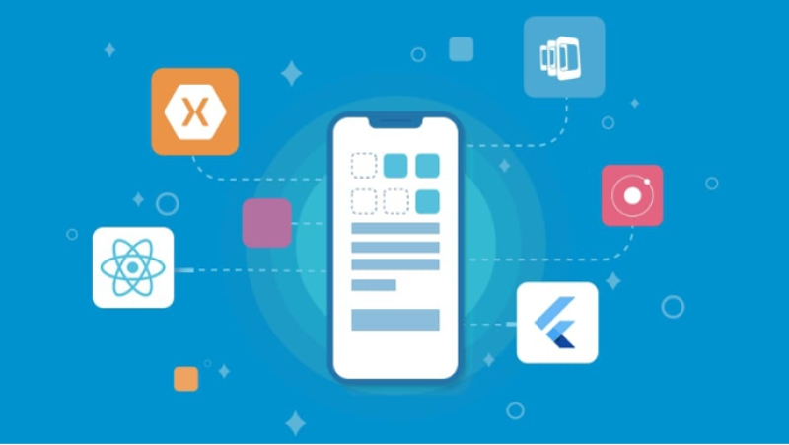
Cross-Platform Architecture
Definition: Apps developed using frameworks that support cross-platform development. “Write once, run anywhere.”
Evaluation: Consider the following when deciding to use cross-platform:
Target user group (Android, iOS, or both)?
Budget for development?
User experience expectations?
Preferred payment solution?
General Assessment: Cross-platform apps are faster and cheaper to develop, but often not as high-quality.

Slide 12
Cross-Platform Architecture
Previous issues:
Poor UI and performance
Large app size
Ignored by platform developers
Current improvements:
Better customizable UIs
Backed by major tech companies (Microsoft, Google, Facebook)
Smaller installation sizes
More development tools available

Slide 13
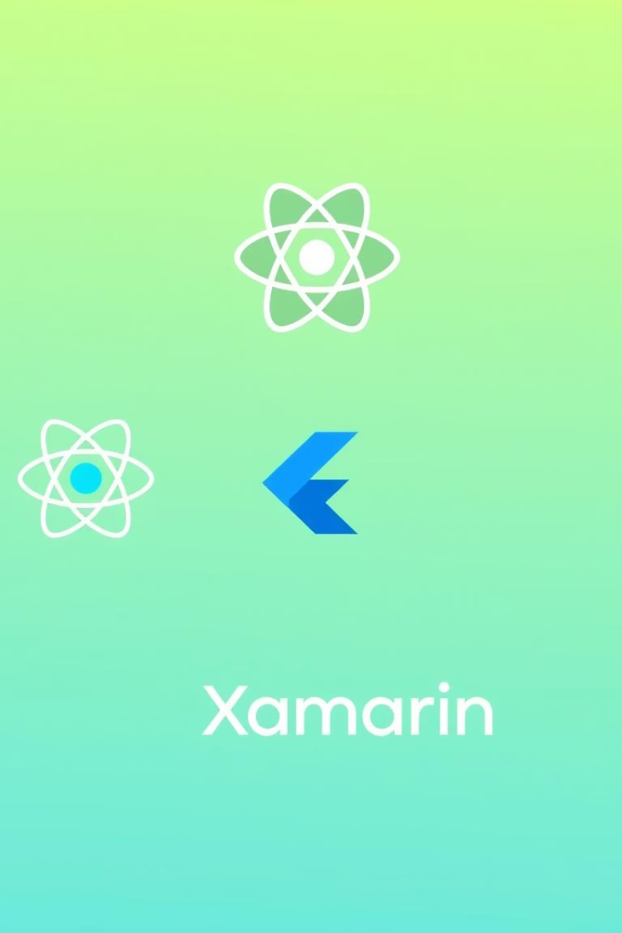
Popular Cross-Platform Frameworks
React Native
Flutter
JavaScript-based, converts to native code with flexible UI.
Dart-based, uses its own engine, optimized performance, and independent UI.
Xamarin
C#-based, supports native bindings and cross-platform development.

Slide 14
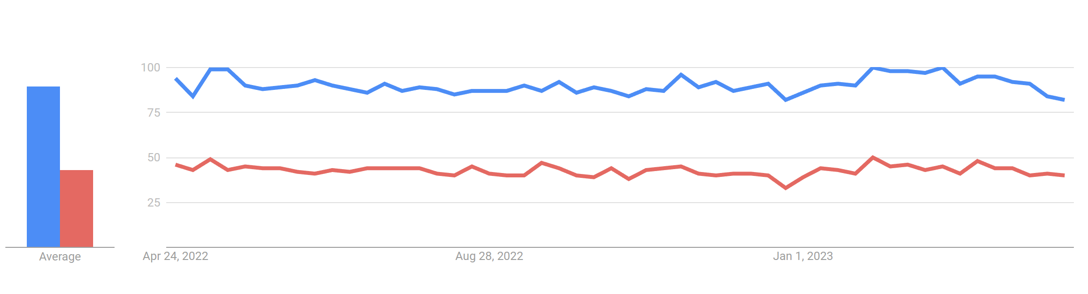
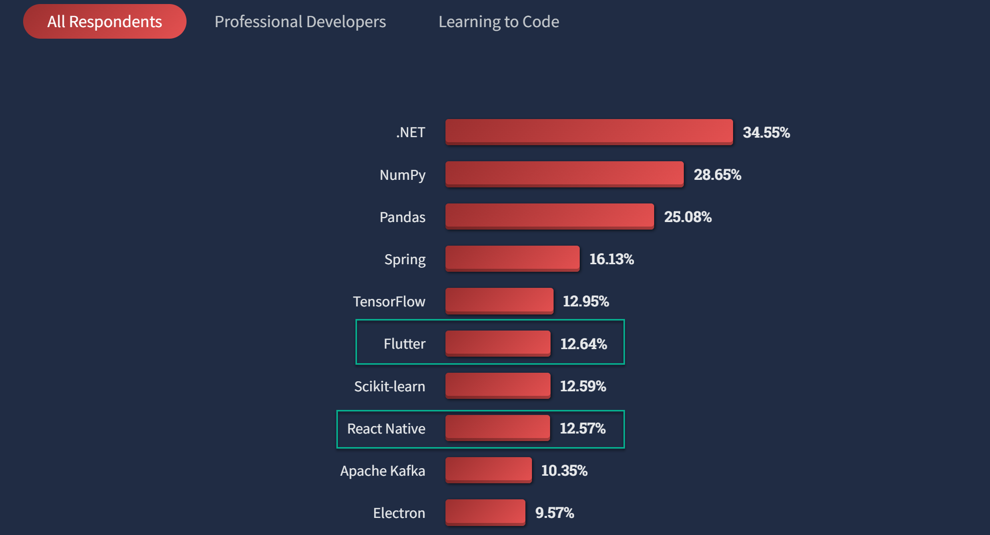
Cross-Platform Architecture
Google Trends
Stack Overflow

Slide 15

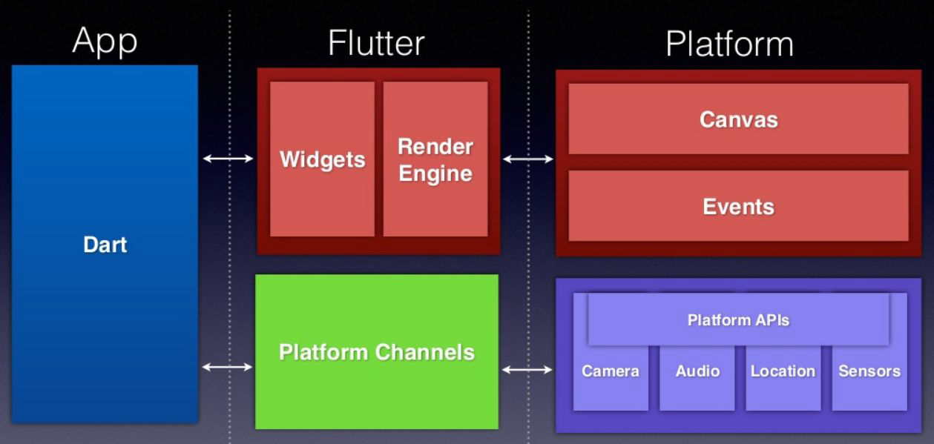


Flutter Highlights
Custom Widgets
Doesn’t use native widgets, ensuring consistent UI across platforms.
High Performance
Unlike JavaScript-native which may cause lag, Flutter directly accesses native files.
Dart
Supports both JIT (Just In Time) and AOT (Ahead Of Time) compilation for speed and optimization.
Can also compile to JavaScript for web support.

Slide 16
Conclusion and Orientation
Choose the Right Architecture
Prioritize User Experience
Sustainable Development
Evaluate project needs, users, and available resources.
Ensure performance, friendly UI, and stability.
Choose technologies that reduce cost and accelerate growth.

