Slide 1
Cross-Platform Application Development

Slide 2

Introduction to Dart Language
Dart is an open-source, general-purpose programming language developed by Google.
Dart was announced in 2011, with its stable release in 2013. The latest version is Dart 2.14.
Dart is a cross-platform language used for developing web, desktop, server, and mobile applications.
Flutter applications are written in Dart, providing developers with the best experience in building high-quality mobile apps.

Slide 3

Introduction to Dart Language
Characteristics of Dart:
Productive tooling
Garbage collection
Type annotations
Statically typed
Portability

Slide 4
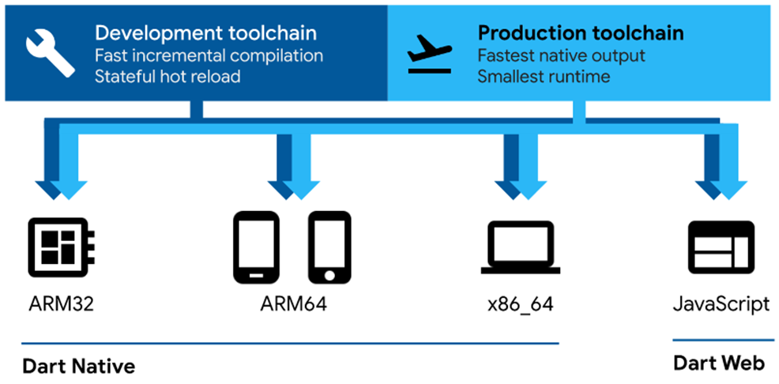
Execution Platforms
Mobile and desktop applications, including the Dart virtual machine (Dart VM) with Just-In-Time (JIT) and Ahead-Of-Time (AOT) compilation | Web-based applications. Dart source code is compiled into JavaScript

Slide 5

Dart Application Development Tools
The Dart SDK provides specific tools for each Dart development ecosystem:
dart: Command-line interface for creating, formatting, analyzing, testing, compiling, and running Dart code
dartaotruntime: execution environment for AOT compiled apps
dartdoc: documentation generator
pub: package manager
For web development, additional tools include: dart2js, webdev, dartdevc,…

Slide 6

Dart Development Tools
Example of a basic Dart program:
//First program
void main() {
var a = 'World’;
print('Hello $a');
}
The main() function is the starting point
of every Dart application.
Executed via command line: dart hello_world.dart
DartPad: An online tool that allows writing and executing Dart code from the browser at: https://www.dartpad.dev

Slide 7
Basic Syntax of Dart
Main () function: A Dart application starts from the main function, which may or may not have parameters.
Dart is case-sensitive; every statement ends with a semicolon ;
A group of statements grouped together is called a statement block, using the pair of braces {} to create the block.
Blocks can be nested.
Comments:
Single-line: //
Multi-line: /* ... */

Slide 8
Basic Syntax of Dart
dentifiers (variable names, function names, class names...): must start with a letter (a-zA-Z) or underscore _, followed by letters or digits.
Everything stored in a variable is an object (including numbers and null). All objects originate from class definitions; all classes inherit from the base class Object.
Dart doesn’t use public, private, or protected keywords.
A name starting with _ is considered private.

Slide 9
Basic Syntax of Dart
Variable Declaration: Use var, the type is inferred from the assigned value.
var a = "Learn Dart"; // a is of type String
Can also explicitly specify the data type.
String | s | = | 'Chuỗi ký | tự'; | // | Declare string variable
double | d | = | 1.1234; |  | // | Declare real variable
int | i | = | 1; |  | // | Integer variable
bool | found | = | true; |  | // | Logical integer variable
To allow any type: use dynamic.
dynamic dyn = 123; | // | Initialize to int number
dyn = "Dynamic"; | // | String assignment
dyn = 1.12345; | // | Assign the number double

Slide 10
Declaring Constants in Dart
Constant declaration: Use const or final
Const name_constant
final name_1
final String name_2
= value_expression;
= value_expression;
= value_expression; //Specify the type of the constant
const: compile-time constant; value must be known at code writing.
final: run-time constant; can only be assigned once, The second assignment will be an error (there must be an assignment before use). It is called a runtime constant, the value of this constant can be different each time it is run.
const minutes = 24 * 60;
var randomValue = Random(800).nextInt(400);
final a = randomValue * 2;

Slide 11
Basic Data Types in Dart
Basic data types
Data types | Describe
int | Representing integer values
double | Represents 64-bit real numbers
String | Represents Unicode (UTF-16) character strings. They are entered in single quotes '' or double quotes "". Use the symbols \", \' to represent the character ', " in the string
bool | Represents true/false logic with two values ​​true and false.
List / Mảng | Also known as a list, it stores a collection of data, similar to the concept of JavaScript. Initialize an array using the symbol [], the values ​​of the listed elements are separated by ,. Array elements have indices from 0, to access any element use the symbol [index]
Map | Also stores a collection of values ​​(also known as an associative array), instead of using indices from 0 to refer to an element, each element in the Map is stored in a key:value pair, use the symbol {} to initialize the Map or initialize with Map(); Access to a Map element using the dot symbol .key

Slide 12
Operators in Dart
Arithmetic Operators:
Common Operators: +, -, *, /
~/ : integer division
% : modulo
Increment/Decrement: ++var, var++, --var, var --
Logical Operators:
Operator | Meaning
|| | The logical or, a || b, evaluates to true if either a or b is true.
&& | The logical operator and , a && b evaluates to true if both a and b are true.
!expression | Negation !a if a is true then the result of the operation is false

Slide 13
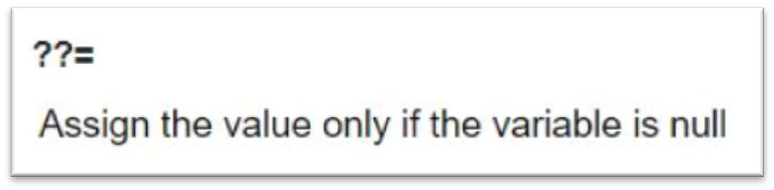
Operators in Dart
Comparison operators:
Operator | Meaning
== | Comparison by 3==3 results true
!= | Compare other 3!=3 results false
> | Compare other 3>3 results false
< | Compare other 3<3 results false
<= | Compare less than or equal to
>= | Compare greater than or equal to
Assignment Operator: = and Shortcut Assignment Operators

Slide 14
Operators in Dart
Conditional Operators:
condition ? expr1 : expr2
expr1 ?? expr2
String Operations:
Concatenation: +
Comparison: ==
Multi-line: use ''' or """
String interpolation: $varName, ${expression}
var a = 10;
var b = 20;
String result = "Two numbers $a, $b have sum ${a + b}";
print(result); // Output: Two numbers 10, 20 have sum 30

Slide 15
Operators in Dart
Some operators on classes and objects:
Operator | Meaning
[] | Accessing array elements
. | Access object methods and properties
as | Type conversion (var as MyClass)
is | Type checking (var is MyClass)
is! | Type checking (var is! MyClass)
Dart provides some control flow syntax very similar to other programming languages
if-else
switch/case
Looping constructs: for, while, and do-while
break and continue statements
Asserts
Exception handling with: try/catch and throw

Slide 16
Control Structures in Dart
Dart provides some control flow syntax very similar to other programming languages.
Conditional: if-else, switch-case
Loops: for, while, do-while
Flow control: break, continue, assert
Exception handling: try-catch, throw

Slide 17
Function construction
Syntax:
return_type function_name(parameter_list) {
// statements
return value;
}
In Dart, functions are first-class objects, meaning they can be assigned to variables or passed as parameters.
String sayHello() {
return "Hello world!";
}
void main() {
var sayHelloFunction = sayHello; print(sayHelloFuncti n());
}

Slide 18
Function construction
Optional parameters: when calling the function, whether to use it or not. Optional parameters are grouped in [], if when calling the function there is no parameter, it will receive the value null
double sum(var a, [double b, double c]) {
var total = a;
if (b != null) total += b;
total += (c != null) ? c : 0;
return total;
}
print(sum(1)); print(sum(1,2)); print(sum(1,2,3));
//1.0
//3.0;
//6.0;
Default parameter: when calling a function without a value for that parameter, it will take the default
parameter b defaults to 1, c defaults to 2
double sum(var a, {double b:1, double c:2}) { return a + b + c;
}

Slide 19
Function construction
Shorthand Syntax (also known as arrow functions or lambda functions):
[return_type] function_name(parameters) => expression;
double tinhtong(var a, var b) => a + b;
In most cases, functions are declared with a name. However, in many contexts where the function is used only once and does not require a name, it is called an anonymous function.
(var a, var b) { return a + b;
};
() => {}
//Arrow symbols can be used.
(var a, var b) => {
return a + b;
}
//If there is only 1 return expression as above, it can be written more concisely.
(var a, var b) => return a + b;

Slide 20
Package Management in Dart
Package Manager: Dart uses pub, https://pub.dev.
Each package on pub.dev requires metadata to declare its dependencies.
This information is stored in the pubspec.yaml file.
Fields in a pubspec.yaml may include: name, version, description, dependencies, etc.
For example, the project uses the dialog and google_maps packages:
name: my_project
description: Project description
name: my_project
description: Project description
dependencies:
package1: '^version_pack1' package2: '^version_pack2' package3: '^version_pack3'
dependencies:
dialog: '^0.7.0' google_maps: '^3.3.2'

Slide 21
Package Management in Dart
Load libraries for use in source code, syntax:
import 'uri';
uri as a unique identifier pointing to the library to be loaded. It can have the following forms:
Dart's built-in libraries have a uri structure dart:name_libraries
Examples dart:convert, dart:html, dart:math, dart:js, dart:web_sql. For example, if you need to load the math library dart:math then use
import 'dart:math';
Load from project file, url points to the dart file path to load. For example:
import 'lib/mylib.dart';
The library is loaded from downloaded packages, then the uri is in the form package:package_name/package_library.
For example, the googleapis_auth package, which has the auth_browser component that provides Auth authentication functionality with a google account, then load that library using
import "package:googleapis_auth/auth_browser.dart";

Slide 22
Package Management in Dart
Libraries provided in Dart:
dart:core
The library provides basic functions and classes, it is automatically loaded so you will not need to import this library.
dart:collection
Provides data structures like HashSet, HashMap, Queue,...
dart:math
Provide mathematical functions
dart:convert
Data encoding and decoding capabilities, including JSON, UTF-8
dart:io
IO library provides File, Socket, HTTP functions
Some libraries for Web like dart:js, dart:html

