Slide 1
Cross-platform application development

Slide 2
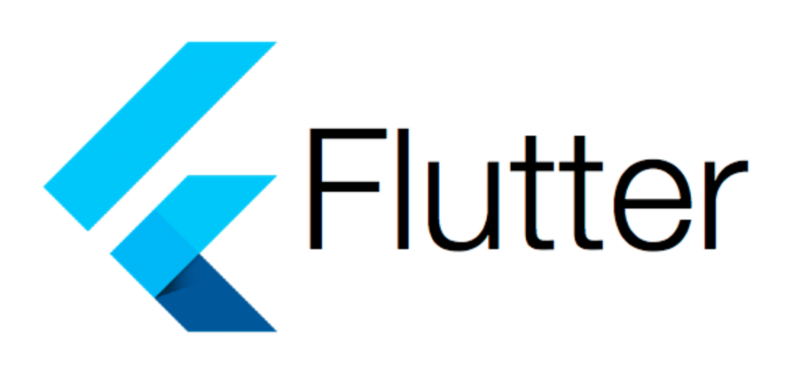
Introduction to Flutter
Flutter is a cross-platform application development SDK developed by Google. It allows developers to build beautiful, high-performance apps from a single codebase:
A complete UI Framework for mobile applications
Rich widget catalog
Developer tools
Enables building platform-independent mobile apps. Currently supports Android, iOS, Fuchsia, Web, and Desktop

Slide 3
Introduction to Flutter
Key Features of Flutter:
High performance
Full UI control: supports various widgets, beautiful and flexible UI, same UI across platforms
Efficient UI reuse thanks to widget tree architecture
Dart programming language: simple, easy to learn, rich package ecosystem, strong async/await support
Backed by Google
Hot Reload: Flutter retains application state on reload
Open source framework with a large developer community and extensive documentation

Slide 4
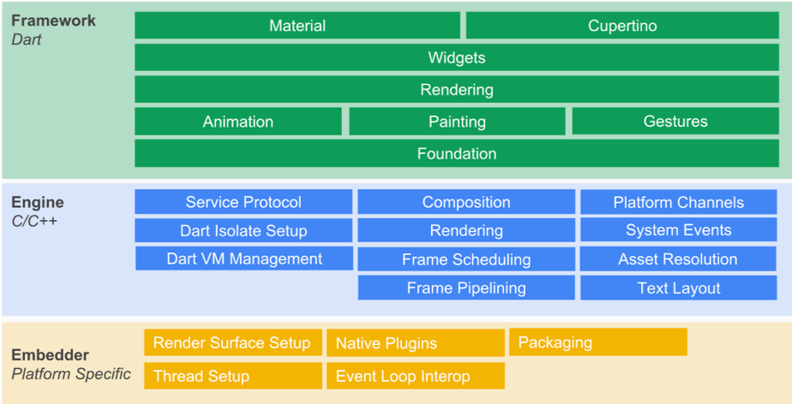
Flutter Architecture
Framework Layer(Dart)
Foundation: core library
Animation/Painting/Gesture: handles animation, painting the UI, gesture recognition
Rendering: UI components organized as a tree of RenderObjects
Widgets: built in a tree structure; each widget inherits from RenderObject. Widgets hold UI state and rebuild when state changes
Material/Cupertino: built from the widget library to implement Material (Android) or Cupertino (iOS) design

Slide 5
Flutter Architecture
Engine Layer (C/C++)
Implements core Flutter APIs including graphics (via Skia), text layout, file and network I/O, accessibility, plugin architecture, and Dart runtime
Acts as a bridge between Dart source code and the device hardware or external software
Interprets Dart code using JIT or AOT
Executes the compiled/interpreted code and provides runtime systems like garbage collector and core libraries.
Embedder Layer:
Provides access to platform-specific services (Android, iOS, etc.)

Slide 6
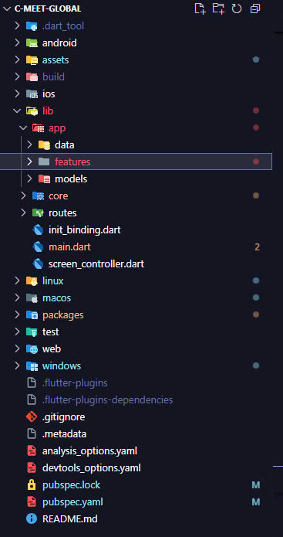
Flutter Application
Flutter apps are developed in Android Studio.
Typical Flutter project structure:
android: auto-generated code for Android
ios: auto-generated code for iOS
lib: main folder containing Dart code written using the Flutter framework
lib/main.dart: entry point of the Flutter application
test: folder with test code for the app
test/widget_test.dart: sample test code
.gitignore: Git version control configuration
.metadata: auto-generated by Flutter tools
.packages: tracks Flutter packages
.iml: Android Studio project file
pubspec.yaml: defines dependencies, uses Flutter's package manager, Pub
pubspec.lock: auto-generated by Pub
README.md: project description written in Markdown

Slide 7
Flutter Application
lib/main.dart source code
import 'package:flutter/material.dart';
import flutter package, named material. Material is a flutter package used to create Material design user interfaces for Android
void main() => runApp(MyApp());
class MyApp extends StatelessWidget {
// This widget is the root of your application.
@override
Widget build(BuildContext context) { return MaterialApp(
title: 'Hello World Demo Application', theme: ThemeData(
primarySwatch: Colors.blue,
),
home: MyHomePage(title: 'Home page'),
);
}
}
The starting point of a Flutter application is the main function of the application.
The runApp method is called and passed an object of the MyApp class. The main purpose of the runApp method is to bring the widget interface to display on the screen.

Slide 8
Ứng dụng Flutter
lib/main.dart source code
class MyHomePage extends StatelessWidget { MyHomePage({Key key, this.title}) : super(key: key);
final String title; @override
Widget build(BuildContext context) { return Scaffold(
appBar: AppBar(
title: Text(this.title),
),
body: Center( child: Text(
MyHomePage is similar to MyApp except it returns a Scaffold Widget.
Scaffold is a top level widget that stands behind the MaterialApp widget and is used to create material design UI.
It has two most important properties appBar to display the top of the application and body to display the main content of the application.
'Hello World',
AppBar is another widget to create the front end of the application and uses the properties of appBar.
In the properties of the body, we use a
Center widget, which is a child widget. Text is the last widget, popular for displaying a text in the middle of the screen
)
),
);
}
}
48

Slide 9
Flutter Widgets
Widgets are the basic building blocks of Flutter UIs
Every app is a top-level widget with one or more child widgets
Each child can contain more widgets, forming a hierarchical tree
This structure allows building complex UIs flexibly

Slide 10
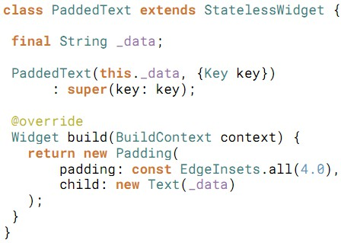
Flutter Widgets
Widgets can be:
Structural elements (e.g., buttons, menus)
Styling elements (themes, styles, fonts)
Layout elements (padding, center, etc.)
And more...

Slide 11
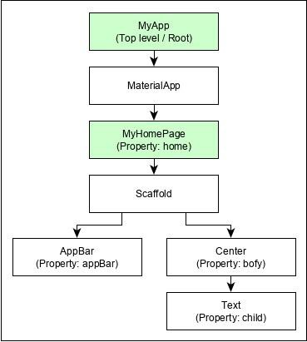
Flutter Widgets
Structure of the widget tree for the "Hello World" example (previously illustrated)

Slide 12
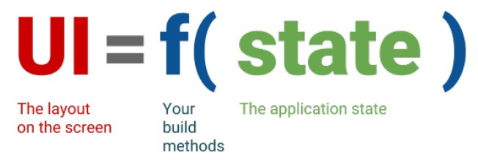
Flutter Widgets
Flutter's approach to rendering user interfaces is declarative.
Widgets declare their appearance based on input configuration (properties) and internal state
Advantage: UI is rebuilt when state changes, ensuring consistent display
Developers only need to describe what the UI should look like for a given state
UI Formula:
Notes:
Việc mô tả giao diện người dùng của mình sẽ trông như thế nào dựa trên trạng thái hiện tại của ứng dụng, thay vì phải chỉ định từng bước để thay đổi giao diện khi trạng thái thay đổi (cách tiếp cận mệnh lệnh - imperative)
Điểm quan trọng là có một "đường ống" mà qua đó dữ liệu (trạng thái) di chuyển. Khi trạng thái thay đổi, Flutter sẽ sử dụng thông tin này để xây dựng lại (rebuild) những phần giao diện người dùng bị ảnh hưởng, đảm bảo giao diện luôn phản ánh đúng trạng thái hiện tại.

Slide 13
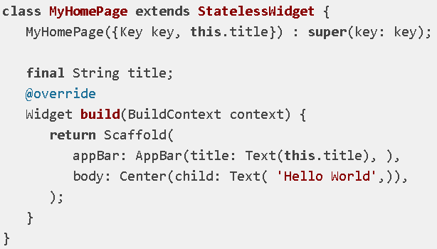
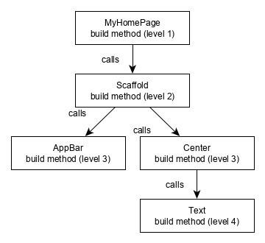
Flutter Widgets
Widget Tree - build() Method Call

Slide 14
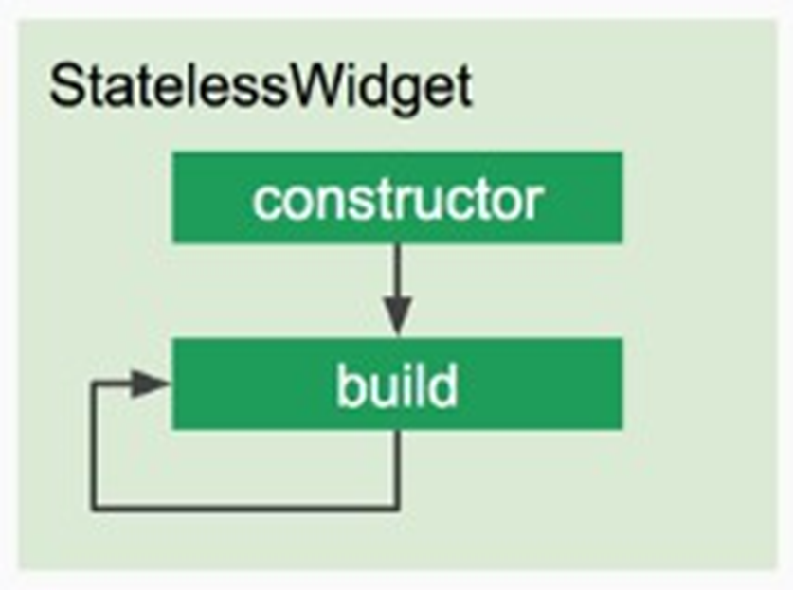
Stateless Widgets
These widgets are completely immutable, which are widgets in Flutter whose state never changes after they are created.
class MyStaticText extends StatelessWidget {
final String text;
MyStaticText({Key key, @required this.text}) : super(key: key);
@override
Widget build(BuildContext context) {
return Text(
text,
style: TextStyle(fontSize: 20.0),
);
}
}
No internal state variables (typically found in a paired State class)
Use for UI components that don’t change, like icons, static text, static images
Improves performance; should be used for most parts of the app
Should use Stateless Widgets for UI elements that do not need to change dynamically in response to user interaction or new data, such as icons, static images, or fixed header text.
Should take up the majority of Flutter applications to improve performance.

Slide 15
Stateful Widgets
A type of Flutter widget that holds state data that can change throughout the life of the widget.
Separation between widget and state: The StatefulWidget class itself is immutable, but the State object it creates can change.
Three reasons to use Stateful Widget:
The widget needs to change data during its lifecycle
The widget performs initialization on creation
The widget disposes of resources at the end.
StatefulWidgets should not be used much for performance reasons.
class MyCounter extends StatefulWidget {
@override
_MyCounterState createState() => _MyCounterState();
}
class _MyCounterState extends State<MyCounter> {
int _counter = 0;
void _incrementCounter() {
setState(() {
_counter++;
});
}
@override
Widget build(BuildContext context) {
return Column(
children: <Widget>[
Text('You have pushed the button $_counter times:'),
ElevatedButton(
onPressed: _incrementCounter,
child: Text('Increment'),
),],);}}

Slide 16
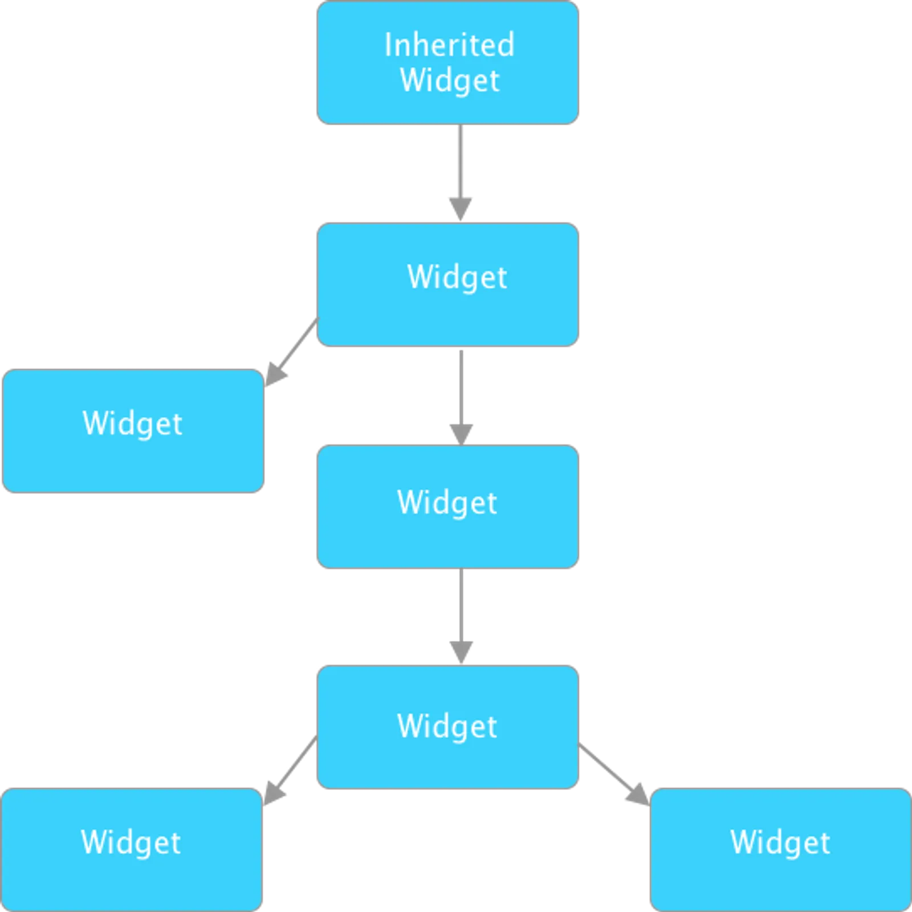
Inherited Widget
An Inherited Widget is a special widget in Flutter that plays an important role in efficiently passing data down the widget tree.
An InheritedWidget can provide any type of data to all its descendants in the widget tree.
The data is passed implicitly, without needing to pass it explicitly through constructor parameters.
When the data inside the InheritedWidget changes, only the descendant widgets that are listening to it will rebuild.
This helps optimize performance.
When to use:
InheritedWidget is especially useful for managing and sharing state or data across a large portion of the widget tree.
Common use cases include:App themes, Provider/BLoC, Authentication state, Locale/Localization, etc.

Slide 17
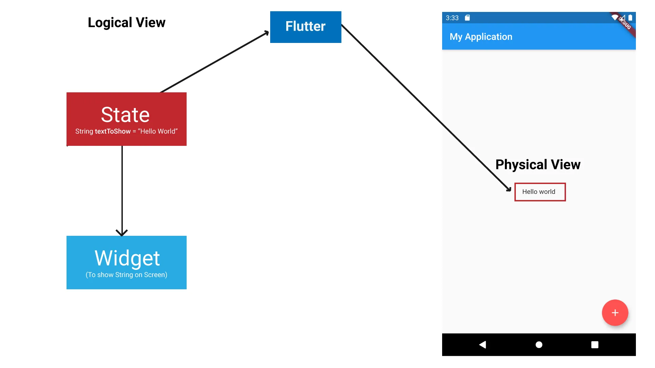
Flutter State
State is any piece of data that can change over the lifetime of the app, examples:
User input (e.g., from a form)
Login state (logged in / not logged in)
A counter value
Data fetched from an API (e.g., a list of articles).
State classification:
Local state: Attached to a specific widget. Example: the current tab in a tab selector or the state of a checkbox
Application state: Global, shared across multiple widgets. Example: user’s login status, items in a shopping cart, or chat messages

Slide 18
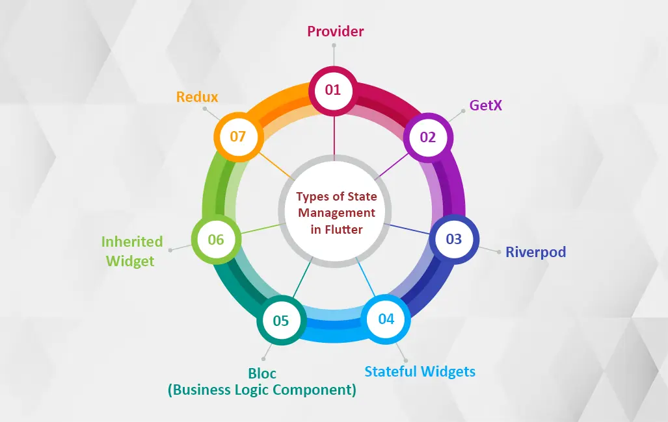
Quản lý trạng thái
State management is one of the most important and necessary tasks in the lifecycle of an application.
It is the method of tracking and handling data changes in the app and ensuring that the UI accurately reflects the current data. It answers questions such as:
What should we do with a page after the user presses the refresh button in the URL?
What should we do when the server updates or refreshes its data?
How do components and services become aware of the current state?
How do we ask the server to update the page?
Popular state management methods:
Provider
GetX
Riverpod
Stateful Widgets
BLoC
Inherited Widget
Redux

Slide 19
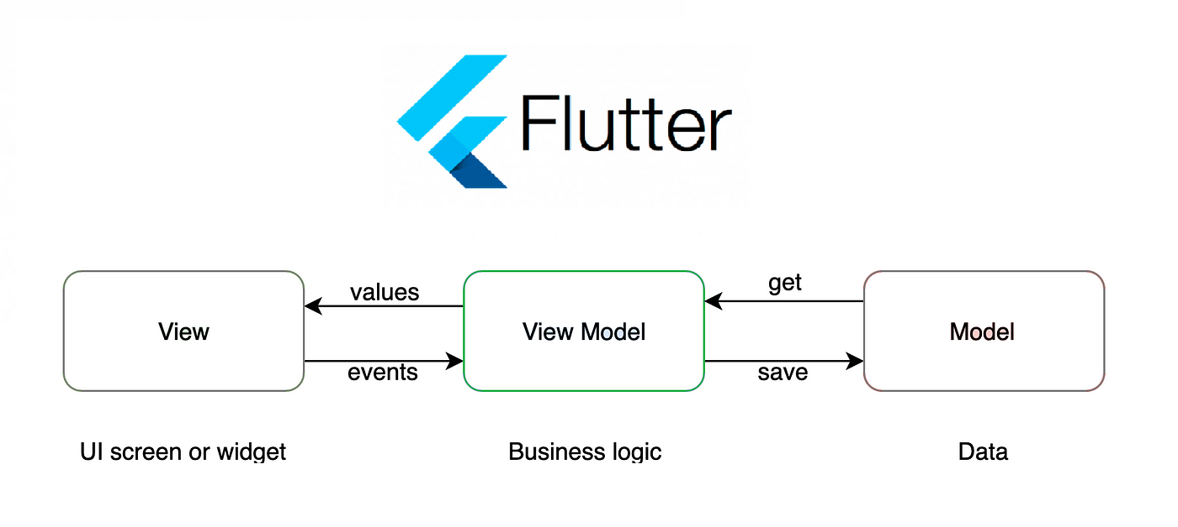
Provider
Description: Provider is a very popular state management solution in Flutter. It allows you to create and manage providers to store app state, enabling widgets to listen to state changes.
Use case: Managing global state or sharing state between multiple widgets.
Pros
Easy to use and widely adopted
Supports state sharing between widgets without passing data via constructors.
Well-integrated with Flutter and easy to test.
Cons
Requires understanding of ChangeNotifier and how Consumer works.
Can become a bit complex in larger apps with many state variables.

Slide 20
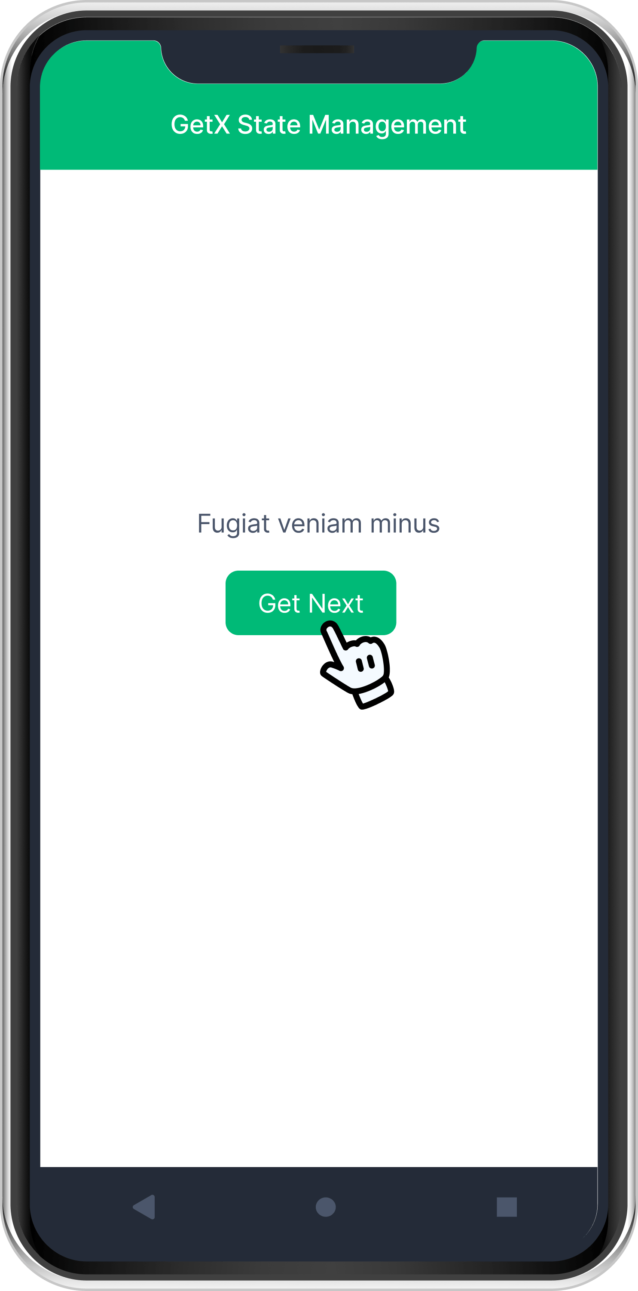
GetX
Description: GetX is a powerful and lightweight state management library for Flutter.
It provides a simple and effective way to handle navigation, state, and dependency injection.
Use case: Global state management, routing, and dependency injection.
Pros:
High performance
Very lightweight and easy to use
Handles state and routing with minimal code
Supports dependency injection with clear syntax.
Cons:
May be harder to maintain in large applications
Smaller community compared to Provider and Riverpod

Slide 21
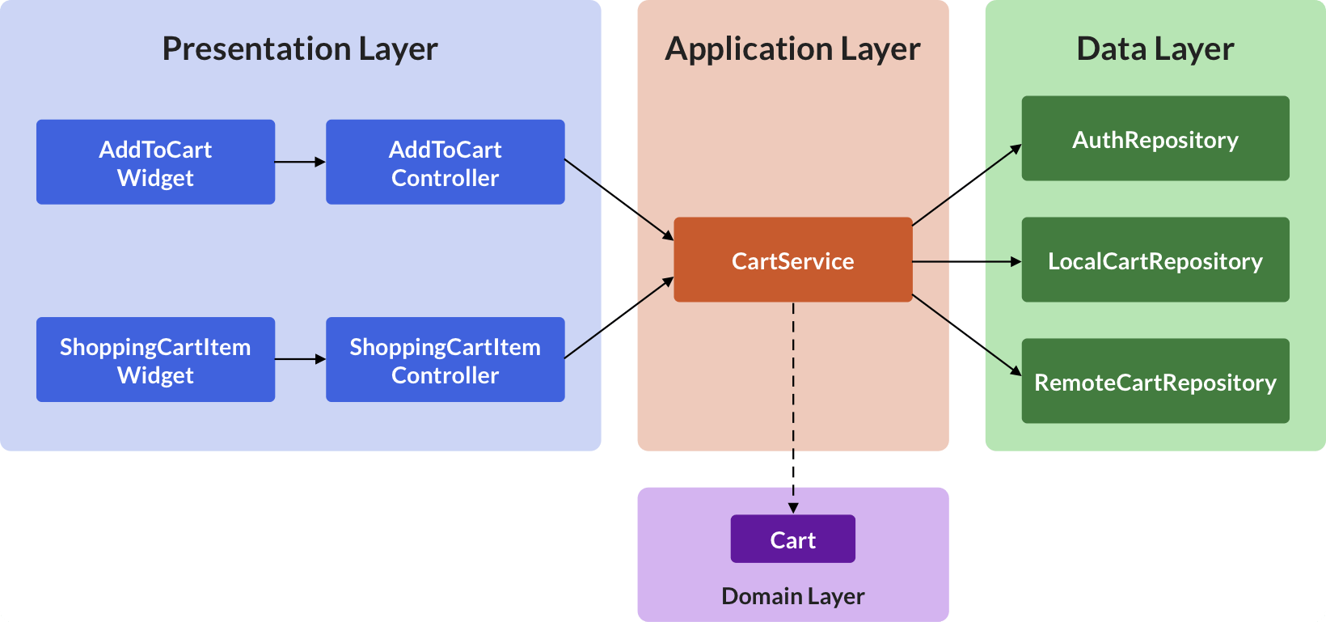
Riverpod
Description: Riverpod is a state management library similar to Provider but with some improvements.
It uses unidirectional data flow and helps reduce issues with readability, testability, and performance.
Use case: Global state management, especially suitable for large, testable applications
Pros:
Reduces runtime errors; helps catch issues at compile time
Does not depend on BuildContext, improving testability
Better performance and code clarity
Cons:
Newer than Provider, requires learning its syntax and concepts

Slide 22
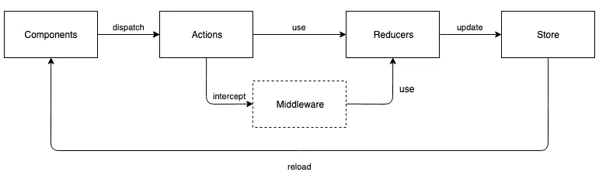
Redux
Description: Redux is a state management model based on the unidirectional data flow principle.
It provides a clear separation between UI and business logic.
Use case: Complex applications or apps requiring strict logic synchronization
Pros:
Clear state management and business logic separation
Easy to test and debug; helps efficiently identify bugs
Cons:
More complex compared to solutions like Provider or Riverpod
May be overkill for small applications

Slide 23
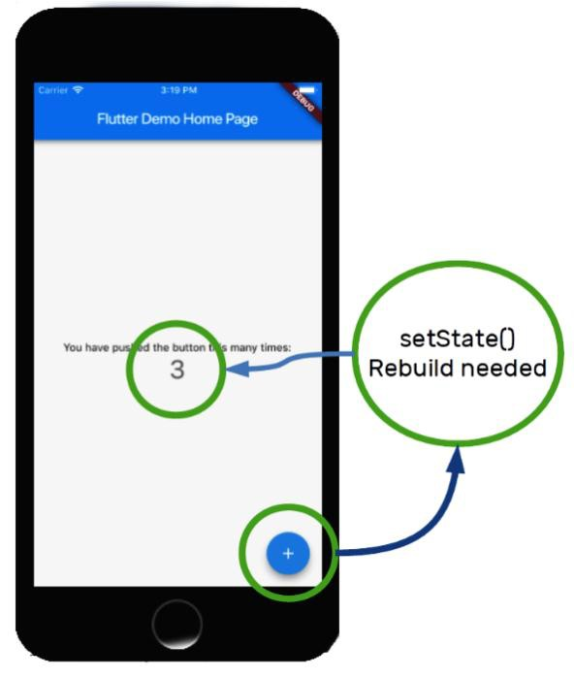
Example
Example: The function of the program is simple: When the user clicks the “+” button at the bottom-right corner, the number at the center of the screen increases by 1.

Slide 24
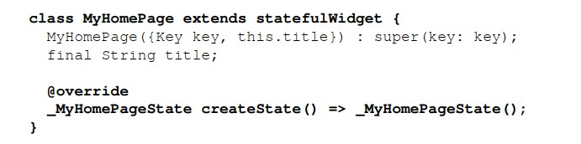
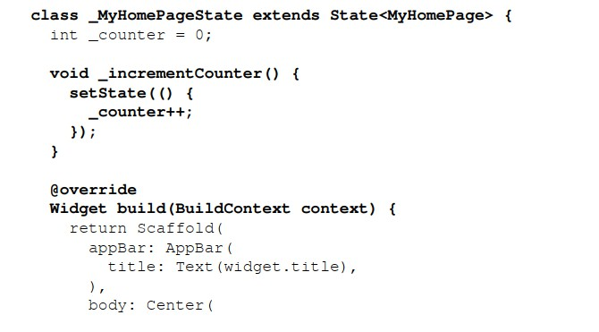
Example
MyHomePage is a StatefulWidget
Example:
It defines a State object named _MyHomePageState
A valid State widget is a class that extends State
MyHomePage must return a valid State object from createState() → this is an instance of _MyHomePageState
The widget's state is defined by the _counter property, which stores the number of button presses.

Slide 25
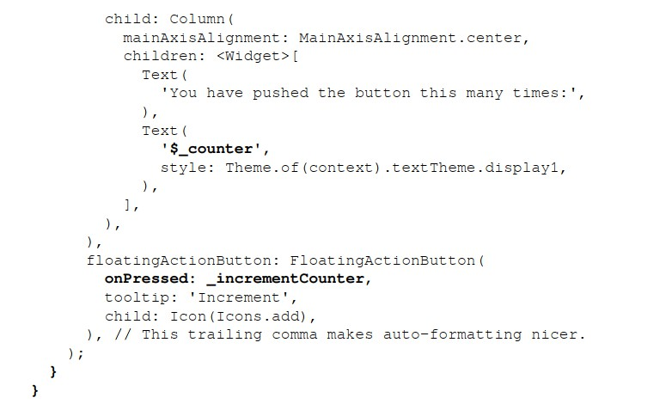
Example
onPressed of the FloatingActionButton receives a function (here _incrementCounter()), which is executed when the button is pressed.
The _incrementCounter() function calls setState(), indicating that the widget’s state has changed.
→ The framework is notified and rebuilds the affected child widgets.

