Slide 2
EXECUTIVE SUMMARY
The Internet today is not just used as another promotional tool with the traditional marketing activities, but used to reassess the web as a tool for growth. It is another way of reaching a wider target audience in the borderless world.
With this in mind, this report entails the huge potential available by using the Internet as a sales and promotional medium for The Bookstore, a book importer and wholesaler specialising in antique and speciality books.
A budget of RM100,000 has been allocated for the implementation of an online web store to complement its existing traditional book business. The main goal is to establish an online electronic commerce (“e-commerce”) web store and build an electronic brand (“e-brand”) to be the foremost antique books leader in the region.

Slide 3
SWOT analysis of existing business model
Strength | Availability of most books requested. Pricing of books is relatively cheaper than foreign competitors. New clientele gained on referrals by existing clientele.
Weakness | Many sales are dependent on telephone calls. This only works during the opening hours of The BookStore. Any calls made after closing hours are missed sales.
Opportunity | Increasing number of overseas customers. Sales portfolio tilting towards that of an overseas market.
Threats | Entrants of new competitors.

Slide 4
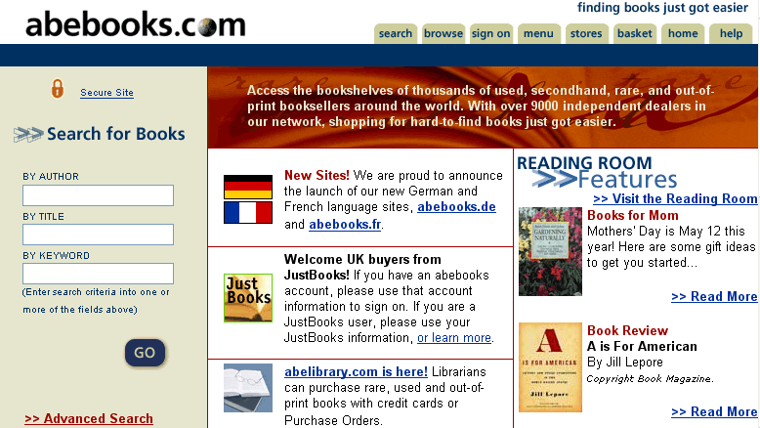
Abebooks.com home page

Slide 5
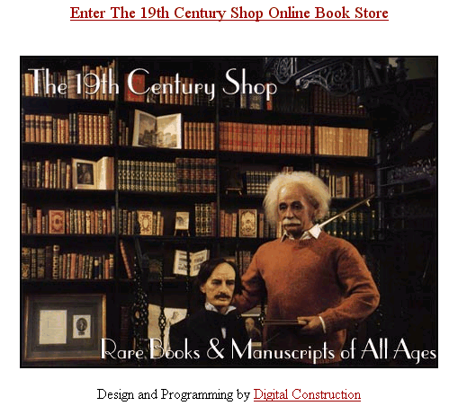
The 19th Century Shop home page

Slide 6
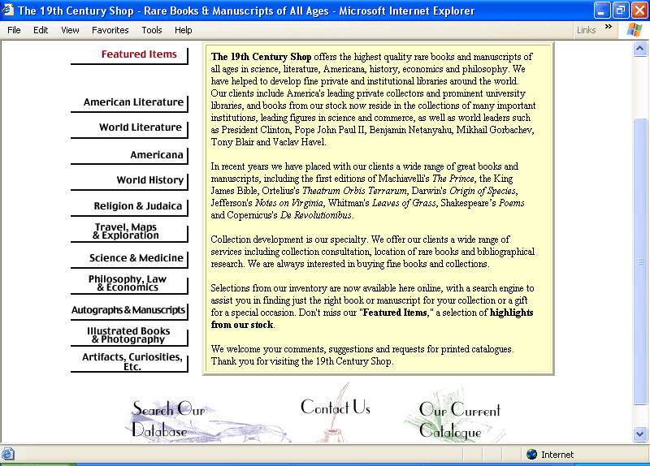
Search by categories for the 19th Century Shop

Slide 7
Breakdown of allocated of budget
No. | Details | Cost (RM)
1. | Web site and search database design (retrieves books by author’s name, title and/or publisher) | 20,000
2. | Secure e-commerce system using SSL (integration of search database with accounting system) | 13,000
3. | PC server and relevant software (dedicated for online project only) | 14,000
4. | Online banner advertisement and exchange programs (RM1,000 x 12 months) | 12,000
5. | Hosting externally by ISP (web space and setup, monthly charges i.e. RM500 x 12 months, and support charges | 10,000
6. | Employing an IT Assistant to maintain and reply all online sales queries (RM2,000 x 12 months) | 24,000
7. | Consultant’s fee | 7,000
 | Total: | 100,000

