Slide 1
FICSES usage
V_2.0
2019/08/10
Akram

Slide 2
Outline
Perquisites
Revisions
High-level architecture
FIC design modifications
HLS modules
Testing
Remarks

Slide 3
Perquisites
This document is based on:
  :drive/FIC_DDR4_Feb22_2019.pdf
  :drive/FICSES.pptx
Please read carefully the above two documents before going any further

Slide 4
Revisions
V_1.0
  Initial version
V_2.0
  Change the connecting lane between FICSES and FIC boards from Lane3 to Lane5
  Add FICSES support to MARK2 boards
  Notes about HLS output to FICSES
  FICSES control can be done using C programs (ficses.h) instead of shell scripts

Slide 5
High-level architecture
Transceiver
Firefly cable
FIC00
FIC01
FIC07
Lane0
ZEUS
Lane1
Lane2
FICSES
KUC1500
Lane3
…..
Lane4
Lane5
Lane6
Lane7
FICSES is attached to ZEUS through PCIexpress.
Two transceivers are available on FICSES. But only one is used at the moment.
FICSES is connected to FIC00 via Lane5 through a Firefly cable.
In FIC00 ~ FIC07, Lane6 and Lane7 are reserved for a ring network to transfer the data and control from/to ZEUS
Lane0~Lane4 can be used for the user network

Slide 6
High-level architecture
The lane used by FICSES to connect to FIC00 has four channels.
As explained in “FICSES.pptx”, ZEUS writes a 512KB binary file to FICSES for each lane: 256KB write data + 256KB zeros (read space initialization).
The received data in FICSES is first stored in a 512KB buffer (256bit x 16384).
Then, only the the lowest 170 bit are forwarded to Aurora. Data[255:170] is discarded!
The 170th bit must be “1” and it is used as the valid signal (Similar to FIC!).
In a similar approach, ZEUS reads the entire 512KB FICSES buffer and store it to a binary file.
The “Read Binary File” contains both the previously write data as well as the new data read from FICSES.
512KB
Write Binary File
256bit x 16384 buffer
Write Space
(256KB)
170bit
170 bit
512KB
PCIe
Aurora
Aurora (Lane3)
Read Binary File
Read Space
(256KB)
170bit
170 bit
ZEUS
FICSES
FIC00

Slide 7
High-level architecture:
Zeus --> FIC00
Write Binary File
256bit x 16384
Buffer
256bit x 16384
Received data
in func4x4
1
{86'h0,1'h1,169'h1}
1
{86'h0,1'h1,169'h1}
1
{1'h1,169'h1}
.
.
.
.
.
.
.
.
.
8192
{1'h1,169'hF}
8192
{86'h0,1'h1,169'hF}
8192
{86'h0,1'h1,169'hF}
8193
{256'h0}
8193
{256'h0}
.
.
.
.
.
.
.
.
.
.
.
.
16384
{256'h0}
16384
{256'h0}
ZEUS
FICSES
FIC00

Slide 8
High-level architecture:
FIC00 --> Zeus
Read Binary File
256bit x 16384
Buffer
256bit x 16384
Received data
in func4x4
1
{86'h0,1'h1,169'h1}
1
{86'h0,1'h1,169'h1}
1
{1'h1,169'h1}
.
.
.
.
.
.
.
.
.
8192
{1'h1,169'hF}
8192
{86'h0,1'h1,169'hF}
8192
{86'h0,1'h1,169'hF}
Sent data
from func4x4
8193
{86'h0,1'h1,169'hA}
8193
{86'h0,1'h1,169'hA}
.
.
.
.
.
.
1
{1'h1,169'hA}
.
.
.
16384
{86'h0,1'h1,169'hB}
16384
{86'h0,1'h1,169'hB}
8192
{1'h1,169'hB}
ZEUS
FICSES
FIC00

Slide 9
FIC design modification:
Top level
To allow receiving/sending packets from/to ZEUS, a new module is added at the top_level:
  In FIC00, the new module (ficses_ctrl.v) receives data/control from FICSES through Lane5, and either pass it to the local func4x4.v, or forward it to other FIC boards through Lane6.
  In FIC01~07, ficses_ctrl.v receives data/control from other FIC boards through Lane6/7, and either pass it to the local func4x4.v, or forward it to other FIC boards through Lane6/7.
FIC00
FIC01
FIC07
fic_top.v
func4x4.v
func4x4.v
func4x4.v
ficses_ctrl.v
…..
ficses_ctrl.v
FICSES
Lane5
ficses_ctrl.v
Lane6
Lane6
Lane6
Lane7
Lane7
Lane7

Slide 10
FIC design modification:
Data/Control path
When writing data (DDR or control reg) from ZEUS to FIC01~07, ficses_ctrl in FIC00 always forwards the write packet via Lane6.
When reading data (DDR or control reg) from FIC01~07, this later should always make sure that the reply packet arrives to FIC00 via Lane7.
  if(board_id[0] == 0) send reply through Lane6
  if(board_id[0] == 1) send reply through Lane7
FIC00
(000)
FIC01
(001)
FIC02
(010)
FIC03
(011)
FIC04
(100)
FIC05
(101)
FIC06
(110)
FIC07
(111)
Lane6
Lane6
Lane6
Lane6
Lane6
Lane6
Lane6
Lane6
Lane7
Lane7
Lane7
Lane7
Lane7
Lane7
Lane7
Lane7

Slide 11
FIC design modification:
Channel partition
Although each lane has 4 channels, in the current design only two channels are used in FICSES:
  Channel 0 (unused)
  Channel 1 (Control): dedicated for register access in func4x4
  Channel 2 (Data): dedicated for DDR data access (write/read)
  Channel 3 (unused)
FIC00
FIC01
func4x4.v
to_ses_ctrl
from_ses_ctrl
to_ses_data
FICSES
from_ses_data
Channel0
Lane5
Channel0
ficses_ctrl.v
Channel0
Lane6
Channel0
Lane6
Channel1
Channel1
Channel1
Channel1
Channel2
Channel2
Channel2
Channel2
Channel3
Channel3
Channel3
Channel3

Slide 12
FIC design modification:
Packet format
From ZEUS, users always send a 256bit packet. In FICSES, only 170bit are kept and transferred to FIC00 in the below format:
Valid:
  Should always be assigned to “1”; otherwise it will be dropped in FICSES
Payload:
  Data to be written to DDR or control reg
Command:
  9'h1: ap_start
  9'h2: write
  9'h3: read
  9'h4: ap_reset
  9'h5: Routing table setting
Valid
1bit
Command
9bit
Dest_board
8bit
Src_board
8bit
Register Address
16bit
Payload
128bit

Slide 13
FIC design modification:
Packet format
Dest_board:
  Board ID to which ZEUS wants to write/read to/from.
  The ID is represented by the Dip_switch value in the board.
  When setting Dest_board to 0xBB, a write packet is broadcasted to all the boards connected in the ring network
  (Read broadcast is not supported at the moment!!)
Src_board:
  Board ID from which the data/control is coming from.
  0xFF represents ZEUS ID
Valid
1bit
Command
9bit
Dest_board
8bit
Src_board
8bit
Register Address
16bit
Payload
128bit

Slide 14
FIC design modification:
Packet format
Register Address:
  SES_STAT 16'hffff // (R/W) Status register
  SES_TEST 16'hfffe // (R) Direct read/write to HLS module
  SES_LUP 16'hfffd // (R) Link up
  SES_DIPSW 16'hfffc // (R) Dipsw value
  SES_LED 16'hfffb // (R/W) LED value.
  SES_CHUP 16'hfffa // (R) Channel up
  SES_TIMER 16'hfff9 // (R) Timer
  SES_SNUM 16'hfff8 // (R/W) Slot number register
  SES_PKT0_3 16'hfff7 // (R) PKT monitor 0~3
  SES_PKT4_7 16'hfff6 // (R) PKT monitor 4~7
  SES_SLOT 16'h2000 // (R/W) Slot register
  SES_DDR_WR_START 16'hDDD1 // (W) For ddr_write_start HLS module
  SES_DDR_RD_START 16'hDDD2 // (W) For ddr_read_start HLS module
  SES_DDR_ADDR 16'hDDDA // (R/W) DDR address
Valid
1bit
Command
9bit
Dest_board
8bit
Src_board
8bit
Register Address
16bit
Payload
128bit

Slide 15
HLS modules:
High-level view
fic_top.v
fucn4x4.v
AXI
Interconnect
from_ses_data
128bit
AXI4
S
HLS
ddr_write
MIG
Interface
ddr4_0
AXI4
ficses_ctrl.v
M
AXI4
HLS
ddr_read
S
to_ses_data
128bit
100 MHz
200 MHz

Slide 16
HLS modules:
DDR Access
Two HLS modules are used in this design similar to “:drive/FIC_DDR4_Feb22_2019.pdf”
  ddr_write: receives data from FICSES and write them to DDR
  ddr_read: read from DDR and send them to FICSES
In func4x4, Payload (128bit) is fetched from the 170bit from_ses_data packet coming from “ficses_ctrl” and fed to “ddr_write” HLS module
Also, func4x4 adds the necessary fields to the read data (128bit) from the “ddr_write” HLS module and send it to “ficses_ctrl” as 170bit to_ses_data packet
  Add the valid bit
  Set the “Dest_board” to 0xFF (Zeus ID)
  Set the “Src_board” to the board ID read from the Dip_switch

Slide 17
HLS modules: ddr_write.c
#include "ap_cint.h"
#include "string.h"
#define MAXDATA 8192
void ddr_write (uint128 input[], volatile uint128 *ddr)
{
#pragma HLS INTERFACE m_axi port=ddr offset=direct max_write_burst_length=256
#pragma HLS INTERFACE axis port=input
int i;
uint128 buff_wr [MAXDATA];
for (i = 0; i< MAXDATA; i++) { // input from FICSES
#pragma HLS PIPELINE
buff_wr[i] = input[i];
}
memcpy((uint128*)ddr, buff_wr, MAXDATA*sizeof(uint128));
return;
}

Slide 18
HLS modules: ddr_read.c
#include "ap_cint.h"
#include "string.h"
#define MAXDATA 8192
void ddr_read (uint128 output[], volatile uint128 *ddr)
{
#pragma HLS INTERFACE m_axi port=ddr offset=direct max_write_burst_length=256
#pragma HLS INTERFACE axis port=output
int i, j;
uint128 buff_rd [MAXDATA];
memcpy(buff_rd, (uint128*)ddr, MAXDATA*sizeof(uint128));
for (i = 0, j=0; i< MAXDATA; i++, j+= 2) {
#pragma HLS PIPELINE
output[j] = buff_rd[i];
output[j+1] = buff_rd[i];
}
return;
}
- FICSES requires that each packet sent over AURORA should be 2 cycles (@100MHz)
- If the HLS output is directly sent to FICSES, you should make sure that each data is sent over 2 cycles. Otherwise, the data will be invalid!
- To respect this requirement, in this example the same data is outputted twice.

Slide 19
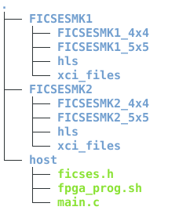
Testing
Example designs that allow users to perform DDR access and check for both MARK1 and MARK2, as well as sw4x4 and sw5x5, is provided under:
/home/asap/fic/FICSES/
The directory structure is as follows:
//MK1 Vivado projects
//MK2 Vivado projects
//FICSES user programs

Slide 20
Testing
The usual control from RaspberryPi is preserved.
From Zeus (through FICSES) users can access any FIC board (MARK1 and MARK2) connected to the ring:
  Start and reset HLS module
    Through the control channel (Ch1)
  Write/read a control register in func4x4/func5x5 on each board
    Through the control channel (Ch1)
  Setup routing table
    Through the control channel(Ch1)
  Write/read data to/from DDR
    Through the data channel (Ch2)

Slide 21
Testing:
./host
The “host” directory contains the following:
  fpga_prog.sh: download bitsream to all 8 boards (by nyacom)
  ficses.h: header file for FICSES control
  main.c: User program

Slide 22
Testing: ficses.h
ficses.h contains the following fuctions:
  int ficses_write_128KB(char* binary_file, int ficses_channel)
  int ficses_read_128KB(char* binary_file, int ficses_channel, int * read_data)
    int read_binary_file (char* binary_file, int * read_data)
    int ficses_start(int channel_enable)
  int ficses_register_access(int BOARD_ID, int command, int address, int payload, int ficses_channel, int * read_data)
    int ficses_register_read(int BOARD_ID, int address, int ficses_channel)
    int ficses_register_write(int BOARD_ID, int address, int payload, int ficses_channel)
    int ficses_ap_start(int BOARD_ID, int ficses_channel)
    int ficses_ap_rst(int BOARD_ID, int ficses_channel)
  int ficses_table_setting(int BOARD_ID, char* table_file, int ficses_channel)
  int user_write_data(float *array, int BOARD_ID, int data_count, int ficses_channel) (Customizable)

Slide 23
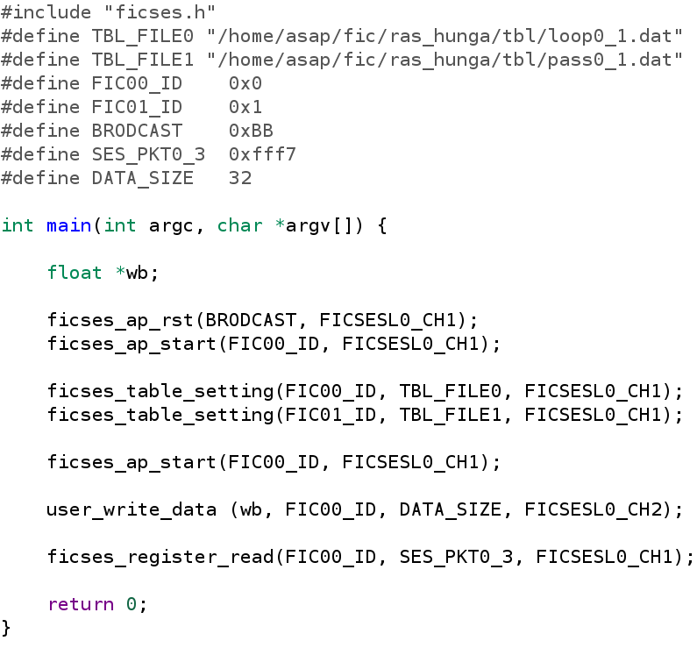
Testing: main.c (example)

Slide 24
Remarks
You must login as root in order to execute the different functions in ficses.h
The board IDs should be always selected as (odd-even-odd-even-..)
To broadcast a write command to a register, use 0xBB as the destination boards.
(Read broadcast is not supported at the moment!!)

