Slide 1
Design Pattern
Note of Head First Design Pattern

Slide 2
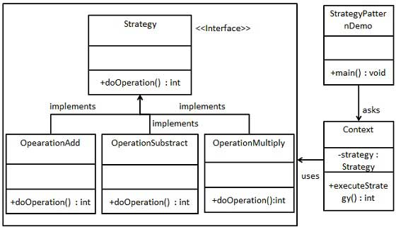
Strategy Pattern
defines a family of algorithms, encapsulates each one, and makes them interchangeable. Strategy lets the algorithm vary independently from clients that use it.

Slide 3
Strategy Class Diagram

Slide 4
Observer Pattern
defines a one-to-many dependency between objects so that when one object changes state, all of its dependents are notified and updated automatically.

Slide 5
Observer Class Diagram

Slide 6
Java in-built API for observer pattern
The java API provides one class and one inteface for implementing observer pattern.
1. java.util.Observable-class
2. java.util.Observer-interface
java.util.Observable:
For being observed,class must extend this class. The subclass becomes observable and override methods of java.util.Observable and other objects can "observe" changes in state of this object.
Methods:
addObserver(Observer o) :add Observer to the list of observers for this subject.
deleteObserver(Observer o) :delete Observers from the list of observers .
notifyObservers() : notify all the observers if object has changed.
hasChanged() :return true if object has changed.
setChanged() :This method marks object has changed
clearChanged() :this method will indicate that subject has no changes or all the observers has been notified.
Java.util.Observer:
The class that performs the "observing" must implement the java.util.Observer interface. There is a single method:

Slide 7
OO Patterns
Strategy – defines a family of algorithms, encapsulates each one, and makes them interchangeable. Strategy lets the algorithm vary independently from clients that use it.
Observer – defines a one-to many dependency between objects shothat when one object changes state, all its dependents are notified and updated automatically.

Slide 8
OO Basics
Abstraction
Encapsulation
Polymorphism
Inheritance

Slide 9
OO Design Principles
Identify the aspects of your application that vary and separate then from what stays the same. Encapsulate what varies.
Program to an interface, not an implementation.
Favor composition over inheritance.

