Slide 1
Introduction to GIT
Created By Oliver Hu

Slide 2
Outlines
Introduction …………………………………..3
Git Internals ………………………….…….....8
Working With Git ………….………………...32
Branching And Merging in Git …….……..51
Tools…………………………………………..57
CVS2GIT Conversion………………………58

Slide 3
Introduction
Distributed vs. Centralized
Snapshot vs. Differences
Version Control Products
Birth of Git

Slide 4
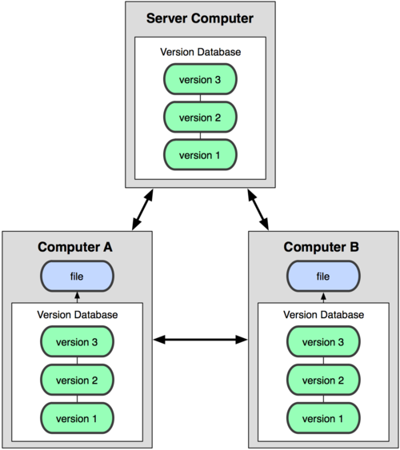

Distributed vs. Centralized
Distributed
Centralized

Slide 5
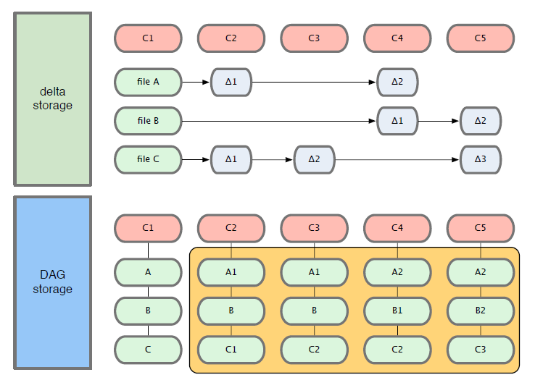
Snapshots vs. Differences

Slide 6
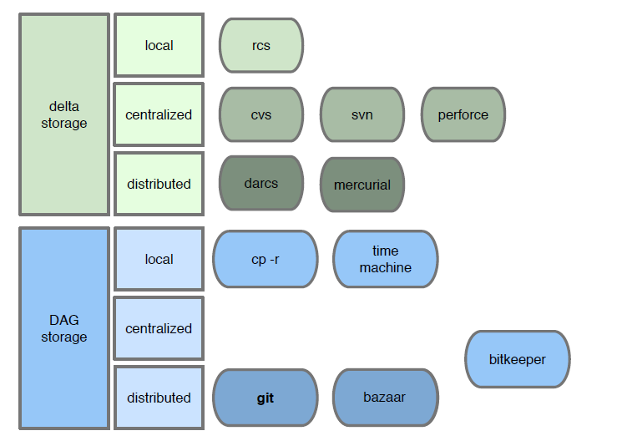
Version Control Products

Slide 7
Birth of Git
2002
Linus uses BitKeeper for tracking Linux
BitKeeper gets better
Linux development scales better
April, 2005
BitMover drops free license
Linux writes his own SCM, Git
Git can merge
June, 2005
Git is officially used to track Linux
Feb, 2007
Git 1.5.0 is released

Slide 8
Git Internal
Everything Has Hash
Git Objects
Blob Object
Tree Object
Commit Object
Tag Object
Object Model
Git directory, Working Directory and Staging Area

Slide 9
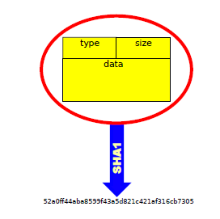
Everything Has Hash
All the information needed to represent the history of a project is stored in files referenced by a 40-digit "object name" that looks something like this:
6ff87c4664981e4397625791c8ea3bbb5f2279a3

Slide 10
Git Objects
Every object consists of three things - a type, a size and content
There are four different types of objects: "blob", "tree", "commit", and "tag".
A "blob" is used to store file data - it is generally a file
A "tree" is basically like a directory
A "commit" points to a single tree, marking it as what the project looked like at a certain point in time
A "tag" is a way to mark a specific

Slide 11
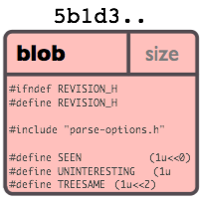
Blob Object
Chunk of binary data
Files with same content (anywhere in repo) share same blob

Slide 12
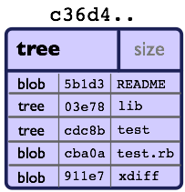
Tree Object
Simple object with pointers to blobs and other trees – like directory.
Two trees have the same hash name if and only if their contents (including, recursively, the contents of all subdirectories) are identical

Slide 13
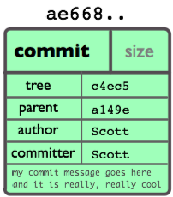
Commit Object
Links a physical state of a tree with a description of how we got there and why.

Slide 14
Commit Object
Commit is defined by
a tree: The SHA1 name of a tree object, representing the contents of a directory at a certain point in time.
parent(s): The SHA1 name of some number of commits which represent the immediately previous step(s) in the history of the project. A commit with no parents is called a "root" commit, and represents the initial revision of a project.
an author: The name of the person responsible for this change, together with its date.
a committer: The name of the person who actually created the commit, with the date it was done.
a comment describing this commit.

Slide 15
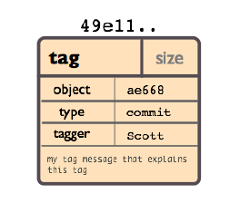
Tag Object
Contains an object name, object type, tag name, the name of the person who create the tag, and a message as can be seen using git cat-file.

Slide 16
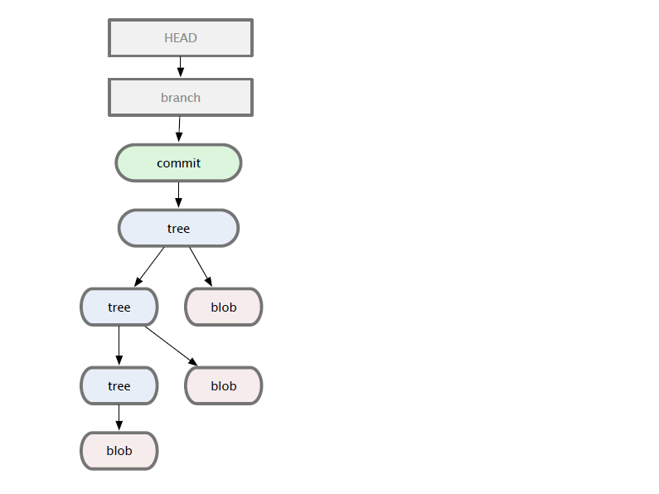
Object Model

Slide 17
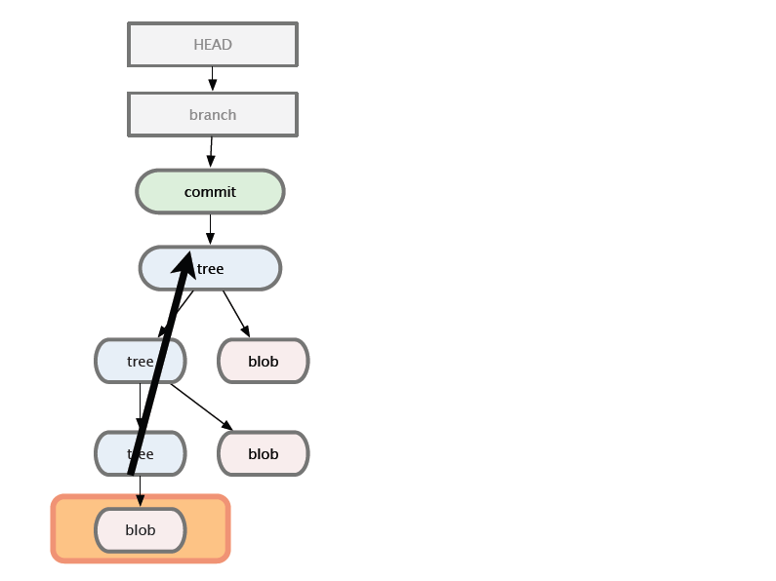
Object Model

Slide 18
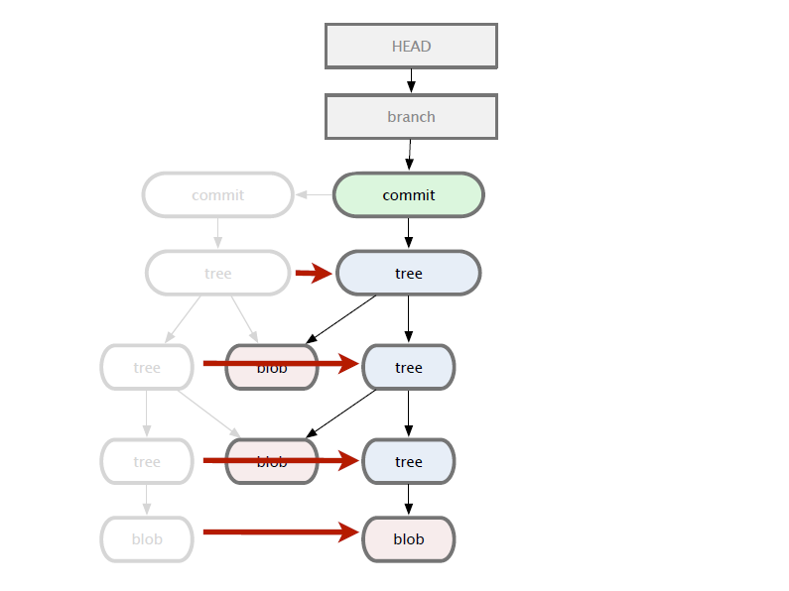
Object Model

Slide 19
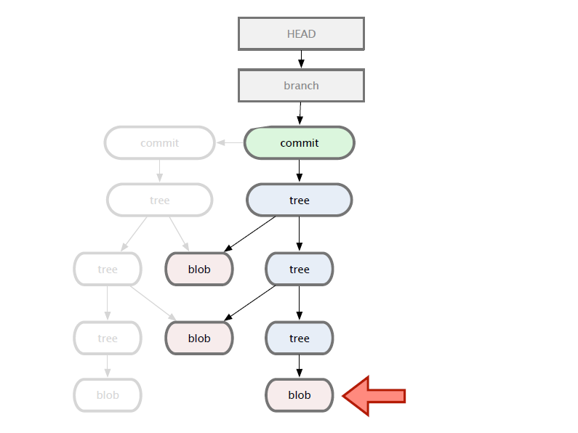
Object Model

Slide 20
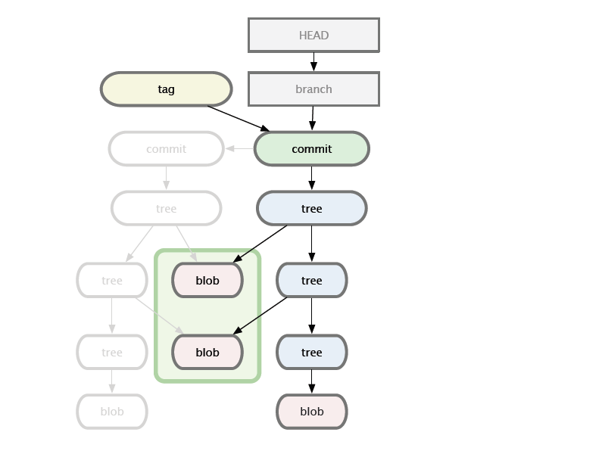
Object Model

Slide 21
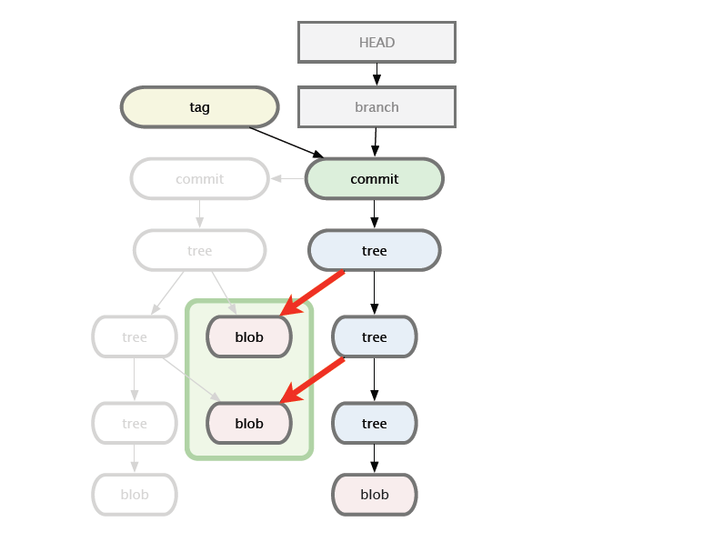
Object Model

Slide 22
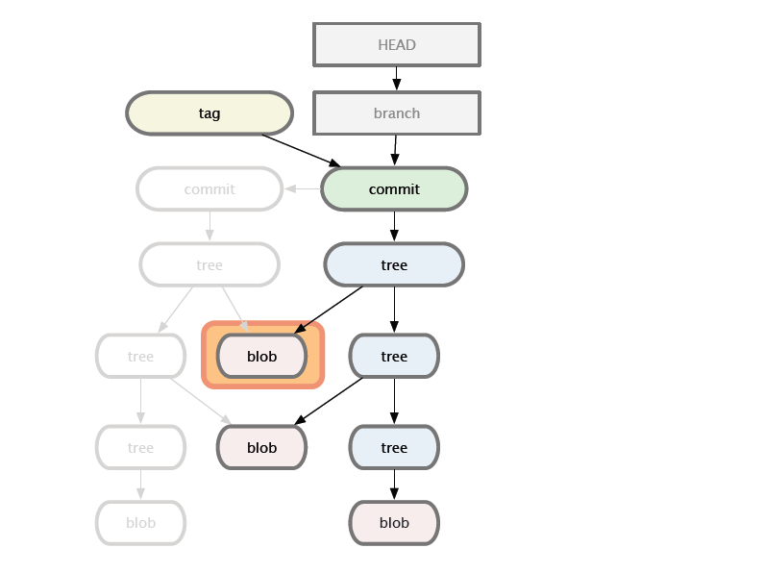
Object Model

Slide 23
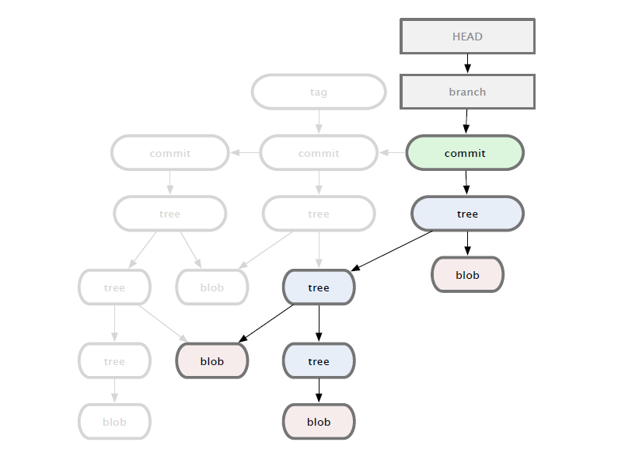
Object Model

Slide 24
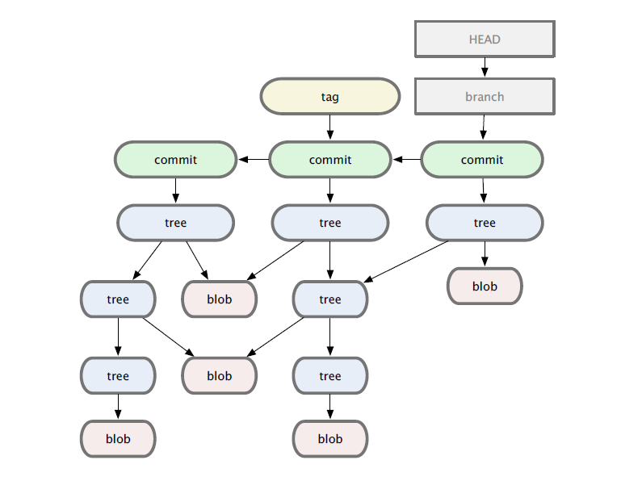
Object Model

Slide 25
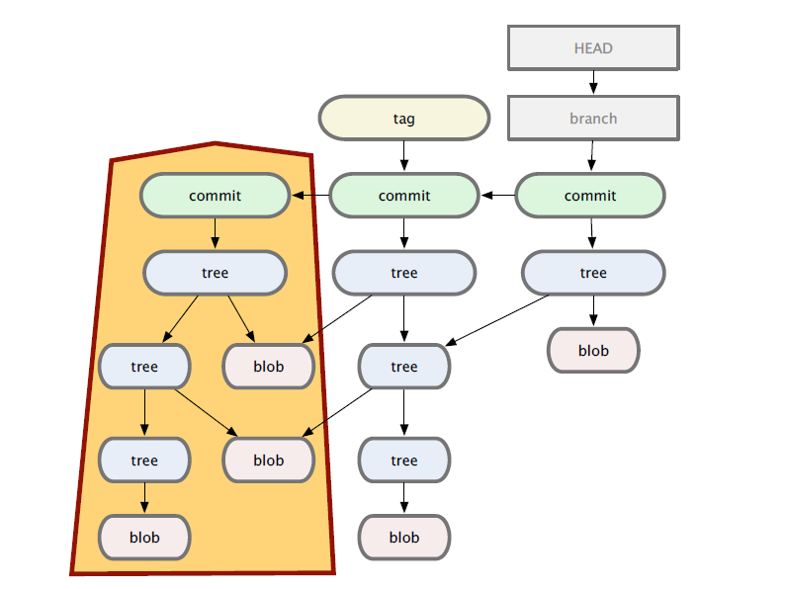
Object Model

Slide 26
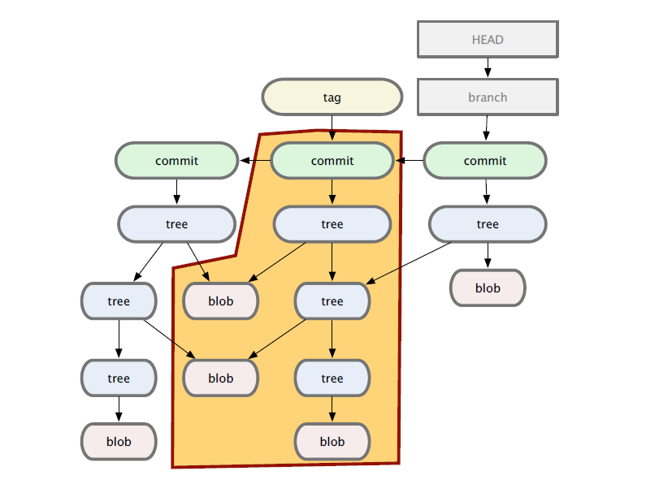
Object Model

Slide 27
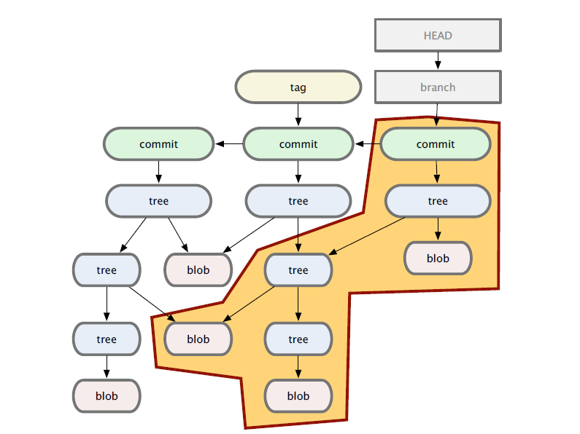
Object Model

Slide 28
Git Directory
The git directory is where git stores its local repository (containing all the git objects in the repository).
The git directory lives at the topmost directory of your codebase.
The git directory is called .git.
$>tree -L 1
.
|-- HEAD # pointer to your current branch
|-- config # your configuration preferences
|-- description # description of your project
|-- hooks/ # pre/post action hooks
|-- index # index file (see next section)
|-- logs/ # a history of where your branches have been
|-- objects/ # your objects (commits, trees, blobs, tags)
`-- refs/ # pointers to your branches

Slide 29
Git Working Directory
The git working directory is where your current working copy of files are kept. Note: these files will be deleted and replaced with files from the git directory whenever you switch branches.
The working directory is a temporary space where files stay while they are being worked with. If all the data were deleted in it, it could be restored from your .git directory as of the last commit.
Git prevents data loss by prompting you to commit, release, or stash data in the working directory before switching between branches.

Slide 30
Git Staging Area: The Index
The Git index is used as a staging area between your working directory and your repository.
You can use the index to build up a set of changes that you want to commit together.
When you create a commit, what is committed is what is currently in the index, not what is in your working directory.

Slide 31

States Switch Among Three

Slide 32
Working with Git
Getting Help
First time Git Setup
Getting a Git Repository
Diffs
Check File Status
Commit
View the Commit History
Undoing Things
Merging vs. Rebasing
Remote Branches

Slide 33
First Time Git Setup
Your Identity
git config --global user.name ”Barack”
git config --global user.email barack@cobrasonic.com
Your Editor
git config --global core.editor vim
Your Diff Tool
git config --global merge.tool vimdiff
Check Your Settings
git config --list
~/.gitconfig

Slide 34
Getting Help
List of common command
git help
Brief help output
git <command> -h
Manual page
man git-<command>
git help <command>
git <command> --help

Slide 35
Getting a Git Repository
Initial a Repository
git init
Cloning an Existing Repository
git clone http://github.com/schacon/grit.git
Create a subdirectory .git
Create a directory grit and a subdirectory .git inside it
Pull down all the data of the repository
Check out the latest working copy

Slide 36
Diffs
Changes between index and working files
git diff
Changes between HEAD and index
git diff –staged
Changes between HEAD and working files
git diff HEAD
Changes between two commits
git diff $commit $commit

Slide 37
Object References
Specific commit ID
full hash | 24b9da6552252987aa493b52f8696cd6d3b00373
short hash | 24b9da
tag | v1.5.6.1
local branch | master
remote branch | origin/master
by message | “:/some text”
checkout | HEAD
last fetch | FETCH_HEAD
previous head | ORIG_HEAD

Slide 38
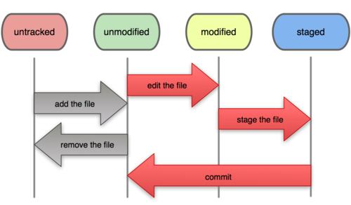
File Status Work Flow
Check status
git status
Track new files
git add filename
Stage modified files
git add filename
Commit your changes
git commit
Remove files
git rm filename

Slide 39



Check File Status
$>git status
# On branch master
# Your branch is behind 'origin/master' by 11 commits, and can be fast-forwarded.
#
# Changes to be committed:
# (use "git reset HEAD <file>..." to unstage)
#
# modified: daemon.c
#
# Changed but not updated:
# (use "git add <file>..." to update what will be committed)
#
# modified: grep.c
# modified: grep.h
#
# Untracked files:
# (use "git add <file>..." to include in what will be committed)
#
# blametree
# blametree-init
# git-gui/git-citool

Slide 40
Commit
Additions
git add <file>
Removal
git rm <file>
Renames
git mv <old> <new>
Commit staged items
git commit –m ”brief comment”
Commit all items
git commit –a –m ”brief comment”

Slide 41
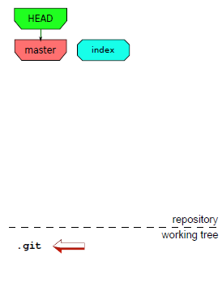
Commit Object Model
mkdir project
cd project
git init

Slide 42

Commit Object Model
echo test > test

Slide 43
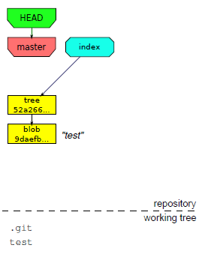
Commit Object Model
echo test > test
git add test

Slide 44
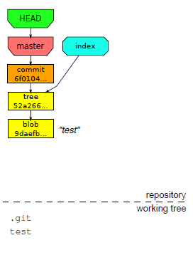
Commit Object Model
echo test > test
git add test
git commit –m ”test”

Slide 45
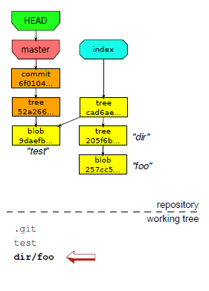
Commit Object Model
echo test > test
git add test
git commit –m ”test”
mkdir dir
echo foo > dir/foo
git add dir/foo

Slide 46
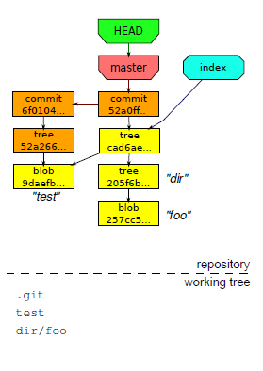
Commit Object Model
echo test > test
git add test
git commit –m ”test”
mkdir dir
echo foo > dir/foo
git add dir/foo
git commit –m ”foo”

Slide 47
Commit Guidelines
Check the file list to be committed with “git status”.
Review the code changed with “git diff” before commit.
Commit only staged files. Add files with “git add file1 file2 …” instead of “git add .” or “git commit –a -m”
Include other’s work with “git pull”, If there are submodules in your project, update every sub-module to the latest version with “git submodule update”,

Slide 48
Commit Message Guidelines
Split the work into one commit per issue, with useful message
The commit message starts with a concise subject at most 50 characters, followed by a blank line, optionally followed by a more detailed explanation
A message example
Short (50 chars or less) summary of changes
More detailed explanatory text, if necessary. Wrap it to about 72 characters or so.
In some contexts, the first line is treated as the subject of an email and the rest
of the text as the body. The blank line separating the summary from the body is
critical (unless you omit the body entirely); tools like rebase can get confused
if you run the two together.
Further paragraphs come after blank lines.
• Bullet points are okay, too
• Typically a hyphen or asterisk is used for the bullet, preceded by a single space,
with blank lines in between, but conventions vary here

Slide 49
View the Commit History
See commit history
git log
git log --pretty=online
Limit by range
git log HEAD~10..
git log -10
Limit by commit attributes
git log –author=fred
Limit by changes to specific path
git log -- path/file
Search for a change
git log –S”some code change”

Slide 50
Undoing Things
Changing your last commit with the current contents of index
git commit --amend
Undo the last commit
git revert HEAD
Unstaging a staged file
git reset HEAD <file>
Unmodifying a modified file
git checkout -- <file>

Slide 51
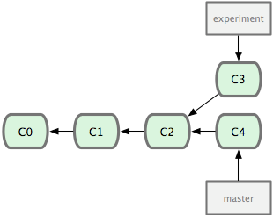
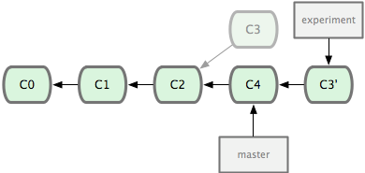
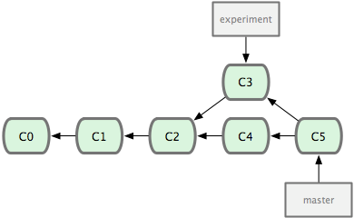
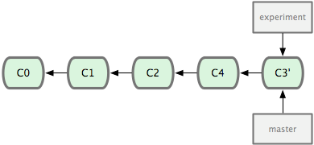
Merging vs. Rebasing
Merge
Rebase
Reapply C3 as a patch on top of C4
A clean history

Slide 52
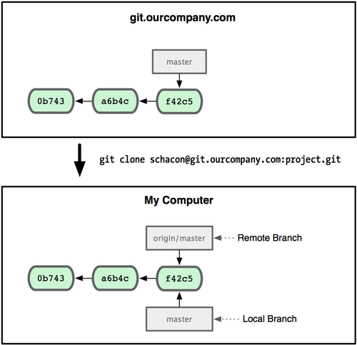
Remote Branches
Suppose a remote git server git.ourcompany.com
Git name it origin/master locally after git clone
Git also creates a local branch master starting at the same place

Slide 53
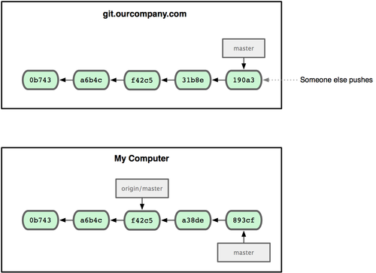
Remote Branches
Someone pushes his work to git.ourcompany.com
You also do some work on your local master branch
The origin/master pointer does not move if you stay out of contact with your origin server

Slide 54
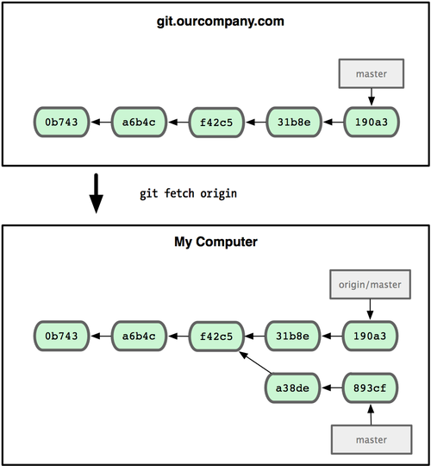
Remote Branches
Run git fetch origin to synchronize your work
It fetch any data from last fetch, update your local database, and move origin/master pointer to up-to-date position

Slide 55
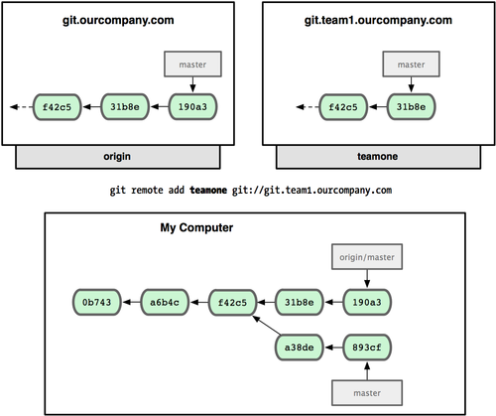
Mutiple Remote Branches
Assume another git server git.team1.ourcompany.com
Run git remote add to add it as a new remote reference to the project

Slide 56
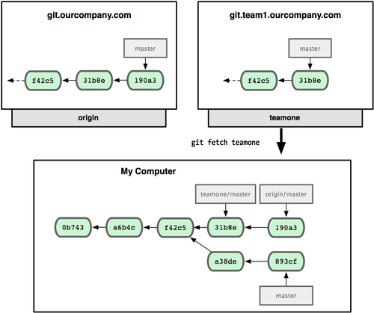
Remote Branches
Run git fetch teamone to fetch everything from the remote teamone server
Git set a remote branch teamone/master to point to the latest commit that teamone server did

Slide 57
Git Tools
Windows
Clients
MsysGIT http://code.google.com/p/msysgit/
TortoiseGit http://code.google.com/p/tortoisegit/
SmartGit http://www.syntevo.com/smartgit/index.html
Diff Tool
DiffMerge http://www.sourcegear.com/diffmerge/index.html
Linux Tools
Clients
SmartGit http://www.syntevo.com/smartgit/index.html
gitk
git-gui

Slide 58
git-daemon
For public, unauthenticated read access to your project
/etc/xinetd.d/git
Restart xinetd daemon: service restart xinetd
Example: git clone git://192.168.123.50/DBSonar65
service git { disable = no socket_type = stream wait = no user = nobody server = /usr/libexec/git-core/git-daemon server_args = --base-path=/opt/git --export-all --user-path=public_git --syslog --inetd --verbose log_on_failure += USERID }

Slide 59
SmartGit Client
A graphical client, running on Windows, Linux and Mac OS X, for Git and SVN
JRE 1.6 or higher is required
Linux/Unix installation
Set the SMARTGIT_JAVA_HOME environment variable to the root path of the Java Runtime Environment 1.6 from SUN
Set the PATH environment variable to include $SMARTGIT_JAVA_HOME/bin:[smartgit_install_path]/bin
Start the application by launching smartgit.sh

Slide 60
CVS2GIT
Requirement
Direct file access to a copy of CVS repository
Python 2, version 2.4 or later
Git version 1.5.4.4 or later
Download cvs2svn-2.3.0.tar.gz from tigris.org
Usage
Conversion
cvs2git --blobfile=cvs2svn-tmp/git-blob.dat --dumpfile= cvs2svn-tmp/git-dump.dat --username=cvs2git /path/to/cvs/repo
Initialize a git repository
mkdir myproject.git; cd myproject.git; git init
Load the dumps to git repository
cat ../cvs2svn-tmp/git-blob.dat ../cvs2svn-tmp/git-dump.dat | git fast-import

Slide 61
CVS2GIT Conversion Steps
Host: 192.168.123.50 User: git
Directories:
cvs2git-tmp -- temporary directory to store the converted dump files
cvs2svn-2.3.0 -- tools of CVS to SVN/GIT
cvsroot -- the CVS repository
gitrepo -- directory containing GIT repositories
CVS convert to GIT:
1. Login to CVS server (clear,192.168.123.9) as root.
ssh root@192.168.123.9
2. Backup the latest CVS repository
cd /var/lib/gforge; tar zcvf cvs.tar.gz cvsroot
4. Transfer the backup file (~3.8GB) to git server (192.168.123.50) as git
scp cvs.tar.gz git@192.168.123.50:
5. In GIT server, restore the backup to /home/git.
tar zxvf cvs.tar.gz
6. Convert CVS modules to GIT repositories, one module to a repository
cd cvs2svn-2.3.0; ./run.sh > run.log 2>&1 &
7. Fix any error if exists: grep ERROR run.log
8. Create GIT repositories from the converted dump files
cd gitrepo; ./run.sh > run.log 2>&1 &
9. Fix any error if exists: grep ERROR run.log

Slide 62
CVS2GIT: cvs2svn-2.3.0/run.sh
#!/bin/bash
git_tmp='/home/git/cvs2git-tmp'
cvsroot='/home/git/cvsroot'
for module in $cvsroot/*
do
project=`basename $module`
./cvs2git \
--blobfile=$git_tmp/$project-blob.dat \
--dumpfile=$git_tmp/$project-dump.dat \
--username=cvs2git \
--encoding='big5' \
--encoding='utf8' \
--encoding='ascii' \
$cvsroot/$project
done

Slide 63
CVS2GIT: gitrepo/run.sh
#!/bin/bash
gitrepo='/home/git/gitrepo'
cvs2git_home='/home/git/cvs2svn-2.3.0'
git_tmp='/home/git/cvs2git-tmp'
cvsroot='/home/git/cvsroot'
for module in $cvsroot/*
do
project=`basename $module`
cd $gitrepo
# initial a git repository
rm -rf $project
mkdir $project
cd $project
git init
# load the dump files into the new git repository using git fast-import
cat $git_tmp/$project-blob.dat $git_tmp/$project-dump.dat | git fast-import
# remove unnecessary tag fixup branches
$cvs2git_home/contrib/git-move-tags.py
# move the bare repository to git reporository
cd $gitrepo
mv $project/.git $project.git
rm -rf $project
# modify description used for gitweb
echo $project > $project.git/description
# set up default bare repository configuration
cp git_config $project.git/config
# create permanent branch develop
cd $project.git
git branch develop
done

Slide 64
Git Statistics
GitStats is a statistics generator for git repositories. It examines the repository and produces statistics, including total files, lines, commits, authors, etc, from the history of it.
GitStats Home - http://gitstats.sourceforge.net/
Requirement
Git
Python
Gnuplot
Getting GitStats by git
git clone git://repo.or.cz/gitstats.git
Run
./gitstats [git_path] [output_path]

Slide 65
References
Git community Book
http://book.git-scm.com/index.html
Git the basics by Bart Trojanowski
http://excess.org/article/2008/07/ogre-git-tutorial/
Pro GIT by Scott Chacon
http://progit.org/book/
Getting Git by Scott Chacon
http://www.slideshare.net/chacon/getting-git
cvs2svn: cvs2git document
http://cvs2svn.tigris.org/cvs2git.html

