Slide 1
A GIT Branching Model
Oliver Hu

Slide 2
Agenda
Branch modeling
Naming guideline
GIT Basics

Slide 3
Branch modeling
Main branches
The Master branch
The Develop branch
Supporting branches
Feature branches
Release branches
Hotfix branches

Slide 4
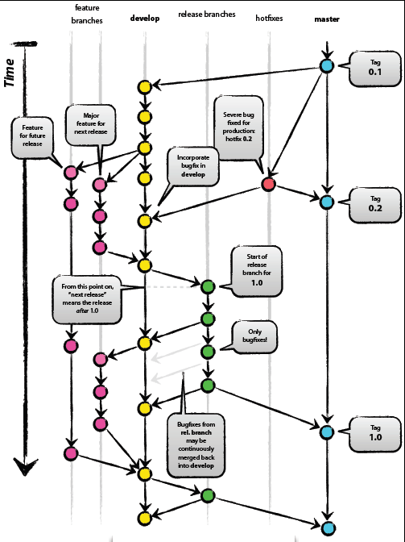
The Branching Model

Slide 5
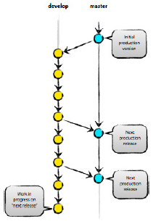
Master and Develop Branches
Master - reflects a production-ready state
Develop – reflects a state with the latest delivered development changes for the next release.
When the develop branch reaches stable and is ready to be released, all the changes should be merged into master and tagged with a release number

Slide 6
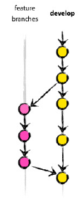
Feature Branches
Must branch off from : develop
Must merge back into: develop
Branch naming convention: topic-*
Used to develop new features for the upcoming release.

Slide 7
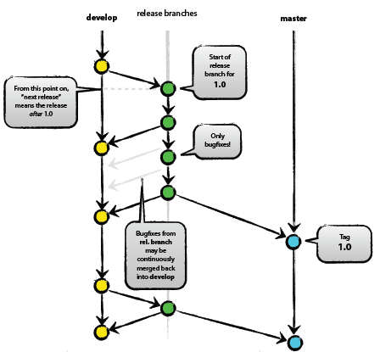
Release Branches
May branch off from : develop
Must merge back into: develop
and master
Naming convention: release-*
A new release branch is created
when the develop is ready for
release.
Do the last-minute double check,
fix minor bugs and prepare the
meta-data for a release
Develop branch stops to accept
new features while the release
branch is alive

Slide 8
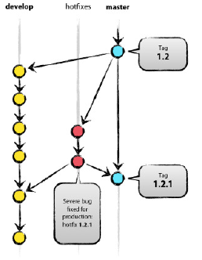
Hotfix Branches
May branch off from : master
Must merge back into: develop and master
Branch naming convention: hotfix-*
Hotfix branches are like release branches which are ready for a new production release, though unplanned.

Slide 9
Naming Guideline
Semantic versioning
Release naming convention
Branch naming convention

Slide 10
Semantic Versioning
X.Y.Z (Major.Minor.Patch) where X, Y, and Z are integer
A public API is well defined in both code and document
Backward compatible bug fixes increment the patch version
Backwards compatible API additions/changes increment the minor version
Backwards incompatible API changes increment the major version
Major version zero (0.y.z) is for initial development, version above 1.0.0 defines the public API
The content of a version MUST NOT be modified after it is released

Slide 11
Branch Naming Convention
Master: master
Develop: develop
Release: release-*
Feature: topic-*
Hotfix: hotfix-*
* is alphanumeric plus dash [a-zA-Z-]

Slide 12
Release Naming Convention
The tag name of the master (stable) branch
Format: product.X.Y.Z
Product is the product name which can be dbaegis, dbsonar, etc.
X.Y.Z (Major.Minor.Patch) follows the rule of semantic versioning rules

Slide 13
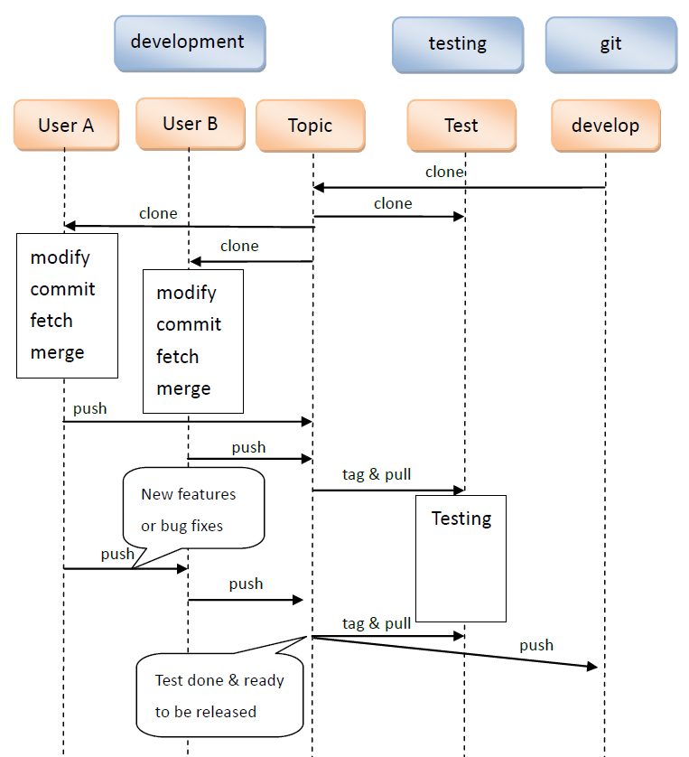
Project Work Flow
Developers new a topic branch on develop server
Developers clone their private branches
QA team sync the topic branch on testing server
Developers modify programs and push to topic
QA team sync with topic and test
After the test is done, all the commits are pushed back to develop@git for releasing

Slide 14
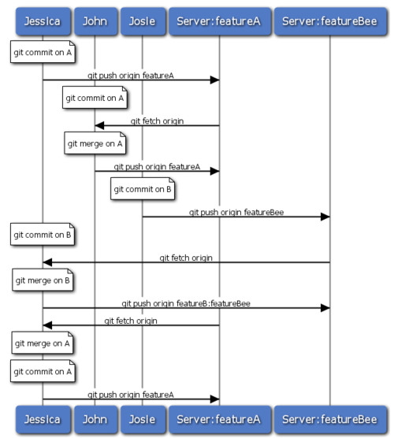
Personal Work Flow
Always work on feature branches
Commit your work on local repository
git commit
Fetch other’s work from remote repository
git fetch
Merge other’s work
git merge
Push back your changes into remote repository
git push

Slide 15
Roles and Privileges
Branch | Feature | Release | Hotfix | Develop | Master
Location | Dev | Test | Dev | Git | Git
Integrator | R | RW | R | RW | RW
Developer | RW | RW | RW | R | R

Slide 16
Responsibilities
Integrator: maintain the public branches
Create public branches, e.g. master, develop, topic, etc.
Create tags
Merge changes back into public branches
Developer: new features or fix bugs on development branches
Commit changes development branches, e.g. feature, hotfix.

Slide 17
Git Tools
Windows
Clients
MsysGIT http://code.google.com/p/msysgit/
TortoiseGit http://code.google.com/p/tortoisegit/
Diff Tool
DiffMerge http://www.sourcegear.com/diffmerge/index.html
Mac Tools
Clients
Git-Y http://gityapp.com/ $0
Gitbox http://gitboxapp.com/ $39
Tower http://www.git-tower.com/ $59
Diff Tool
File Merge (included with XCode)

Slide 18
References
GIT home
http://git-scm.com/
A successful GIT branching model
http://nvie.com/posts/a-successful-git-branching-model/
Pro GIT by Scott Chacon
http://progit.org/book/
Semantic versioning
http://semver.org/

