Slide 1
Final project- Reliable multicast retransmission scheme
B06901049 林泓均
B06901096 黃昱翰

Slide 2
Outline

Slide 3
Contribution

Slide 4
Contribution
Previous papers mainly focus on maximize the throughput among multicast channel.
The issue of reliability or

Slide 5
System model
Packets Error Probability determination

Slide 6
Parameters
Explanation | Reference Value
Transmitted power of a base station | 38 dBm(6.3W)
Maximum range a base station can transmit | 2000 m
Carrier central frequency | 3 GHz
Height of the base station | 10 m
Height of the user equipment | 1.5 m
Power spectral density of the noise | -134 dBm/Hz
Transmission gain of the transmitter and receiver | 10 dB
Rayleigh fading variance
Numerology (normal CP) | 2 (4 slots, 60kHz SCS)
Modulation | QPSK

Slide 7
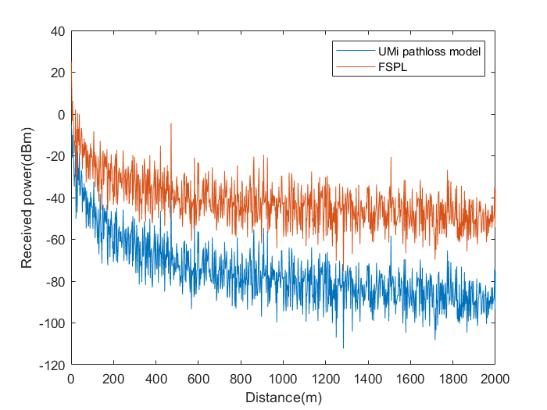

Error Probability determination (Assumption)
The scenario is assumed under UMi-street canyon (Urban Micro cell), NLOS.
There is only one base station(BS), and the user equipment(UE) are uniformly distributed on a circular disk.
The BS is type 1-C and an Medium Range Base Station
From TR 38.901 V16-1 Table 7.4.1-1, the pathloss model is
Using log-normal shadowing with

Slide 8
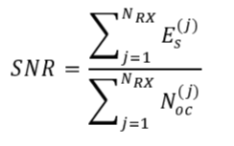
Error Probability determination
The minimum received energy of symbol is -112dBm/Hz, defined in clause 4.4.4.2 in TS 38.521-4.
Also in TS 38.521-4, the clause 4.4.3.2 describes the noise the power spectral density as -134dBm/Hz.
The UE with SNR < 22dB will not be considered.

Slide 9
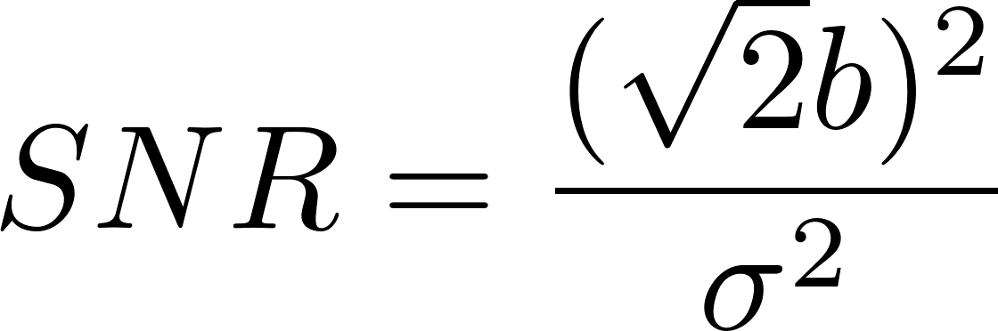

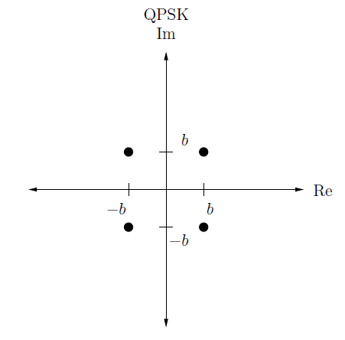
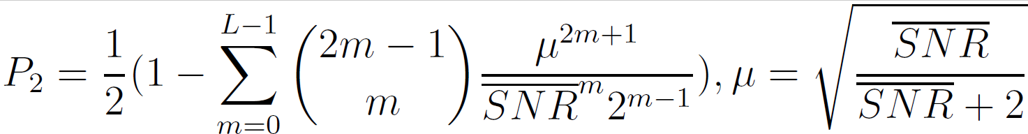


Error Probability determination (Consider Rayleigh fading channel)
Assume the detection is coherent, and the modulation is QPSK.
The bit error rate should be
Assume the data is encoded with an $\left(n,k\right)$ code with minimum distance
We consider the diversity to be
Therefore, the pairwise error probability should be as follows:
We can thus derive the union bound for codeword error rate:

Slide 10
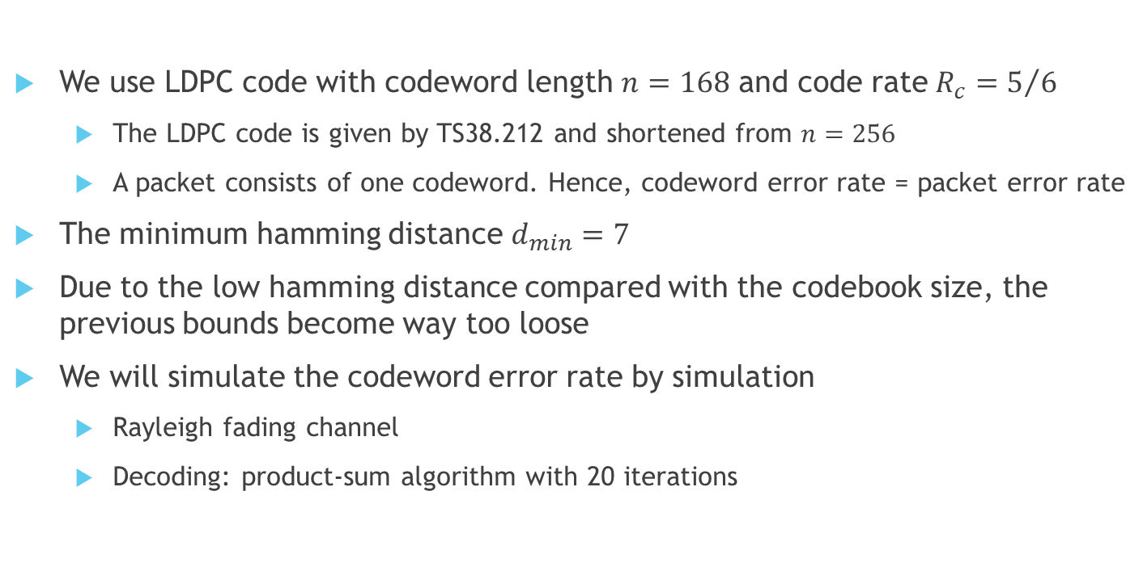
Error Probability determination (Consider Channel Coding)
We use LDPC code with codeword length $n=168$ and code rate$R_{c}=5/6$
The LDPC code is given by TS38.212 and shortened from $n=256$
A packet consists of one codeword. Hence, codeword error rate = packet error rate
The minimum hamming distance $d_{min}=7$
Due to the low hamming distance compared with the codebook size, the previous bounds become way too loose
We will simulate the codeword error rate by simulation
Rayleigh fading channel
Decoding: product-sum algorithm with 20 iterations

Slide 11
System model
Retransmission scheme

Slide 12
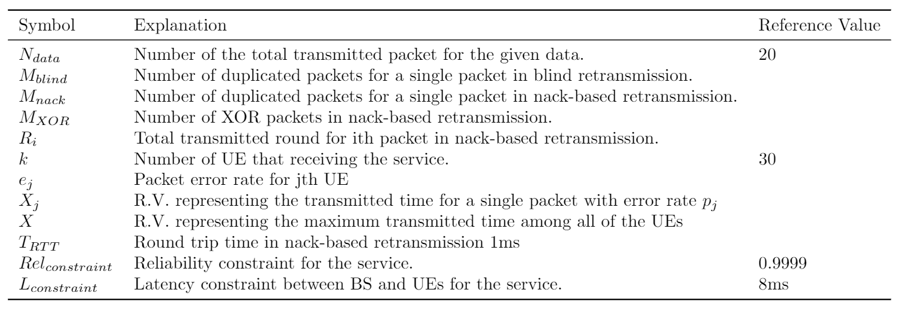
Parameters

Slide 13
Intro to retransmission
Despite of the channel coding, the transmission may fail if we only transmitted once.
To maintain the reliability, retransmission is essential.
Three typical retransmission scheme
Blind retransmission
Nack-based retransmission
HARQ retransmission
In multicast scenario, we usually consider to use blind retransmission and nack-based retransmission

Slide 14

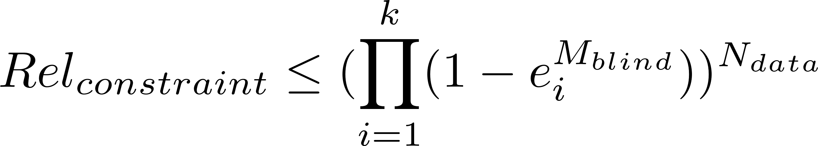
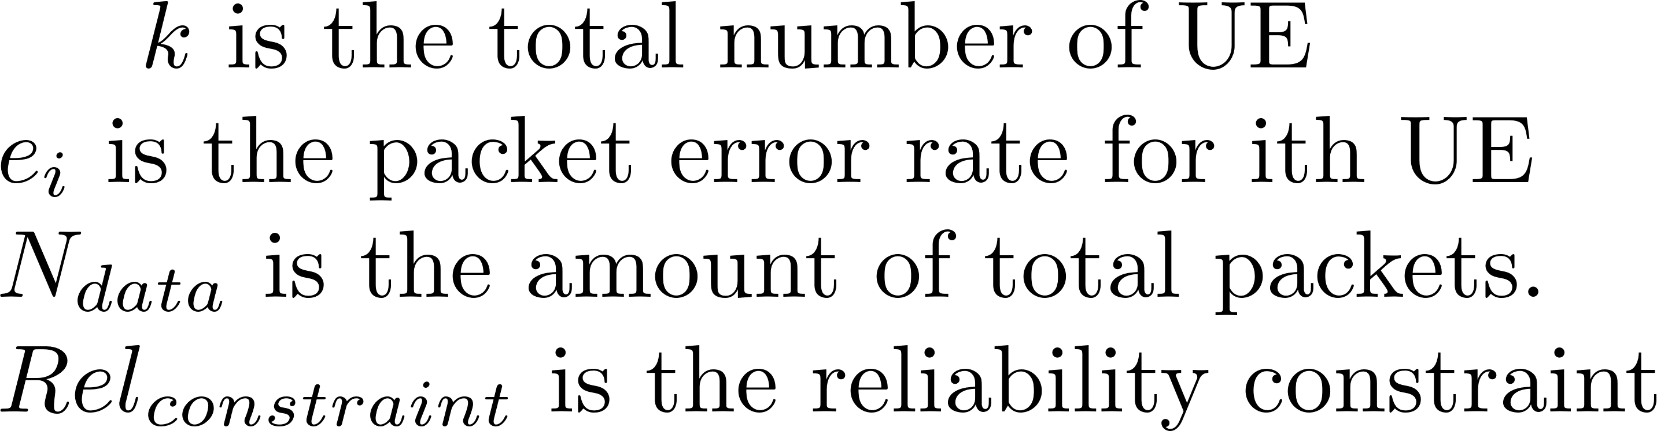
Blind Retransmission
BS will transmit all needed packets without feedback.
Assume there are no round trip time (RTT) in blind retransmission.
Bad at resource utilization, but merely having latency.
Already used in lots of low latency requirement application, such as V2X.
To reach the constraint of reliability, the transmission packets number for a single packet can be determined by selecting the minimum which satisfy the following inequality

Slide 15







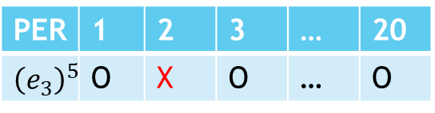
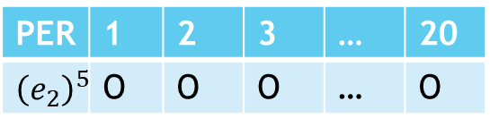
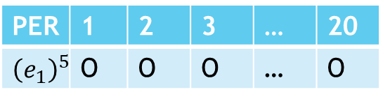
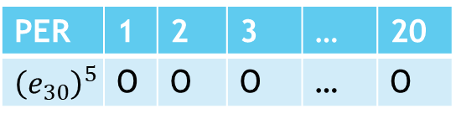
Blind Retransmission
Table indicates receiving successfully or not.
PER | 1 | 2 | 3 | … | 20
$${\left(e_{1}\right)}^{5}$$ | O | O | O | … | O
1
3
19
1
3
19
PER | 1 | 2 | 3 | … | 20
$${\left(e_{2}\right)}^{5}$$ | O | O | O | … | O
1
3
19
1
3
19
PER | 1 | 2 | 3 | … | 20
$${\left(e_{3}\right)}^{5}$$ | O | X | O | … | O
1
3
19
……
2
4
20
……
2
4
20
PER | 1 | 2 | 3 | … | 20
$${\left(e_{30}\right)}^{5}$$ | O | O | O | … | O
2
4
20
2
4
20
The transmission this time is not reliable!
For a reliable transmission, we assume all UEs can decode all of the data correctly.
2
4
20

Slide 16

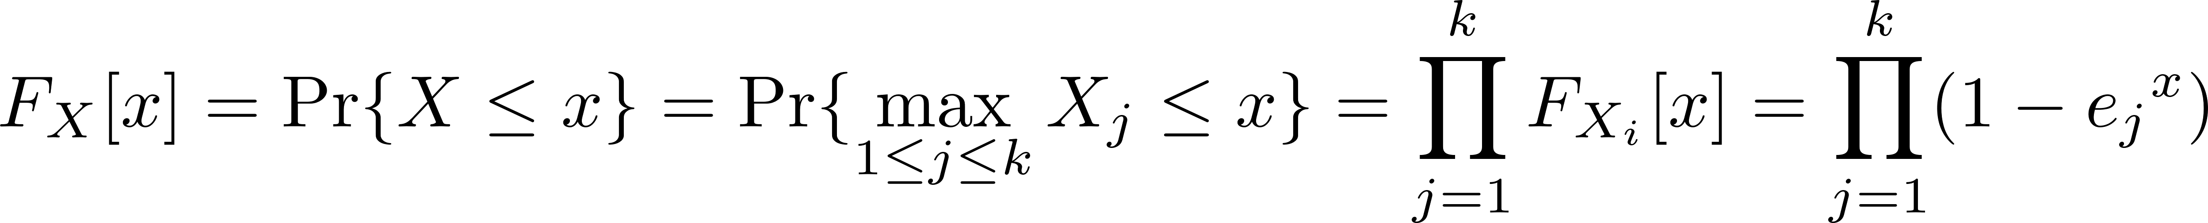
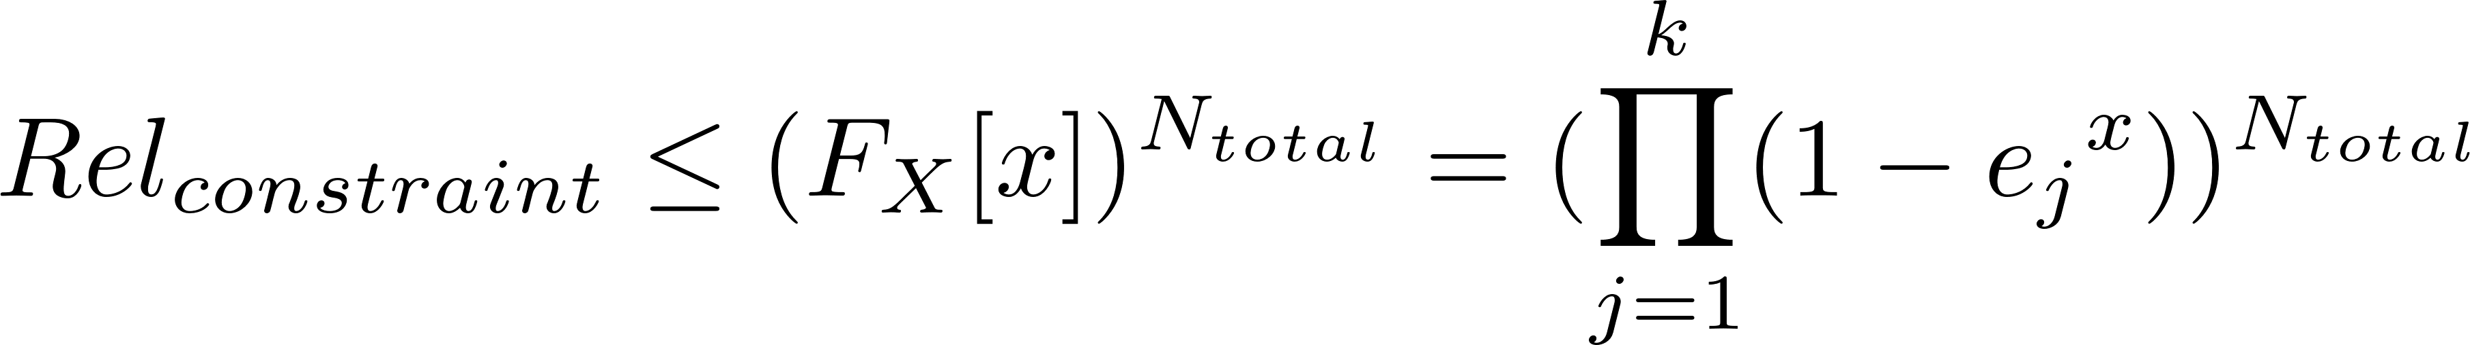
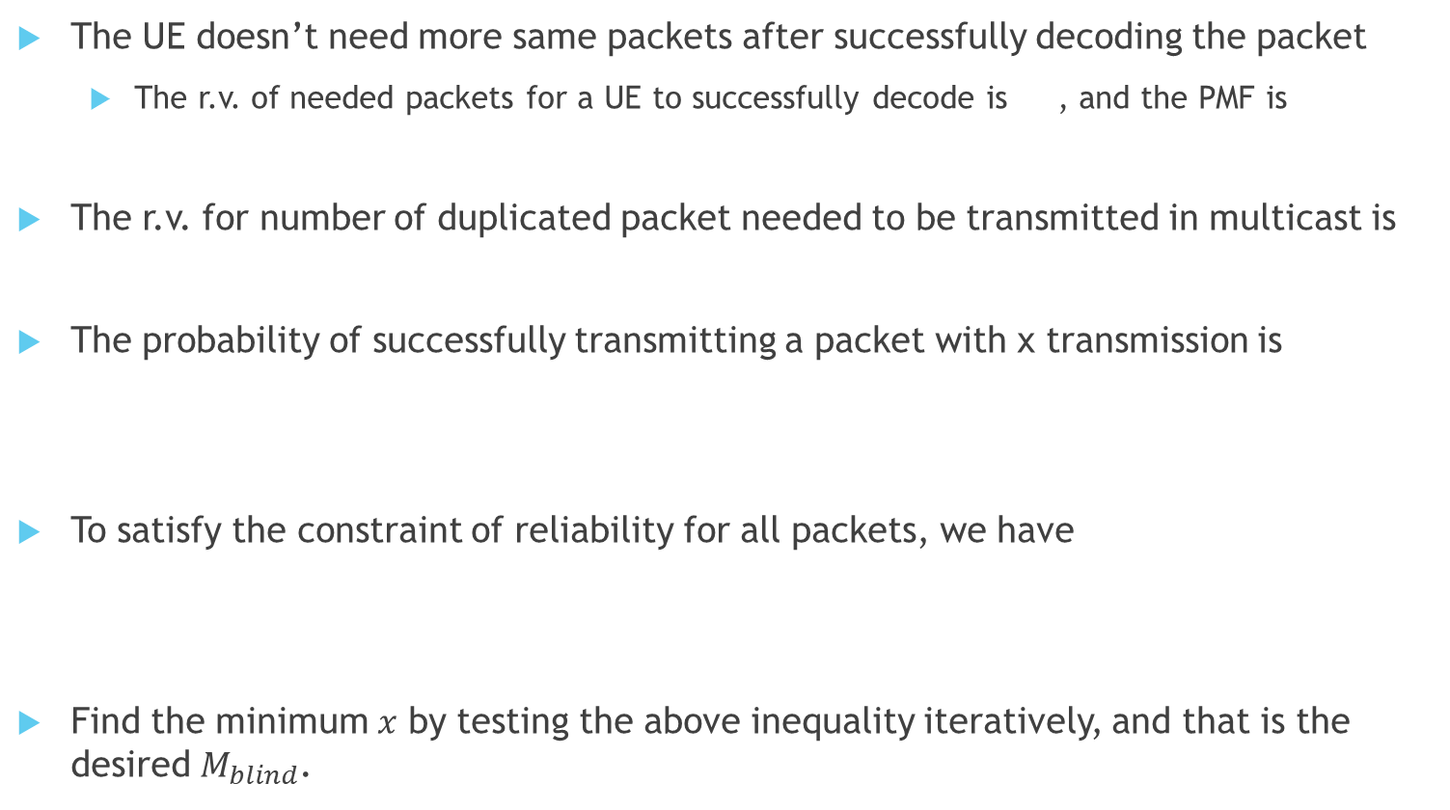
Mathematical derivation
The UE doesn’t need more same packets after successfully decoding the packet
The r.v. of needed packets for a UE to successfully decode is , and the PMF is
The r.v. for number of duplicated packet needed to be transmitted in multicast is
The probability of successfully transmitting a packet with x transmission is
To satisfy the constraint of reliability for all packets, we have
Find the minimum $x$ by testing the above inequality iteratively, and that is the desired $M_{blind}$.

Slide 17
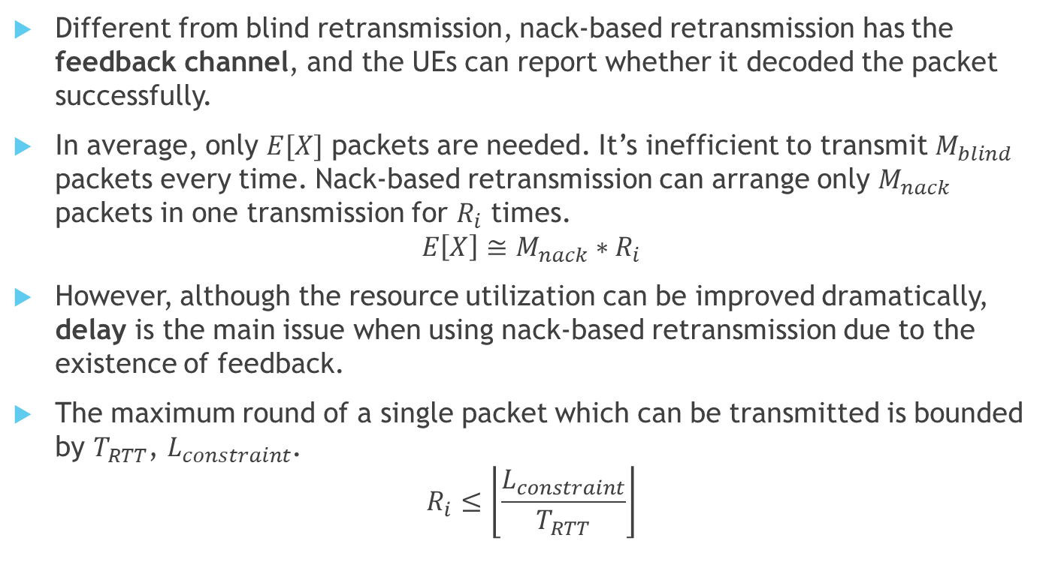
Nack-based Retransmission
Different from blind retransmission, nack-based retransmission has the feedback channel, and the UEs can report whether it decoded the packet successfully.
In average, only $E[X]$ packets are needed. It’s inefficient to transmit $M_{blind}$ packets every time. Nack-based retransmission can arrange only $M_{nack}$ packets in one transmission for $R_{i}$ times.
$$E\left[X\right]≅M_{nack}∗R_{i}$$
However, although the resource utilization can be improved dramatically, delay is the main issue when using nack-based retransmission due to the existence of feedback.
The maximum round of a single packet which can be transmitted is bounded by $T_{RTT}$, $L_{constraint}$.
$$R_{i}≤\left\lfloor \frac{L_{constraint}}{T_{RTT}}\right\rfloor$$

Slide 18

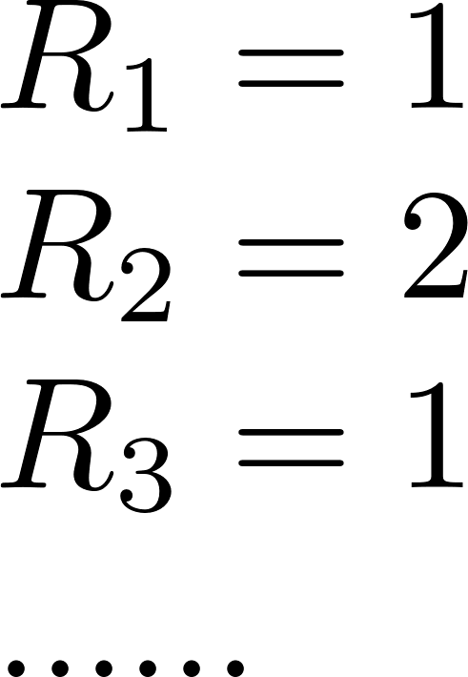
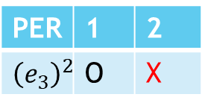
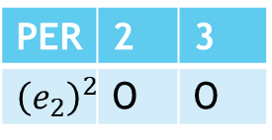
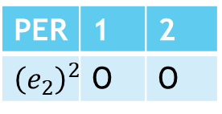
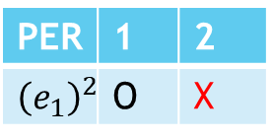

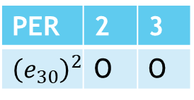
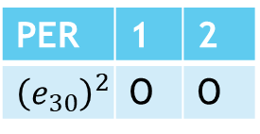
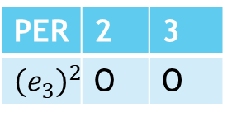
Nack-based Retransmission
PER | 1 | 2
$${\left(e_{1}\right)}^{2}$$ | O | X
PER | 2 | 3
$${\left(e_{1}\right)}^{2}$$ | O | O
1
3
4
1
3
4
PER | 1 | 2
$${\left(e_{2}\right)}^{2}$$ | O | O
PER | 2 | 3
$${\left(e_{2}\right)}^{2}$$ | O | O
……
2
2
5
2
PER | 1 | 2
$${\left(e_{3}\right)}^{2}$$ | O | X
2
PER | 2 | 3
$${\left(e_{3}\right)}^{2}$$ | O | O
5
nack1
nack3
……
nack2
……
nack2
UE1 and UE3 transmit nack2 to the position pre-arranged by the BS to inform that pkt2 didn’t receive successfully for some Ues. Thus the pkt2 is retransmitted.
PER | 1 | 2
$${\left(e_{30}\right)}^{2}$$ | O | O
PER | 2 | 3
$${\left(e_{30}\right)}^{2}$$ | O | O

Slide 19
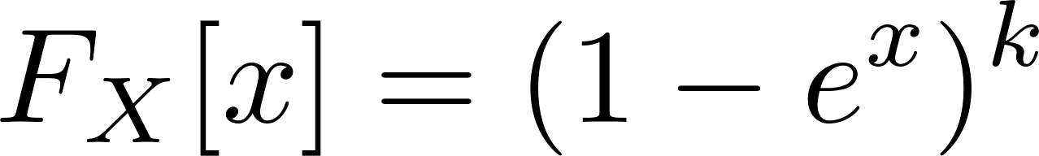
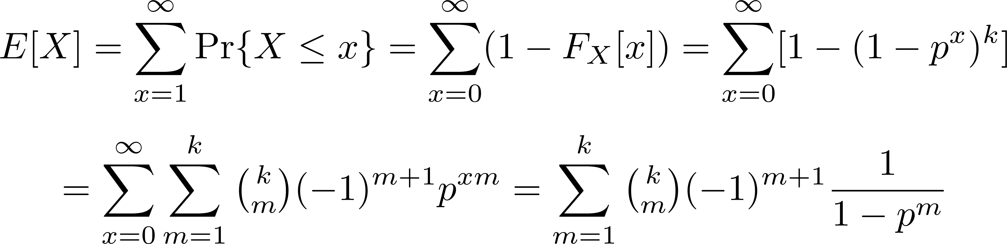
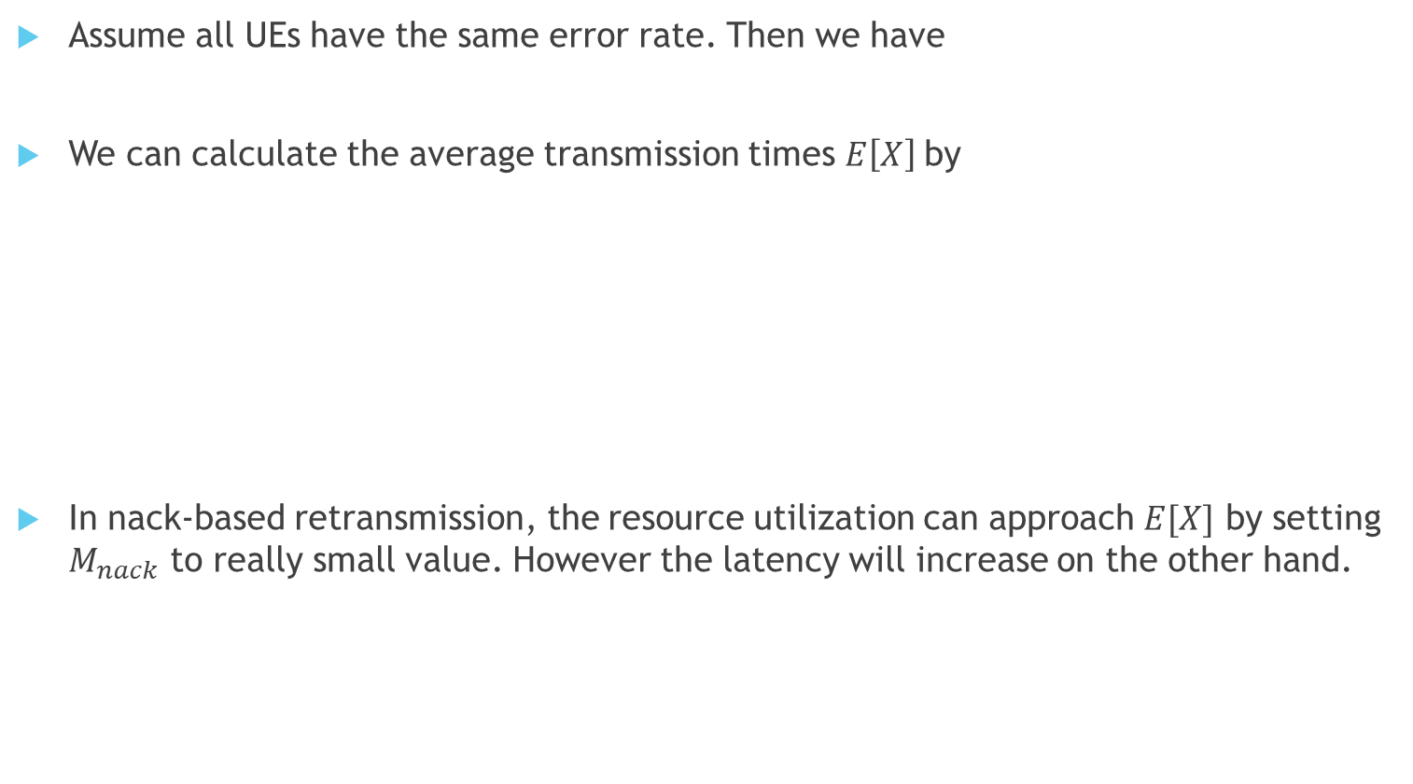
Mathematical derivation
Assume all UEs have the same error rate. Then we have
We can calculate the average transmission times $E\left[X\right]$by
In nack-based retransmission, the resource utilization can approach $E[X]$ by setting $M_{nack}$ to really small value. However the latency will increase on the other hand.

Slide 20
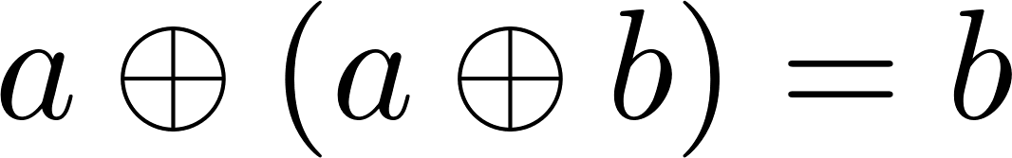
Nack-based retransmission with XOR coding
To improve our efficiency, the network coding can be applied.
Assume two packets, p1 and p2, are transmitted in one time slot. If we XOR the both packets, we can get a new packet, called as p3.
If p1, p2 and p3 are transmitted, although a UE failed to decode the p1, it still can get the information of p1 by XORing p2 and p3 (p1 XOR p2), if p2 and p3 are successfully decoded.
This is due to the fact that
Transmitting p3 is similar with transmitting p1 and p2, while it only costs one resource block.

Slide 21
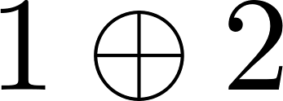
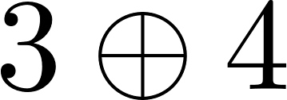

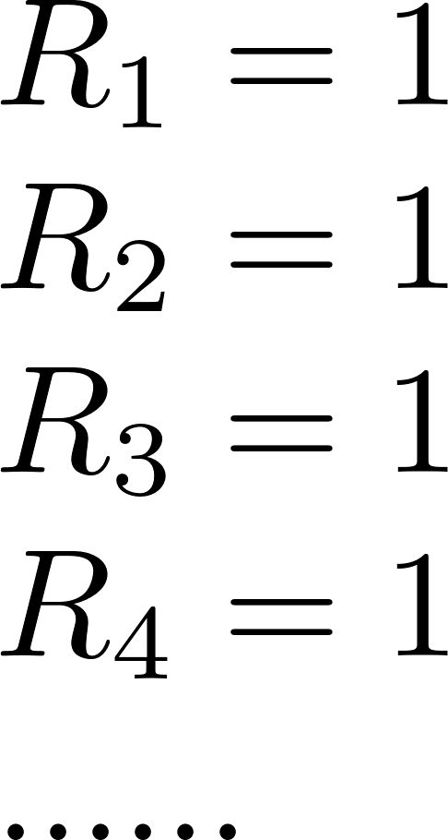
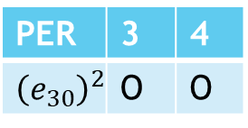
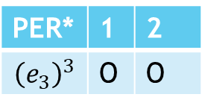

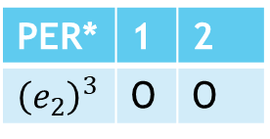



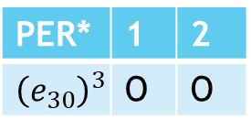
Nack-based Retransmission With XOR Coding
PER* | 1 | 2
$${\left(e_{1}\right)}^{3}$$ | O | O
PER | 3 | 4
$${\left(e_{1}\right)}^{2}$$ | O | O
1
3
1
3
PER* | 1 | 2
$${\left(e_{2}\right)}^{3}$$ | O | O
PER | 3 | 4
$${\left(e_{2}\right)}^{2}$$ | O | O
2
4
……
2
PER* | 1 | 2
$${\left(e_{3}\right)}^{3}$$ | O | O
4
PER | 3 | 4
$${\left(e_{3}\right)}^{2}$$ | O | O
nack1
nack3
……
nack2
……
nack4
Note that
PER* | 1 | 2
$${\left(e_{30}\right)}^{3}$$ | O | O
PER | 3 | 4
$${\left(e_{30}\right)}^{2}$$ | O | O

Slide 22
Assume for the BS, the following information are known and determined
Latency Constraint
Reliability Constraint
Packet error rate for each UE
The things that BS should decide
Which scheme to use? (blind retransmission or nack-based retransmission)
How many packets

Slide 23
Result

Slide 24
Total

Slide 25
Conclusion

Slide 26
For the fixed amount of packets, N,

Slide 27
Future Work
Consider different modulation and coding scheme (MCS)
Isolate the bottleneck UE to improve the total latency.
For the UE with better channel quality, higher MCS can be applied.
The total resource usage will increase.
Fountain code
Here we only consider the XOR of the packets.
In the multicast scenario, some network coding schemes, such as Raptor code, are used.
For total n packets, a UE can decode the data after receiving arbitrary k packets (n>=k).
Combine with the dual connectivity.
Assume the UE can receive the signal from two base station.
What may be the best receiving scheme for the UE ?

Slide 28
Reference
J. Du, W. Zhu, J. Xu, Z. Li and H. Wang, ”A Compressed HARQ Feed-back for Device-to-Device Multicast Communications,” 2012 IEEE Vehicular Technology Conference
F. Takahashi and K. Higuchi, ”HARQ for Predetermined-Rate Multicast Channel,” 2010 IEEE 71st Vehicular Technology Conference
J. Kim, H. Jin, D. K. Sung and R. Schober, ”Optimization of Wireless Multicast Systems Employing Hybrid-ARQ with Chase Combining,” in IEEE Transactions on Vehicular Technology

