Slide 1
Final project- Reliable multicast retransmission scheme
B06901049 林泓均
B06901096 黃昱翰

Slide 2
Outline
Contribution
System model
Packets error rate determination
Retransmission scheme
Result
Performance analysis for different packets number in nack-based retransmission.
Performance analysis for different retransmission scheme
Conclusion
Reference

Slide 3
Contribution
Previous papers mainly focus on maximize the throughput among multicast channel.
In this report, we mainly analyze the performance of multicast retransmission scheme under Ultra-Reliable and Low Latency Communications (URLLC) use case.
We simulate the nack-based retransmission scheme with some network coding techniques and try to increase the reliability using the equal amount of resource.

Slide 4
System model
Packets Error Probability determination

Slide 5
Parameters
Explanation | Reference Value
Transmitted power of a base station | 38 dBm(6.3W)
Maximum range a base station can transmit | 2000 m
Carrier central frequency | 3 GHz
Height of the base station | 10 m
Height of the user equipment | 1.5 m
Power spectral density of the noise | -134 dBm/Hz
Transmission gain of the transmitter and receiver | 10 dB
Numerology (normal CP, mini slot, FDD) | 2 (60kHz SCS, 2 symbols/slot)
Packet size | 120 symbols, 5 PRB/slot
Modulation | QPSK

Slide 6
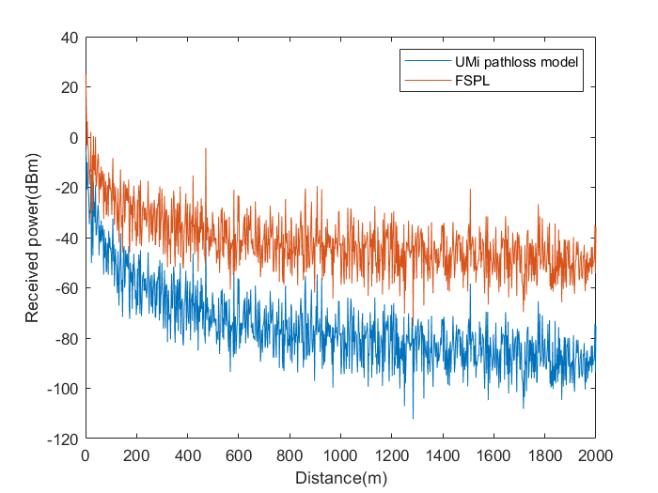

Error Probability determination (Pathloss and shadowing)
The scenario is assumed under UMi-street canyon (Urban Micro cell), NLOS.
There is only one base station(BS), and the user equipment(UE) are uniformly distributed on a circular disk.
The BS is type 1-C and an Medium Range Base Station
From TR 38.901 V16-1 Table 7.4.1-1, the pathloss model is
Using log-normal shadowing with

Slide 7
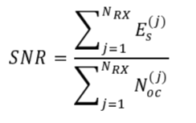
Error Probability determination (UE Sensitivity)
The requirement of minimum received energy of symbol is -112dBm/Hz, defined in clause 4.4.4.2 in TS 38.521-4.
Also in TS 38.521-4, the clause 4.4.3.2 describes the noise the power spectral density as -134dBm/Hz.
The UE with SNR < 22dB will not be considered.

Slide 8
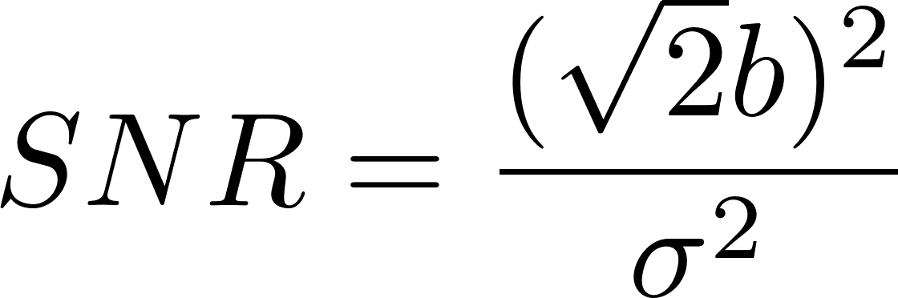


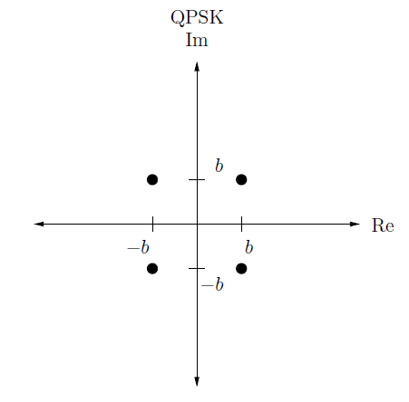


Error Probability determination (Consider Rayleigh fading channel)
Assume the detection is coherent, and the modulation is QPSK.
The bit error rate should be
Therefore, the pairwise error probability should be as follows:
We can thus derive the union bound for codeword error rate:
Assume diversity = 1 in this case

Slide 9
System model
Retransmission scheme

Slide 10
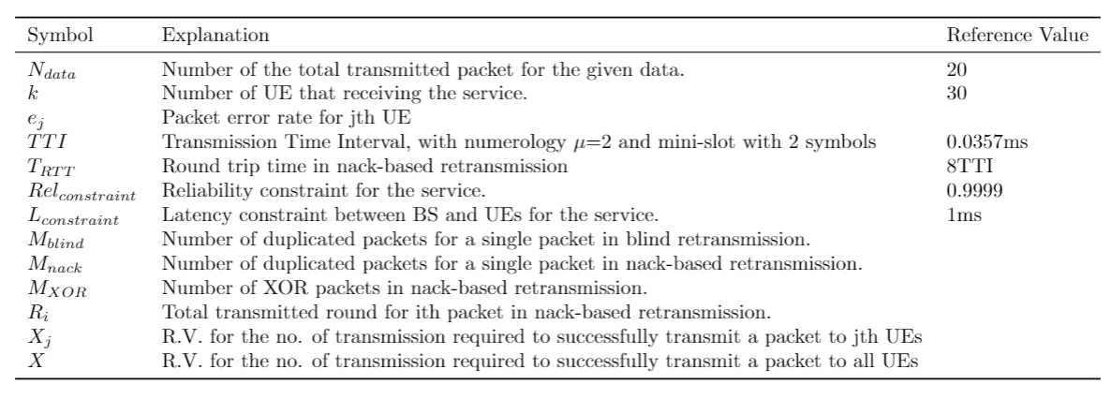
Parameters

Slide 11
Intro to retransmission
Despite of the channel coding, the transmission may fail if we only transmitted once.
To maintain the reliability, retransmission is essential.
Three typical retransmission scheme
Blind retransmission
Nack-based retransmission
HARQ retransmission
In multicast scenario, we usually consider to use blind retransmission and nack-based retransmission.

Slide 12
Definition
Reliability: The probability that all UEs in multicast can decode all of the data correctly under the given latency constraint.
Latency: The total consumed time to transmit a packet in nack-based retransmission.
Resource utilization: How many total packets should be used to achieve the target of reliability.
Remark: Each packets occupies a mini-slot (0.0357ms when numerology = 2) and 60 sub-carrier, 5PRB.

Slide 13

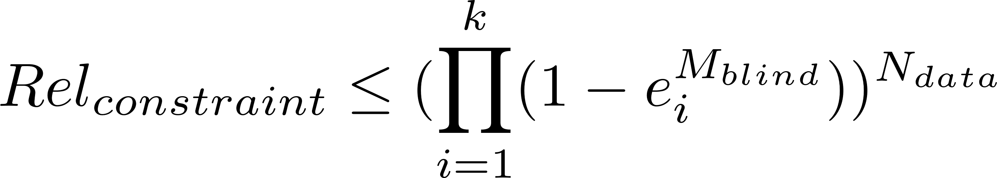
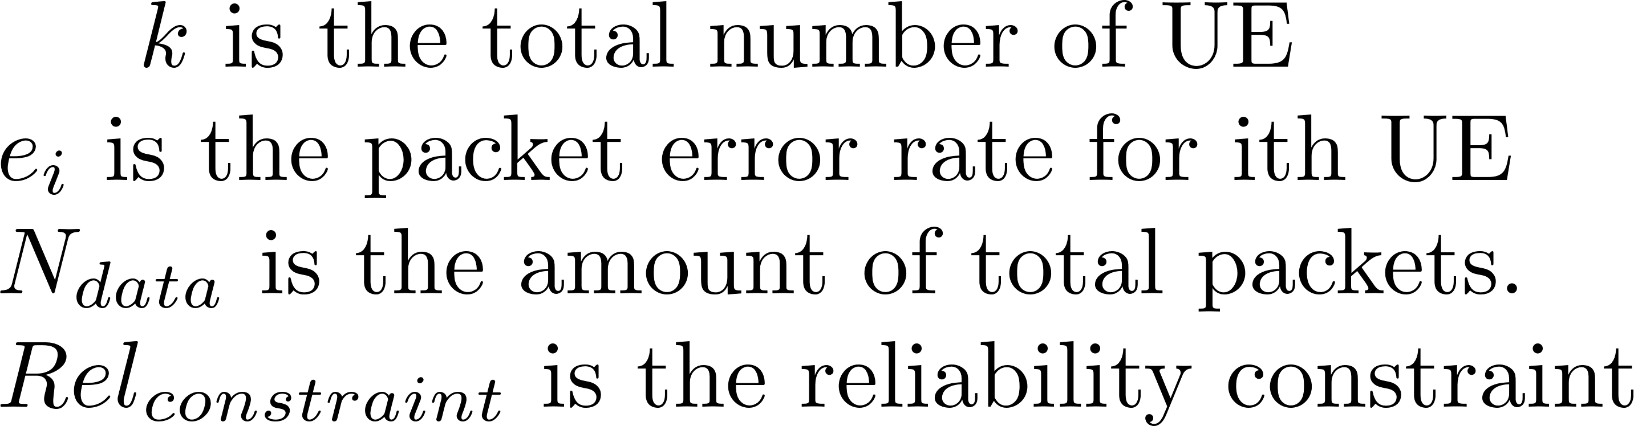
Blind Retransmission
BS will transmit all needed packets without feedback.
Assume there are no round trip time (RTT) in blind retransmission.
Bad at resource utilization, but merely having latency.
Already used in lots of low latency requirement application, such as V2X.
To reach the constraint of reliability, the transmission packets number for a single packet can be determined by selecting the minimum which satisfy the following inequality

Slide 14







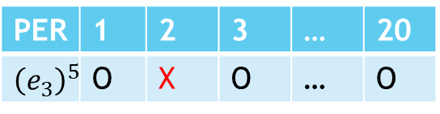
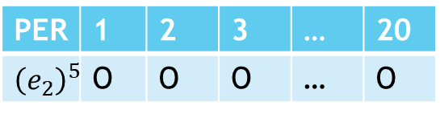
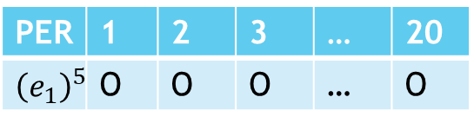
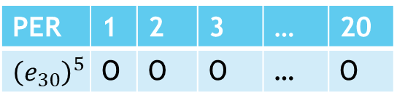
Blind Retransmission
Table indicates receiving successfully or not.
PER | 1 | 2 | 3 | … | 20
$${\left(e_{1}\right)}^{5}$$ | O | O | O | … | O
1
3
19
1
3
19
PER | 1 | 2 | 3 | … | 20
$${\left(e_{2}\right)}^{5}$$ | O | O | O | … | O
1
3
19
1
3
19
PER | 1 | 2 | 3 | … | 20
$${\left(e_{3}\right)}^{5}$$ | O | X | O | … | O
1
3
19
……
2
4
20
……
2
4
20
PER | 1 | 2 | 3 | … | 20
$${\left(e_{30}\right)}^{5}$$ | O | O | O | … | O
2
4
20
2
4
20
The transmission in this time is not reliable!
For a reliable transmission, we assume all UEs can decode all of the data correctly.
2
4
20

Slide 15

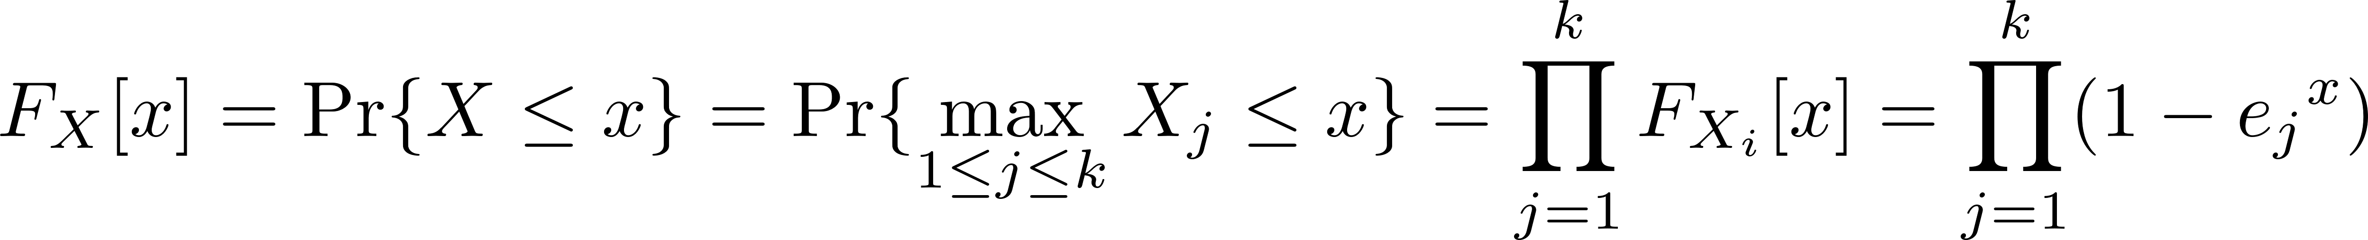
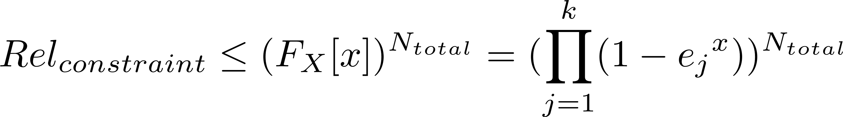
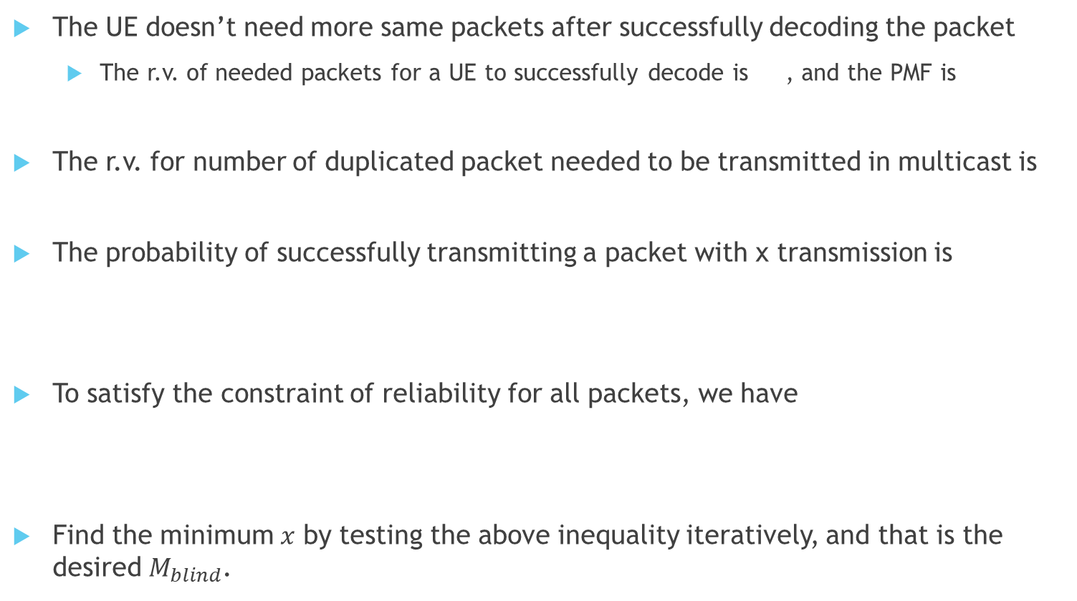
Mathematical derivation
The UE doesn’t need more same packets after successfully decoding the packet
The r.v. of needed packets for a UE to successfully decode is , and the PMF is
The r.v. for number of duplicated packet needed to be transmitted in multicast is
The probability of successfully transmitting a packet with x transmission is
To satisfy the constraint of reliability for all packets, we have
Find the minimum $x$ by testing the above inequality iteratively, and that is the desired $M_{blind}$.

Slide 16
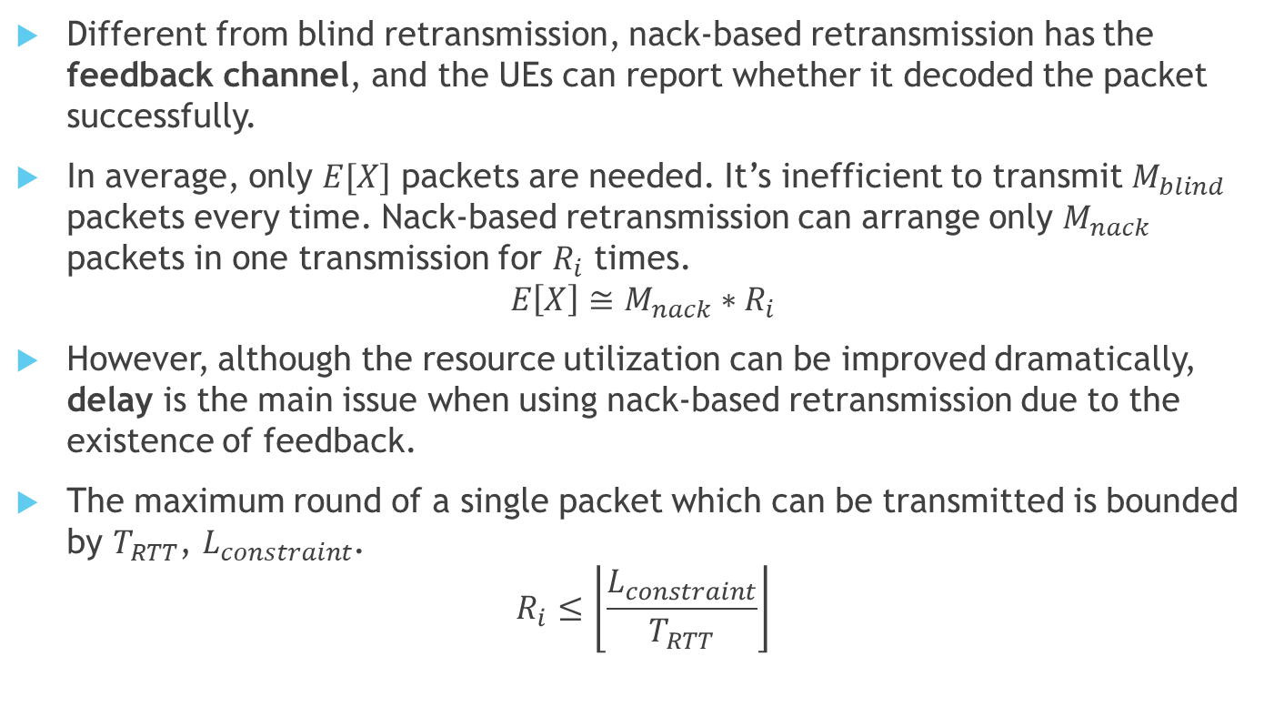
Nack-based Retransmission
Different from blind retransmission, nack-based retransmission has the feedback channel, and the UEs can report whether it decoded the packet successfully.
In average, only $E[X]$ packets are needed. It’s inefficient to transmit $M_{blind}$ packets every time. Nack-based retransmission can arrange only $M_{nack}$ packets in one transmission for $R_{i}$ times.
$$E\left[X\right]≅M_{nack}∗R_{i}$$
However, although the resource utilization can be improved dramatically, delay is the main issue when using nack-based retransmission due to the existence of feedback.
The maximum round of a single packet which can be transmitted is bounded by $T_{RTT}$, $L_{constraint}$.
$$R_{i}≤\left\lfloor \frac{L_{constraint}}{T_{RTT}}\right\rfloor$$

Slide 17

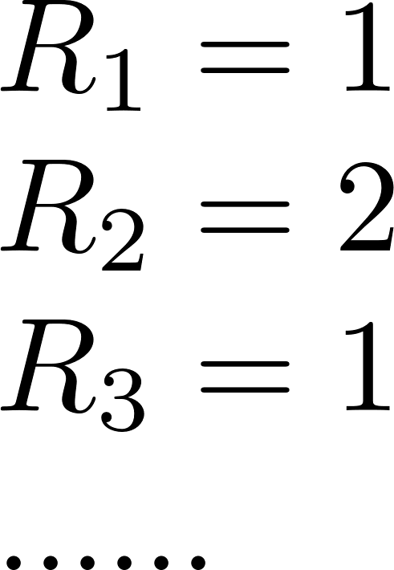
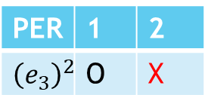
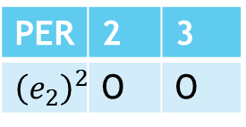
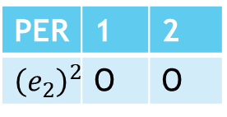
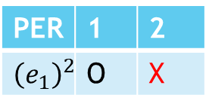

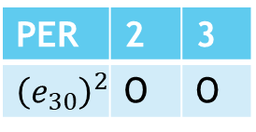
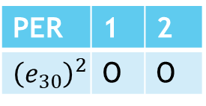
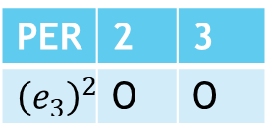
Nack-based Retransmission
PER | 1 | 2
$${\left(e_{1}\right)}^{2}$$ | O | X
PER | 2 | 3
$${\left(e_{1}\right)}^{2}$$ | O | O
1
3
4
1
3
4
PER | 1 | 2
$${\left(e_{2}\right)}^{2}$$ | O | O
PER | 2 | 3
$${\left(e_{2}\right)}^{2}$$ | O | O
……
2
2
5
2
PER | 1 | 2
$${\left(e_{3}\right)}^{2}$$ | O | X
2
PER | 2 | 3
$${\left(e_{3}\right)}^{2}$$ | O | O
5
nack1
nack3
……
nack2
……
nack2
UE1 and UE3 transmit nack2 to the resource block pre-arranged by the BS to inform that pkt2 didn’t receive successfully for some UEs. Thus the pkt2 is retransmitted.
PER | 1 | 2
$${\left(e_{30}\right)}^{2}$$ | O | O
PER | 2 | 3
$${\left(e_{30}\right)}^{2}$$ | O | O

Slide 18
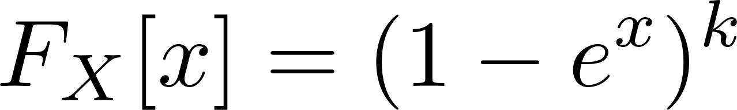
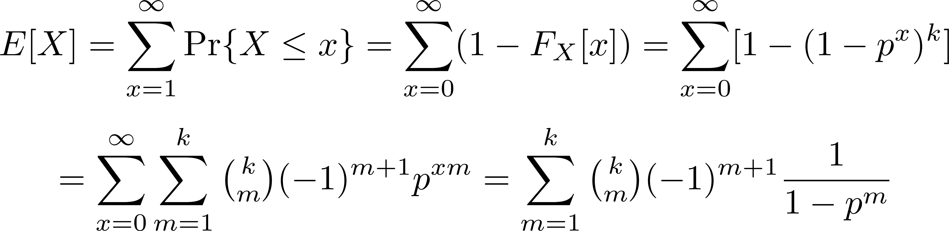
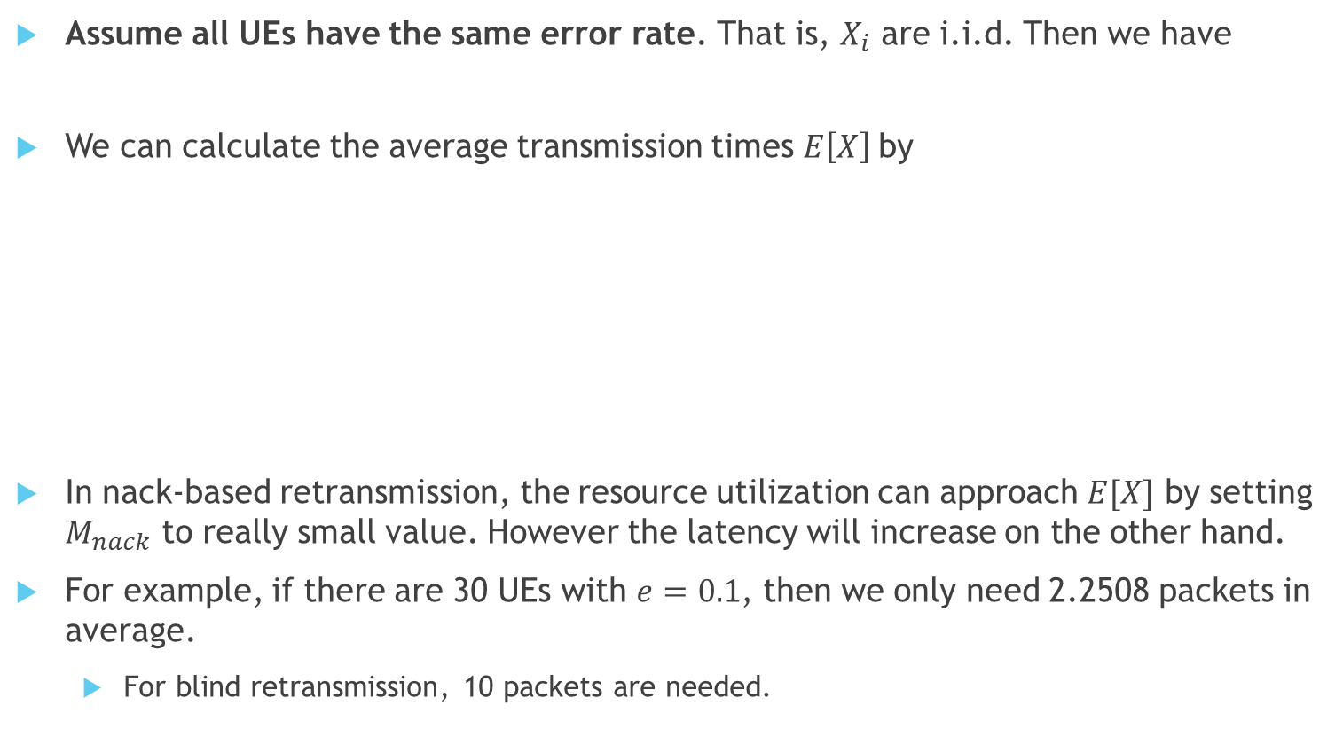
Mathematical derivation
Assume all UEs have the same error rate. That is, $X_{i}$ are i.i.d. Then we have
We can calculate the average transmission times $E\left[X\right]$by
In nack-based retransmission, the resource utilization can approach $E[X]$ by setting $M_{nack}$ to really small value. However the latency will increase on the other hand.
For example, if there are 30 UEs with $e=0.1$, then we only need 2.2508 packets in average.
For blind retransmission, 10 packets are needed.

Slide 19
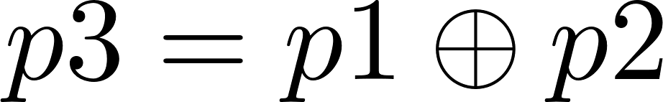
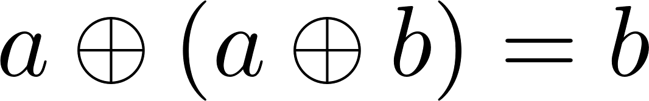
Nack-based retransmission with XOR coding
To improve our efficiency, the network coding can be applied.
Assume two packets, p1 and p2, are transmitted in one time slot. If we XOR the both packets, we can get a new packet, called as p3.
If p1, p2 and p3 are transmitted, although a UE failed to decode the p1, it still can get the information of p1 by XORing p2 and p3 (p1 XOR p2), if p2 and p3 are successfully decoded.
This is due to the fact that
Transmitting p3 is similar with transmitting p1 and p2, while it only costs one resource block.

Slide 20
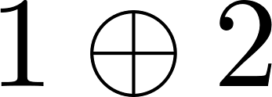
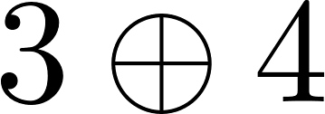

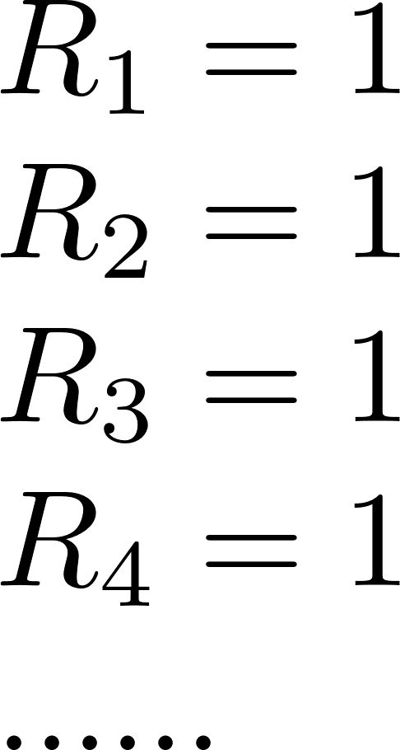
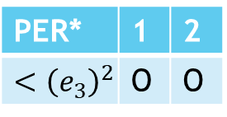
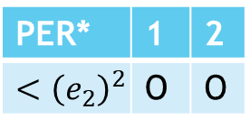
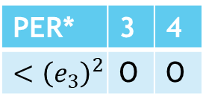
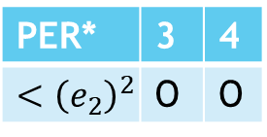
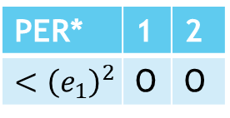
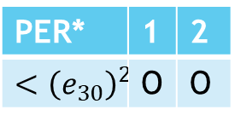
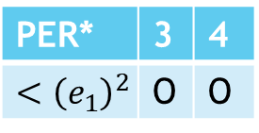
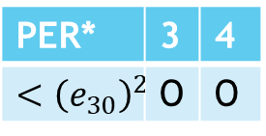
Nack-based Retransmission With XOR Coding
PER* | 1 | 2
$${<\left(e_{1}\right)}^{2}$$ | O | O
PER* | 3 | 4
$${<\left(e_{1}\right)}^{2}$$ | O | O
1
3
1
3
PER* | 1 | 2
$${<\left(e_{2}\right)}^{2}$$ | O | O
PER* | 3 | 4
$${<\left(e_{2}\right)}^{2}$$ | O | O
2
4
……
2
PER* | 1 | 2
$${<\left(e_{3}\right)}^{2}$$ | O | O
4
PER* | 3 | 4
$${<\left(e_{3}\right)}^{2}$$ | O | O
nack1
nack3
……
nack2
……
nack4
PER* | 1 | 2
$${<\left(e_{30}\right)}^{2}$$ | O | O
PER* | 3 | 4
$${<\left(e_{30}\right)}^{2}$$ | O | O
*Note that due to the XOR packet, the PER decrease. But a UE can utilize the XOR packet only when he successfully receive one of the other packets.

Slide 21
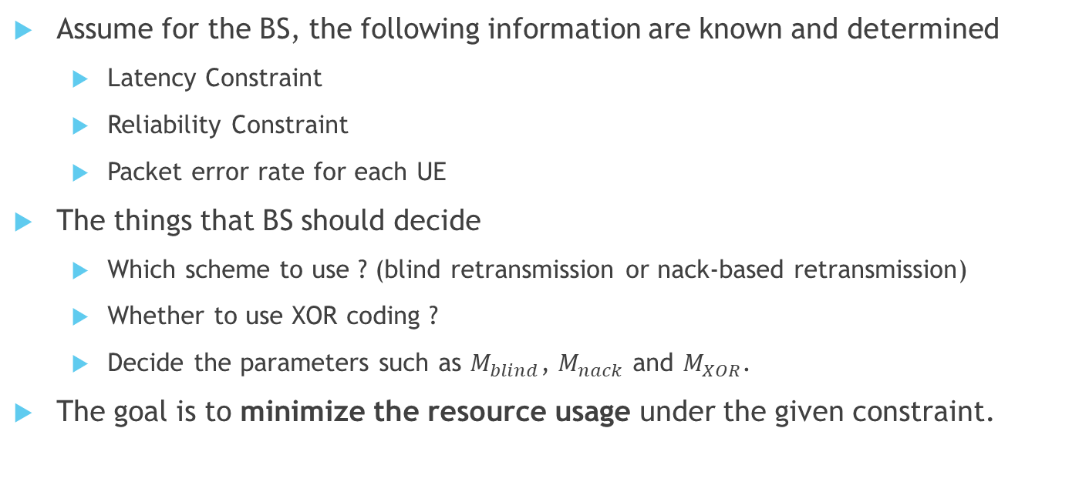
System formulation
Assume for the BS, the following information are known and determined
Latency Constraint
Reliability Constraint
Packet error rate for each UE
The things that BS should decide
Which scheme to use ? (blind retransmission or nack-based retransmission)
Whether to use XOR coding ?
Decide the parameters such as $M_{blind}$, $M_{nack}$ and $M_{XOR}$.
The goal is to minimize the resource usage under the given constraint.

Slide 22
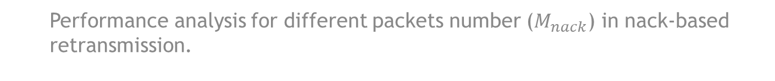
Result
Performance analysis for different packets number ($M_{nack}$) in nack-based retransmission.

Slide 23
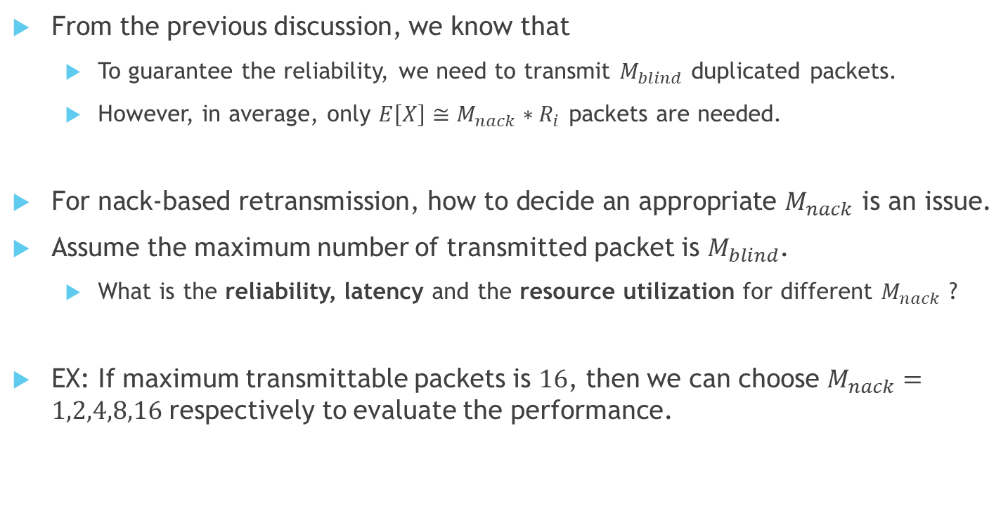
Problem Formulation – performance analysis of nack-based retransmission
From the previous discussion, we know that
To guarantee the reliability, we need to transmit $M_{blind}$ duplicated packets.
However, in average, only $E\left[X\right]≅M_{nack}∗R_{i}$ packets are needed.
For nack-based retransmission, how to decide an appropriate $M_{nack}$ is an issue.
Assume the maximum number of transmitted packet is $M_{blind}$.
What is the reliability, latency and the resource utilization for different $M_{nack}$ ?
EX: If maximum transmittable packets is $16$, then we can choose $M_{nack}=1,2,4,8,16$ respectively to evaluate the performance.

Slide 24
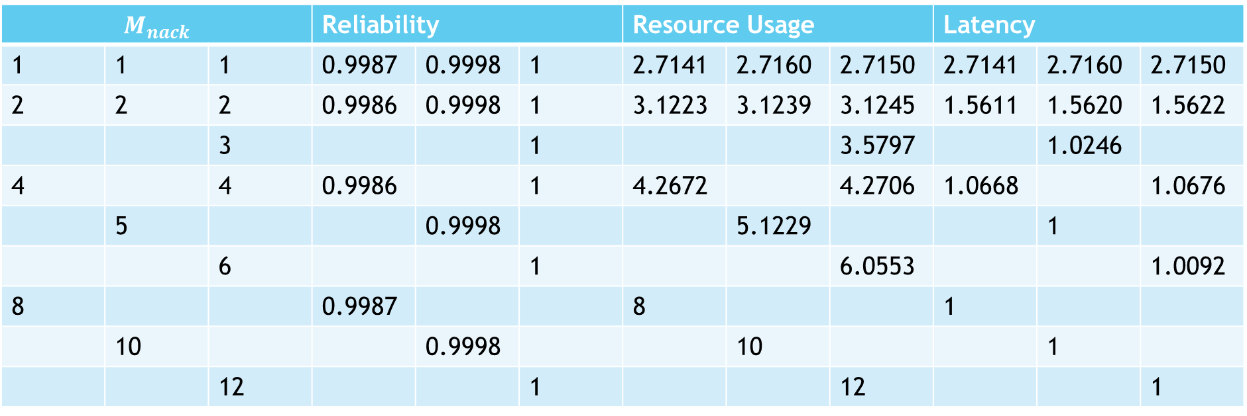

Simulation result
The maximum packets can be transmitted is $8, 10, 12$
Average error prob: 0.079441, and std is: 0.1226783
$M_{blind}=11$ theoretically, if the $Rel_{constraint}=0.9999$.
$$M_{nack}$$ |  |  | Reliability |  |  | Resource Usage |  |  | Latency
1 | 1 | 1 | 0.9987 | 0.9998 | 1 | 2.7141 | 2.7160 | 2.7150 | 2.7141 | 2.7160 | 2.7150
2 | 2 | 2 | 0.9986 | 0.9998 | 1 | 3.1223 | 3.1239 | 3.1245 | 1.5611 | 1.5620 | 1.5622
 |  | 3 |  |  | 1 |  |  | 3.5797 |  | 1.0246
4 |  | 4 | 0.9986 |  | 1 | 4.2672 |  | 4.2706 | 1.0668 |  | 1.0676
 | 5 |  |  | 0.9998 |  |  | 5.1229 |  |  | 1
 |  | 6 |  |  | 1 |  |  | 6.0553 |  |  | 1.0092
8 |  |  | 0.9987 |  |  | 8 |  |  | 1
 | 10 |  |  | 0.9998 |  |  | 10 |  |  | 1
 |  | 12 |  |  | 1 |  |  | 12 |  |  | 1

Slide 25

Simulation result
Reliability is only associated with the maximum transmittable packets.
The smaller the $M_{nack}$, the better the resource utilization.
However, the latency also increase as $M_{nack}$become smaller.
$$M_{nack}$$ |  |  | Reliability |  |  | Resource Usage |  |  | Latency
1 | 1 | 1 | 0.9987 | 0.9998 | 1 | 2.7141 | 2.7160 | 2.7150 | 2.7141 | 2.7160 | 2.7150
2 | 2 | 2 | 0.9986 | 0.9998 | 1 | 3.1223 | 3.1239 | 3.1245 | 1.5611 | 1.5620 | 1.5622
 |  | 3 |  |  | 1 |  |  | 3.5797 |  | 1.0246
4 |  | 4 | 0.9986 |  | 1 | 4.2672 |  | 4.2706 | 1.0668 |  | 1.0676
 | 5 |  |  | 0.9998 |  |  | 5.1229 |  |  | 1
 |  | 6 |  |  | 1 |  |  | 6.0553 |  |  | 1.0092
8 |  |  | 0.9987 |  |  | 8 |  |  | 1
 | 10 |  |  | 0.9998 |  |  | 10 |  |  | 1
 |  | 12 |  |  | 1 |  |  | 12 |  |  | 1

Slide 26
Result
Performance comparison of different retransmission scheme

Slide 27
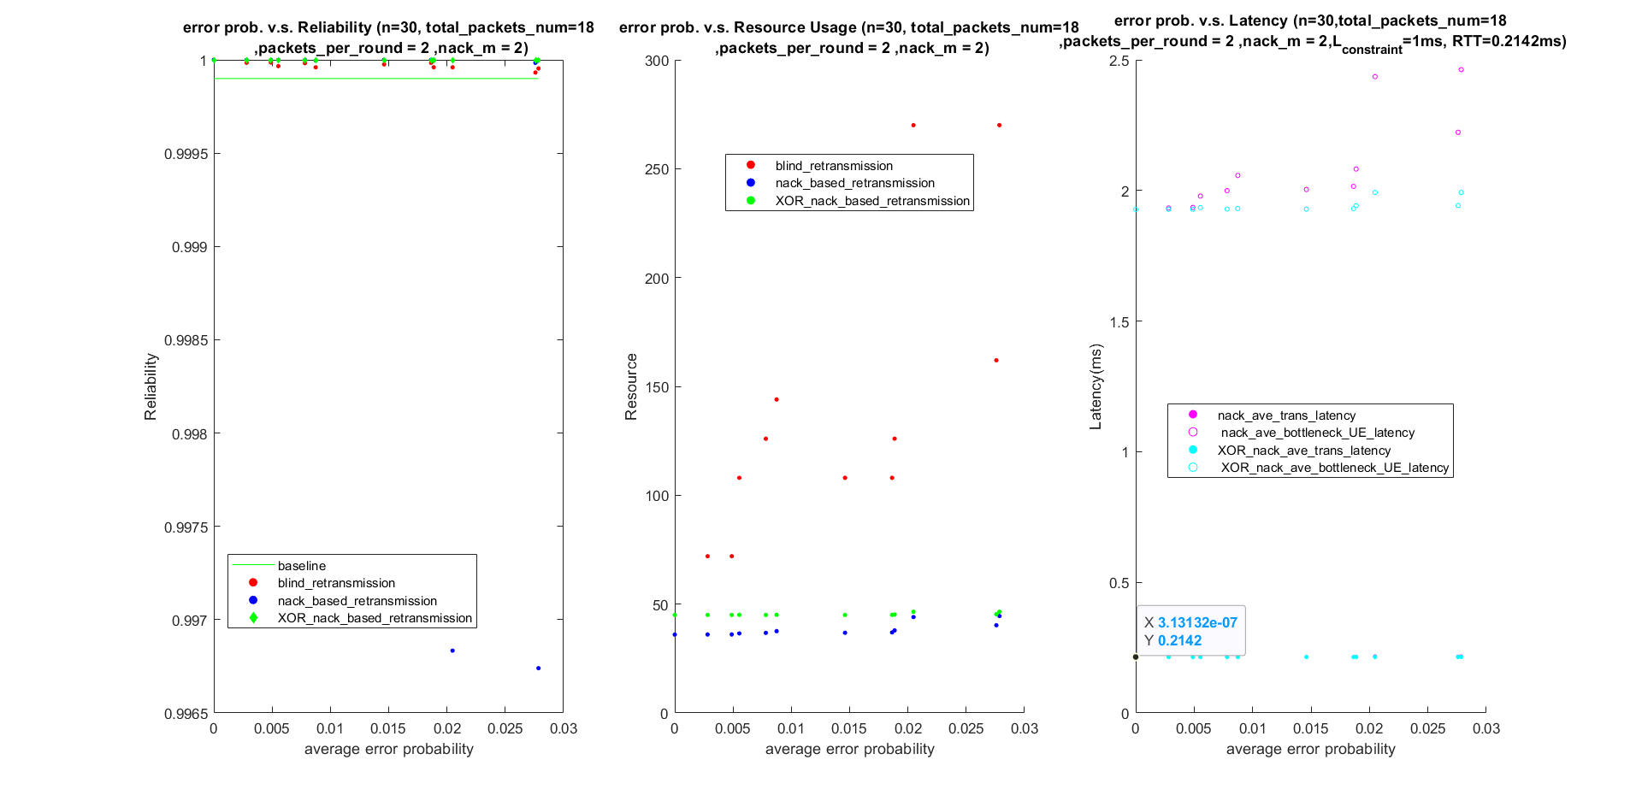
Simulation Result (Normal error rate)

Slide 28
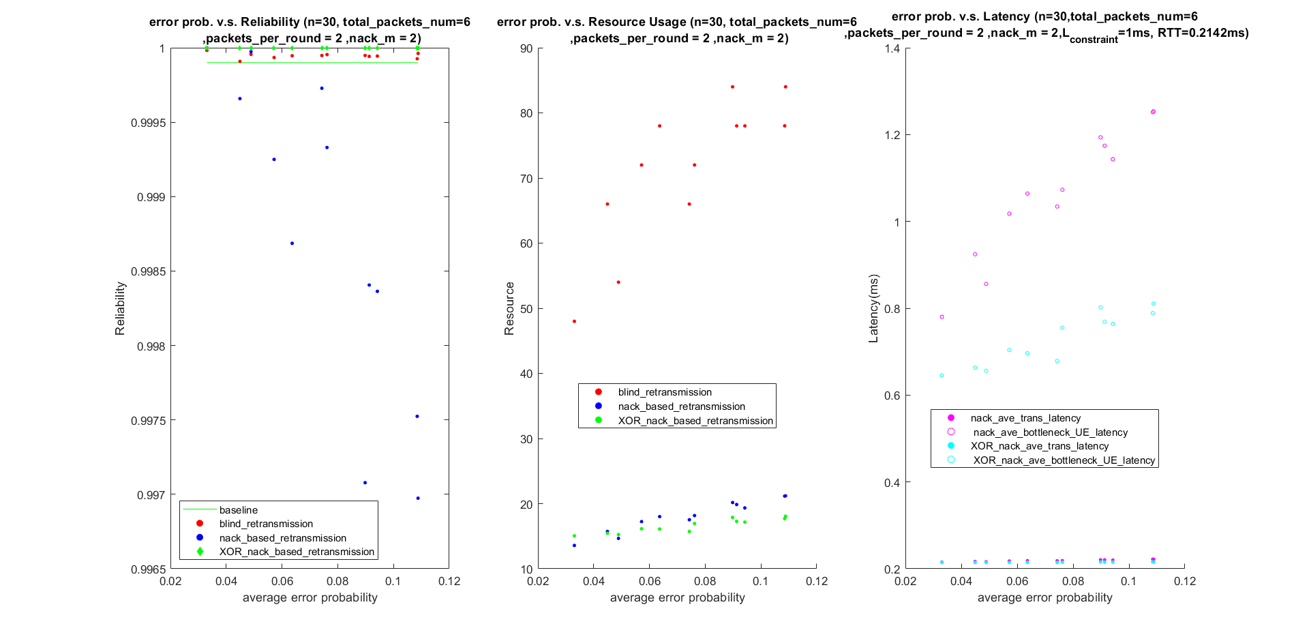
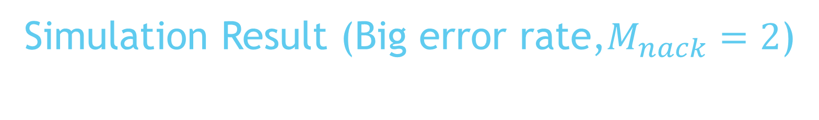
Simulation Result (Big error rate,$M_{nack}=2$)

Slide 29
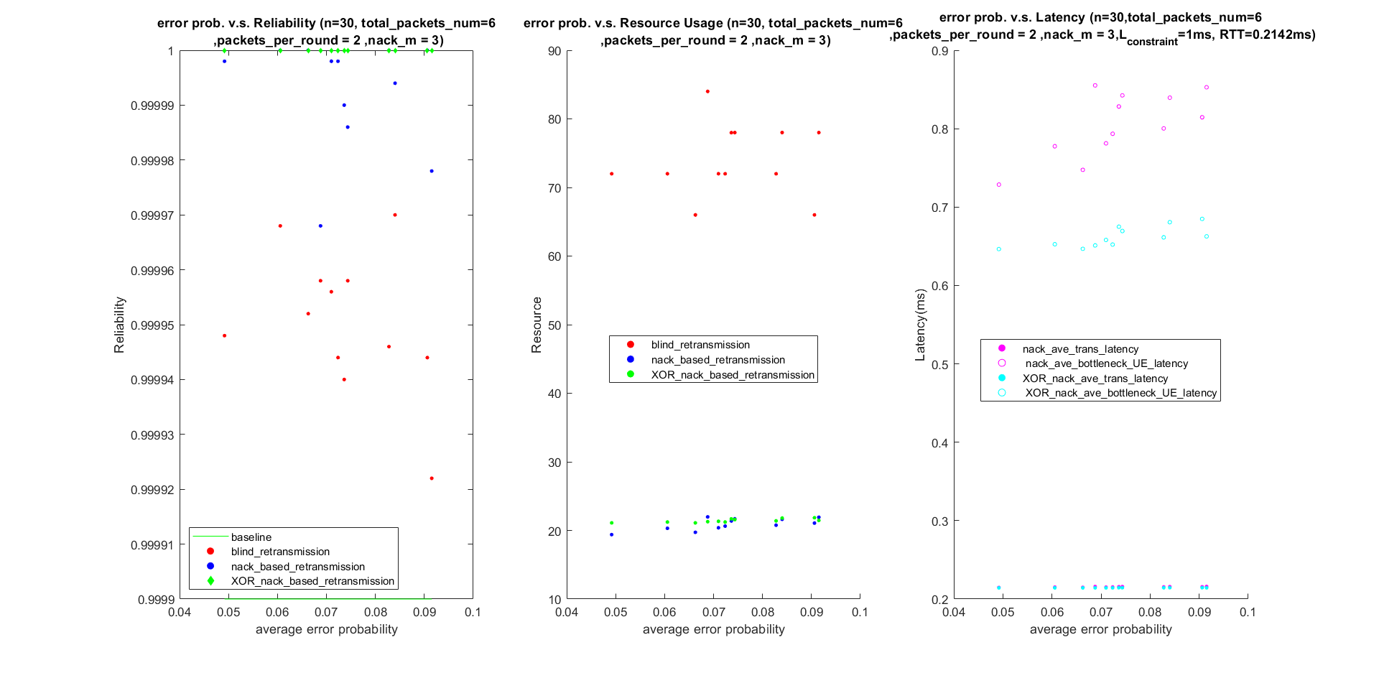
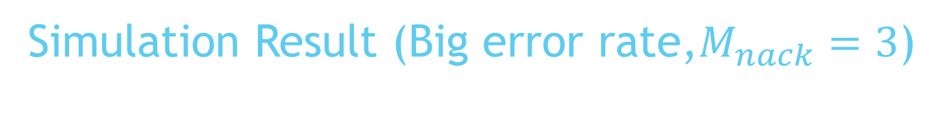
Simulation Result (Big error rate,$M_{nack}=3$)

Slide 30
Conclusion

Slide 31
Some BS strategies for selecting retransmission scheme
The constraint of latency will limit the reliability of nack-based retransmission.
We should use nack-based retransmission if the RTT is tolerable under the given latency constraint.
Using XOR coding can help reduce the total transmission time, but may consume more resource. If the error rate is not big enough, do not use XOR coding.

Slide 32
Conclusion
For the fixed amount of maximum transmittable packets, the reliability will remain.
The latency constraint and RRT will limit the maximum transmittable packets.
The reliability is associated with maximum transmittable packets.
If we transmit less packets in one round, the resource utilization can reduce dramatically.
Blind retransmission will use tremendous resource to achieve reliability.
In most case, we should use nack-based retransmission to deliver our packets.
Using XOR coding can help reduce total transmission time.

Slide 33
Future Work
Consider different modulation and coding scheme (MCS)
Isolate the bottleneck UE to improve the total latency.
For the UE with better channel quality, higher MCS can be applied.
The total resource usage will increase.
Fountain code
Here we only consider the XOR of the packets.
In the multicast scenario, some network coding schemes, such as Raptor code, are used.
For total n packets, a UE can decode the data after receiving arbitrary k packets (n>=k).
Combine with the dual connectivity.
Assume the UE can receive the signal from two base station.
What may be the best receiving scheme for the UE ?

Slide 34
Reference
J. Du, W. Zhu, J. Xu, Z. Li and H. Wang, ”A Compressed HARQ Feed-back for Device-to-Device Multicast Communications,” 2012 IEEE Vehicular Technology Conference
F. Takahashi and K. Higuchi, ”HARQ for Predetermined-Rate Multicast Channel,” 2010 IEEE 71st Vehicular Technology Conference
J. Kim, H. Jin, D. K. Sung and R. Schober, ”Optimization of Wireless Multicast Systems Employing Hybrid-ARQ with Chase Combining,” in IEEE Transactions on Vehicular Technology
D. Maaz, A. Galindo-Serrano and S. E. Elayoubi, "URLLC User Plane Latency Performance in New Radio," 2018 25th International Conference on Telecommunications (ICT), St. Malo, 2018, pp. 225-229, doi: 10.1109/ICT.2018.8464912.

Slide 35
Reference
3GPP TR 38.901 V16.1.0 (2020-11), “Study on channel model for frequencies from 0.5 to 100 GHz,” November 2020.
3GPP TR 38.913 V16.0.0 (2020-07), “Study on scenarios and requirements for next generation access technologies “, July 2020.
3GPP contribution R2-1711550, “UP Latency in NR,” October 2017

Slide 36
QA

