Slide 1
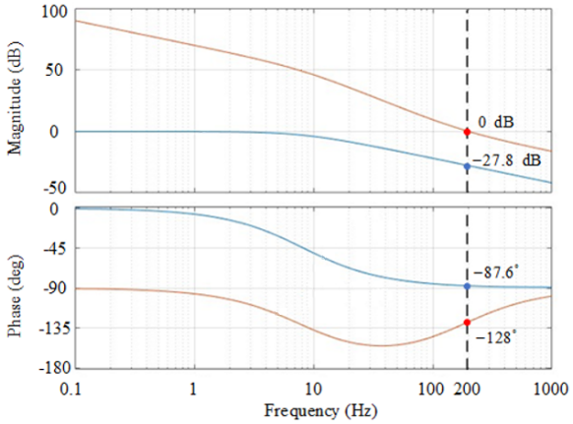
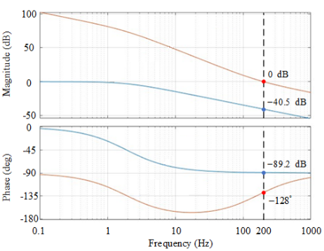
Loop Gain
Loop Gain
Plant
Plant
Loop Gain
Loop Gain
Plant
Plant

Slide 2
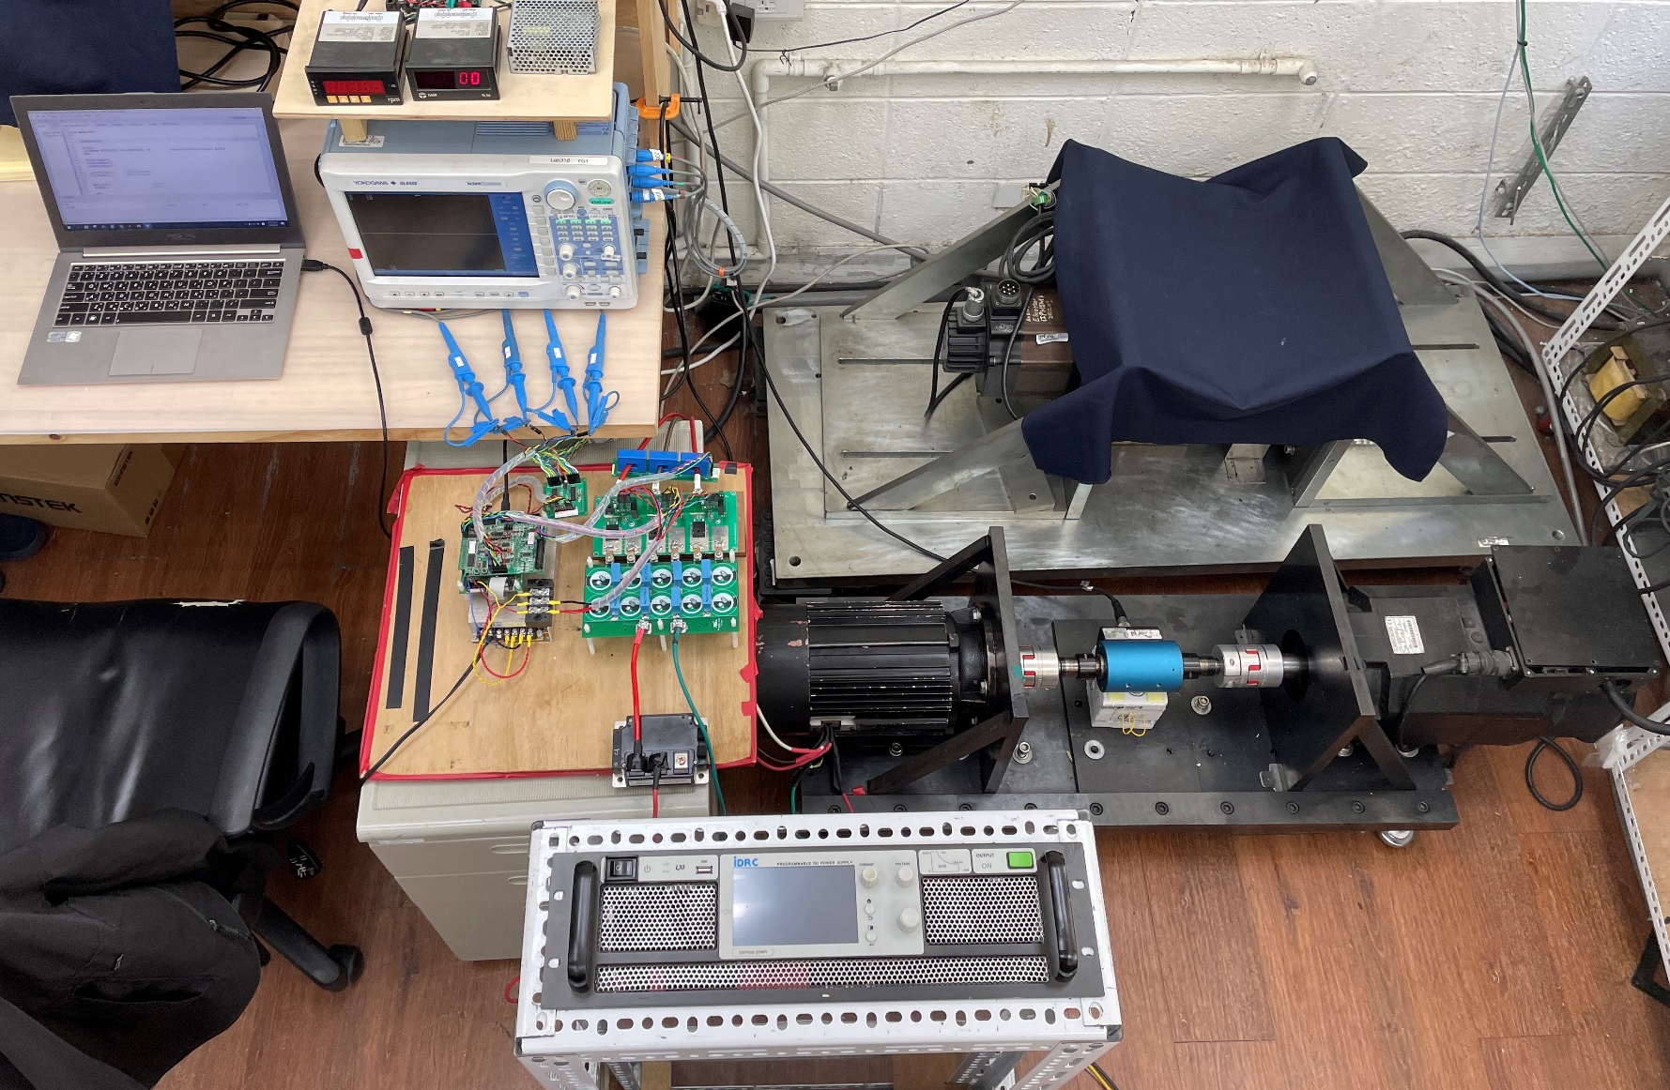
Torque and Speed
Display
Scope
Corder
Personal
Computer
SiC based
VSI
IPMSM
Load
Torque
Meter
PMASynRM
DSP 28075 Control
Board,I/O Extension
Board, and Encoder Interface Board
DC Power
Supply

