Slide 1

Deep learning model to detect human emotion through image
Group 15

Slide 2
Group members
Đoàn Tuấn Hùng-20205154
Hoàng Đức Trung-20200640
Nguyễn Tuấn Dũng-20205148

Slide 3
Table of contents
Introduction
Project details
Contents
Results and findings
Challenges

Slide 4

Introduction

Slide 5
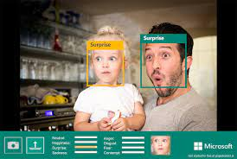
Introduction
As humans, we learn to express ourselves and understand others’ feelings. Yet, having a machine figuring out human sentiments can be challenging: it is virtually impossible to write a program that can tell human emotion apart.
=> Deep learning comes into play

Slide 6
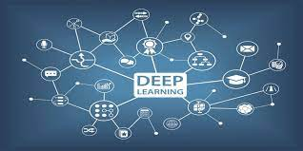
Deep learning
- Definition: a subfield of machine learning that utilizes artificial neural networks and representational learning to teach computers to do what comes natural to humans
-Computers are provided with sufficient and accurate data and are trained using appropriate algorithms => can actually perform what we think are only feasible to us.

Slide 7







Goals
Happiness
Sadness
Disgust
Emotion detector
Fear
Neutrality
Anger
Surprise

Slide 8

Project details

Slide 9

Details
+ Dataset: Fer2013 from kaggle.com, which contains:
35,000 images of human portraits in a 48x48 grayscale format.
Separated into train and test data
- 7 categories corresponding to 7 basic human emotions

Slide 10
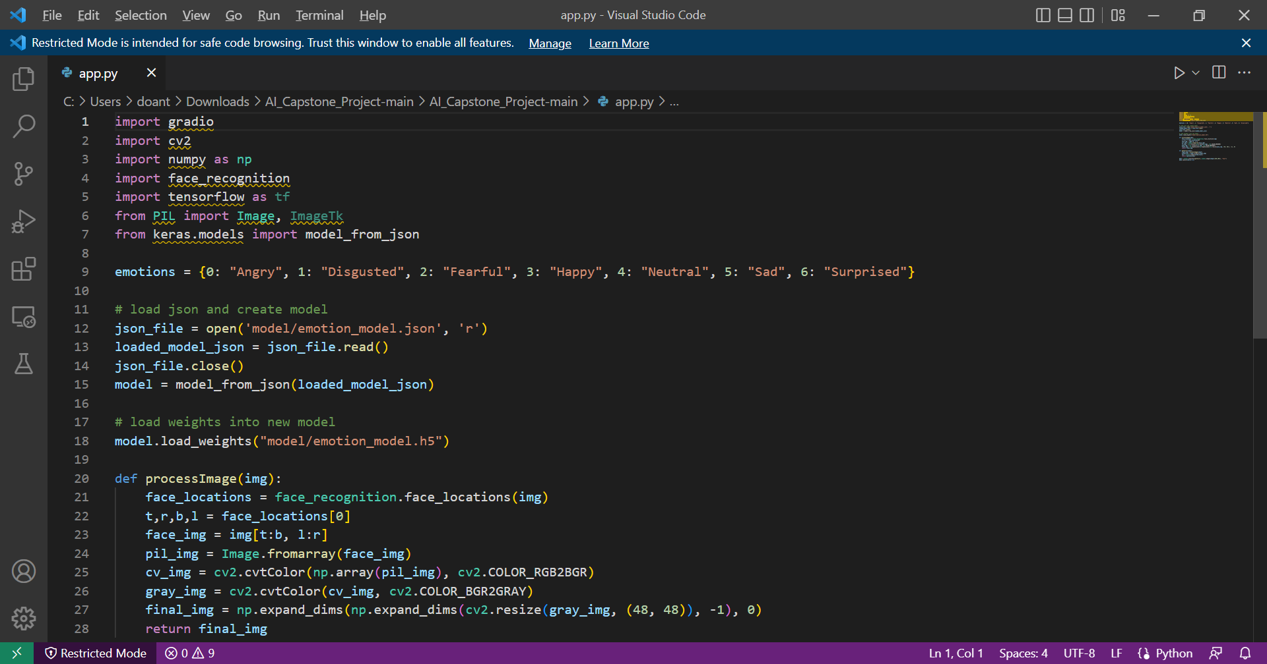
Details
+ Technologies: Python, along with Tensorflow / Keras machine learning framework. Tkinter is also used to build a graphical interface to demonstrate the model

Slide 11
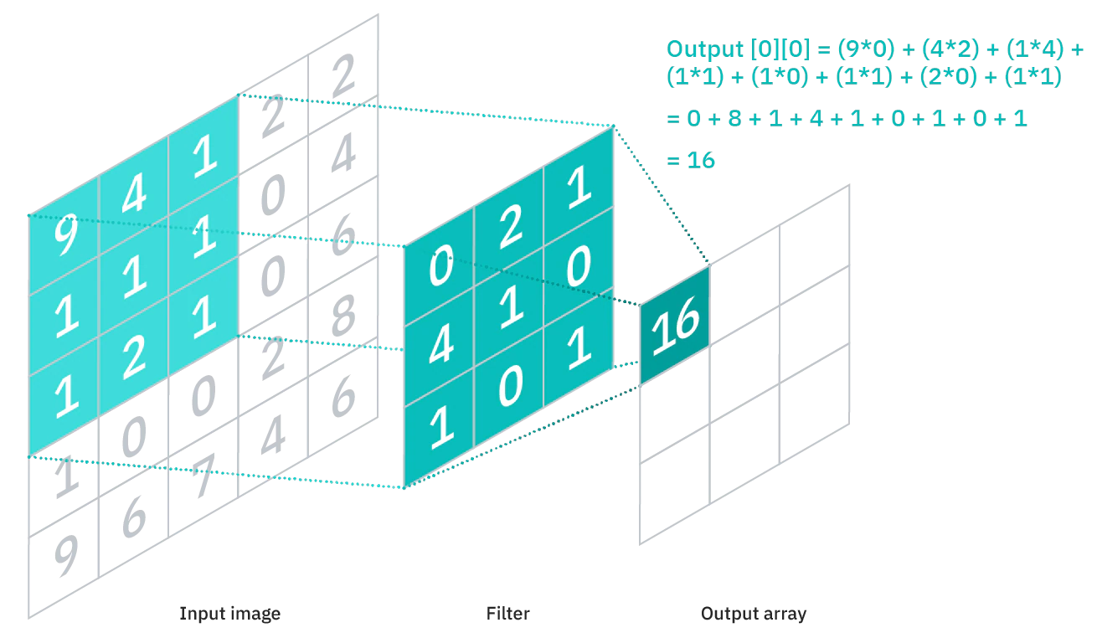
Processes
General idea
The model uses convolutional neural networks, which is mostly used for image recognition and processing. The model will be passed through a number of layers in the network before it produces an output – an array of probabilities of every human emotion
The input of the shape (48,48,1) is fed into a conv2D layer.
The model then consists of several convolutional layers stacking on top of each other with some max pooling layers and dropout layers in between
The output layer is a dense layer with the output size of 7 corresponding to the number of emotion categories, combined with the softmax activation function to obtain the array of probability of all the emotions.

Slide 12
Layers role
+ Conv2D layer: Applies a specified number of filters across the image to extract the features from the image and tries to learn the best filter that helps matching the image with the correct label.

Slide 13
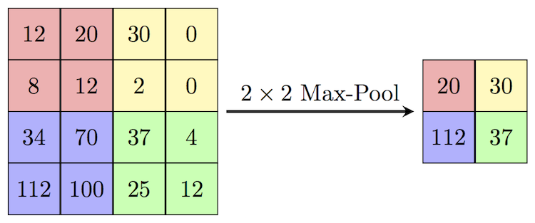
Layers role
+ Max pooling layer: Downsamples the image to produce a downsampled feature map. The downsampled version of the image will help mitigate the computational costs but still contain the sharp and smooth features of it.

Slide 14
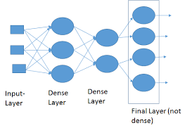
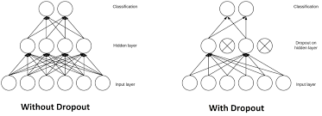
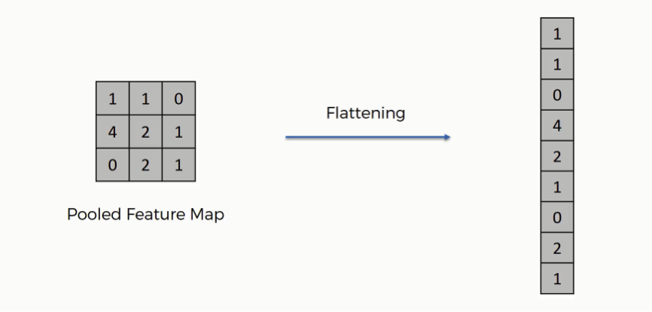
Layers role
+ The Dropout layer: helps with reducing overfitting and generalization. It works by randomly randomly setting input units to 0 with a specified rate at each step during training time.
+ Dense layer:a layer where its inside neurons connect to every neuron in the preceding layer, usually placed before the output layer and form the last few layers of a CNN Architecture.
+Flatten layer: reduces the multi-dimensional input down to one dimension

Slide 15
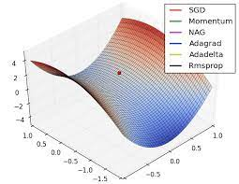
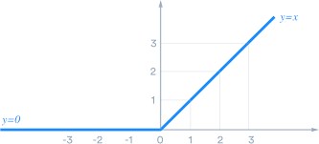
Other details
In each of the conv2D layers we specify the activation function to be the relu, or rectified linear unit activation function, which returns the value if it is bigger than zero
- When compiling the model, we use the Adam optimizer to adjust the parameters to minimize the losses. And since it is a categorical problem, we set the loss function to be “categorical_crossentropy”

Slide 16
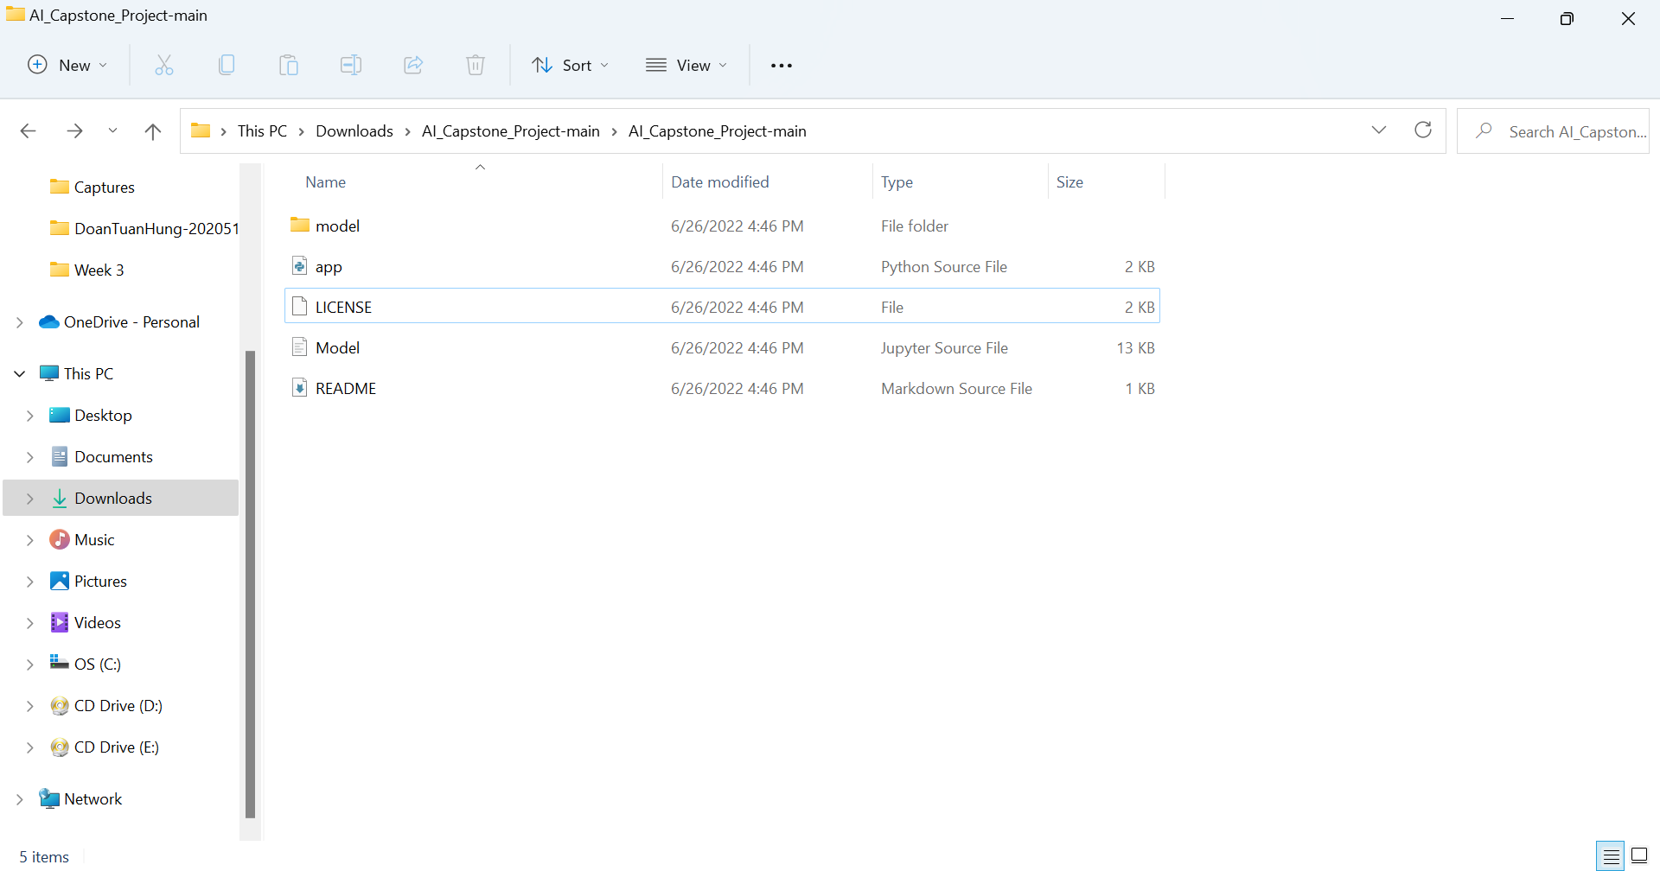
Code overview
Project has 2 main files, “Model.ipynb” and “app.py”.
+ Jupyter notebook file (first file) is used to train the model and visualize information.
+ Second file is used to take the weights of the trained model to perform a demo on normal, colored images

Slide 17
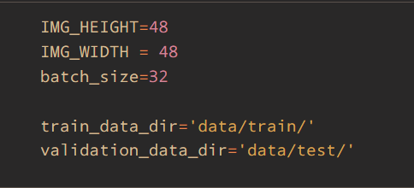
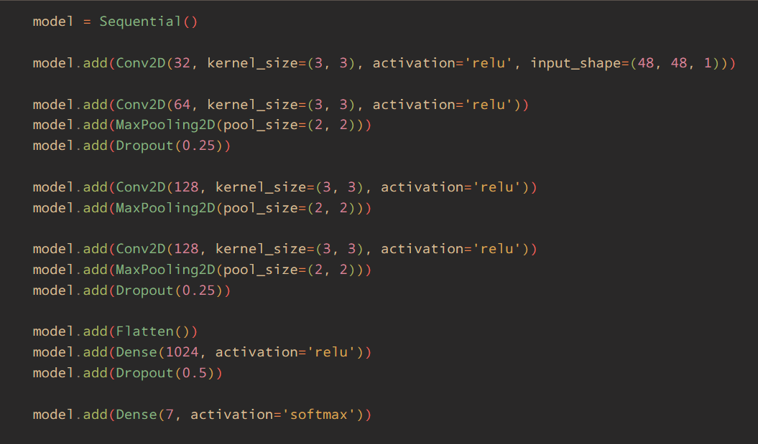
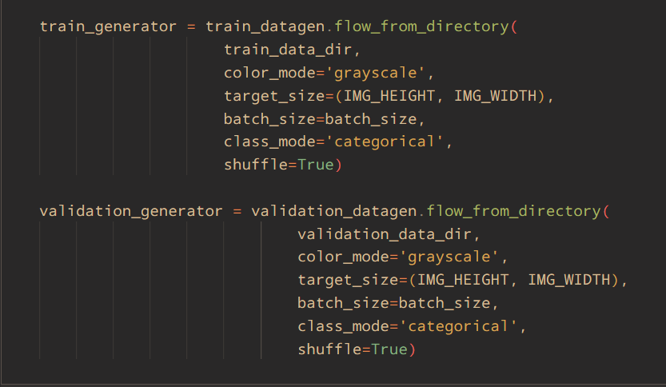
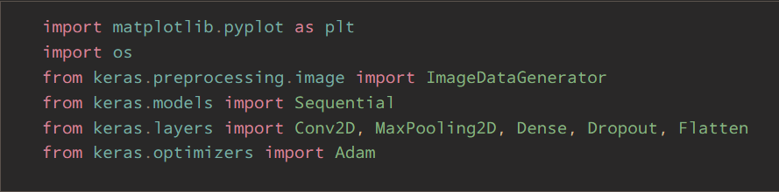
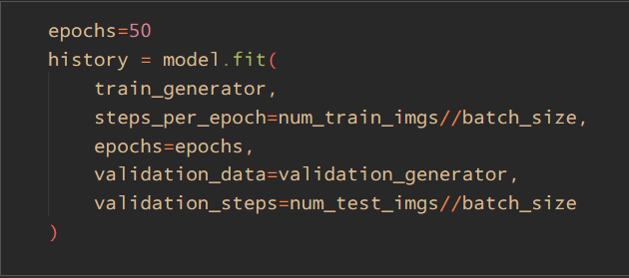

Jupyter notebook file
Processes
+ Import libraries
+ Define constants
+ Import training data and validation data with additional preprocessing
+ Define model layers
+ Compile model
+Train specified model
+ Save model weight into another file

Slide 18
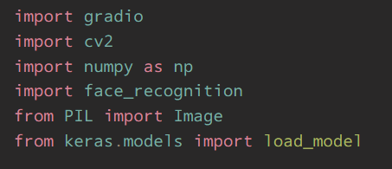
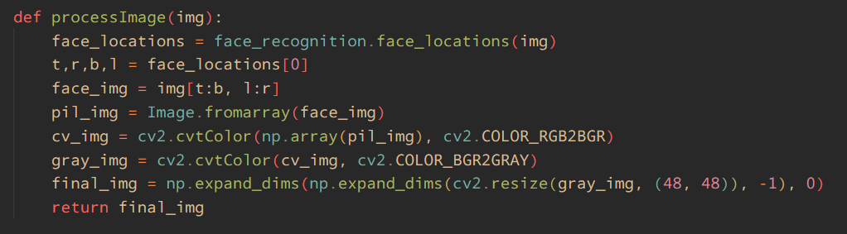
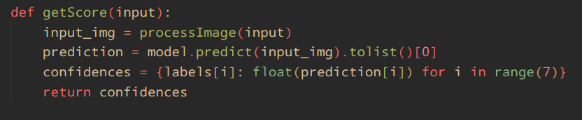
Python file
Processes
+ Import libraries
+ Load model weighs
+ Image preprocessing function: first tries to locate human face in the input image, then convert the cropped image into a grayscale image as well as resize it to be of the same dimension as what the model would expect:
+ getScore function: used to take the input image, pass it to the image preprocessing function and get the prediction result. Finally it returns a dictionary, in which the key is the emotion label and the value is the score, ranging from 0-1:

Slide 19
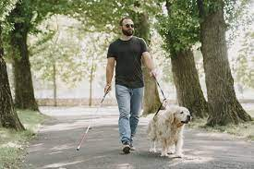
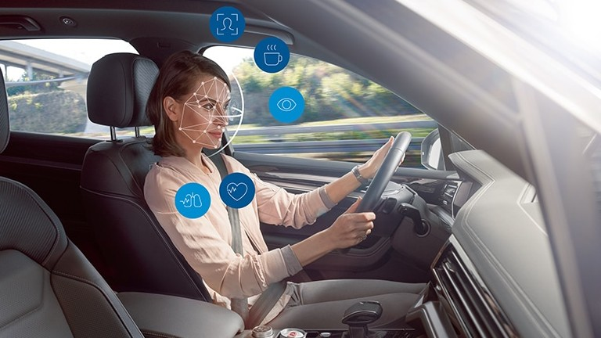
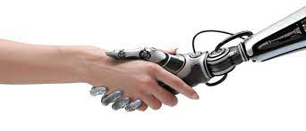
Uses
Application
Help people with blindness
Driver monitor system
Human-bots interaction

Slide 20

Findings and results

Slide 21
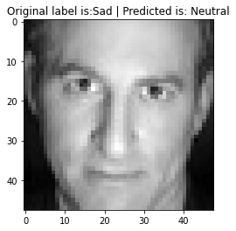
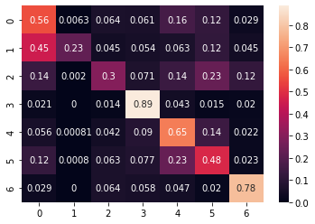
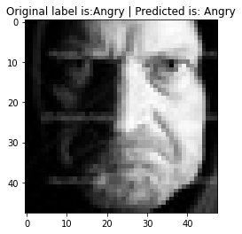
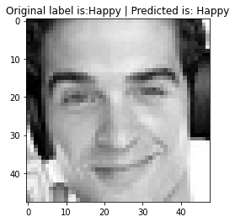
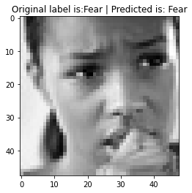
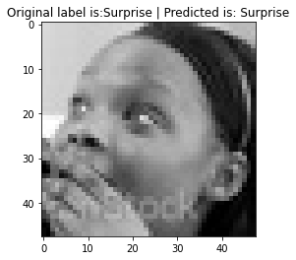
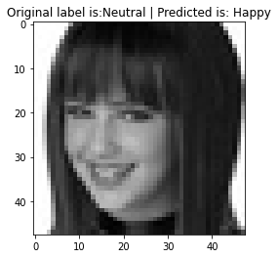
Results
- Here are the results of the model:
Confusion matrix, overall accuracy 0.63

Slide 22
Findings
- Evaluation results:
+Model can operate on acceptable accuracy (about 65%-70%)
+ Dataset has an imbalance number of images between different categories => Bias in the model
+ Some images seem to be mislabeled, but the model can still give accurate results
+ Model might have a hard time differentiating between some emotions if the intensity of the expressed emotion is low

Slide 23

Challenges

Slide 24
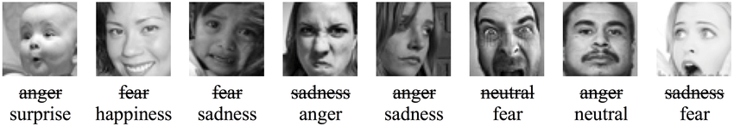
Difficulties
- FER2013 is a difficult dataset:
+Imbalance in distribution data, Example: 435 training images of disgust category while that of happy category has 7215
+Unrelated and mislabeled images which makes training model harder:
=> We tried out several model configurations & optimizers to obtain the model that best performed.
+28000 training images => Process took quite a lot of time. We did not have much opportunity to try out other model architecture and techniques, such as transfer learning,...

Slide 25
Technical challenges
Racial differences
Data augmentation
Technical challenges
Incomplete emotions
Face occlusion and lighting issues

Slide 26

Thanks for listening!
Do you have any question?

