Slide 1
LẬP TRÌNH HỢP NGỮ
BÀI 1: CÁC KHÁI NIỆM CƠ BẢN
kipirvine.com

Slide 2
Giới thiệu về giáo viên
Bộ môn ATTT 2203.S1
Email ngoctn@mta.edu.vn
Giờ tiếp sinh viên: Sáng thứ 6 8h30-9h30
Hướng nghiên cứu chuyên sâu:, ATTT, Nhận dạng mẫu

Slide 3
Giới thiệu môn học
Khái niệm cơ bản
Kiến trúc x86
Giới thiệu Ngôn ngữ lập trình Assembly
Trao đổi dữ liệu, địa chỉ và các phép toán số học
Thủ tục thực thi
Xử lý có điều kiện
Các phép toán trên số nguyên
Xâu ký tự và mảng số
Lập trình trong môi trường Windows

Slide 4
Tài liệu tham khảo
Assembly Language for x86 Processors. Sixth Edition. KIP R. IRVINE. ISBN: 978-0133769401. Published by: Prentice-Hall (Pearson Education)
Kỹ thuật vi xử lý và lập trình Assembly cho hệ vi xử lý – Đỗ Xuân Tiến – NXB Khoa học Kỹ thuật – 2008
The Art of Assembly Language - Randall Hyde – No Starch Press - 2010

Slide 5
Môi trường lập trình cần chuẩn bị
Microsoft Visual Studio 2012 (hoặc mới hơn)
Microsoft Macro Assembler (MASM 7 trở lên)
Tạo template lập trình ASM trong VS

Slide 6
Ví dụ về lập trình Assembly
IN ra màn hình kết quả A nhân B cộng C
C++: cout << (A * B + C);
one to many
Assembly Language:
mov eax,A
mul B
add eax,C
call WriteInt
Intel Machine Language:
A1 00000000
F7 25 00000004
03 05 00000008
E8 00500000
one to one

Slide 7
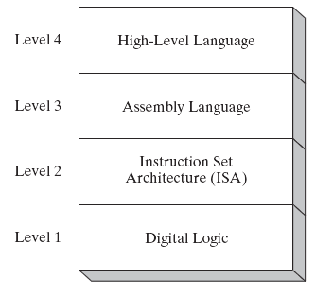
Các cấp độ tương tác với máy tính
(descriptions of individual levels follow . . . )

Slide 8
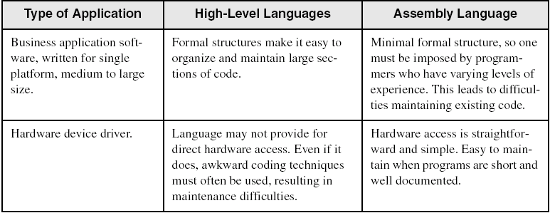
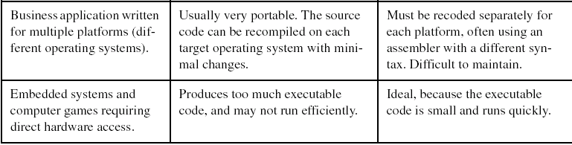
ASM và các ngôn ngữ lập trình bậc cao

Slide 9
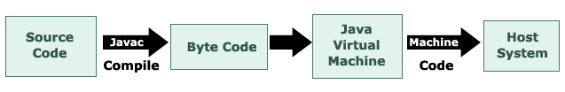
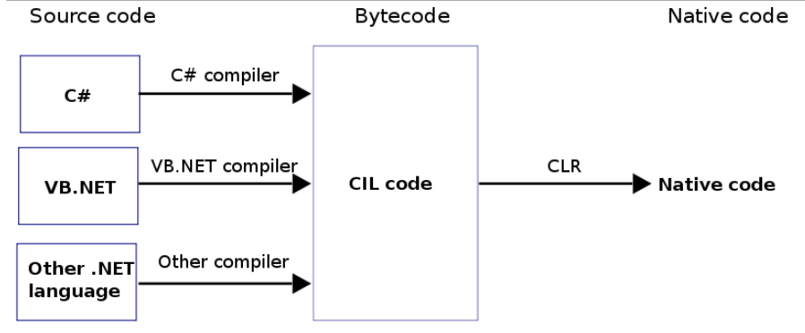
Mô hình máy ảo JVM và .NET CLR
http://en.wikipedia.org/wiki/Java_virtual_machine
Common Language Runtime

Slide 10
Virtual Machines
  Ngôn ngữ máy mức L0 có thể thực thi trực tiếp trên phần cứng
  Ngôn ngữ cấp độ thân thiện hơn với con người mức trên ngôn ngữ máy ký hiêu L1
Chương trình viết bởi L1 có thể chạy theo 2 cách:
  Thông dịch Interpretation – L0 program interprets and executes L1 instructions one by one
  Biên dich Translation – L1 program is completely translated into an L0 program, which then runs on the computer hardware

Slide 11
High-Level Language
Level 4
Application-oriented languages
  C++, Java, Pascal, Visual Basic . . .
Programs compile into assembly language (Level 4)

Slide 12
Assembly Language
Level 3
Instruction mnemonics that have a one-to-one correspondence to machine language
Programs are translated into Instruction Set Architecture Level - machine language (Level 2)

Slide 13
Instruction Set Architecture (ISA)
Level 2
Also known as conventional machine language
Executed by Level 1 (Digital Logic)

Slide 14
Digital Logic
Level 1
CPU, constructed from digital logic gates
System bus
Memory
Implemented using bipolar transistors
next: Data Representation

Slide 15
What's Next
Welcome to Assembly Language
Virtual Machine Concept
Data Representation
Boolean Operations

Slide 16
Data Representation
Binary Numbers
  Translating between binary and decimal
Binary Addition
Integer Storage Sizes
Hexadecimal Integers
  Translating between decimal and hexadecimal
  Hexadecimal subtraction
Signed Integers
  Binary subtraction
Character Storage

Slide 17
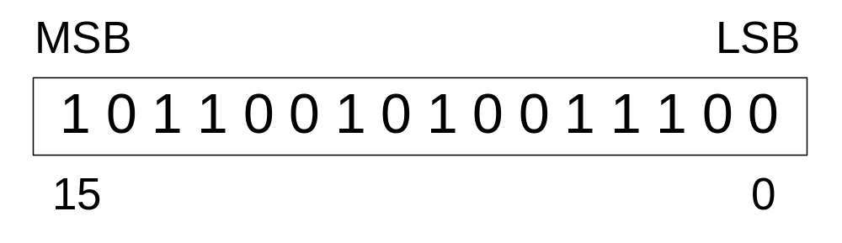
Binary Numbers
Digits are 1 and 0
  1 = true
  0 = false
MSB – most significant bit
LSB – least significant bit
Bit numbering:
Reference:
  Binary numeral system at Wikipedia

Slide 18

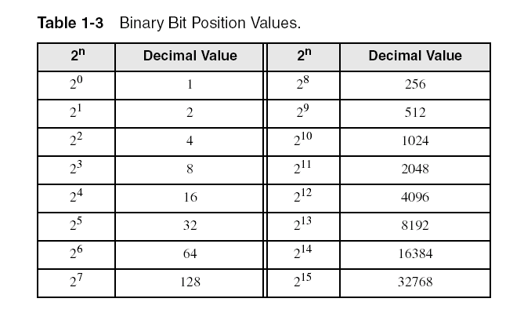
Binary Numbers
Each digit (bit) is either 1 or 0
Each bit represents a power of 2:
Every binary number is a sum of powers of 2

Slide 19
Translating Binary to Decimal
Weighted positional notation shows how to calculate the decimal value of each binary bit:
dec = (D_{n-1} × 2^{n-1}) + (D_{n-2} × 2^{n-2}) + ... + (D₁ × 2¹) + (D₀ × 2⁰)
D = binary digit, 0 or 1
binary 00001001 = decimal 9:
(1 × 2³) + (1 × 2⁰) = 9
w =1; dec =0;
Loop, i: 0 ~ n-1 {
How to implement with multiplication complexity of O(n)?
Dec += Di * w
w *=2
}

Slide 20
Translating Binary to Decimal
Horner's rule: http://en.wikipedia.org/wiki/Horner’s_rule
dec = ((…( (D_{n-1} × 2) + D_{n-2})× 2) + ... + D₁)× 2 + D₀
10001001_{b} = 128 +8 +1 = 137_{d}
dec = ((…( (D₇ × 2) + D₆)× 2) + ... + D₁)× 2 + D₀
= ((…( (1 × 2) + 0)× 2) + ... + 0)× 2 + 1
Good for code implementation
Example: 10010101101_{b} ➔ 1197_{d}
  http://en.wikipedia.org/wiki/Binary-to-decimal_conversion#Conversion_to_and_from_other_numeral_systems

Slide 21
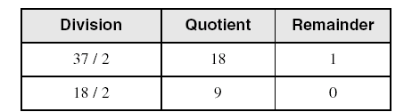
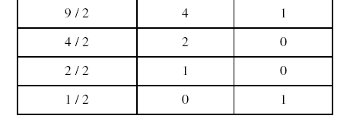
Translating Unsigned Decimal to Binary
Repeatedly divide the decimal integer by 2. Each remainder is a binary digit in the translated value:
37 = 100101

Slide 22
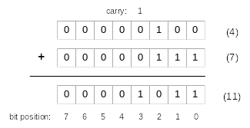
Binary Addition
Starting with the LSB, add each pair of digits, include the carry if present.

Slide 23

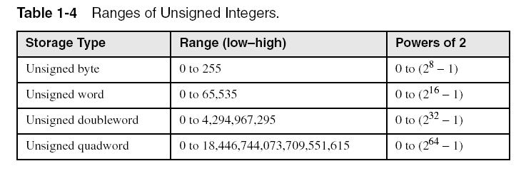
Integer Storage Sizes
Standard sizes:
What is the largest unsigned integer that may be stored in 20 bits?
1048475

Slide 24
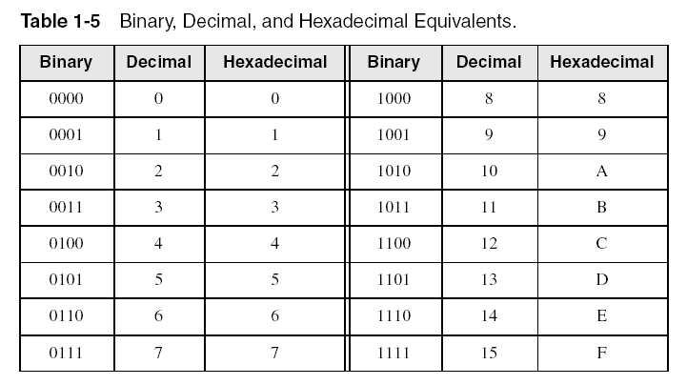
Hexadecimal Integers
Binary values are represented in hexadecimal.

Slide 25

Translating Binary to Hexadecimal
Each hexadecimal digit corresponds to 4 binary bits.
Example: Translate the binary integer 101101010011110010100 to hexadecimal:
Try to separate: 0001,0110,1010,0111,1001,0100

Slide 26
Converting Hexadecimal to Decimal
Multiply each digit by its corresponding power of 16:
  dec = (D₃ × 16³) + (D₂ × 16²) + (D₁ × 16¹) + (D₀ × 16⁰)
Hex 1234 equals (1 × 16³) + (2 × 16²) + (3 × 16¹) + (4 × 16⁰), or decimal 4,660.
Hex 3BA4 equals (3 × 16³) + (11 × 16²) + (10 × 16¹) + (4 × 16⁰), or decimal 15,268.
  Horner's rule: (((3 × 16) + 11) × 16) + 10 )× 16) + 4

Slide 27
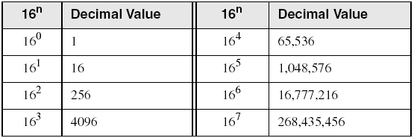
Powers of 16
Used when calculating hexadecimal values up to 8 digits long:

Slide 28
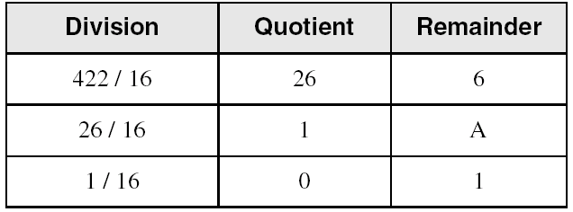
Converting Decimal to Hexadecimal
decimal 422 = 1A6 hexadecimal
Verify the value of 1A6 by Horner's rule?

Slide 29
Hexadecimal Addition
Divide the sum of two digits by the number base (16). The quotient becomes the carry value, and the remainder is the sum digit.
1
1
36 28 28 6A
42 45 58 4B
78 6D 80 B5
21 / 16 = 1, rem 5
Important skill: Programmers frequently add and subtract the addresses of variables and instructions.

Slide 30
Hexadecimal Subtraction
When a borrow is required from the digit to the left, add 16 (decimal) to the current digit's value:
16 + 5 = 21
−1
C6 75
A2 47
24 2E
Practice: The address of var1 is 00400020. The address of the next variable after var1 is 0040006A. How many bytes are used by var1?

Slide 31
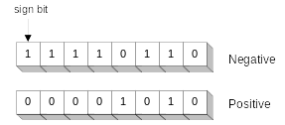
Signed Integers
The highest bit indicates the sign. 1 = negative,
0 = positive
What’s this?
-10
+10
If the highest digit of a hexadecimal integer is > 7, the value is negative. Examples: 8A, C5, A29D, B1234567

Slide 32
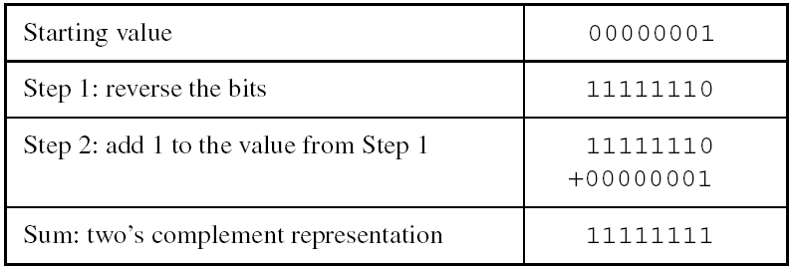
Forming the Two's Complement
Negative numbers are stored in two's complement notation
Represents the additive Inverse
Note that 00000001 + 11111111 = 00000000
Two's Complement operation is reversible. Two's Complement of 11111111 is 00000001

Slide 33
Binary Subtraction
When subtracting A – B, convert B to its two's complement
Add A to (–B)
0 0 0 0 1 1 0 0 0 0 0 0 1 1 0 0
– 0 0 0 0 0 0 1 1 + 1 1 1 1 1 1 0 1
0 0 0 0 1 0 0 1
0 0 0 0 1 0 0 1
Practice: Subtract 0101 from 1001.

Slide 34
Learn How To Do the Following:
Form 2's complement of a hexadecimal WORD: (-27197_{d})
  6A3D_{h}
Convert signed byte to decimal
  11110000_{b}
Convert signed decimal to binary, byte
  -43_{d}:
Convert signed decimal to hexadecimal byte
  -43_{d}
Convert signed hexadecimal byte to decimal
  D5_{h}:
→ 95C2_{h}+1→ 95C3_{h}
→ -16_{d}
What if unsigned?
(43_{d} → 00101011_{b}, 11010100_{b}+1) 11010101_{b}
→ D5_{h}
(2A_{h}+1 = 2B_{h}) -43_{d}

Slide 35
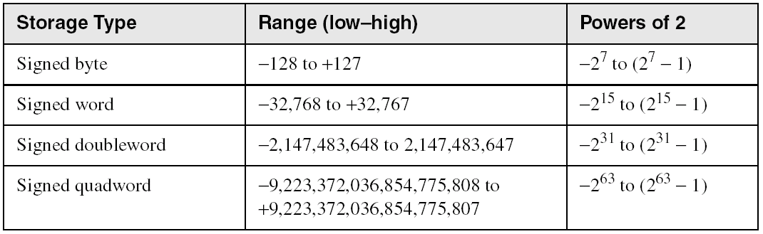
Ranges of Signed Integers
The highest bit is reserved for the sign. This limits the range:
10000000 - 01111111
Why?
Practice: What is the largest positive value that may be stored in 20 bits?

Slide 36
Character Storage
Character sets
  Standard ASCII (0 – 127)
  Extended ASCII (0 – 255)
  ANSI (0 – 255)
  Unicode (0 – 65,535)
Null-terminated String
  Array of characters followed by a null byte
Using the ASCII table
  Back inside cover of book
  Control characters, Front inside cover of book
http://en.wikipedia.org/wiki/ASCII

Slide 37
Numeric Data Representation
Pure binary: binary integer
  can be calculated directly, 01000001b, 41h, 65, 101o
ASCII binary
  string of digits: "01000001"
ASCII decimal
  string of digits: "65"
ASCII hexadecimal
  string of digits: “41“
ASCII octal
  string of digits: “101"
next: Boolean Operations

Slide 38
What's Next
Welcome to Assembly Language
Virtual Machine Concept
Data Representation
Boolean Operations

Slide 39
Boolean Operations
NOT
AND
OR
Operator Precedence
Truth Tables

Slide 40
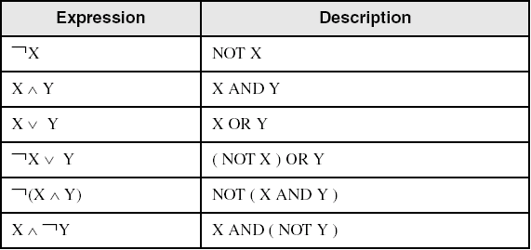
Boolean Algebra
Based on symbolic logic, designed by George Boole
  http://en.wikipedia.org/wiki/George_Boole
Boolean expressions created from:
  NOT, AND, OR

Slide 41
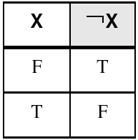
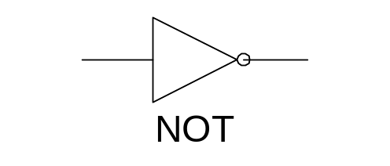
NOT
Inverts (reverses) a boolean value
Truth table for Boolean NOT operator:
Digital gate diagram for NOT:

Slide 42
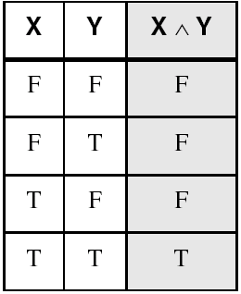
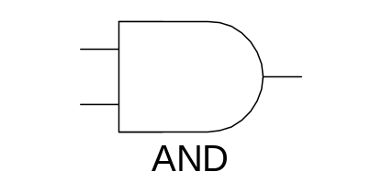
AND
Truth table for Boolean AND operator:
Digital gate diagram for AND:

Slide 43
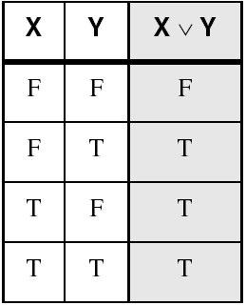
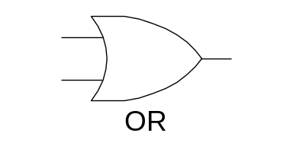
OR
Truth table for Boolean OR operator:
Digital gate diagram for OR:

Slide 44
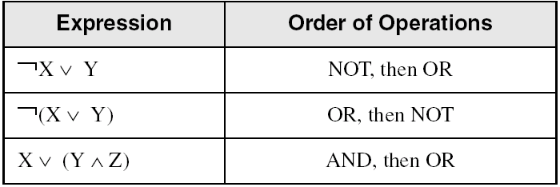
Operator Precedence
Examples showing the order of operations:

Slide 45
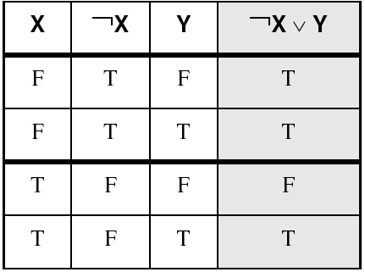
Truth Tables (1 of 3)
A Boolean function has one or more Boolean inputs, and returns a single Boolean output.
A truth table shows all the inputs and outputs of a Boolean function
Example: ¬X ∨ Y

Slide 46
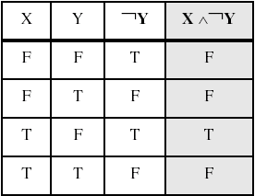
Truth Tables (2 of 3)
Example: X ∧ ¬Y

Slide 47
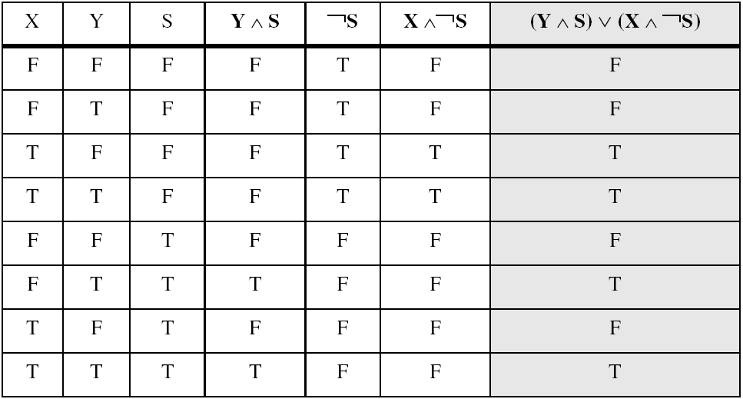
Truth Tables (3 of 3)
Example: (Y ∧ S) ∨ (X ∧ ¬S)
Two-input multiplexer
http://en.wikipedia.org/wiki/Multiplexer

Slide 48
Summary
Assembly language cho phép xây dựng chương trình máy tính có cấu trúc ở tầng thấp nhất
Assembly language có quan hệ one-to-one với ngôn ngữ máy
Each layer in a computer's architecture is an abstraction of a machine
  layers can be hardware or software
Boolean expressions are essential to the design of computer hardware and software

