Slide 1
Assembly Language for x86 Processors 7th Edition
Kip Irvine
Chapter 2: x86 Processor Architecture
Slides prepared by the author
Revised by Zuoliu Ding at Fullerton College, 07/2014
(c) Pearson Education, 2015. All rights reserved. You may modify and copy this slide show for your personal use, or for use in the classroom, as long as this copyright statement, the author's name, and the title are not changed.

Slide 2
Chapter Overview
General Concepts
IA-32 Processor Architecture
IA-32 Memory Management
Components of an IA-32 Microcomputer
Input-Output System
Irvine, Kip R. Assembly Language for x86 Processors 6/e, 2010.

Slide 3
General Concepts
Basic microcomputer design
Instruction execution cycle
Reading from memory
How programs run
Irvine, Kip R. Assembly Language for x86 Processors 6/e, 2010.

Slide 4
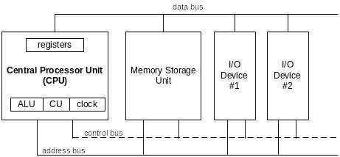
Basic Microcomputer Design
clock synchronizes CPU operations
control unit (CU) coordinates sequence of execution steps
ALU performs arithmetic and bitwise processing
Irvine, Kip R. Assembly Language for x86 Processors 6/e, 2010.

Slide 5
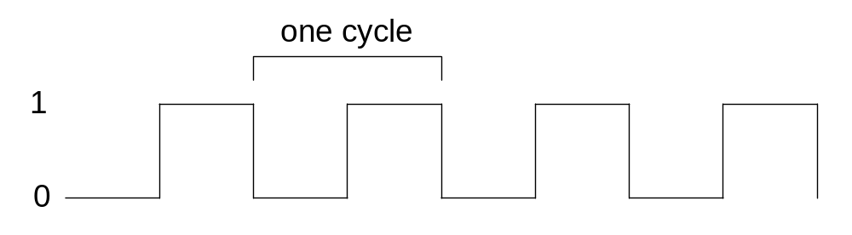
Clock
Synchronizes all CPU and BUS operations
Machine (clock) cycle measures time of a single operation
Clock is used to trigger events
A cycle duration is the reciprocal of the clock’s speed
  1 GHz: cycle duration 1 billionth of a second, 1 nanosecond
Wait state, empty cycle
Irvine, Kip R. Assembly Language for x86 Processors 6/e, 2010.

Slide 6
What's Next
General Concepts
IA-32 Processor Architecture
IA-32 Memory Management
Components of an IA-32 Microcomputer
Input-Output System
Irvine, Kip R. Assembly Language for x86 Processors 6/e, 2010.

Slide 7
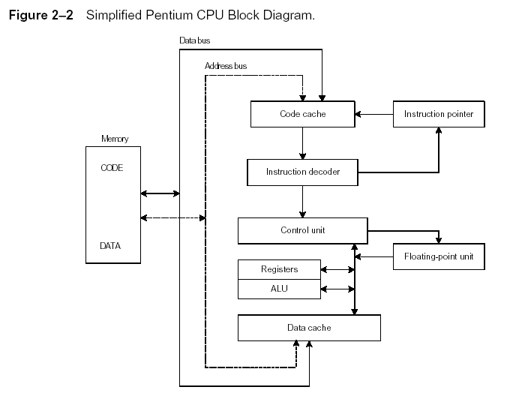
Instruction Execution Cycle
Instruction Execution Cycle
Irvine, Kip R. Assembly Language for x86 Processors 6/e, 2010.

Slide 8
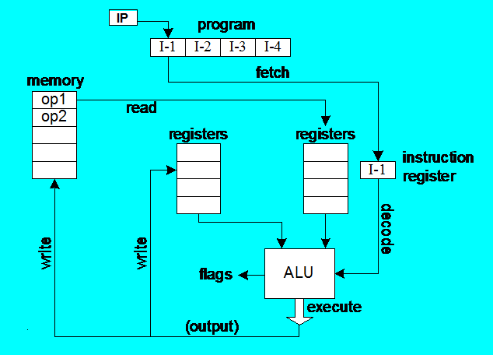
Instruction Execution Cycle
Fetch
Decode
Fetch operands
Execute
Store output
Irvine, Kip R. Assembly Language for Intel-Based Computers 5/e, 2007.

Slide 9
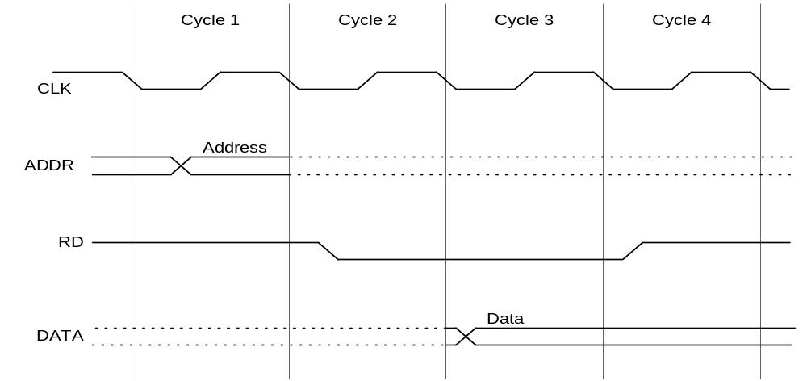
Reading from Memory
Multiple machine cycles are required when reading from memory, because it responds much more slowly than the CPU. The steps are:
  Place the address of the value you want to read on the address bus.
  Assert (changing the value of) the processor’s RD (read) pin.
  Wait one clock cycle for the memory chips to respond.
  Copy the data from the data bus into the destination operand
Irvine, Kip R. Assembly Language for x86 Processors 6/e, 2010.

Slide 10
Cache Memory
High-speed expensive static RAM both inside and outside the CPU.
  Level-1 cache: inside the CPU
  Level-2 cache: outside the CPU
Cache hit: when data to be read is already in cache memory
Cache miss: when data to be read is not in cache memory.
Online reading: How Computer Memory Works
  http://computer.howstuffworks.com/computer-memory4.htm
Irvine, Kip R. Assembly Language for x86 Processors 6/e, 2010.

Slide 11
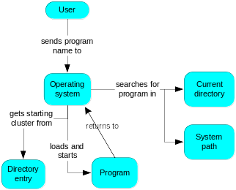
How a Program Runs
As soon as the program begins running, it’s called a Process
A process has its memory and may contains multiple Threads
Irvine, Kip R. Assembly Language for x86 Processors 6/e, 2010.

Slide 12
Multitasking
OS can run multiple programs at the same time.
Multiple threads of execution within the same program.
Scheduler utility assigns a given amount of CPU time to each running program.
Rapid switching of tasks
  gives illusion that all programs are running at once
  the processor must support task switching.
Irvine, Kip R. Assembly Language for x86 Processors 6/e, 2010.

Slide 13
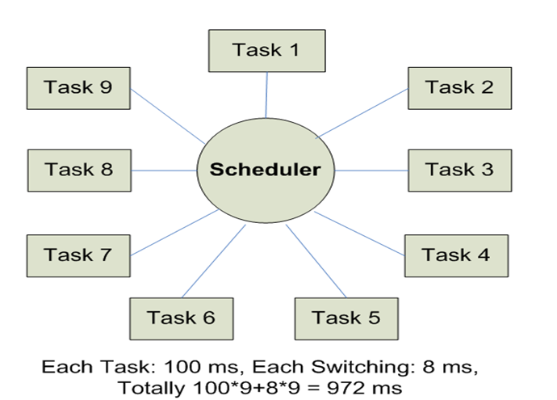
Round-Robin Scheduler
Task switching: Context, Priority
Irvine, Kip R. Assembly Language for Intel-Based Computers 5/e, 2007.

Slide 14
IA-32 Processor Architecture
Modes of operation
Basic execution environment
Floating-point unit
Intel Microprocessor history
Irvine, Kip R. Assembly Language for x86 Processors 6/e, 2010.

Slide 15
Modes of Operation
Protected mode
  native mode (Windows, Linux)
Real-address mode
  native MS-DOS
System management mode
  power management, system security, diagnostics
Virtual-8086 mode
  hybrid of Protected
  each program has its own 8086 computer
Irvine, Kip R. Assembly Language for x86 Processors 6/e, 2010.

Slide 16
Basic Execution Environment
Addressable memory
General-purpose registers
Index and base registers
Specialized register uses
Status flags
Floating-point, MMX, XMM registers
Irvine, Kip R. Assembly Language for x86 Processors 6/e, 2010.

Slide 17
Addressable Memory
Protected mode
  4 GB
  32-bit address
Real-address and Virtual-8086 modes
  1 MB space
  20-bit address
Irvine, Kip R. Assembly Language for x86 Processors 6/e, 2010.

Slide 18

General-Purpose Registers
Named storage locations inside the CPU, optimized for speed.
Irvine, Kip R. Assembly Language for x86 Processors 6/e, 2010.

Slide 19


Accessing Parts of Registers
Use 8-bit name, 16-bit name, or 32-bit name
Applies to EAX, EBX, ECX, and EDX
Irvine, Kip R. Assembly Language for x86 Processors 6/e, 2010.

Slide 20

Index and Base Registers
Some registers have only a 16-bit name for their lower half:
Irvine, Kip R. Assembly Language for x86 Processors 6/e, 2010.

Slide 21
Some Specialized Register Uses (1 of 2)
General-Purpose
  EAX – accumulator
  ECX – loop counter
  ESP – stack pointer
  ESI, EDI – index registers
  EBP – extended frame pointer (stack)
Segment
  CS – code segment
  DS – data segment
  SS – stack segment
  ES, FS, GS - additional segments
Irvine, Kip R. Assembly Language for x86 Processors 6/e, 2010.

Slide 22
Some Specialized Register Uses (2 of 2)
EIP – instruction pointer
    IP for 16-bit
EFLAGS
  status and control flags
  each flag is a single binary bit
Irvine, Kip R. Assembly Language for x86 Processors 6/e, 2010.

Slide 23
Status Flags
Carry
  unsigned arithmetic out of range
Overflow
  signed arithmetic out of range
Sign
  result is negative
Zero
  result is zero
Auxiliary Carry
  carry from bit 3 to bit 4
Parity
  sum of 1 bits is an even number
Irvine, Kip R. Assembly Language for x86 Processors 6/e, 2010.

Slide 24

Floating-Point, MMX, XMM Registers
Eight 80-bit floating-point data registers
  ST(0), ST(1), . . . , ST(7)
  arranged in a stack
  used for all floating-point arithmetic
Eight 64-bit MMX registers
Eight 128-bit XMM registers for single-instruction multiple-data (SIMD) operations
Irvine, Kip R. Assembly Language for x86 Processors 6/e, 2010.

Slide 25
CISC and RISC
CISC – complex instruction set
  large instruction set
  high-level operations
  requires microcode interpreter
  examples: Intel 80x86 family
RISC – reduced instruction set
  simple, atomic instructions
  small instruction set
  directly executed by hardware
  examples:
    ARM (Advanced RISC Machines)
      ARM Assembly Language Programming
    DEC Alpha (now Compaq)
Irvine, Kip R. Assembly Language for x86 Processors 6/e, 2010.

Slide 26
What's Next
General Concepts
IA-32 Processor Architecture
IA-32 Memory Management
64-Bit Processors
Components of an IA-32 Microcomputer
Input-Output System
Irvine, Kip R. Assembly Language for x86 Processors 6/e, 2010.

Slide 27
IA-32 Memory Management
Real-address mode
Calculating linear addresses
Protected mode
Multi-segment model
Paging
Irvine, Kip R. Assembly Language for x86 Processors 6/e, 2010.

Slide 28
Real-Address mode
1 MB RAM maximum addressable
Application programs can access any area of memory
Single tasking
Supported by MS-DOS operating system
Irvine, Kip R. Assembly Language for x86 Processors 6/e, 2010.

Slide 29
Protected Mode
4 GB addressable RAM
  (00000000 to FFFFFFFFh)
Each program assigned a memory partition which is protected from other programs
Designed for multitasking
Supported by Linux & MS-Windows
Irvine, Kip R. Assembly Language for x86 Processors 6/e, 2010.

Slide 30
Paging
Supported directly by the CPU
Divides each segment into 4096-byte blocks called pages
Sum of all programs can be larger than physical memory
Part of running program is in memory, part is on disk
Virtual memory manager (VMM) – OS utility that manages the loading and unloading of pages
Page fault – issued by CPU when a page must be loaded from disk
Irvine, Kip R. Assembly Language for x86 Processors 6/e, 2010.

Slide 31
What's Next
General Concepts
IA-32 Processor Architecture
IA-32 Memory Management
64-Bit Processors
Components of an IA-32 Microcomputer
Input-Output System
Irvine, Kip R. Assembly Language for x86 Processors 7/e, 2015.

Slide 32
64-Bit Processors
64-Bit Operation Modes
  Compatibility mode – can run existing 16-bit and 32-bit applications (Windows supports only 32-bit apps in this mode)
  64-bit mode – Windows 64 uses this
Basic Execution Environment
  addresses can be 64 bits (48 bits, in practice)
  16 64-bit general purpose registers
  64-bit instruction pointer named RIP
Irvine, Kip R. Assembly Language for x86 Processors 7/e, 2015.

Slide 33
64-Bit General Purpose Registers
32-bit general purpose registers:
  EAX, EBX, ECX, EDX, EDI, ESI, EBP, ESP, R8D, R9D, R10D, R11D, R12D, R13D, R14D, R15D
64-bit general purpose registers:
  RAX, RBX, RCX, RDX, RDI, RSI, RBP, RSP, R8, R9, R10, R11, R12, R13, R14, R15
Irvine, Kip R. Assembly Language for x86 Processors 7/e, 2015.

Slide 34
64-bit Processors
Intel64
  64-bit linear address space
  Intel: Pentium Extreme, Xeon, Celeron D, Pendium D, Core 2, and Core i7
IA-32e Mode
  Compatibility mode for legacy 16- and 32-bit applications
  64-bit Mode uses 64-bit addresses and operands
x64 Assembly Information
x64 Registers: http://www.ntcore.com/files/vista_x64.htm
x86-64: http://en.wikipedia.org/wiki/X86-64
Irvine, Kip R. Assembly Language for x86 Processors 6/e, 2010.

Slide 35
What's Next
General Concepts
IA-32 Processor Architecture
IA-32 Memory Management
Components of an IA-32 Microcomputer
Input-Output System
Irvine, Kip R. Assembly Language for x86 Processors 6/e, 2010.

Slide 36
Components of an IA-32 Microcomputer
Motherboard
Video output
Memory
Input-output ports
Irvine, Kip R. Assembly Language for x86 Processors 6/e, 2010.

Slide 37
Motherboard
CPU socket
External cache memory slots
Main memory slots
BIOS chips
Sound synthesizer chip (optional)
Video controller chip (optional)
IDE, parallel, serial, USB, video, keyboard, joystick, network, and mouse connectors
PCI bus connectors (expansion cards)
Irvine, Kip R. Assembly Language for x86 Processors 6/e, 2010.

Slide 38
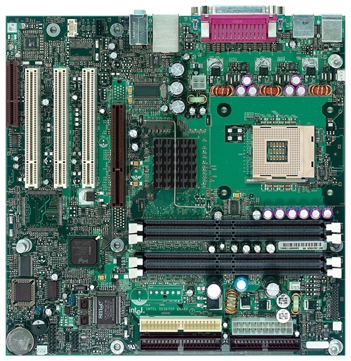
Intel D850MD Motherboard
mouse, keyboard, parallel, serial, and USB connectors
Video
Audio chip
PCI slots
memory controller hub
Pentium 4 socket
AGP slot
dynamic RAM
Firmware hub
I/O Controller
Speaker
Power connector
Battery
Diskette connector
Source: Intel® Desktop Board D850MD/D850MV Technical Product Specification
IDE drive connectors
Irvine, Kip R. Assembly Language for x86 Processors 6/e, 2010.

Slide 39
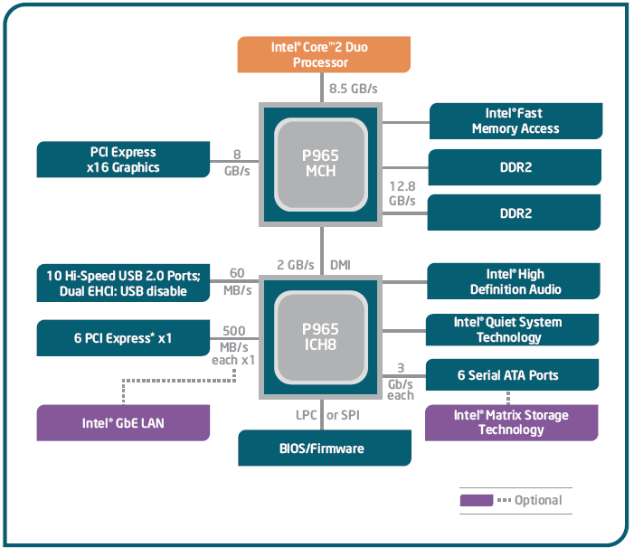
Intel 965 Express Chipset
Irvine, Kip R. Assembly Language for x86 Processors 6/e, 2010.

Slide 40
Video Output
Video controller
  on motherboard, or on expansion card
  AGP (accelerated graphics port technology)*
Video memory (VRAM)
Video CRT Display
  uses raster scanning
  horizontal retrace
  vertical retrace
Direct digital LCD monitors
  no raster scanning required
* This link may change over time.
Irvine, Kip R. Assembly Language for x86 Processors 6/e, 2010.

Slide 41
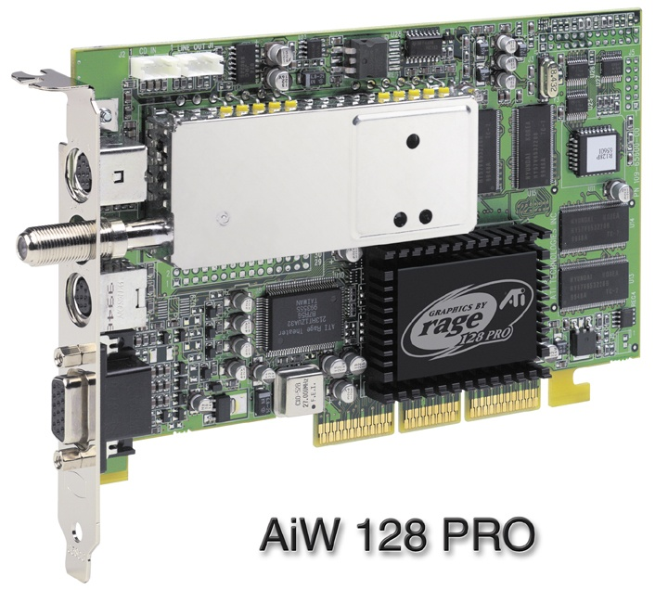
Sample Video Controller (ATI Corp.)
  128-bit 3D graphics performance powered by RAGE™ 128 PRO
  3D graphics performance
  Intelligent TV-Tuner with Digital VCR
  TV-ON-DEMAND™
  Interactive Program Guide
  Still image and MPEG-2 motion video capture
  Video editing
  Hardware DVD video playback
  Video output to TV or VCR
Irvine, Kip R. Assembly Language for x86 Processors 6/e, 2010.

Slide 42
Memory
ROM
  read-only memory
EPROM
  erasable programmable read-only memory, ultraviolet light
Dynamic RAM (DRAM)
  inexpensive; must be refreshed constantly
Static RAM (SRAM)
  expensive; used for cache memory; no refresh required
Video RAM (VRAM)
  dual ported; optimized for constant video refresh
CMOS RAM
  complimentary metal-oxide semiconductor
  system setup information
See: Intel platform memory (Intel technology brief: link address may change)
Irvine, Kip R. Assembly Language for x86 Processors 6/e, 2010.

Slide 43
Input-Output Ports
USB (universal serial bus)
  intelligent high-speed connection to devices
  480 megabits/second (2.0), 12 mb/s (1.0)
  USB hub connects multiple devices
  enumeration: computer queries devices
  supports hot connections
Parallel
  short cable, high speed
  common for printers
  bidirectional, parallel data transfer
  Intel 8255 controller chip
Irvine, Kip R. Assembly Language for x86 Processors 6/e, 2010.

Slide 44
Input-Output Ports (cont)
Serial
  RS-232 serial port
  one bit at a time
  uses long cables and modems
  16550 UART (universal asynchronous receiver transmitter)
  programmable in assembly language
Irvine, Kip R. Assembly Language for x86 Processors 6/e, 2010.

Slide 45
Device Interfaces
ATA host adapters
  intelligent drive electronics (hard drive, CDROM)
SATA (Serial ATA)
  inexpensive, fast, bidirectional
FireWire
  high speed (800 MB/sec), many devices at once
Bluetooth
  small amounts of data, short distances, low power usage
Wi-Fi (wireless Ethernet)
  IEEE 802.11 standard, faster than Bluetooth
Irvine, Kip R. Assembly Language for x86 Processors 6/e, 2010.

Slide 46
What's Next
General Concepts
IA-32 Processor Architecture
IA-32 Memory Management
Components of an IA-32 Microcomputer
Input-Output System
Irvine, Kip R. Assembly Language for x86 Processors 6/e, 2010.

Slide 47
Levels of Input-Output
Level 3: High-level language function
  examples: C++, Java
  portable, convenient, not always the fastest
Level 2: Operating system
  Application Programming Interface (API)
  extended capabilities, lots of details to master
Level 1: BIOS
  drivers that communicate directly with devices
  OS security may prevent application-level code from working at this level
Irvine, Kip R. Assembly Language for x86 Processors 6/e, 2010.

Slide 48
Displaying a String of Characters
When a HLL program displays a string of characters, the following steps take place:
Irvine, Kip R. Assembly Language for x86 Processors 6/e, 2010.

Slide 49
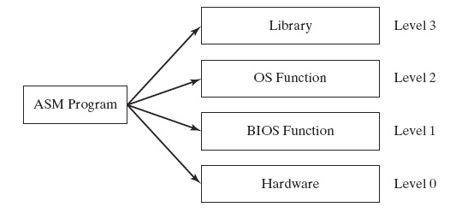
Programming levels
Assembly language programs can perform input-output at each of the following levels:
Irvine, Kip R. Assembly Language for x86 Processors 6/e, 2010.

Slide 50
Summary
Central Processing Unit (CPU)
Arithmetic Logic Unit (ALU)
Instruction execution cycle
Multitasking
Floating Point Unit (FPU)
Complex Instruction Set
Real mode and Protected mode
Motherboard components
Memory types
Input/Output and access levels
Irvine, Kip R. Assembly Language for x86 Processors 6/e, 2010.

Slide 51
42 69 6E 61 72 79
What does this say?
Irvine, Kip R. Assembly Language for x86 Processors 6/e, 2010.

