Slide 1
Deskhand drafts replies to your support tickets
Deskhand
Each reply links every claim to the order or help article it came from.
Brand introduction · Fictional product for a Brand Studio demo
Notes:
Deskhand is a fictional product. Everything in this deck comes from its brand contract and demo page.

Slide 2
Support leads need to trust a reply before it goes out
Deskhand is for online shops with one to ten support agents. Each draft shows the order or help article behind every fact.
1 Deskhand brand contract: audience and positioning

Slide 3
One ticket shows how a reply gets made
01
Ticket #2291: a lamp arrived cracked, and the customer wants a refund.

Slide 4
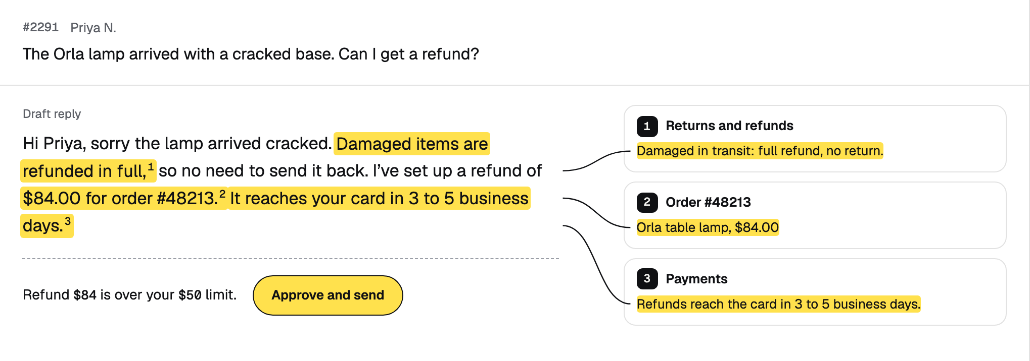
Ticket #2291 gets a cited reply in one view
The message, three sources, the cited draft and the approval bar on one screen.
1 Capture of the Deskhand demo page, Brand Studio showcase, 25 Sep 2026
Notes:
Point at a highlighted claim, then follow its line to the source.

Slide 5
Deskhand reads three sources, then writes a cited reply
1
2
3
4
5
Reads the order
Reads the help article
Reads the thread
Writes a cited reply
Holds large refunds
Checks what the customer bought and paid.
Finds the policy that covers the ticket.
Picks up what the customer already said.
Numbers each claim and links it to its source.
A refund over your limit waits for you.
1 Deskhand brand contract: how chapter

Slide 6
An $84 refund over your limit waits for your approval
$84
Refund drafted for ticket #2291, a lamp that arrived cracked
Deskhand writes the reply and holds it until you approve and send.
1 Sample ticket from the Deskhand brand contract; the data is fictional

Slide 7
You set the refund limit, and chargebacks always go to a person
Where a ticket goes, by refund amount and type
Deskhand sends
Waits for you
Replies with a refund at or under your limit
Replies with no refund
Refunds over your limit
Every chargeback
1 Deskhand brand contract: limits chapter

Slide 8
Next step: try Deskhand free for 14 days
Deskhand
After the trial, you pay for each reply Deskhand sends.
Start a 14-day trial
Deskhand is fictional · brandstudio.js.org
Notes:
Pricing follows the contract: free for 14 days, then a price per reply Deskhand sends.

