Slide 1
Call stack - Event loop

Slide 2
1. Javascript engine
- Wiki: A JavaScript engine is a program or interpreter which executes JavaScript code.
- SpiderMonkey : Firefox, viết bằng C và C++.
- Chakra: Internet Explorer, Microsoft Edge, viết bằng C++.
- Rhino: viết hoàn toàn bằng Java, hiện tại được phát triển bởi Mozilla Foundation.
- V8: Chrome V8, được phát triển bởi Chromium Project, mục đích ban đầu là dành cho Google Chrome và Chromium, sau này nodejs cũng dùng thằng này

Slide 3
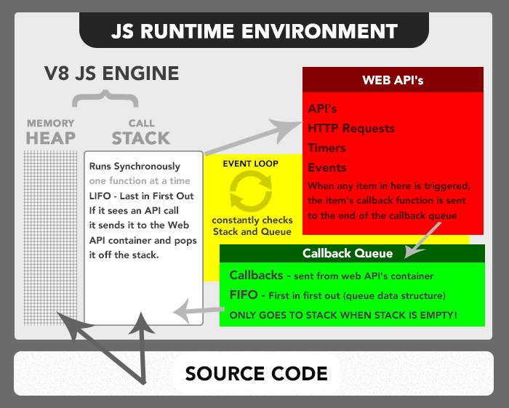
2. JavaScript Runtime Enviroment
Chrome Browser sử dụng các đối tượng như window, DOM object hay các method như AJAX… để giao tiếp với network và hiển thị.
Node.js lại cung cấp các thư viện cho phép truy cập trực tiếp các file trên máy tính, truy cập database, tiến trình (Chrome Browser không làm được các việc này)
Memory Heap, memory stack?

Slide 4
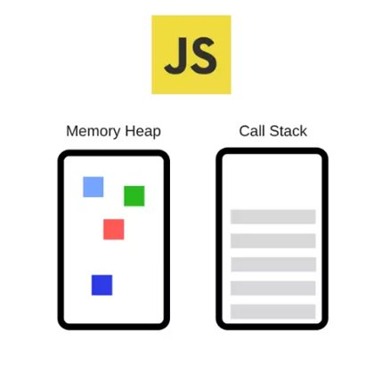
3. Javascript
- Chỉ có một thread
- Chỉ có một call stack
- Chỉ chạy một thứ ở một thời điểm

Slide 5
4. Call stack
Call stack
function foo() {
return "foo";
}
function bar() {
return foo() + " bar";
}
function far() {
return bar() + " far";
}
function boo() {
console.log(far() + " boo");
}
boo();
main()

Slide 6
4. Call stack
Call stack
function foo() {
return "foo";
}
function bar() {
return foo() + " bar";
}
function far() {
return bar() + " far";
}
function boo() {
console.log(far() + " boo");
}
boo();
boo()
main()

Slide 7
4. Call stack
Call stack
function foo() {
return "foo";
}
function bar() {
return foo() + " bar";
}
function far() {
return bar() + " far";
}
function boo() {
console.log(far() + " boo");
}
boo();
console.log()
boo()
main()

Slide 8
4. Call stack
Call stack
function foo() {
return "foo";
}
function bar() {
return foo() + " bar";
}
function far() {
return bar() + " far";
}
function boo() {
console.log(far() + " boo");
}
boo();
far()
console.log()
boo()
main()

Slide 9
4. Call stack
Call stack
function foo() {
return "foo";
}
function bar() {
return foo() + " bar";
}
function far() {
return bar() + " far";
}
function boo() {
console.log(far() + " boo");
}
boo();
bar()
far()
console.log()
boo()
main()

Slide 10
4. Call stack
Call stack
function foo() {
return "foo";
}
function bar() {
return foo() + " bar";
}
function far() {
return bar() + " far";
}
function boo() {
console.log(far() + " boo");
}
boo();
foo()
bar()
far()
console.log()
boo()
main()

Slide 11
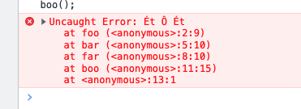
5. Stack trace
function foo() {
throw Error("Ét Ô Ét");
}
function bar() {
return foo() + " bar";
}
function far() {
return bar() + " far";
}
function boo() {
console.log(far() + " boo");
}
boo();

Slide 12
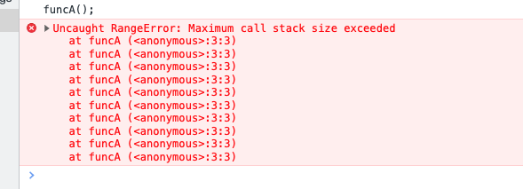
6. Stackoverflow
Call stack
function funcA() {
funcA()
}
funcA();
funcA()
funcA()
funcA()
funcA()
funcA()
funcA()
funcA()
funcA()
funcA()
funcA()
main()

Slide 13
7. Blocking
- Vòng for mấy trăm/triệu lần
- Call API
- Đọc data

Slide 14
8. Asynchronous – Non-blocking
Call stack
Web APIs
console.log(1)
setTimeout(function cb() { console.log(2)
}, 5000);
console.log(3)
main()
Event loop
Queue

Slide 15
8. Asynchronous – Non-blocking
Call stack
Web APIs
console.log(1)
setTimeout(function cb() { console.log(2)
}, 5000);
console.log(3)
console.log(1)
main()
Event loop
Queue

Slide 16
8. Asynchronous – Non-blocking
Call stack
Web APIs
console.log(1)
setTimeout(function cb() { console.log(2)
}, 5000);
console.log(3)
setTimeout()
main()
Event loop
Queue

Slide 17
8. Asynchronous – Non-blocking
Call stack
Web APIs
console.log(1)
setTimeout(function cb() { console.log(2)
}, 5000);
console.log(3)
timer() => cb
main()
Event loop
Queue

Slide 18
8. Asynchronous – Non-blocking
Call stack
Web APIs
console.log(1)
setTimeout(function cb() { console.log(2)
}, 5000);
console.log(3)
timer() => cb
console.log(3)
main()
Event loop
Queue

Slide 19
8. Asynchronous – Non-blocking
Call stack
Web APIs
console.log(1)
setTimeout(function cb() { console.log(2)
}, 5000);
console.log(3)
main()
Event loop
Queue
cb

Slide 20
8. Asynchronous – Non-blocking
Call stack
Web APIs
console.log(1)
setTimeout(function cb() { console.log(2)
}, 5000);
console.log(3)
Event loop
Queue
cb

Slide 21
8. Asynchronous – Non-blocking
Call stack
Web APIs
console.log(1)
setTimeout(function cb() { console.log(2)
}, 5000);
console.log(3)
cb()
Event loop
Queue

Slide 22
8. Asynchronous – Non-blocking
Call stack
Web APIs
console.log(1)
setTimeout(function cb() { console.log(2)
}, 5000);
console.log(3)
console.log(2)
cb()
Event loop
Queue

Slide 23
8. Asynchronous – Non-blocking
Call stack
Web APIs
console.log(1)
setTimeout(function cb() { console.log(2)
}, 5000);
console.log(3)
cb()
Event loop
Queue

Slide 24
8. Asynchronous – Non-blocking
Call stack
Web APIs
console.log(1)
setTimeout(function cb() { console.log(2)
}, 5000);
console.log(3)
Event loop
Queue

Slide 25
* Web APIs
- DOM event (click, mousedown,...)
- Http request (Ajax...)
- Timers (SetTimeout, SetInterval,…)

Slide 26
8. Thứ tự khi chạy
- Macrotasks: setTimeout , setInterval , setImmediate , requestAnimationFrame , I / O
- Microtasks: process.nextTick , Promises callback, async function, queueMicrotask , MutationObserve

Slide 27
async function abc() {
console.log(8);
await Promise.resolve(2).then(console.log);
console.log(3);
}
setTimeout(() => console.log(1), 0);
abc();
Promise.resolve(4).then(console.log);
console.log(6);
A. 8 6 2 4 3 1
B. 8 6 2 3 1 4
C. 8 6 2 3 4 1
D. 8 6 1 4 2 3

Slide 28
async function abc() {
console.log(8);
await Promise.resolve(2).then(console.log);
console.log(3);
}
setTimeout(() => console.log(1), 0);
abc();
Promise.resolve(4).then(console.log);
console.log(6);
A. 8 6 2 4 3 1
B. 8 6 2 3 1 4
C. 8 6 2 3 4 1
D. 8 6 1 4 2 3

Slide 29
async function abc() {
console.log(8);
await Promise.resolve(2).then(console.log);
console.log(3);
}
setTimeout(() => console.log(1), 0);
abc();
Promise.resolve(4).then(console.log);
console.log(6);
Call stack
Web APIs
Event loop
main()
Microtask Queue
Output:
Macrotask Queue

Slide 30
async function abc() {
console.log(8);
await Promise.resolve(2).then(console.log);
console.log(3);
}
setTimeout(() => console.log(1), 0);
abc();
Promise.resolve(4).then(console.log);
console.log(6);
Call stack
Web APIs
Event loop
setTimeout
main()
Microtask Queue
Output:
Macrotask Queue

Slide 31
async function abc() {
console.log(8);
await Promise.resolve(2).then(console.log);
console.log(3);
}
setTimeout(() => console.log(1), 0);
abc();
Promise.resolve(4).then(console.log);
console.log(6);
Call stack
Web APIs
Timer => log(1)
Event loop
main()
Microtask Queue
Output:
Macrotask Queue

Slide 32
async function abc() {
console.log(8);
await Promise.resolve(2).then(console.log);
console.log(3);
}
setTimeout(() => console.log(1), 0);
abc();
Promise.resolve(4).then(console.log);
console.log(6);
Call stack
Web APIs
console.log(8)
Event loop
abc()
main()
Microtask Queue
Output:
Macrotask Queue
Cb => log(1)

Slide 33
async function abc() {
console.log(8);
await Promise.resolve(2).then(console.log);
console.log(3);
}
setTimeout(() => console.log(1), 0);
abc();
Promise.resolve(4).then(console.log);
console.log(6);
Call stack
Web APIs
.then()
Event loop
abc()
main()
Microtask Queue
Output: 8
Macrotask Queue
Cb => log(1)

Slide 34
async function abc() {
console.log(8);
await Promise.resolve(2).then(console.log);
console.log(3);
}
setTimeout(() => console.log(1), 0);
abc();
Promise.resolve(4).then(console.log);
console.log(6);
Call stack
Web APIs
Cb => log(2)
Event loop
.then() => log 4
main()
Microtask Queue
Output: 8
Macrotask Queue
Cb => log(1)

Slide 35
async function abc() {
console.log(8);
await Promise.resolve(2).then(console.log);
console.log(3);
}
setTimeout(() => console.log(1), 0);
abc();
Promise.resolve(4).then(console.log);
console.log(6);
Call stack
Web APIs
Cb => log(4)
Event loop
main()
Microtask Queue
Cb => log(2)
Output: 8
Macrotask Queue
Cb => log(1)

Slide 36
async function abc() {
console.log(8);
await Promise.resolve(2).then(console.log);
console.log(3);
}
setTimeout(() => console.log(1), 0);
abc();
Promise.resolve(4).then(console.log);
console.log(6);
Call stack
Web APIs
Event loop
main()
Microtask Queue
Cb => log(2)
Cb => log(4)
Output: 8 6
Macrotask Queue
Cb => log(1)

Slide 37
async function abc() {
console.log(8);
await Promise.resolve(2).then(console.log);
console.log(3);
}
setTimeout(() => console.log(1), 0);
abc();
Promise.resolve(4).then(console.log);
console.log(6);
Call stack
Web APIs
Event loop
Microtask Queue
Cb => log(2)
Cb => log(4)
Output: 8 6
Macrotask Queue
Cb => log(1)

Slide 38
async function abc() {
console.log(8);
await Promise.resolve(2).then(console.log);
console.log(3);
}
setTimeout(() => console.log(1), 0);
abc();
Promise.resolve(4).then(console.log);
console.log(6);
Call stack
Web APIs
Event loop
console.log(2)
Cb()
Microtask Queue
Cb => log(4)
Output: 8 6 2
Macrotask Queue
Cb => log(1)

Slide 39
async function abc() {
console.log(8);
await Promise.resolve(2).then(console.log);
console.log(3);
}
setTimeout(() => console.log(1), 0);
abc();
Promise.resolve(4).then(console.log);
console.log(6);
Call stack
Web APIs
Event loop
.then => log(3)
Cb()
Microtask Queue
Cb => log(4)
Output: 8 6 2
Macrotask Queue
Cb => log(1)

Slide 40
async function abc() {
console.log(8);
await Promise.resolve(2).then(console.log);
console.log(3);
// .then(() => console.log(3))
}
setTimeout(() => console.log(1), 0);
abc();
Promise.resolve(4).then(console.log);
console.log(6);
Call stack
Web APIs
Cb => log(3)
Event loop
Cb()
Microtask Queue
Cb => log(4)
Output: 8 6 2
Macrotask Queue
Cb => log(1)

Slide 41
async function abc() {
console.log(8);
await Promise.resolve(2).then(console.log);
console.log(3);
// .then(() => console.log(3))
}
setTimeout(() => console.log(1), 0);
abc();
Promise.resolve(4).then(console.log);
console.log(6);
Call stack
Web APIs
Event loop
Microtask Queue
Cb => log(4)
Cb => log(3)
Output: 8 6 2
Macrotask Queue
Cb => log(1)

Slide 42
async function abc() {
console.log(8);
await Promise.resolve(2).then(console.log);
console.log(3);
// .then(() => console.log(3))
}
setTimeout(() => console.log(1), 0);
abc();
Promise.resolve(4).then(console.log);
console.log(6);
Call stack
Web APIs
Event loop
console.log(4)
Cb()
Microtask Queue
Cb => log(3)
Output: 8 6 2 4
Macrotask Queue
Cb => log(1)

Slide 43
async function abc() {
console.log(8);
await Promise.resolve(2).then(console.log);
console.log(3);
// .then(() => console.log(3))
}
setTimeout(() => console.log(1), 0);
abc();
Promise.resolve(4).then(console.log);
console.log(6);
Call stack
Web APIs
Event loop
Cb()
Microtask Queue
Cb => log(3)
Output: 8 6 2 4
Macrotask Queue
Cb => log(1)

Slide 44
async function abc() {
console.log(8);
await Promise.resolve(2).then(console.log);
console.log(3);
// .then(() => console.log(3))
}
setTimeout(() => console.log(1), 0);
abc();
Promise.resolve(4).then(console.log);
console.log(6);
Call stack
Web APIs
Event loop
Microtask Queue
Cb => log(3)
Output: 8 6 2 4
Macrotask Queue
Cb => log(1)

Slide 45
async function abc() {
console.log(8);
await Promise.resolve(2).then(console.log);
console.log(3);
// .then(() => console.log(3))
}
setTimeout(() => console.log(1), 0);
abc();
Promise.resolve(4).then(console.log);
console.log(6);
Call stack
Web APIs
Event loop
console.log(3)
Cb()
Microtask Queue
Output: 8 6 2 4 3
Macrotask Queue
Cb => log(1)

Slide 46
async function abc() {
console.log(8);
await Promise.resolve(2).then(console.log);
console.log(3);
// .then(() => console.log(3))
}
setTimeout(() => console.log(1), 0);
abc();
Promise.resolve(4).then(console.log);
console.log(6);
Call stack
Web APIs
Event loop
Cb()
Microtask Queue
Output: 8 6 2 4 3
Macrotask Queue
Cb => log(1)

Slide 47
async function abc() {
console.log(8);
await Promise.resolve(2).then(console.log);
console.log(3);
// .then(() => console.log(3))
}
setTimeout(() => console.log(1), 0);
abc();
Promise.resolve(4).then(console.log);
console.log(6);
Call stack
Web APIs
Event loop
Microtask Queue
Output: 8 6 2 4 3
Macrotask Queue
Cb => log(1)

Slide 48
async function abc() {
console.log(8);
await Promise.resolve(2).then(console.log);
console.log(3);
// .then(() => console.log(3))
}
setTimeout(() => console.log(1), 0);
abc();
Promise.resolve(4).then(console.log);
console.log(6);
Call stack
Web APIs
Event loop
console.log(1)
Cb()
Microtask Queue
Output: 8 6 2 4 3 1
Macrotask Queue

Slide 49
async function abc() {
console.log(8);
await Promise.resolve(2).then(console.log);
console.log(3);
.then(() => console.log(3))
}
setTimeout(() => console.log(1), 0);
abc();
Promise.resolve(4).then(console.log);
console.log(6);
Call stack
Web APIs
Event loop
Microtask Queue
Output: 8 6 2 4 3 1
Macrotask Queue

Slide 50
Tài liệu tham khảo
[1] https://medium.com/@gaurav.pandvia/understanding-javascript-function-executions-tasks-event-loop-call-stack-more-part-1-5683dea1f5ec
[2] https://www.youtube.com/watch?v=8aGhZQkoFbQ&ab_channel=JSConf
[3] https://medium.com/@saravanaeswari22/microtasks-and-macro-tasks-in-event-loop-7b408b2949e0
[4] https://olinations.medium.com/the-javascript-runtime-environment-d58fa2e60dd0
[5] https://nodejs.org/en/docs/guides/event-loop-timers-and-nexttick/

Slide 51
Thank you!

