Slide 1
Correlation Workflow and Analysis
Hung Lin, 4/11/2025
A sample presentation regarding my workflow and results from creating a pipeline to analyze the correlation of gene expression at different points in the tissue, as a function of distance.
Data is taken from control tissue sample

Slide 2
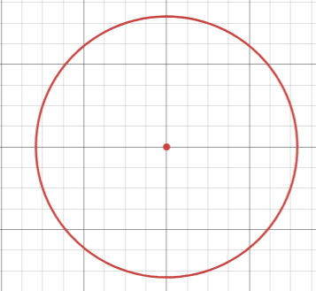
Overview / Recap of goals
Do the “brute force” for loop method because squareform requires too much memory
Step 0: standardize gene expression of normalized grid
(point - mean of grid) / SD of grid
For loop per distance
General Idea (not entirely accurate):
For each point, treat it as a center point
Multiply center point expression with all radius-point expression
Sum it up
Sum up the sums of each point
Take the total mean: current sum / all the pairs we summed up in total
Not actually a nested for-loop.
Actually highly vectorized

Slide 3

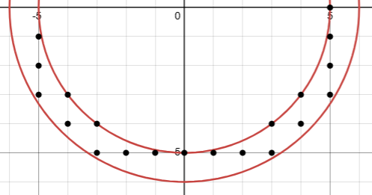
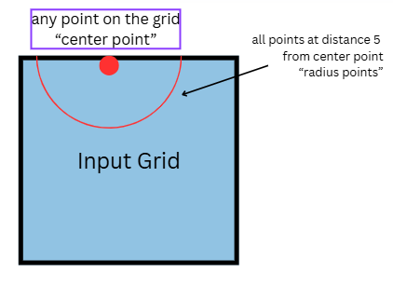
Variable: dist-vecs (vectors)
<5, 0>
<5,1>
<-5,1>
“center point”
“radius points”
Points along the semicircle
<-5,3>
<5,3>
Purposefully exclude <-5,0> because that would cause repetition when all the semi-circles come together
Notes:
For each center point, we find all the points on its boundary by adding vecs

Slide 4
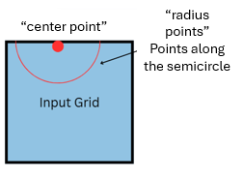
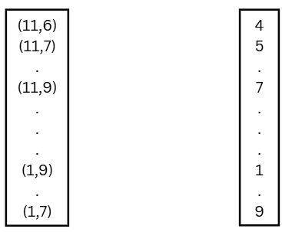
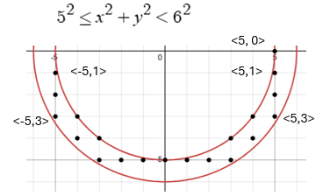
Variable: dist-vecs (vectors)
For now, assume all points are within-bounds
Radius points
expression
Radius points
Add vecs to the
Center point
(6,6)

Slide 5
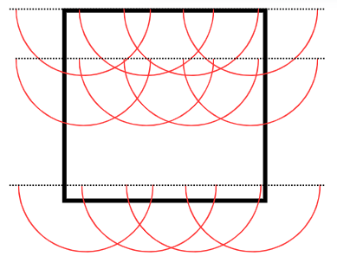
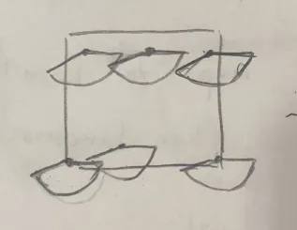
Assumption 1: my almost-semicircle method is able to capture all pairs exactly once
ignore out-of-boundary points

Slide 6
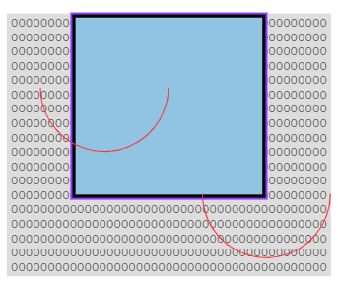
Out-of-boundary points
“Extended Grid”
3 margins: left, right, bottom
All zeros
Width is “dist”
Obviously, we shift all our coordinates
Only the x coordinates

Slide 7
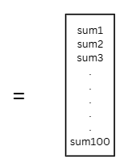
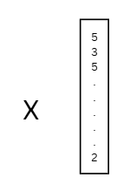
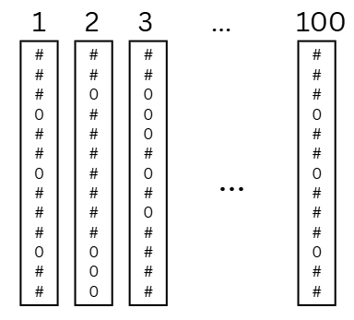

Extracting data
Extract the Count of non-zero values
(ie. Points that are within-boundary)
Expression of the center points
In order
Expression of the radius points for
Each center point
/ Count

Slide 8
Assumption 2: no within-boundary zero point in standardized grid
(point - mean of grid) / SD of grid
For there to be a 0 in standardized grid, there must be a raw counts that is exactly equal to the mean
Mean is very likely a decimal number
Very key assumption

Slide 9
Code time analysis
700x600 grid (8um data):
1 min for dist up to ~100
Code is slower as distance increases
Vecs gets longer
Although, additional distance is unnecessary / scientifically meaningless

Slide 10
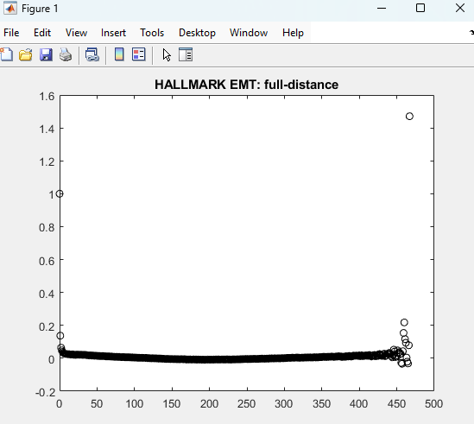
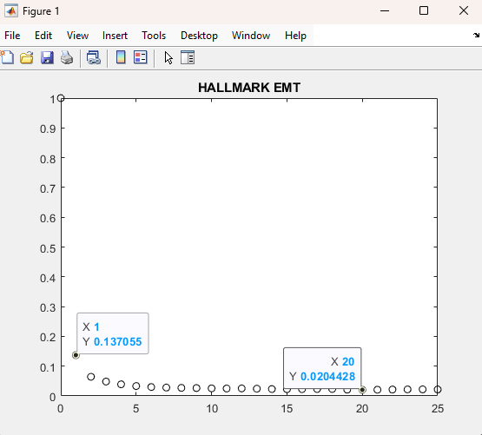
Control 16um Deeper Sequencing: Correlation Data
As expected, correlation drops to zero quite quickly

Slide 11
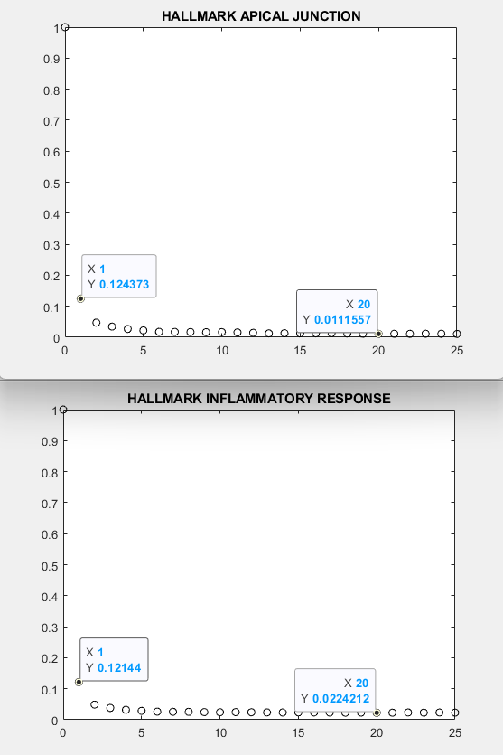
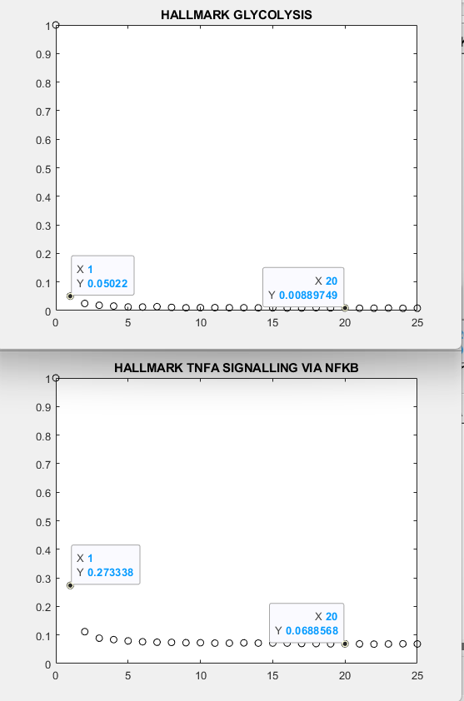
Interesting that correlation stays steady at 0.1

Slide 12
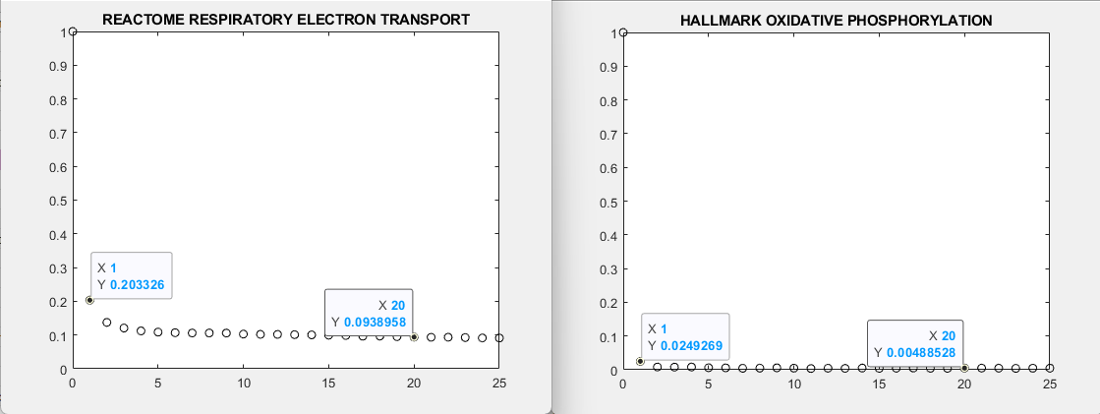
Again, correlation stays steady at 0.1

Slide 13
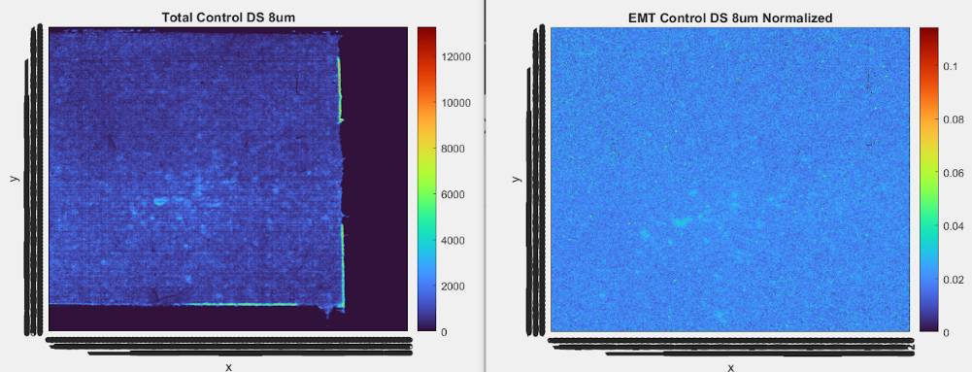
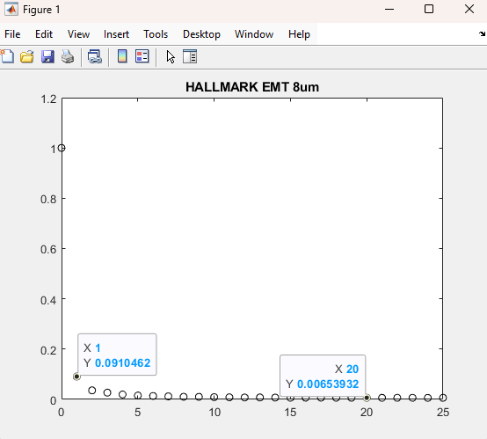
Brief Analysis on 8um data
16um

Slide 14
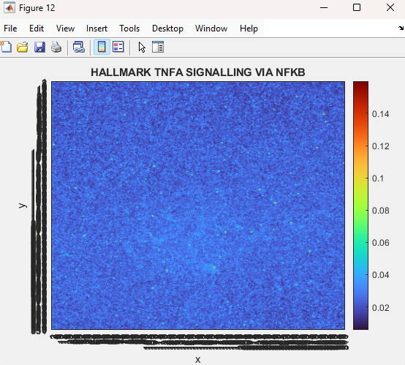
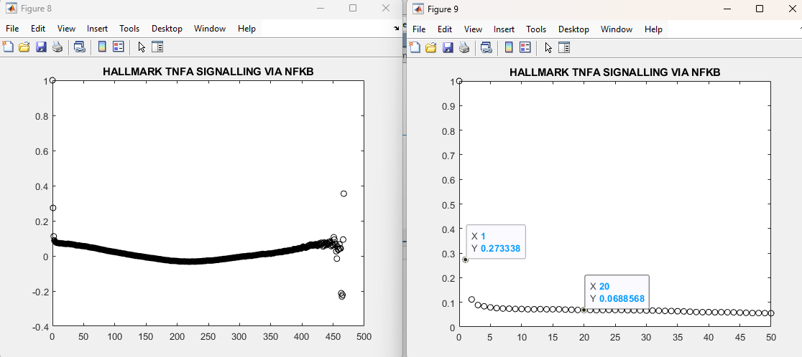
Further Data on Unexpected 0.1 Correlation Finding

Slide 15
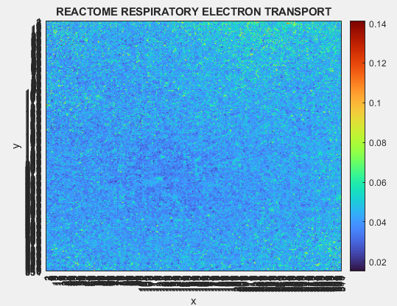
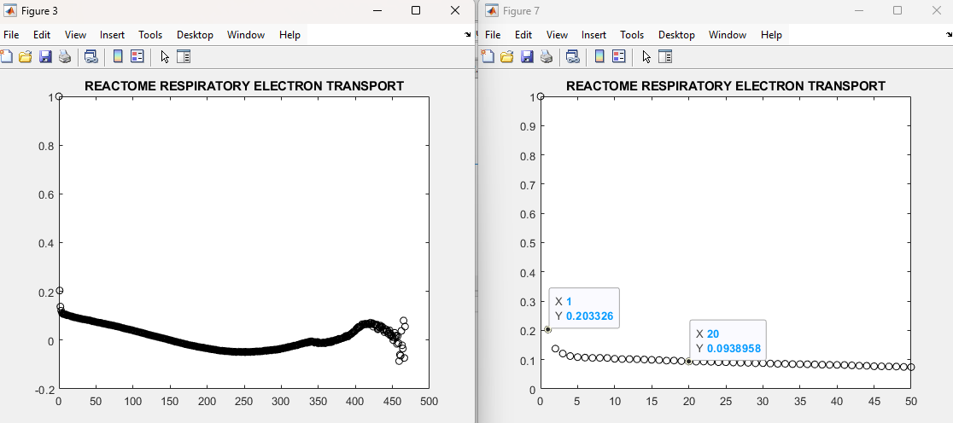
Further Data on Unexpected 0.1 Correlation Finding

