Slide 1
Performance tips and trick for QML application
Overview QML Profiler
JavaScript and Use Anchors
App Start
Image
List
2017.07.05

Slide 2
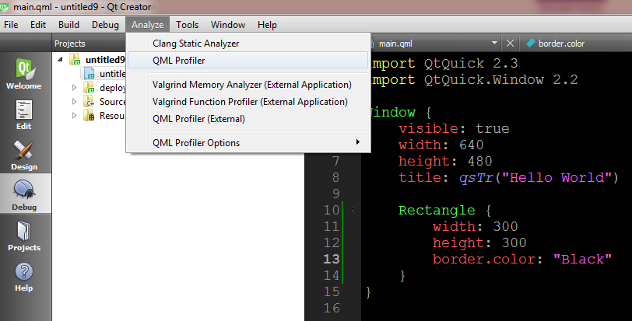
1. Overview QML Profiler
You can use the QML Profiler to find causes for typical performance problems in your applications, such as slowness and unresponsive, stuttering user interfaces.
Typical causes include executing too much JavaScript
Another typical cause for similar performance problems is creating, painting, or updating invisible items, which takes time in the GUI thread
Using QML Profiler to monitor the performance of an application.

Slide 3
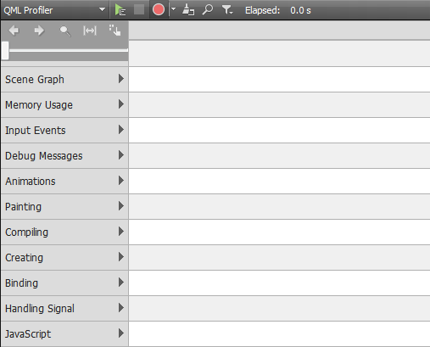
1. Overview QML Profiler

Slide 4
1. Overview QML Profiler
Scene Graph: Displays the time when scene graph frames are rendered and some additional timing information
Memory Usage: Displays block allocations of the JavaScript memory manager.
Input events: Display mouse and keyboard events
Painting: Displays the time spent painting the scene for each frame
Animations: Displays the amount of animations that are active and the frame rate that they are running.
Compiling: Displays the time spent compiling the QML files.
Creating: Displays the time spent creating the elements in the scene
Binding : Displays the time when a binding is evaluated and how long the evaluation takes
Handling Signal: Displays the time when a signal is handled and how long the handling takes.
JavaScript: Displays the time spent executing the actual JavaScript behind bindings and signal handlers
Notes:
Link refer: http://doc.qt.io/qtcreator/creator-qml-performance-monitor.html

Slide 5
1. Overview QML Profiler
Window {
visible: true
width: 640
height: 480
title: qsTr("Hello World")
property int count: 100
MouseArea {
anchors.fill: parent
onClicked: {
txt1.visible = true
}
}
Text {
id: txt1
text: (count === 100) ? "100" : "!= 100“
anchors.centerIn: parent
visible: false
}
}

Slide 6
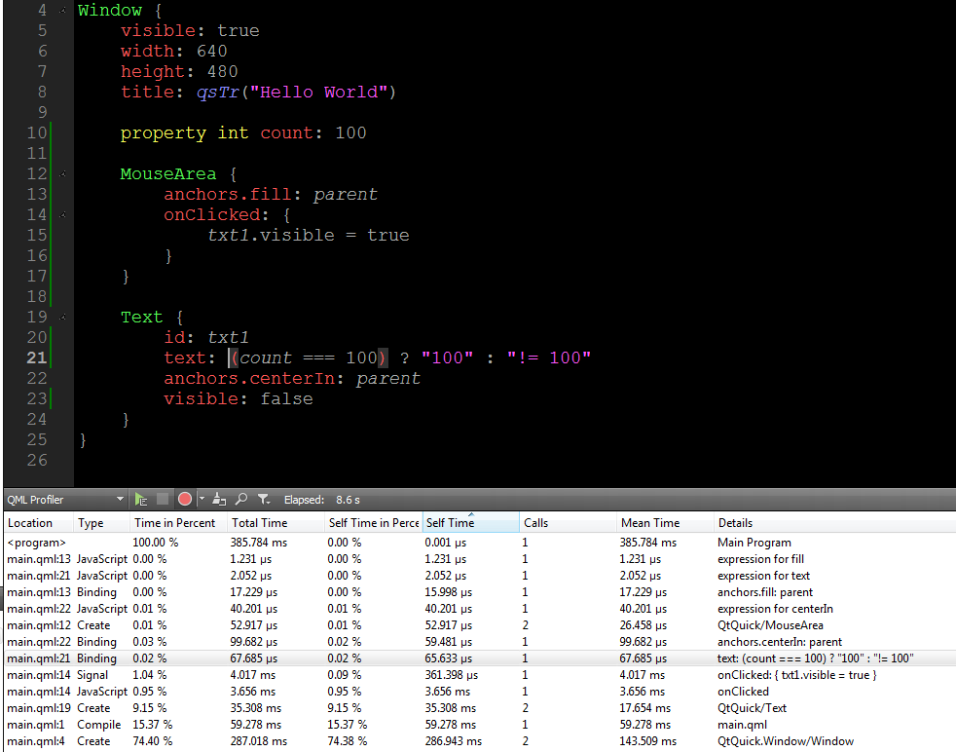
1. Overview QML Profiler

Slide 7
2. JavaScript And Use Anchors.
Do not use JavaScript, but rather implement the UI with QML and the engine with C++
JavaScript should be avoided as much as possible. Do not use it at all.
JavaScript code should be kept to a minimum. C++ should be used to implement application's the business logic.
JavaScript is especially bad for performance when it is run during animation, e.g. in lists.
If you must use JavaScript anyway, simplify your JavaScript expressions as much as possible.
It is also recommended to set values for properties using QML property binding than JavaScript value assignment.
Example: Wrong:
Text {
text: {
if (titleItem === titleItem1) {
return "This is hunght";
}
return "hunghoang"
} anchors.centerIn: parent
}
Right:
text: (titleItem === titleItem1) ? "This is hunght" : "hunghoang"

Slide 8
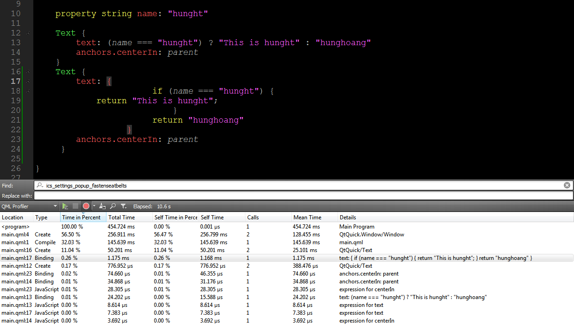
2. JavaScript And Use Anchors.
Compare result

Slide 9
2. JavaScript And Use Anchors.
Use anchors rather than bindings to position items relative to each other
- It is more efficient to use anchors rather than bindings to position items relative to each other
- Positioning with anchors is relatively slow, although it allows maximum flexibility.
2 way to fix position rectangle:
Way 1:
Rectangle {
width: 60
height: 60
Rectangle {
id: rect2
x: 20
y: 20
width: 20
height: 20
}

Slide 10
2. JavaScript And Use Anchors.
- This is achieved more efficiently using anchors:
Way 2 :
Rectangle {
width: 60
height: 60
Rectangle {
id: rect3
anchors.fill: parent
anchors.margins: 20
}

Slide 11
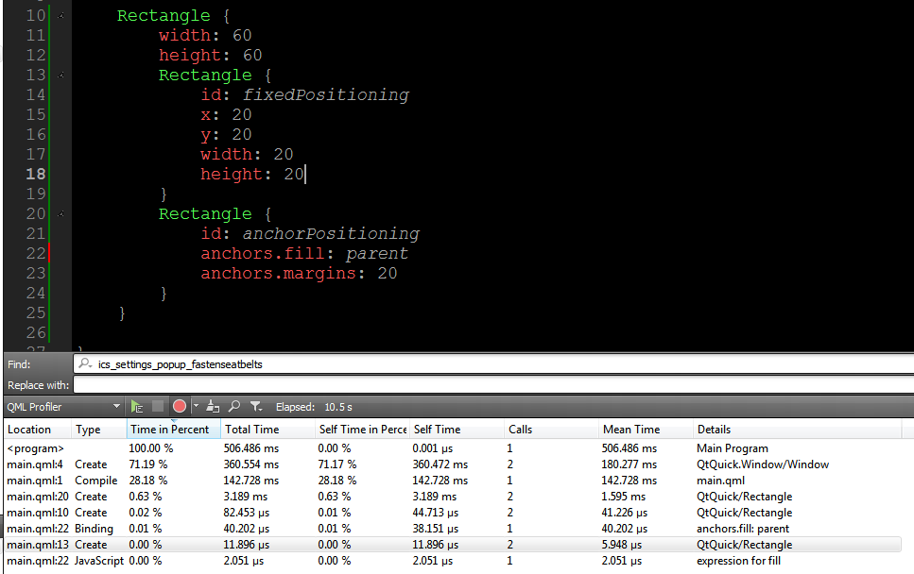
2. JavaScript And Use Anchors.
Result:
Notes:
(*) http://doc.qt.io/qt-5/qtquick-performance.html#position-elements-with-anchors

Slide 12
3. App Start
Use loaders to dynamically load/unload QML
QML application starts quite slow if the whole application is implemented in one huge QML file
Should partition your application into logical entities, load minimum QML at start and load more as you need it using Loader
The Loader item can be used to dynamically load and unload visual QML components defined in a QML file or items/components defined within a QML file
When partition your application into serveral QML file, so this way loading and unloading are easier to control. DO NOT HAVE ONE HUGE QML FILE PER APPLICATION.
Load minimum amount of QML file at application start to make your application can start quickly as possible. After that, you can connect network, show spinner,...If your first view is very complex and requires lots of QML to be loaded, show a splash screen or something,...
Creating a dialog can take more than 100ms of time. Make sure you use Loader to load the dialog

Slide 13
3. App Start
Example use Loader in QML
Wrong way:
MouseArea {
anchors.fill: parent
onClicked: {
rect.visible = true
}
}
Rectangle {
id: rect
width: 300 ;height: 300
visible: false
Text { text: "hunght abcd" y: 0 }
Text { text: "hunght abcd" y: 20 }
Text { text: "hunght abcd" y: 40 }
........................
Text{ text: "hunght abcd" y: 200 } }

Slide 14
3. App Start
Right Way
MouseArea {
anchors.fill: parent
onClicked: {
loader.source = "qrc:/LoaderItem.qml"
}
}
Loader {
id: loader
source: ""
}

Slide 15
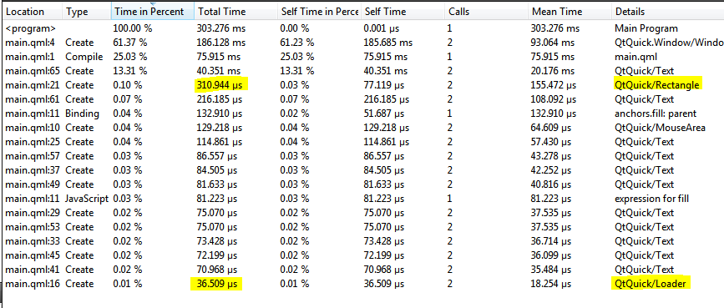
3. App Start
Result:

Slide 16
4. Image
Images consume a great deal of memory and may also be costly to load
Load large images : use Image::sourceSize
Large images that do not necessarily need to be visible immediately, set the Image::asynchronous property to true. This will load the image in a low priority thread.
Enable Image.smooth only when necessary
Avoid composing an image from a number of elements
Notes:
http://doc.qt.io/qt-4.8/qml-image.html#sourceSize-prop

Slide 17
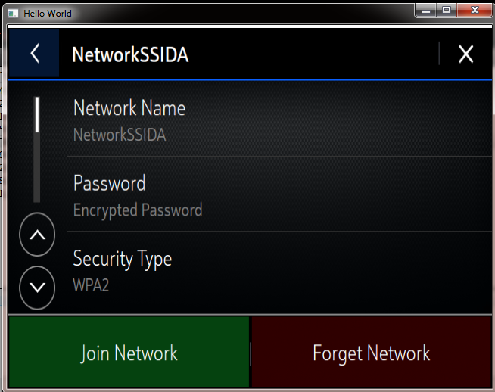
4. Image
2 way:
Way 1:
Image {
anchors.fill: parent
source: "qrc:/previous.PNG“
sourceSize.width: 640
sourceSize.height: 480
}
Way 2:
Image {
anchors.fill: parent
source: "qrc:/previous.PNG“
}
Notes:
http://doc.qt.io/qt-4.8/qml-image.html#sourceSize-prop

Slide 18
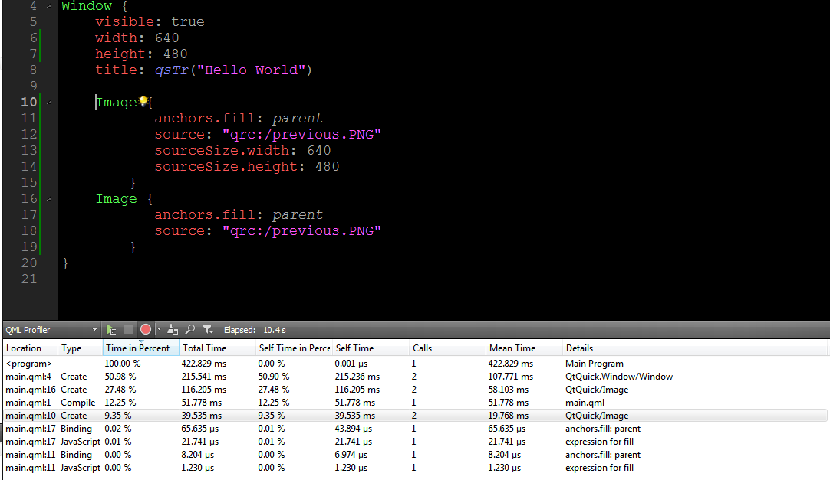
4. Image
Result
Notes:
http://doc.qt.io/qt-4.8/qml-image.html#sourceSize-prop

Slide 19
5. List
Delegates must be created quickly as the view is flicked:
Small delegates - keep the amount of QML to a minimum, should be created by a Loader as needed.
Fast data access - ensure the data model is as fast as possible.

Slide 20


