Slide 1
Housing Price Prediction using Multiple Linear Regression
Author: Jason Hung

Slide 2
Introduction
The purpose of this project was to create a prediction model based on different housing features and sales price.
The variables were tested by calculating their correlation coefficients against Sales Price and filtered to be selected to use in combination via multiple linear regression to achieve the prediction model.
Only numeric data was analyzed.
*Please add slides as required.

Slide 3
Introduction
Work flow/Processes
Data imported into a Pandas dataframe where individual columns are inspected
Data is then filtered to have just numeric data for easier processing
corr() function to find individual correlations between each of the columns and final sale price
Prediction models created based on correlations
Metrics for validation include r² value and a histogram showing the amount of error from the original data
As an extra step, new data was introduced at the end to further measure the strength of the prediction model that was chosen
3

Slide 4
The Data
The data file included 80 columns of variables relating to homes such as features and sale price all up to 100 rows.
Includes housing features such as:
MSSubClass: Identifies the type of dwelling involved in the sale.
MSZoning: Identifies the general zoning classification of the sale.
LotFrontage: Linear feet of street connected to property
BldgType: Type of dwelling
OverallQual: Rates the overall material and finish of the house
Etc…
Note that features include numeric as well as categorical data.
*Please add slides as required.

Slide 5
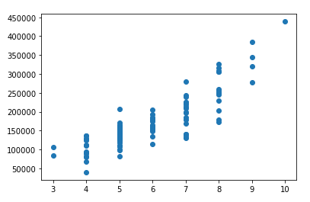
Data Exploration
OverallQual vs. SalePrice
A good example of a positive and strongly correlated variable
As Overal Qual goes up, SalePrice also goes up
*Please add slides as required.

Slide 6
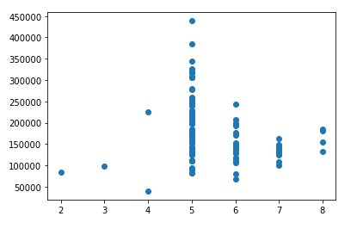
Data Exploration
OverallCond vs. SalePrice
An example of a but poorly correlated variable
Apparently, OverallCond by itself is not enough to sway SalePrice strongly
6

Slide 7
Data Preparation
Data needed to be cleaned up and reshaped due to direct processing and analysis on categorical columns (non-numeric) not being possible.
Data was filtered for numeric columns
Each column had its correlation coefficient calculated relative to Sale Price
Data was sorted by correlation coefficient in descending order
Columns that were picked had their null values dropped
No appropriate values to fill nulls at this point
*Please add slides as required.

Slide 8
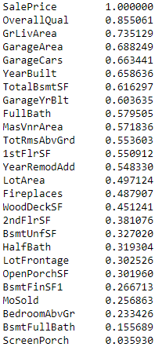
Correlation
With strong positive or negative correlations, variables are shown to affect and pull the sales price in a certain direction.
Using this knowledge, we can find and combine different variables that exhibit mild to strong correlations in order to attempt the prediction of sales prices.
With positive correlations, as the independent variable goes up, the dependent variable will go up as well.
With negative correlations, as the independent variable goes up, the dependent variable goes down. In essence, the variables go in opposite directions.

Slide 9
Project Description
With linear regression, the data is assume to be linearly dependent and therefore correlation values are very important when trying to create a linear regression model.
There are certain variables such as overall condition, certain areas, and garage features that are well correlated with sale price of a house and therefore a linear regression model for prediction would be very appropriate for predicting housing sale price
*Please add slides as required.

Slide 10
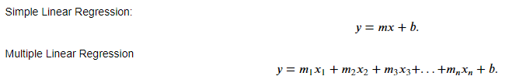
Project Description
Linear Regression
A machine learning algorithm to predict values within a continuous range assuming data has a linear relationship (correlation).
The two forms are simple, where there is a single independent variable 𝑥 used to predict a single dependent variable 𝑦 , and multiple linear regression, where as an extension multiple independent variables 𝑥𝑛 are used to predict a single dependent variable 𝑦 .
10

Slide 11
Project Description
Linear Regression
To derive the regression by hand, we use least-squares to fit a line to the data. Least-squares is where a lines known as residuals are drawn vertically from each data point to a fitted line and its distance is squared to get squares that are added up -or summed- to be minimized as the fitted line is rotated to find the best fit. The smaller the sum of squares, the tighter the fit of the line, and the higher the 𝑟² value.
In Python, the sklearn library has a linear_model submodule that will take care of calculations and data points once input data is provided. All that is needed is analysis and selection of the independent variables relative to the dependent variable and with the use of the linear_model submodule, Python will be able to implement a linear model for data input and give out predictions. Graphical plots with the matplotlib library and numerical scores such as the $r^2$ value with the sklearn library are used to validate the effectiveness of the model.
11

Slide 12
Analysis and Results
3 models chosen, all based on the highest correlation values
Model 1 was top 23 variables based on correlation
Chosen based on all positive correlations higher than 0.1
Model 2 was top 3 variables based on correlation
Chosen to test whether more variable truly equates to a better quality prediction model
Model 3 was top 5 variables based on correlation
Chosen based on the initial example to compare other with other models
All models performed fairly well with Model 1 having the highest r² value of 0.91
All models had error plots centered around 0 to show good fit for the regression models
*Please add slides as required.

Slide 13
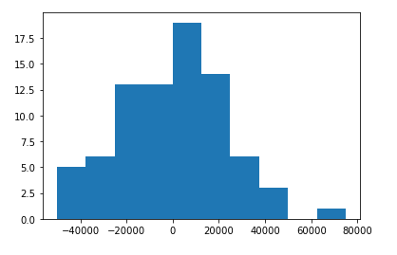
Analysis and Results
Model 1
R² value of 0.91
Error model centered around 0

Slide 14
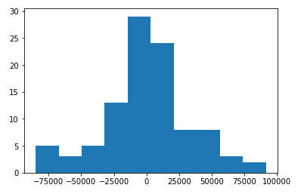
Analysis and Results
Model 2
R² value of 0.79
Error model also centered around 0

Slide 15
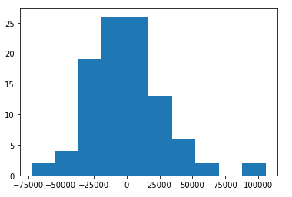
Analysis and Results
Model 3
R² value of 0.83
Error model centered around 0, although slightly skewed

Slide 16
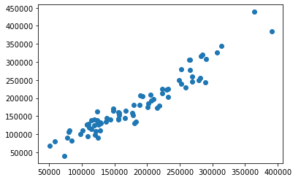
Analysis and Results
By comparison, it would seem that model 1 with the 23 columns with the highest correlations to sales price did the best with a centered error plot around 0 and the highest 𝑟² value of 0.91. This means that model 1 is the best prediction model with the best fit line through the dataset. Another way to think about it is that the 𝑟² shows that the variables chosen explain 0.91 or 91% of the variation in sale price, at least within the dataset.
Prediction model 1 vs. Data

Slide 17
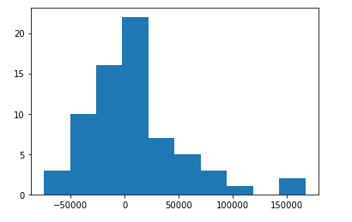
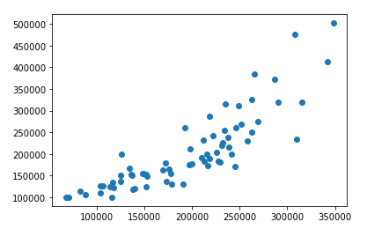
Verification
Test data
Using the prediction model on the test data yielded a lower 𝑟2 value of 0.71. This is lower than anticipated but not unexpected since new data may not always correlate well to the original parameters.
Error plot shows the error centered around 0 still, so that is a good sign of a fairly decent prediction.
Scatter plot of predictions vs test data
*Please add slides as required.

Slide 18
Conclusion
In terms of results based in the original dataset, the model with the most positively correlated variables yielded the best prediction mode. This was shown by an extremely high 𝑟2 value and a good error plot with a mean about 0.
However, the conclusion drawn from this study is that although linear regression is a great tool for finding relationships/correlations between variables, it would seem that fitting well on one set of data does not necessarily translate into fitting well in another set of data.
There is always more to be done and more trials to be done
*Please add slides as required.

Slide 19
References
References
Starmer, Josh. "Linear Regression, Clearly Explained!!!!." Youtube, 2017. https://www.youtube.com/watch?v=nk2CQITm_eo
Williams, John. "Module 7 - A Model to Predict Housing Prices." student.emeritus.org, 2022. https://student.emeritus.org/courses/4289/modules
*Please add slides as required.

