Slide 1

LAB 11
January 2025

Slide 2
CONTENTS
01
Creating the simple Counter Design
02
Testing the simple Counter Design
03
Achieved Outcomes.
Tegister Design

Slide 3
Creating the simple Counter Design
01

Slide 4




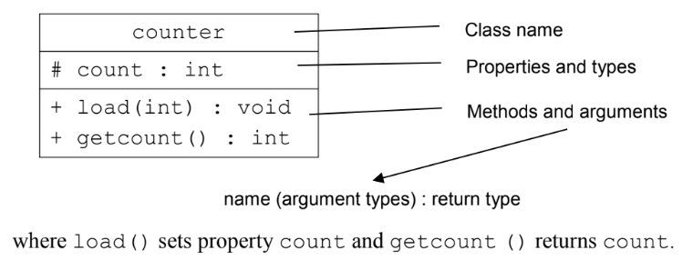
1. Creating the simple Counter Design
01
Creating a Simple Class
Working in the lab11-countclass directory, perform the following.
Edit the file counter.sv to declare a class as described in this diagram.
Create instances of class counter and use the methods. Simulate and debug as needed.
Notes:
IC: Integrated Circuit

Slide 5
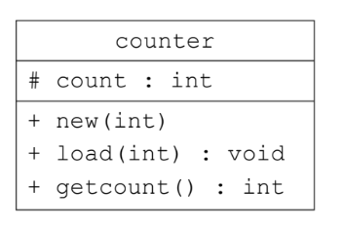
1. Creating the simple Counter Design
01
Adding a Class Constructor
Working in the lab11-countclass directory, perform the following.
Add a class constructor with one int argument to set the initial value of count. Give the argument a default value of 0.
Modify your code to test the constructor. Simulate and debug as needed.
Notes:
IC: Integrated Circuit

Slide 6
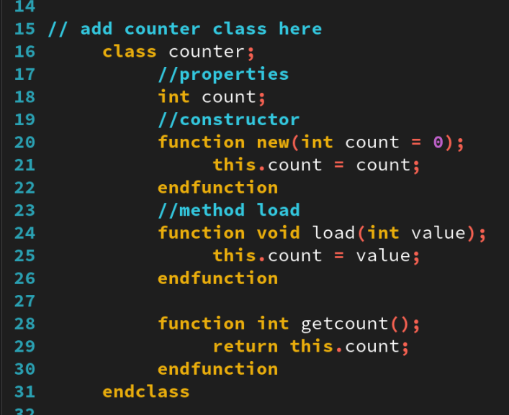
1. Creating the simple Counter Design
01
class couter
Notes:
IC: Integrated Circuit

Slide 7
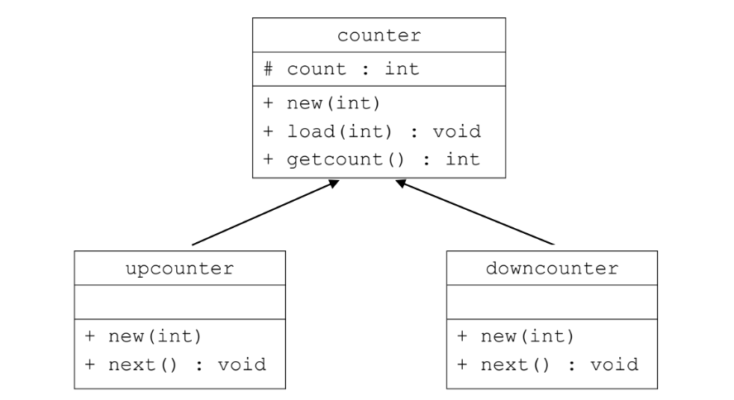
1. Creating the simple Counter Design
01
Defining Derived Classes
Extend the counter class by declaring two subclasses, upcounter and downcounter, as follows:
upcounter and downcounter inherit the count property from counter.
upcounter and downcounter have explicit constructors, with a single argument, which pass the argument to the counter constructor.
The upcounter next method increments count and display the value for debugging.
The downcounter next method decrements count and displays the value for debugging.
Create instantiations of both subclasses and verify their methods. Simulate and debug as needed.
Notes:
IC: Integrated Circuit

Slide 8
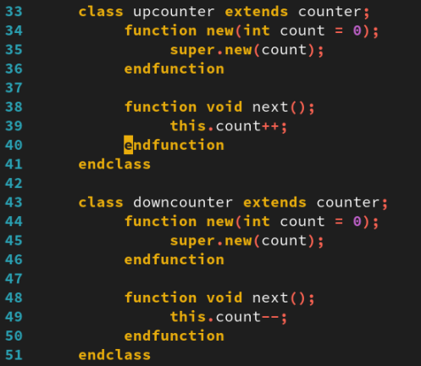
1. Creating the simple Counter Design
01
class upcounter and downcounter
Notes:
IC: Integrated Circuit

Slide 9
1. Creating the simple Counter Design
01
Setting Counter Limits. You need to control the upper and lower count limits of both counter subclasses.
Add max and min properties (type int) to counter for upper and lower count limits.
Add a check_limit method to counter with two input int arguments. The method should assign the greater of the two arguments to max and the lesser to min.
Add a check_set method to counter with a single input int argument set: If the set argument is not within the max-min limits, assign count from min and display a warning message. Otherwise, assign count from set.
Add arguments for the max and min limits to the constructors so they can be set for each class instance. The upcounter and downcounter constructors should pass the limit arguments to the counter constructor.
In the counter constructor, call check_limit with the two limit arguments to ensure that max and min are consistent and check_set to ensure the initial count value is within limits.
In the load method, call check_set to ensure that the load value is within limits.
Modify the upcounter and downcounter next()methods to count between the two limits, e.g., upcounter counts up to max and then rolls over to min.
Modify your test code to check the new functionality. Simulate and debug as needed.
Notes:
IC: Integrated Circuit

Slide 10
1. Creating the simple Counter Design
01
Indicating Roll-Over and Roll-Under. You need to indicate when an upcounter instance rolls over, or downcounter instance rolls under.
Modify upcounter as follows:
Add a new property carry of type bit, initialized to 0 in the constructor.
Modify the next method to set carry to 1 only when count rolls over from max to min; otherwise, carry should be 0.
Modify downcounter as follows:
Add a new property borrow of type bit, initialized to 0 in the constructor.
Modify the next method to set borrow to 1 only when the count rolls under from min to max, otherwise borrow should be 0.
Modify your test code to check the carry and borrow work. Simulate and debug as needed.
Notes:
IC: Integrated Circuit

Slide 11
1. Creating the simple Counter Design
01
Implementing a Static Property and a Static Method
Add a static property to both upcounter and downcounter to count the number of instances of the class that have been created.
Increment the property in the class constructors.
Add a static method to both classes, which returns the static property.
Modify your test code to check the static properties work. Simulate and debug as needed.
For a tool to probe class values, the objects must be constructed (probably not yet at time 0).
Notes:
IC: Integrated Circuit

Slide 12
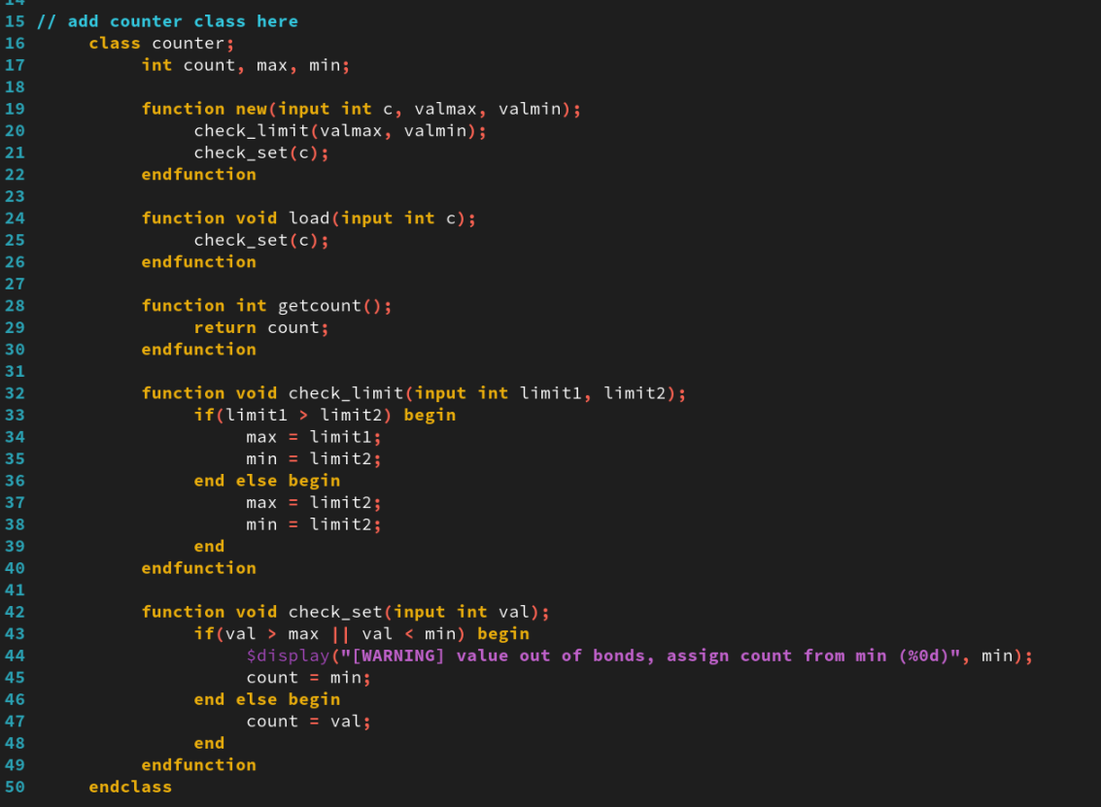
1. Creating the simple Counter Design
01
class counter
Notes:
IC: Integrated Circuit

Slide 13
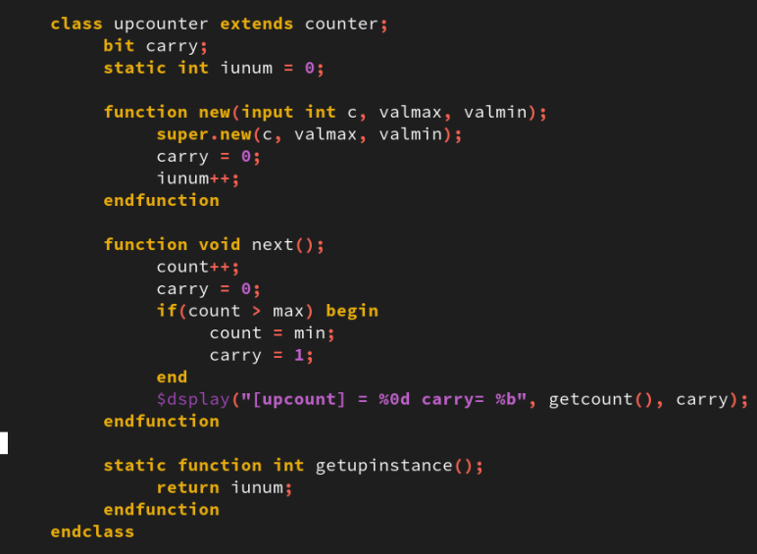
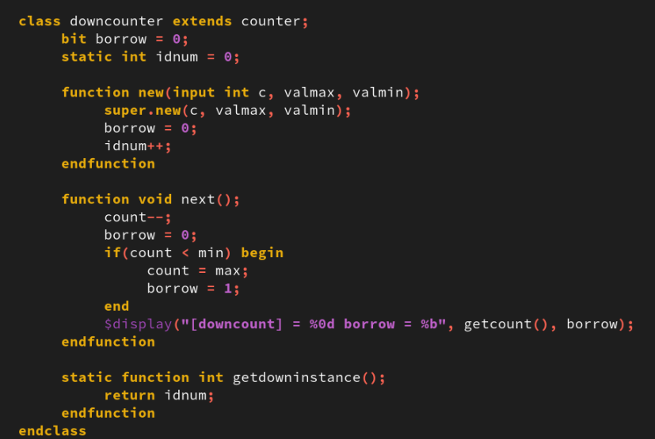
1. Creating the simple Counter Design
01
class upcounter class downcounter
Notes:
IC: Integrated Circuit

Slide 14
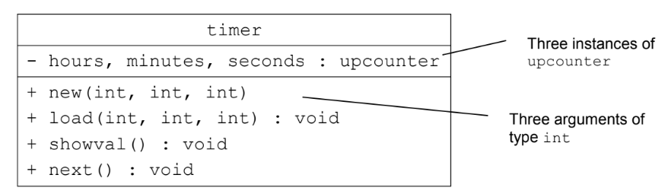
1. Creating the simple Counter Design
01
Defining an Aggregate Class
Define a new aggregate class timer as follows:
hours, minutes and seconds are three instances of upcounter.
The timer constructor has three arguments for the initial hour, minute and second counts (with default values). The constructor creates each upcounter instance with the appropriate initial value and sets max and min to operate the timer as a clock, e.g., the hours instance should have a max of 23 and a min of 0.
The load method has three arguments to set the hour, minute and second counts.
The showval method displays the current hour, minute and second.
The next method increments the timer and displays the new hour, minute and second. Increment the timer by making calls to the next methods of the upcounter instance and use the carry properties to control which next method is called, e.g., the minutes next method is called only when the seconds carry is 1. Use the showval method to display the new values.
Modify your test code to check the timer works. Use load to set the timer to values such as 00:00:59 and next to check the roll-over. Simulate and debug as needed.
Notes:
IC: Integrated Circuit

Slide 15
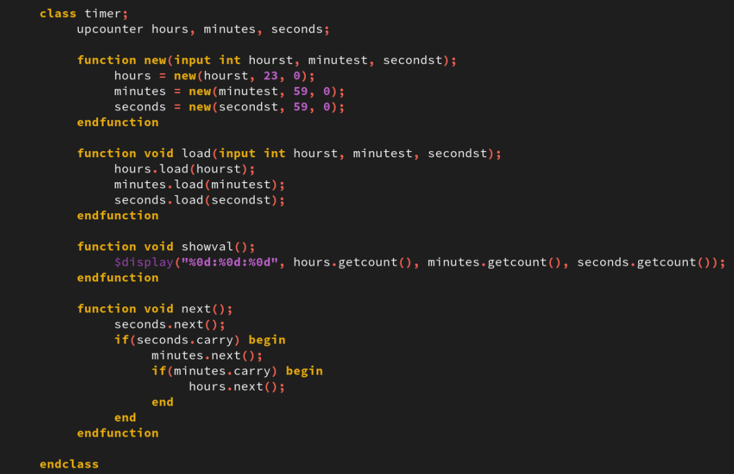
1. Creating the simple Counter Design
01
class timer
Notes:
IC: Integrated Circuit

Slide 16
Testing the simple Counter Design
02

Slide 17
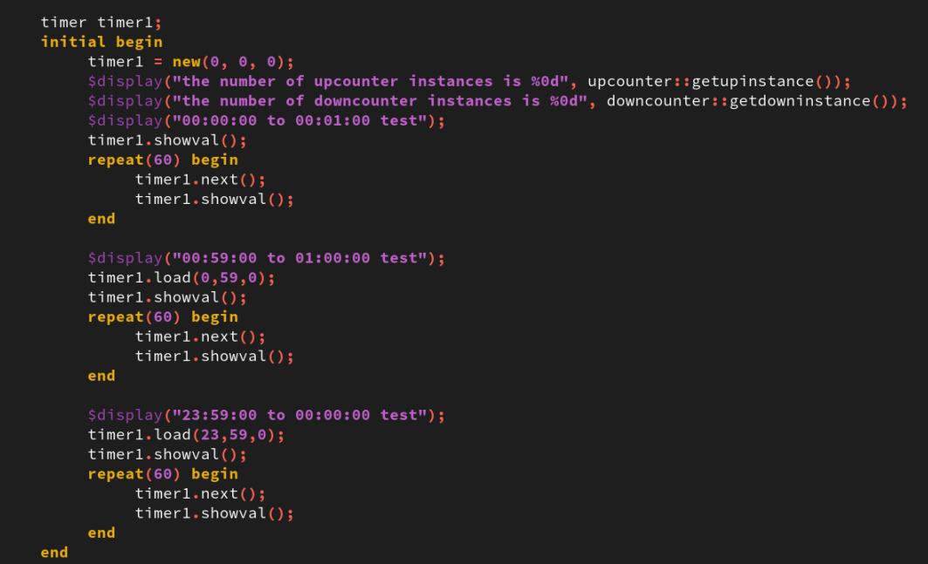
2. Testing the simple Counter Design
01
test feature class timer
Notes:
IC: Integrated Circuit

Slide 18
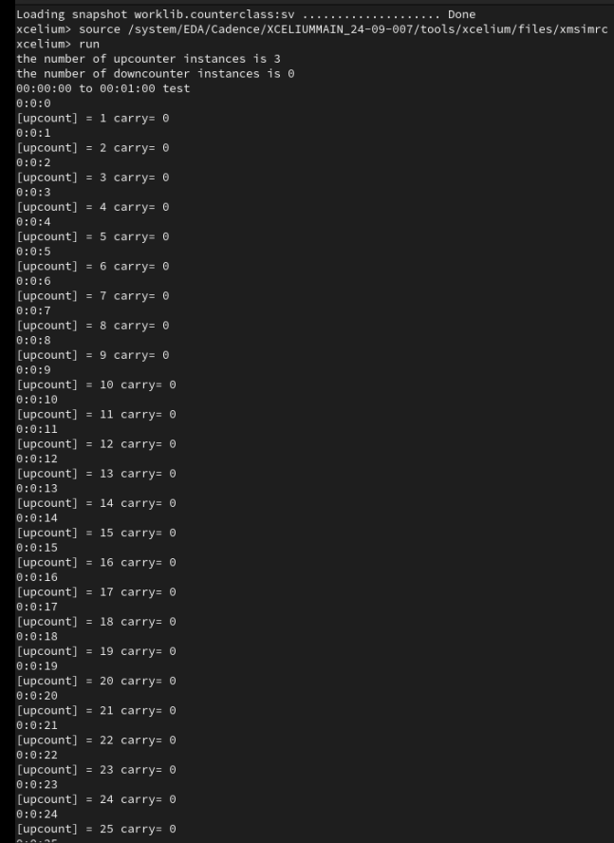
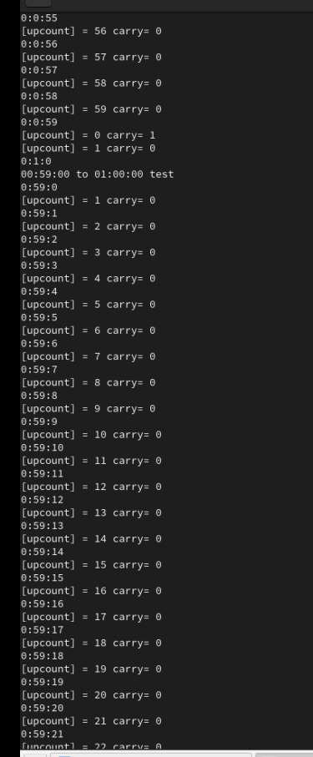
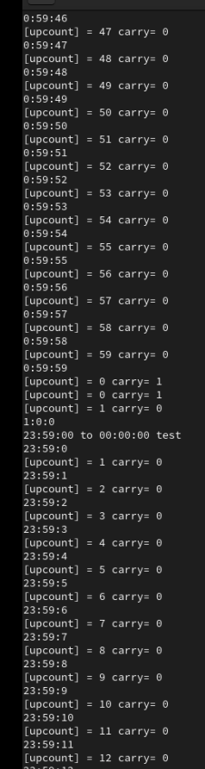
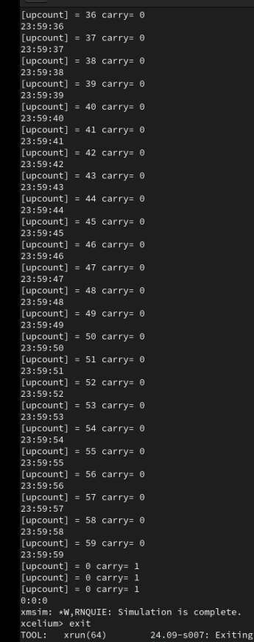



2. Testing the simple Counter Design
01
Notes:
IC: Integrated Circuit

Slide 19
Achieved Outcomes.
03

Slide 20
4. Achieved Outcomes
01
Create a simple counter design using the following SystemVerilog object-oriented design features:
Class declarations, with explicit constructors and instances
Inheritance
Static properties and methods
Aggregate classes (classes with properties of other class types)
Notes:
IC: Integrated Circuit

Slide 21

THANK YOU!

