Slide 1

LAB 20
January 2025

Slide 2
CONTENTS
01
Creating the Simple DPI Design
02
Testing the Simple DPI Design
03
Achieved Outcomes
Testing the Register Design

Slide 3
Creating the Simple DPI Design
01

Slide 4




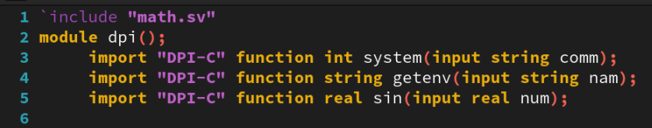
1. Creating the Simple DPI Design
01
Working in the lab20-simpledpi directory, perform the following.
The stdlibs.c file simply includes the standard and math C libraries.
Create a module dpi in a dpi.sv file and import the following C functions to appropriate SystemVerilog function declarations:
system – Executes a command on the operating system. The C definition is: int system (const char* command);
Where the input command is a string containing the system command. The return int type depends on the command executed (can be ignored in the call).
getenv – Returns the value of an environmental variable. The C definition is: char* getenv (const char* name);
Where the input name is a string containing the environmental variable name. The return string type contains the variable value.
sin – Returns the sine of an angle. The C definition is: double sin (double x);
Where the input x is the angle in radians. The return real type is the sine value.
dpi.sv
Notes:
IC: Integrated Circuit

Slide 5
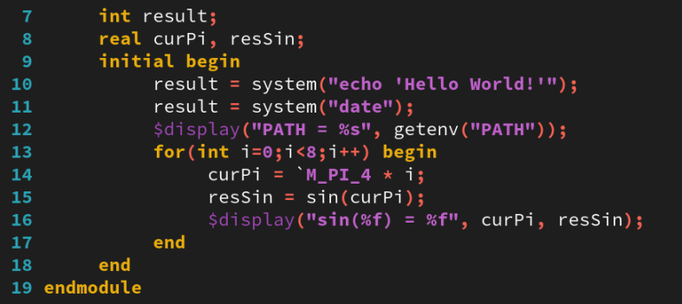
1. Creating the Simple DPI Design
01
Add code to test your imported C functions, by, for example:
Executing the system command echo ‘Hello World’.
Execute date to print the current time and day.
Displaying the PATH environmental variable.
Displaying the first eight sine values at Π/4 intervals (see math.sv for constants).
dpi.sv
Notes:
IC: Integrated Circuit

Slide 6
Testing the Simple DPI Design
02

Slide 7
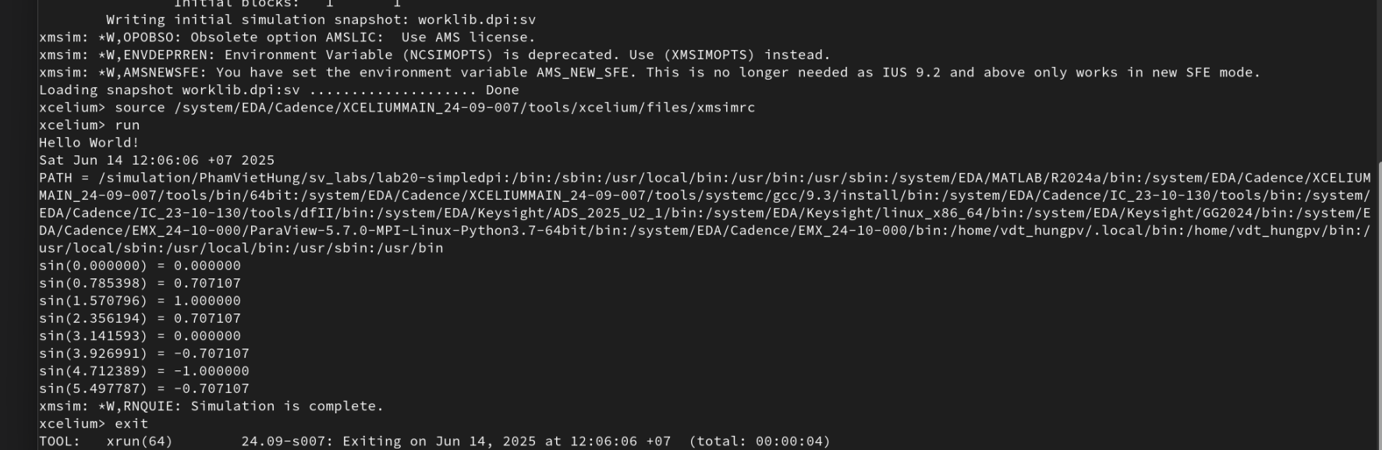
1. Testing the Simple DPI Design
01
We can use the Cadence simulator to compile and simulate both C and SystemVerilog code as follows: xrun stdlibs.c dpi.sv
Notes:
IC: Integrated Circuit

Slide 8
Achieved Outcomes.
03

Slide 9
3. Achieved Outcomes
01
Understand the specification and Import C functions from the standard and math C libraries and execute in SystemVerilog code.
Notes:
IC: Integrated Circuit

Slide 10

THANK YOU!

