Slide 1

LAB 22
January 2025

Slide 2
CONTENTS
01
Synchronizing Processes with a Semaphore
02
Simulating the Semaphore Test Case
03
Achieved Outcomes
Testing the Register Design

Slide 3
Synchronizing Processes with a Semaphore
01

Slide 4




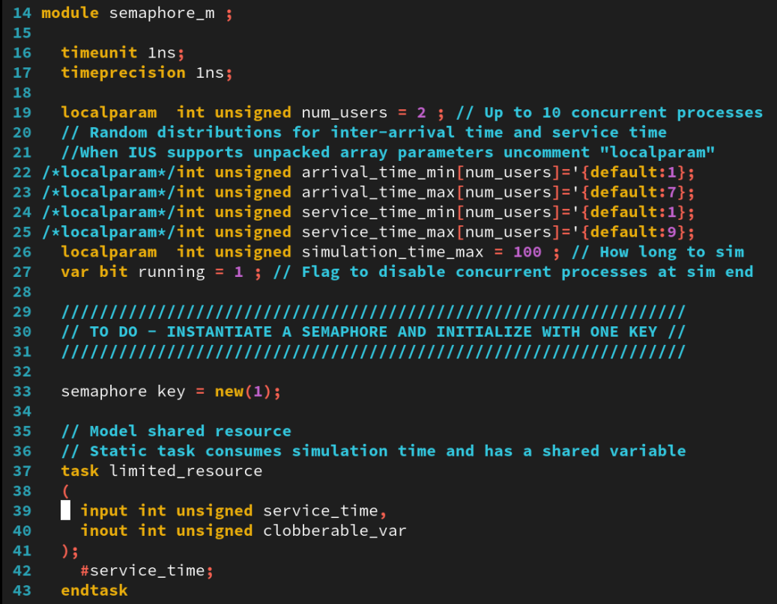
1. Synchronizing Processes with a Semaphore
01
Working in the lab22-semaphore directory, perform the following:
Edit the semaphore_m.sv file to complete the semaphore test case according to the commented instructions to:
Insert statements as instructed to instantiate and initialize the semaphore.
Verify that the semaphore is constructed.
Get the semaphore key (blocking and nonblocking).
Put the key back.
Notes:
IC: Integrated Circuit

Slide 5
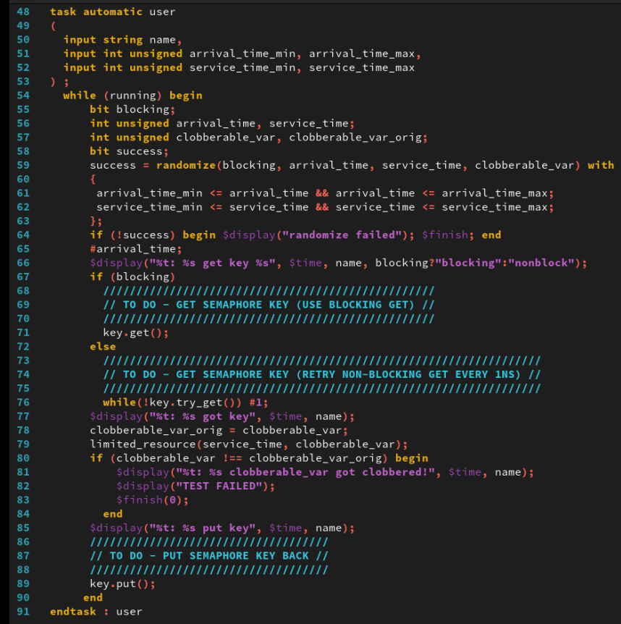
1. Synchronizing Processes with a Semaphore
01
Notes:
IC: Integrated Circuit

Slide 6
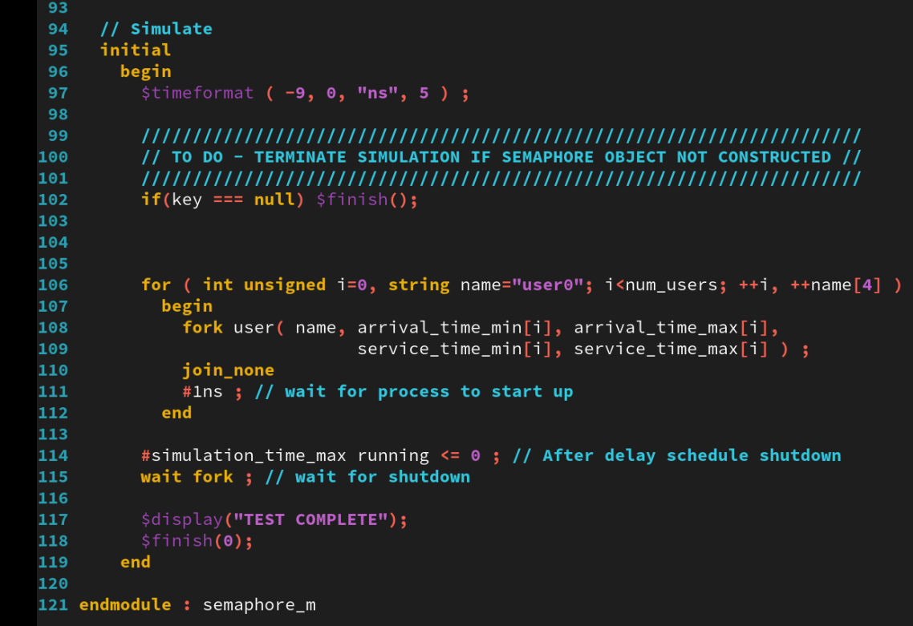
1. Synchronizing Processes with a Semaphore
01
Notes:
IC: Integrated Circuit

Slide 7
Simulating the Semaphore Test Case
02

Slide 8
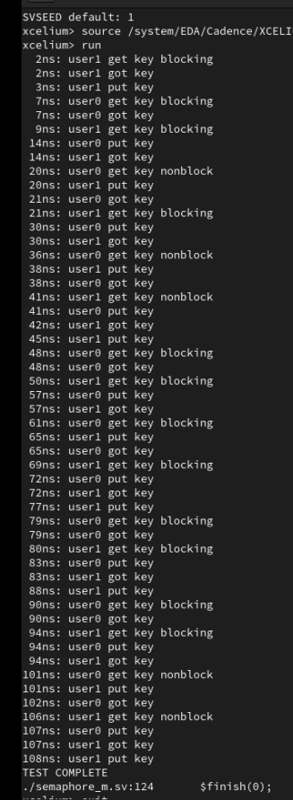
2. Simulating the Semaphore Test Case
01
→ You see that at no time is the resource simultaneously used by both users.
Notes:
IC: Integrated Circuit

Slide 9
Achieved Outcomes.
03

Slide 10
3. Achieved Outcomes
01
Understand the specification and to use a semaphore to synchronize the use by multiple processes of a resource that can support only one process at a time.
This lab models a limited resource with two users that, at random intervals, attempt to use the resource for a random amount of simulation time.
Notes:
IC: Integrated Circuit

Slide 11

THANK YOU!

